Slide 1
Team & Challenge Statement
 | Description | Reference
Team Name | AI Elites
Team SPOC | Sameet Dandawate (SPOC) · Prasad Barsode · Rahul Chavan · Suraj Chaudhari · Abhijeet Rajvaidya · Utkarsh Agrawal
Chosen Challenge Statement | Business Challenge 2 — Insurance Agentic Claims Processing. Build an Agentic AI system for end-to-end claim processing — multi-channel intake, policy validation and missing-information retrieval, document understanding, adjudication, human-in-the-loop handling, and CSR support. Value to Business: Faster claim settlement cycles · reduced manual processing · improved accuracy & fraud detection · enhanced customer satisfaction. Key Objectives: Design multi-agent workflows · implement document-understanding pipelines · build adjudication logic · enable human-in-loop escalation flows. Innovation & Skills: Copilot Studio · Azure AI · Power Automate · Dataverse · Teams · MCP tools. | Please state the exact one liner of the challenge mentioned in the site which was picked during registration.
Idea Name | Insurance Agentic Claims Processing Solution | Provide a clear, concise title that reflects the problem being solved and the proposed solution.

Slide 2
Team & Challenge Statement
 | Description | Reference
Project Proposal | Problem Claims today are slow, fragmented across channels, document-heavy, and prone to fraud; AI rules (CO SB21-169, NAIC, NY DFS C7) penalize black-box decisions. Solution Agentic AI system for end-to-end claim processing — multi-channel intake, policy validation, missing-information retrieval, document understanding, adjudication, human-in-the-loop, and CSR support on Power Platform + Azure AI. Value Faster settlement cycles · reduced manual effort · improved accuracy & fraud detection · enhanced customer satisfaction; every decision logged plain-English to Dataverse. Roadmap All 11 Personal Auto loss types · WhatsApp + Fitbit (PIP) · Property + Specialty · ML fraud · Voice/IVR via Dynamics 365. | The problem statement or business challenge The proposed solution approach Target users or beneficiaries Expected business or technical value (productivity, cost, insights, speed, quality) Real world application Future extensibility (post-hack roadmap)
Microsoft Technology / Services Touched | AI / Data / App Copilot Studio (Intake + Explanation) · Azure OpenAI GPT-4.1 (adjudication, vision, sentiment) · Document Intelligence · Azure AI Search (RAG) · Dataverse (8 tables) · Power Automate · Power BI Embedded. Channels Microsoft Teams (Adaptive Cards) · Outlook · Azure Communication Services (SMS) · Bot Framework Direct Line. Front-end, Infra & DevOps Power Apps (canvas + model-driven) — Microsoft-native default; or React SPA on Azure Static Web Apps. Blob Storage · Key Vault · Entra ID (SSO + RBAC) · Power Platform Pipelines · GitHub Actions · Application Insights · DLP. | List all key technologies, platforms, and services involved in the solution. Include (where applicable): Cloud platforms (e.g., Azure services) AI / Data / App services Integration tools, APIs, or frameworks DevOps / Security components
Business Impact | Market & cost: ~$310B/yr US Personal Auto premium · 50%+ Tier-1 auto-approval halves handler load; Lemonade proven sub-3-sec settlement. Metrics: <2 min Tier-1 decision · <90 sec FNOL · 5 channels · all 11 loss types · 7 fraud checks · 100% audit-logged. Security & compliance: Entra ID SSO + RBAC · Key Vault · DLP; Decision_Rationale satisfies CO SB21-169, NAIC, NY DFS C7, CA AB 2930. | Market relevance/appetite Cost benefits Performance metrics Security

Slide 3
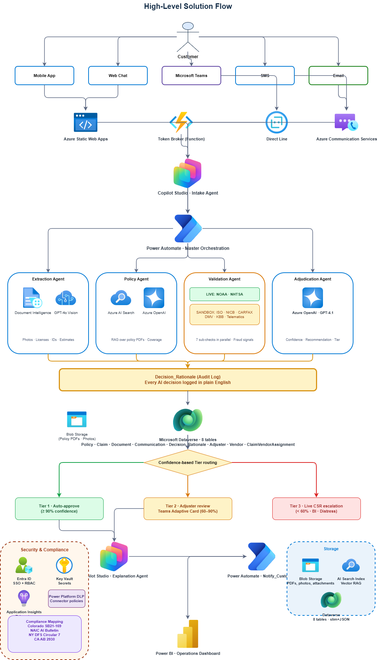
Technical Architecture
Component | Description
Architecture Overview | Stack: 4-layer architecture on Microsoft Power Platform + Azure AI. Channels (Mobile, Web, Teams, Email) → Power Apps (canvas + model-driven) or React SPA on Azure Static Web Apps → Copilot Studio + Power Automate → Dataverse + Power BI. Orchestration: Single Orchestrator agent coordinates 4 specialists — Intake, Document, Policy & Adjudication, CSR / HITL. Every step writes to an immutable Decision_Rationale log. Happy Path Tier-1: Multi-channel intake → Intake agent creates claim → parallel Document understanding + Policy validation → Adjudication → auto-approve or escalate to adjuster in Teams → customer notified → Power BI live.
Core Components | Conversational & Orchestration: Copilot Studio (intake topics + CSR support) · Power Automate flows for orchestration, notifications, audit logging. AI: Azure OpenAI (GPT-4o for adjudication/vision, small models for triage) · Azure AI Document Intelligence for forms/IDs · Azure AI Search RAG over policies & SOPs. Data: Dataverse (claims, policies, decisions, audit) · Blob Storage for documents and photos. Integrations & UX: MCP tools + custom connectors for SoR (Guidewire/Duck Creek), fraud / enrichment, identity, e-sign. Power Apps for Customer + Adjuster UIs; Teams Adaptive Cards for HITL; Power BI Embedded.
Security & Compliance | Identity & secrets: Entra ID SSO + RBAC (handler / supervisor / admin); Key Vault for all credentials; environment-scoped connection refs. Data & PII: Encryption at rest + TLS 1.2+ in transit · row/table-level RBAC · PII detection via Azure AI Language, masking + tokenization, no PII in prompts; data stays in tenant, region-pinned. Governance, ALM & audit: Power Platform DLP classifies connectors; Pipelines (Dev→Test→Prod) + GitHub Actions; observability via Application Insights + Dataverse Audit (append-only). Explainability: Every agent decision logs inputs, model version, rationale and confidence — audit trail for dispute resolution and emerging AI regulations.

Slide 5
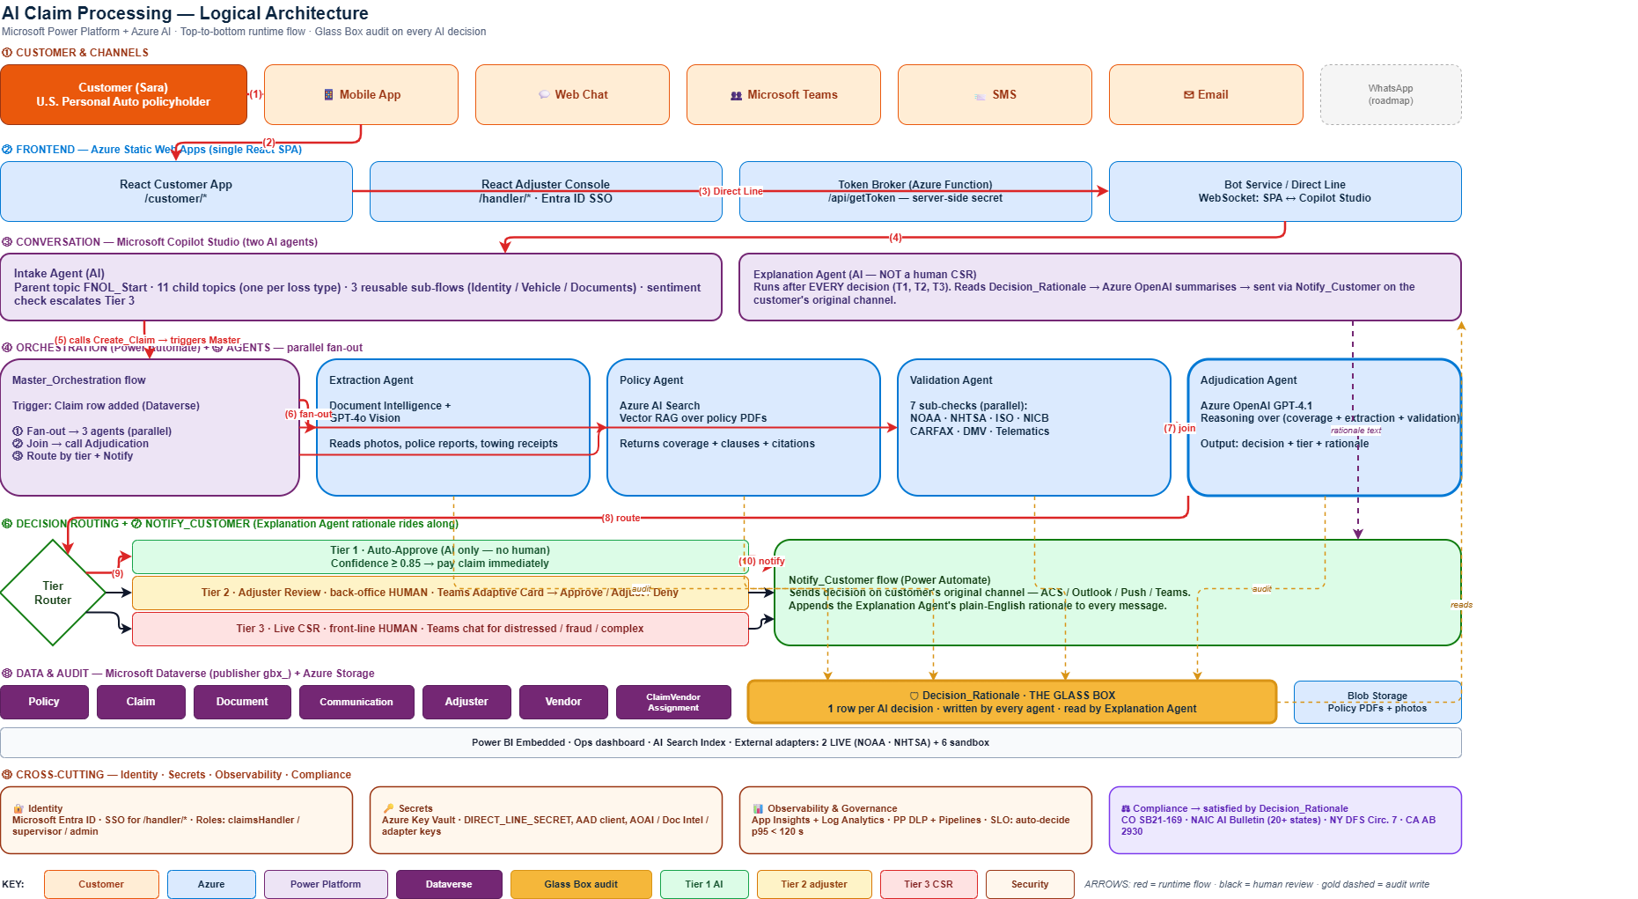
Logical Architecture (C4 L2)

Slide 6
Architecture Flow — top-to-bottom
Customer → 5 channels → Copilot Studio → Power Automate → 4 parallel agents → audit → tier routing → notify
Customer
Security & Compliance
Microsoft Entra ID
SSO + RBAC + roles
Mobile App
Web Chat
Microsoft Teams
SMS
Email
Azure Static Web Apps
Azure Function · Token Broker
Bot Service · Direct Line
Azure Comm Services (SMS)
Azure Key Vault
Secrets + keys
Copilot Studio · Intake Agent (FNOL_Start + 11 child topics)
Application Insights
Telemetry
Power Automate · Master Orchestration
Power Platform DLP
Connector policies
Extraction Agent
Doc Intelligence + Vision
Policy Agent
AI Search RAG + AOAI
Validation Agent
NOAA + NHTSA + 5 sandbox
Adjudication Agent
Azure OpenAI GPT-4.1
Encryption
At rest + in transit (TLS 1.2+)
★ Decision_Rationale audit log — every AI decision in plain English
Compliance Mapping
Colorado SB21-169
NAIC AI Bulletin
NY DFS Circular 7
CA AB 2930 (pending)
Microsoft Dataverse · 8 tables
Tier?
Tier 1
Auto-approve
Tier 2
Teams Adaptive Card
Tier 3
Live CSR escalation
Copilot Studio · Explanation Agent
Power Automate · Notify_Customer
Power BI · Operations Dashboard

Slide 7
Team Profile
Sameet Dandawate
Prasad Barsode
Rahul Chavan
Suraj Chaudhari
Abhijeet Rajvaidya
Utkarsh Agrawal
Team SPOC · End to end Architecture Lead & Data . Dataverse
Domain Product Manager· workflow & expert Architecture
Tech LeadFrontend · React on Static Web Apps
Copilot Studio · Power Automate
Senior Architecture Lead
Demo · Power BI · backup video
Primary contributions shown above — the team worked collaboratively across every component.
Common Microsoft stack used across the team
Copilot Studio
Power Automate
Dataverse
Azure OpenAI
AI Search
Document Intelligence
Power BI
Static Web Apps

Slide 8
References & Supporting Material
All artifacts live in two places — public GitHub repo (read-only) and Confluence (PM space, access on request).
📁 GitHub Repository (public, no access needed)
📚 Confluence (PM space · access on request)
github.com/Sameet1308/Hack2future
aieliteltm.atlassian.net/wiki/spaces/PM
Diagrams (open in app.diagrams.net):
Product Requirements (PRD) · R1–R25
• 02_logical_architecture.drawio · C4 Level 2 swimlanes
• 03_er_diagram.drawio · 8 entities + relationships
Dataverse Schema · 8 tables, slim + JSON pattern
• 04_assignment_flows.drawio · Handler + Vendor engines
• 05_blueprint_flow.drawio · half-slide solution flow
Architecture · 4 layers, channels → orchestration → agents → data
• 06_agent_architecture.drawio · 6 agents, parallel pattern
Schema files:
Architectural Decisions Log · 17+ ADRs
• glassbox_schema.csv · logical + physical column names
Intake Agent FNOL Spec · 11 loss types, sub-flows, escalation
• glassbox_schema.xlsx · 10-sheet color-coded workbook
🔑 How to request Confluence access
1. Open aieliteltm.atlassian.net/wiki/spaces/PM → Atlassian will prompt you to sign in with a Microsoft / Google / Atlassian account.
2. Click any restricted page → use the "Request access" link. Approval lands in the space admin's inbox.
3. Faster path — email the team lead with your Atlassian-account email: sameetdandawate@gmail.com (typical turnaround under 1 business day).

