Slide 1
POWER BI PORTFOLIO PROJECT
HR Analytics Dashboard
Workforce Insights & Employee Metrics
An interactive Power BI dashboard analyzing workforce composition, recruitment channels, performance ratings, and employee satisfaction for a 300+ employee organization.
Sameh El-Hosary | Data Analyst & Business Intelligence Analyst

Slide 2



PROJECT OVERVIEW
One view of the entire workforce
Business Problem
Objective
Audience
HR teams need a consolidated view of demographics, recruitment effectiveness, and satisfaction to support hiring and retention decisions.
Track headcount, department distribution, performance, and satisfaction in one interactive Power BI dashboard.
Built for HR leadership to monitor workforce health and recruitment channel ROI at a glance.
02

Slide 3



TOOLS & APPROACH
Built with a modern BI toolchain
Power BI Desktop & Service
DAX — Headcount, Active/Term %, Satisfaction %
Power Query (M) for data prep
Approach
1
2
3
4
Data Preparation
Data Modeling
Dashboard Design
Interactivity
Cleaned and structured employee records using Power Query (department, status, recruitment source, performance).
Built DAX measures for headcount, gender %, active/terminated %, and satisfaction distribution.
Designed a single-page HR overview combining KPI cards, demographics, and geographic distribution.
Added department and hiring-year filters for drill-down into workforce segments.
03

Slide 4
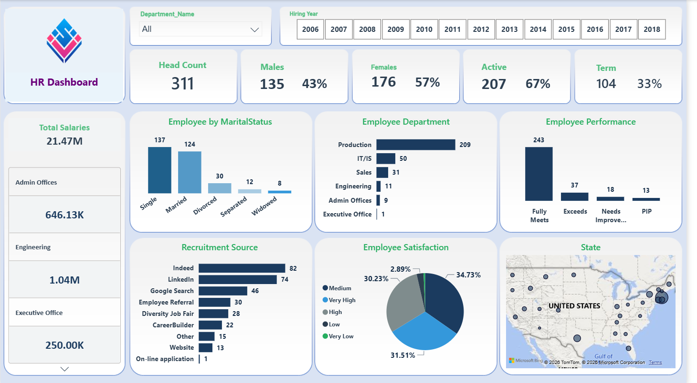
DASHBOARD WALKTHROUGH
Workforce Overview
KPI cards: Head Count, Male/Female split, Active vs. Terminated %, and Total Salaries.
Employee by Marital Status — column chart across 5 categories.
Employee Department — bar chart ranking headcount by department.
Employee Performance — ratings from Fully Meets to PIP.
04

Slide 5
DASHBOARD WALKTHROUGH
Recruitment & Satisfaction
Recruitment Source — bar chart comparing hiring channel effectiveness (Indeed, LinkedIn, Google Search, Referral...).
Employee Satisfaction — donut chart segmenting satisfaction levels from Very High to Very Low.
Salary breakdown by department shown in a drill-down panel.
Geographic distribution — filled map plotting employee locations across the U.S.
05

Slide 6
KEY TAKEAWAY
Workforce data, made actionable.
This dashboard turns scattered employee records into one connected view — helping HR leadership track headcount, recruitment ROI, and satisfaction in real time.
Sameh El-Hosary
Data Analyst & Business Intelligence Analyst
linkedin.com/in/sameh-el-hosary- · github.com/SamehElhosary0 · sameh.sabry656@gmail.com

