Slide 1
POWER BI PORTFOLIO PROJECT
Sales & Profitability Dashboard
Appliance Retail Analytics — ELARABY
A single-page Power BI dashboard tracking sales, quantity, profit margin, and order volume across stores and regions for a home appliance retail business.
Sameh El-Hosary | Data Analyst & Business Intelligence Analyst

Slide 2



PROJECT OVERVIEW
One live view of retail performance
Business Problem
Objective
Audience
Management needed a single, up-to-date view of sales performance across regions, categories, and stores instead of scattered manual reports.
Track revenue, quantity, profit margin, and order volume in one interactive Power BI dashboard for fast, data-driven decisions.
Built for retail management to monitor performance by category, store, region, and time period at a glance.
02

Slide 3



TOOLS & APPROACH
Built with a modern BI toolchain
Power BI Desktop & Service
DAX — Revenue, Profit Margin %, AOV
Power Query (M) for data prep
Approach
1
2
3
4
Data Preparation
Data Modeling
Dashboard Design
Interactivity
Cleaned and transformed raw sales transaction data using Power Query into a star-schema-friendly model.
Built DAX measures for revenue, profit margin %, average order value, and quantity.
Designed a single-page layout combining KPI cards, trend charts, and category-level profitability visuals.
Added slicers for category, store, year, and month for stakeholder drill-down.
03

Slide 4
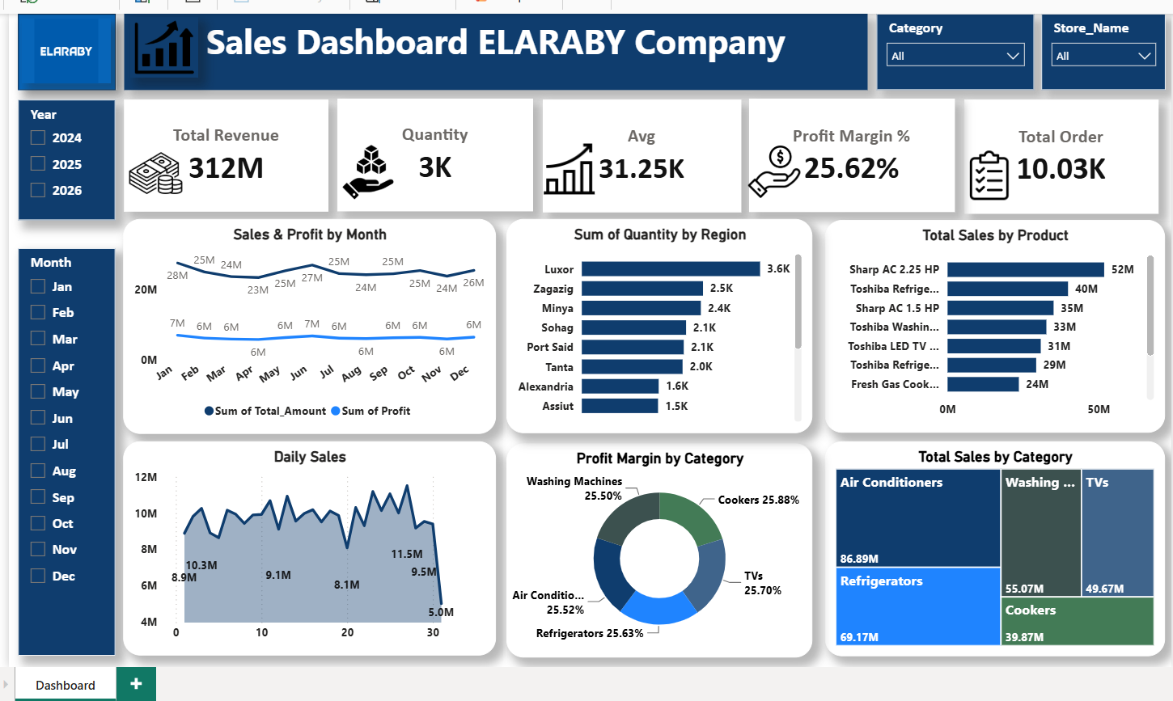
DASHBOARD WALKTHROUGH
KPIs & Sales Trends
Five KPI cards at the top: Total Revenue, Quantity, Average Order Value, Profit Margin %, and Total Orders.
Sales & Profit by Month — dual-line chart comparing monthly revenue against profit.
Daily Sales trend chart tracking day-by-day fluctuation within the month.
Filters for Year, Month, Category, and Store Name drive every visual.
04

Slide 5
DASHBOARD WALKTHROUGH
Regional & Category Breakdown
Regional performance — quantity sold across 8 regions (Luxor, Zagazig, Minya, Sohag, Port Said, Tanta, Alexandria, Assiut).
Product-level ranking — top-selling products (air conditioners, refrigerators, washing machines, TVs, cookers).
Profit Margin by Category — donut chart comparing margin % across 5 categories.
Total Sales by Category — treemap showing each category's contribution to total sales.
05

Slide 6
KEY TAKEAWAY
A single source of truth for retail.
This dashboard replaces scattered manual reporting with one live, interactive view of sales, profitability, and regional performance — giving management the KPIs they need in seconds.
Sameh El-Hosary
Data Analyst & Business Intelligence Analyst
linkedin.com/in/sameh-el-hosary- · github.com/SamehElhosary0 · sameh.sabry656@gmail.com

