Slide 1
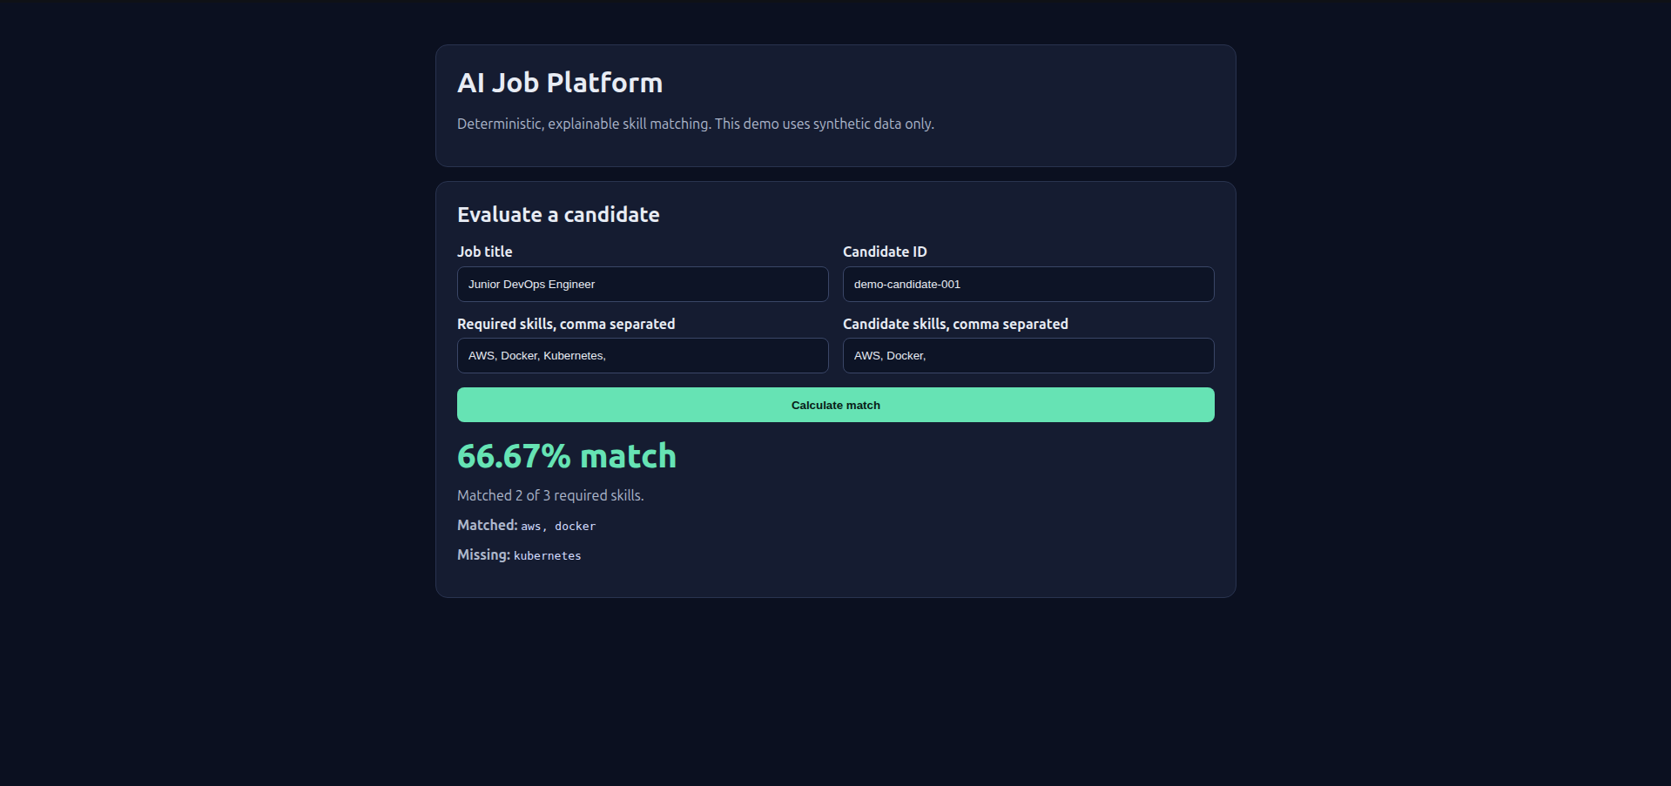
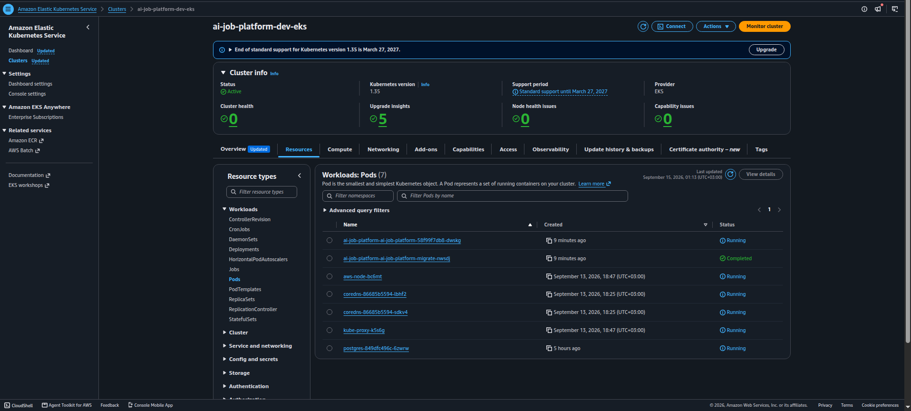
AI Job Platform
Production-oriented Kubernetes deployment demo
FastAPI · PostgreSQL · Docker · ECR · EKS · Helm · Alembic
P01 AI Job Platform · production-oriented demo · 1/8
Notes:
Sources: project screenshots supplied by the project owner. Evidence includes the GUI match demo and EKS workload view captured on September 15, 2026.

Slide 2
Project Scope
The project uses a small matching API to demonstrate the DevOps lifecycle around a real service.
Demo boundary
Deterministic, explainable candidate-to-job skill matching
Production-oriented, not claimed as fully production-ready. The demo uses synthetic data only.
PostgreSQL persistence with Alembic migrations
Container build, security checks, and Kubernetes packaging
Ephemeral AWS environment built for validation and teardown
No real resumes or secrets are included.
P01 AI Job Platform · production-oriented demo · 2/8
Notes:
Sources: repository README and project validation evidence. The production-readiness caveat reflects the documented project scope.

Slide 3
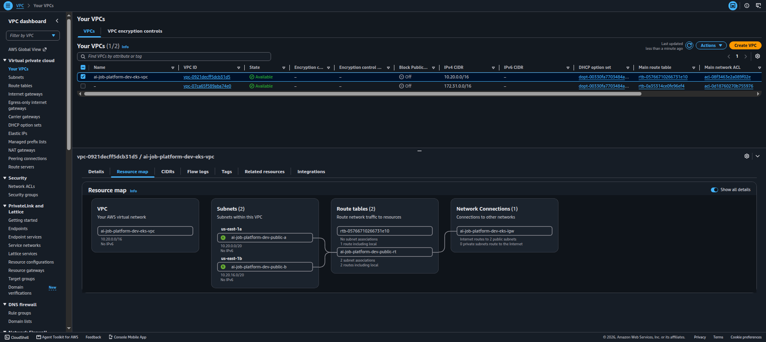
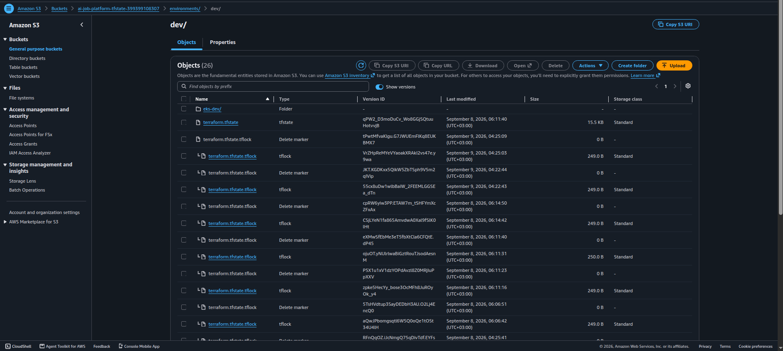
AWS Foundation
Validated foundation
Dedicated VPC: 10.20.0.0/16
Two public subnets across Availability Zones
Terraform remote state stored in S3
EKS cluster created in us-east-1
P01 AI Job Platform · production-oriented demo · 3/8
Notes:
Sources: AWS console screenshots showing VPC resources and the Terraform state bucket.

Slide 4
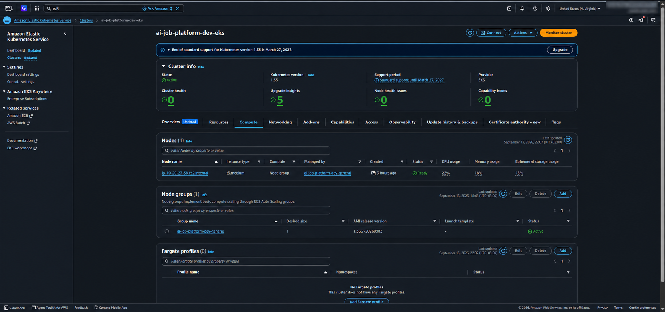
Cluster Runtime
Runtime evidence
EKS 1.35 control plane active
Managed node group active
One On-Demand t3.medium node
Core system workloads healthy
P01 AI Job Platform · production-oriented demo · 4/8
Notes:
Sources: EKS console screenshot and node validation evidence.

Slide 5
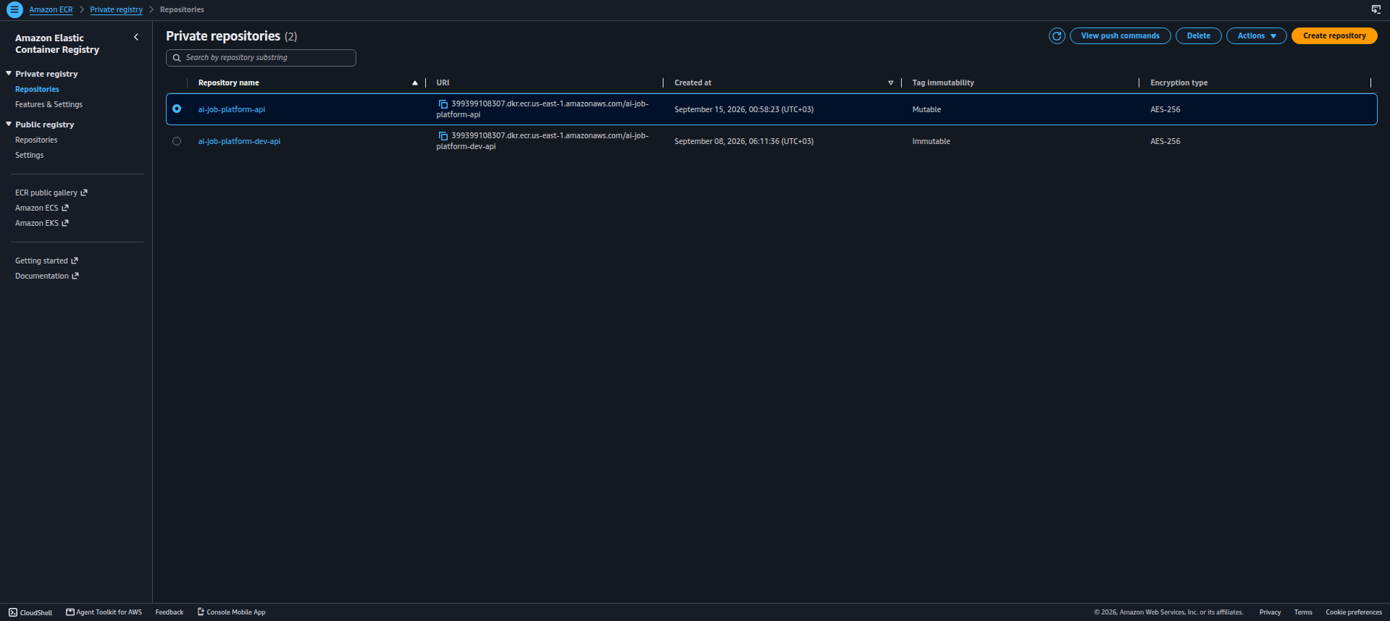
Image Delivery
Delivery path
Application image pushed to Amazon ECR
Helm receives repository and tag at deploy time
Chart rejects empty image values and placeholders
Migration Job and app use the same immutable image tag
P01 AI Job Platform · production-oriented demo · 5/8
Notes:
Sources: ECR screenshot and Helm template changes in the repository.

Slide 6
Kubernetes Deployment
Verified deployment
Helm release status: deployed
Application Pod: Running, 1/1 ready
PostgreSQL Pod: Running, 1/1 ready
Service exposed internally through ClusterIP
P01 AI Job Platform · production-oriented demo · 6/8
Notes:
Sources: kubectl and AWS console workload evidence captured after Helm revision 4.

Slide 7
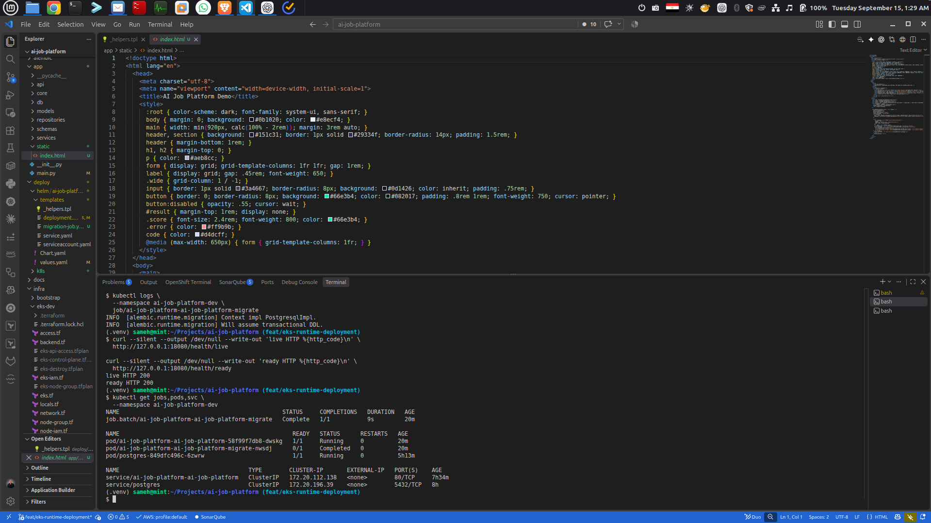
Migration Lifecycle
Operational behavior
Helm pre-upgrade hook runs Alembic
Migration Job completed in 9 seconds
Rollout continued after migration success
Live and ready endpoints returned HTTP 200
P01 AI Job Platform · production-oriented demo · 7/8
Notes:
Sources: terminal screenshot and kubectl logs showing Alembic PostgreSQL migration context and health checks.

Slide 8
Demo Value
Portfolio evidence
Shows an application, not only infrastructure
Connects CI, image delivery, and runtime validation
Documents a real troubleshooting path
Supports LinkedIn, GitHub, and interview discussion
Positioning: production-oriented Kubernetes demo
P01 AI Job Platform · production-oriented demo · 8/8
Notes:
Sources: GUI screenshot, Helm deployment evidence, and project README evidence summary.

