Slide 1

Hotel management project in C++
By
Samendu

Slide 2
What is Hotel Management?
Managing a hotel is a hectic job it requires you to adapt, take care of the services provided by your hotel
Having knowledge in the field of finance and a should make smooth plans
The actions requires in this field test your patience and your leadership skills

Slide 3
What is the need for such a system?
How many flights are boarded in a day? How many people move across the country in a day
When the above scenario takes place where do people stay when there in a unknow land
Why do we need to maintain records?
For tax purposes, analysis and if anything goes wrong

Slide 4

Header files
<iostream>
<fstream>
<string>
<unistd.h>

Slide 5
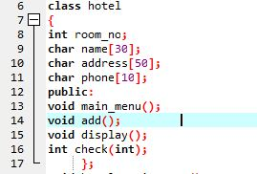
Class and prototypes
*Class
*Function Prototypes

Slide 6
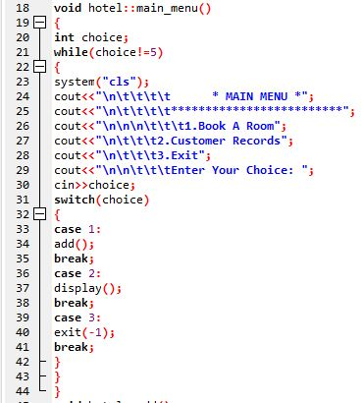
Main menu
*While Loop
*Switch Case

Slide 7
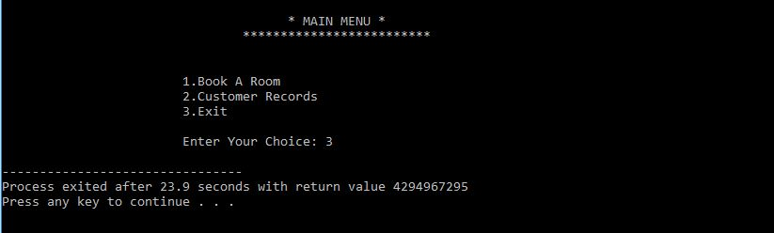
OuTput of main menu

Slide 8
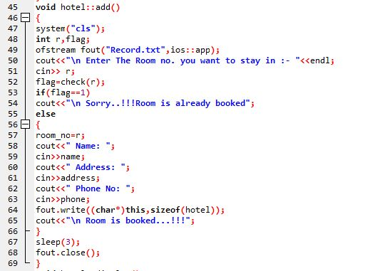
Add TO the Record

Slide 9
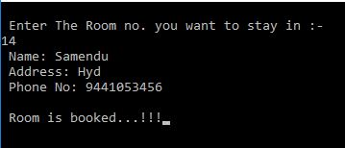

Output of add function

Slide 10
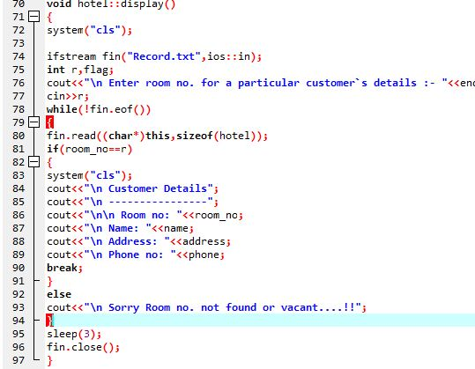
Display a record

Slide 11

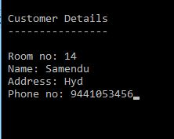
Output of display function

Slide 12
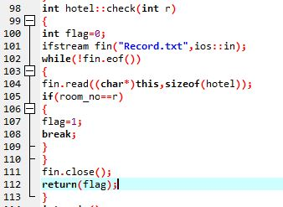
Check function

Slide 13
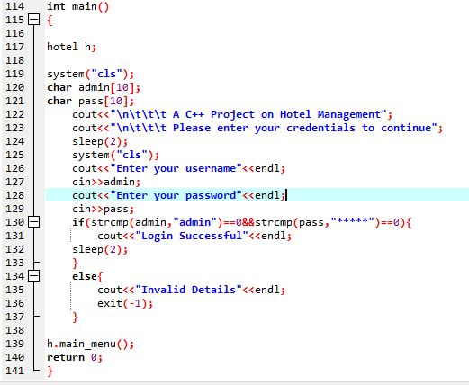
Driver code

Slide 14

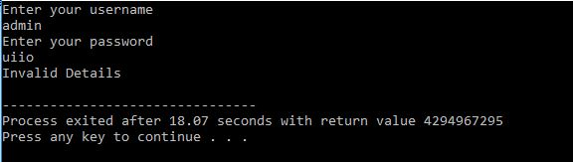

Output of driver code

