Slide 1

Hotel management project in C++
By
Samendu

Slide 2
What is Hotel Management?
Managing a hotel is a hectic job it requires you to understand your customers, render services as well as maintain them
Having knowledge in the field of finance will help you in this field
The actions required in this field test your patience and your leadership skills

Slide 3
What is the need for such a system?
How many flights are boarded in a day? How many people move across the country in a day
When the above scenario takes place where do people stay when in they are in a new place
Why do we need to maintain records?
For tax purposes, analysis and in case of a crime these records can be helpful

Slide 4

Header files
<iostream>
<fstream>
<string>
<unistd.h>

Slide 5
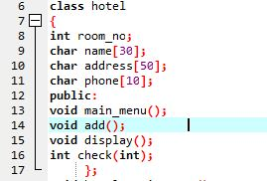
Class and prototypes
*Class
*Function Prototypes

Slide 6
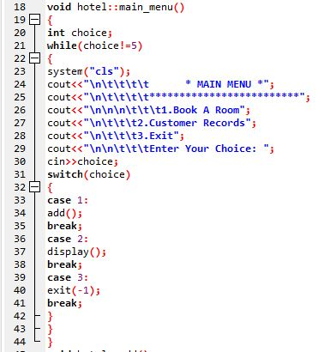
Main menu
*While Loop
*Switch Case

Slide 7
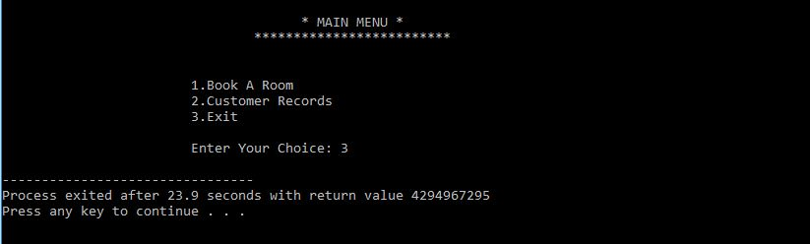
OuTput of main menu

Slide 8
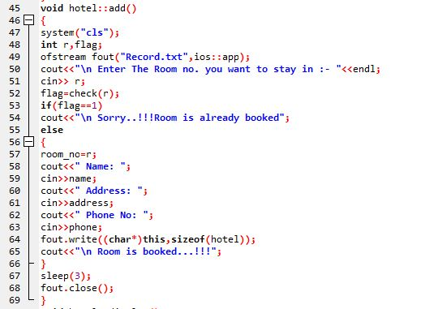
Add TO the Record

Slide 9
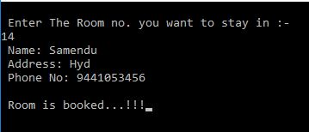

Output of add function

Slide 10
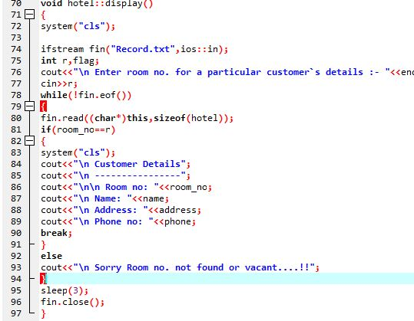
Display a record

Slide 11

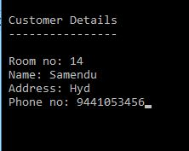
Output of display function

Slide 12
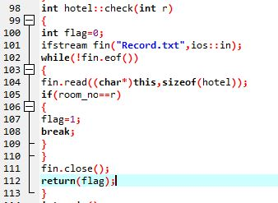
Check function

Slide 13
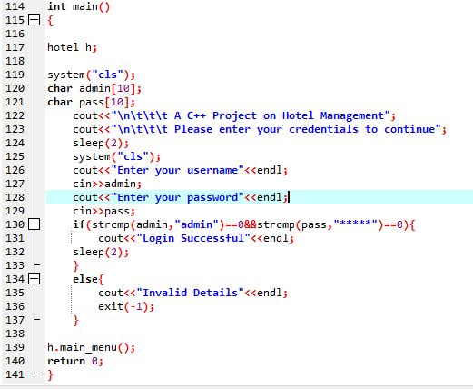
Driver code

Slide 14

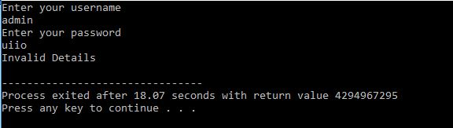

Output of driver code

