Slide 1

Setting a MERN app :
ERP website
SAMER SMATI

Slide 2

Introduction
Well the idea is to design a website allowing different parties to manage their accounts by giving them access by identification.
Two roles will be created:
-Administrator
-user
Let first discuss the topic of this project

Slide 3

A social networking site is an online platform that allows users to create a public profile and interact with other users. Social networking sites usually allow a new user to share, like and comment their and each other posts.
The actors and the use cases for this app are summarized in the following table:

Slide 4
The use Case Diagram study
Use CASE | ACTOR
Login/Logout | Admin/User
Remove post/comment | Admin/User
Add post/Comment | Admin/User
Sign up | User

Slide 5
The use Case Diagram study
ADMIN:
All posts can be deleted and commented on by admins.
Admins have the ability to delete comments
Admin can delete users

Slide 6
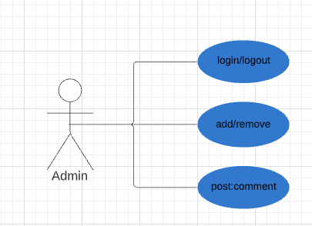
Actors :

Slide 7
The use Case Diagram study
USER
User can comment on all posts
User can delete or edit his own comment
User can create a post
User can delete his own post

Slide 8
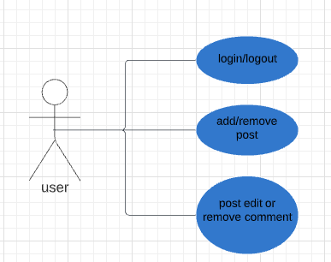

Slide 9
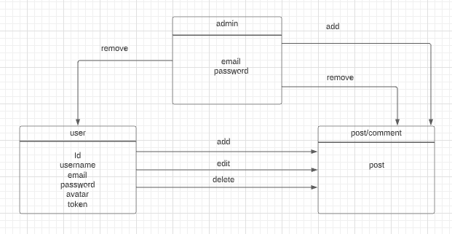

Slide 10
The Class Diagram Study
Users will be able to post and interact with each other in my app

Slide 11


