Slide 1
A Comparative Analysis of Digital Filtering for Seismic Signals from several Earthquakes in Turkey
Capstone Project
By Samer Al-khateeb
Date: May/10/2013

Slide 2
Outline
Introduction
Background
Methodology
Data collection
Pre-Processing
Data Processing
Analysis of results & Conclusion

Slide 3
Introduction
What is an Earthquake?
How can we measure it?
Types of instruments?
Organization that process the data?
Types of data?
Correction methods?
Software used?
Notes:
Definition: is the result of a sudden release of energy in the Earth's crust that creates seismic waves.
Magnitude and intensity
Analog and digital
Broad band strong motion data

Slide 4
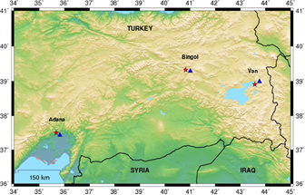
Background
Where these earthquakes happened?
Previous studies what they used?
What I used in this research and why?
Notes:
Adana, van, bingol

Slide 5
Methodology
What kind of filters has been used?
Acausal or Causal?
How the corner frequency has been calculated?
What was the order of the filter applied?

Slide 6
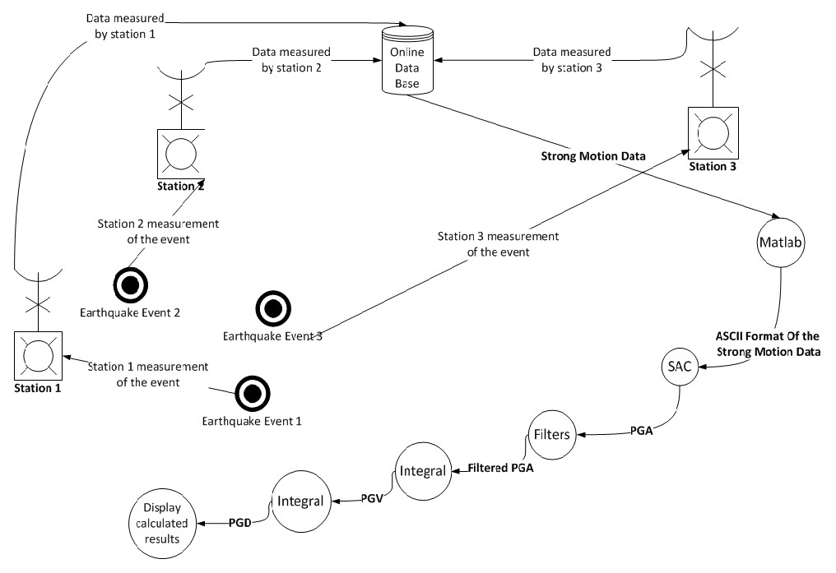
Data Collection
How we collected them?
Where and when these earthquakes happened?
How each station record the data?

Slide 7
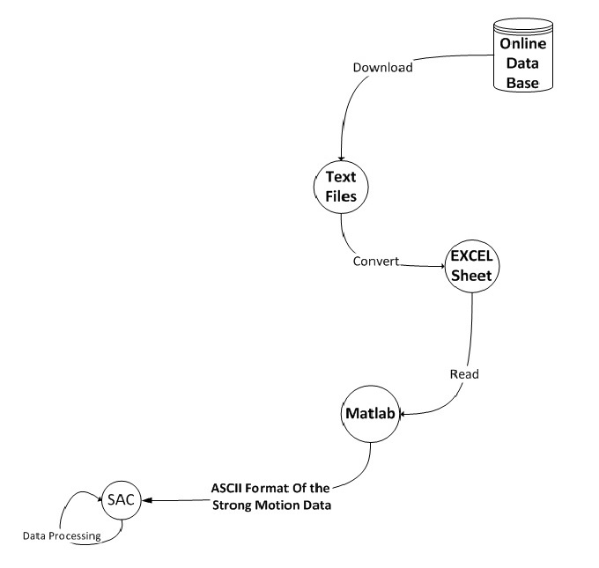
Pre-Processing

Slide 8
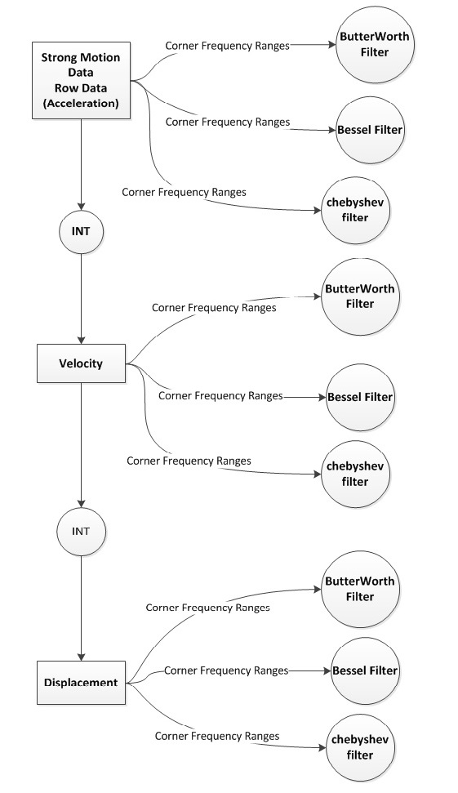
Data Processing

Slide 9
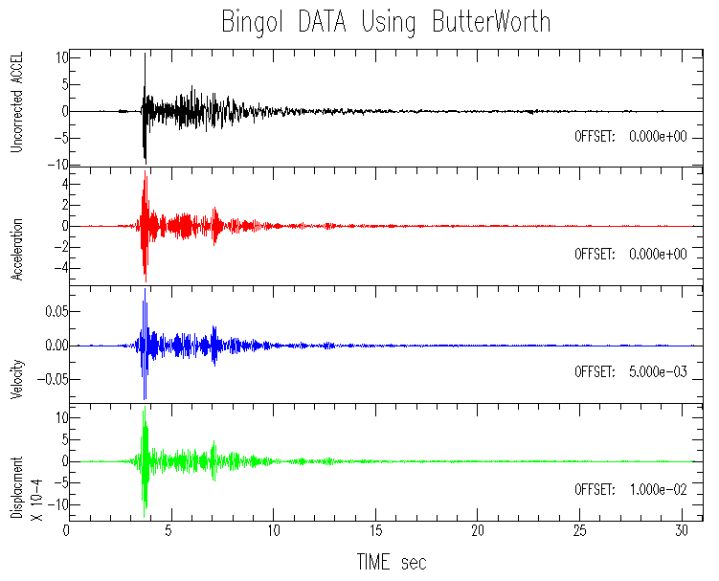
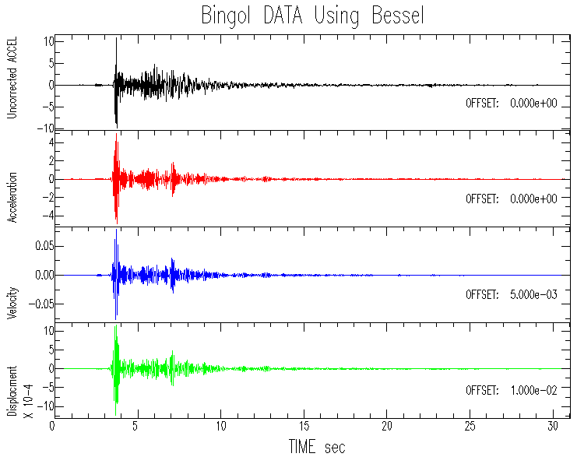
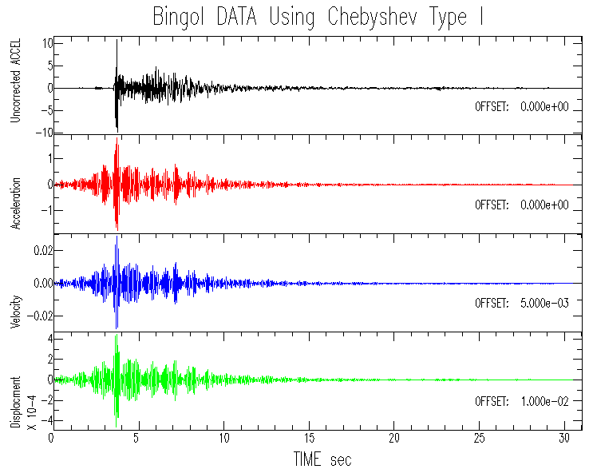
Analysis of Results & Conclusion
Parameters | Raw | F1 [Hz] | F2 [Hz] | Butterworth | Bessel | Chebyshev
PGA | 9.8011 | 7.98 | 11.98 | 5.3265 | 5.03006 | 1.82949
PGV | 0.16052 | 7.98 | 11.98 | 8.449E-2 | 7.866E-2 | 2.89168E-2
PGD | 0.04533 | 7.98 | 11.98 | 1.2903E-3 | 1.2349E-3 | 4.61822E-4

Slide 10
Thank you for Listening
Questions???

