Slide 1
Developing A Conceptual Framework for Modeling “Deviant Cyber Flash Mob”:
A Socio-Computational Approach Leveraging Hypergraph Constructs
Samer Al-khateeb & Nitin Agarwal
sxalkhateeb@ualr.edu, nxagarwal@ualr.edu
Department of Information Science
University of Arkansas at Little Rock

Slide 2
Overview
Background
Introduction
Research Questions
Contributions
Methodology
Modeling DCFM
Postulates
DCFM-Success
DCFM-Failure
Proposed Conceptual Framework
Conclusion and Future Work

Slide 3
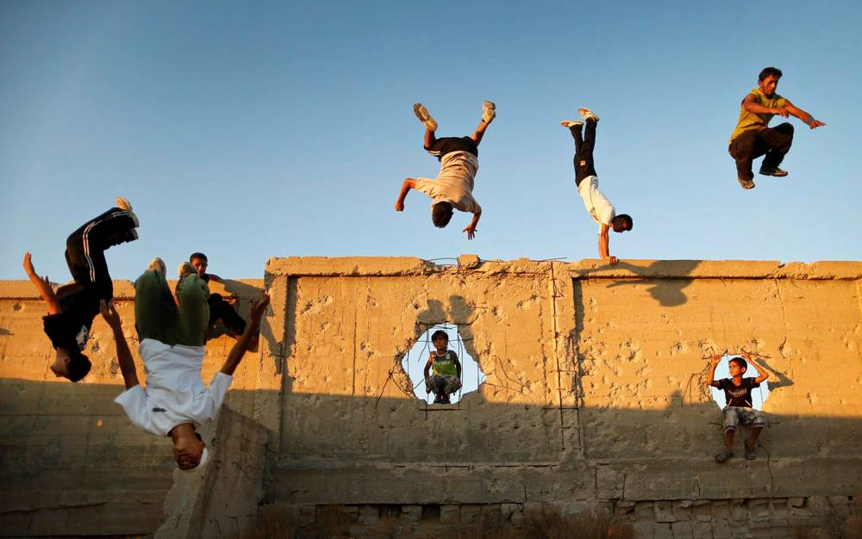



Background
Collective Action?
Forms of Collective Action?
Fig. 1: (a) Palestinians Practicing Parkour in Gaza
(b) a Flash Mob Dance in a Shopping Mall
(c) Saudi Arabian Women’s Right to Drive Campaign’s Bumper Sticker
and (d) The 2011 Arab Spring Social Movement
Notes:
Collective action: is defined as all activity of common or shared interest among two or more individuals (Olson, 1977). Collective action theories can be traced back to Ronald Coase’s (Coase, 1937) economic explanation on why individuals are willing to form companies, and partnerships in business trading other than making bilateral contracts between individuals. Many years later, there are many collective action theories developed such as the Neutrality Theorem (Warr, 1982, 1983), Club Theory (Sandler & Tschirhart, 1980) , Folk Theorem (Rubinstein, 1979), and the most eminent one, Rational Choice Theory (Becker, 1976). Resource Mobilization Theory (Zald & McCarthy, 1979; Kerbo, 1982; Ferree, 1992) that emerged in the 1970s and early 1980s. This theory was the most influential approach in explaining the success of collective action.

Slide 4
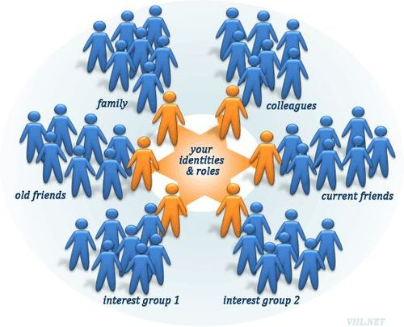
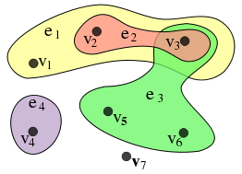
Background Cont...
Social Capital? (Pierre Bourdieu, 2002)
Hypergraph vs. Simple Graph ?
V1
V4
V2
V3
(b) Simple Graph
Fig. 2: (a) Social Capital
(c) Hypergraph
Notes:
Social Capital is defined as “the value that one gains from personal connections such as membership in a family, an ethnic association, elite clubs, or other solidarity groups”, as stated by the French economic and cultural sociologist Pierre Bourdieu
Hypergraph is a generalization of a graph, where an edge can connect any number of vertices. A hypergraph H is a pair H=(X,E) where X is a set nodes or vertices, and E is a set of non-empty subsets of X called hyperedges.
A simple graph can be considered as a special case of hypergraph, where each hyperedge has a cardinality of 2.

Slide 5
Introduction
Flash Mobs (FM)? First flash mob by Bill Wasik
Fig 3.a: Example of FM
Notes:
A flash mob (FM) is a group of individuals who get together in a public place, perform an unusual act, and quickly disperse. These group acts are often conducted for the purposes of entertainment, satire, and artistic expression. The first flash mob was created in Manhattan in 2003, by Bill Wasik, who is a senior editor of the Harper’s Magazine. The purpose of that flash mob as Wasik claimed was “a social experiment designed to poke fun at hipsters and to highlight the cultural atmosphere of conformity and of wanting to be an insider or part of the next big thing”

Slide 6
Introduction Cont…
Cyber Flash Mobs (CFM)? i.e. Impeach Clarence Thomas Cyber Flash Mob
Fig 3.b: Example of CFM
Notes:
Cyber flash mobs (CFM) which are the cyber manifestation of flash mobs (see Figure 1), are known to be coordinated via social media, telecommunication devices, or viral emails. CFMs are self-organized groups of individuals who get together in cyberspace, perform an unpredicted act, and quickly disperse.
Robert Menendez: Senator
Clarence Thomas: Associate Justice of the Supreme Court of the United States

Slide 7
Introduction Cont…
Deviant Cyber Flash Mobs (DCFM)? Cyber Scope i.e. The Comment Cyber Flash Mob
“Dear editors of the German Wall Street Journal, you equated Anonymous with Al- Qaeda in your February 2012 article and the related coverage. With this type of coverage you may be able to stir up fear in the United States, but not in the land of poets and thinkers! With this comment, we oppose the deliberate dissemination of false information and express our displeasure with your lobby journalism. We are Anonymous. We are millions. We do not forgive. We do not forget. Expect us!”
Fig 3.c: Example of DCFMs with Cyber Scope
Notes:
Deviant CFM (or, DCFM) can be considered as a form of a cyber-collective action that is defined as an action aiming to improve a group’s conditions (such as, status or power). These DCFMs are categorized as the new face of transnational crime organizations (TCOs) (e.g., “hacktivist” groups) that can pose significant risks to political, social, and economic stability. The DCFM activities can stretch beyond the cyberspace, i.e., in physical spaces.

Slide 8
Introduction Cont…
Deviant Cyber Flash Mobs (DCFM)? Physical Scope i.e. The Flash Mob Cyber Heist
Fig 3.d: Example of DCFMs with Cyber and Physical Scope

Slide 9
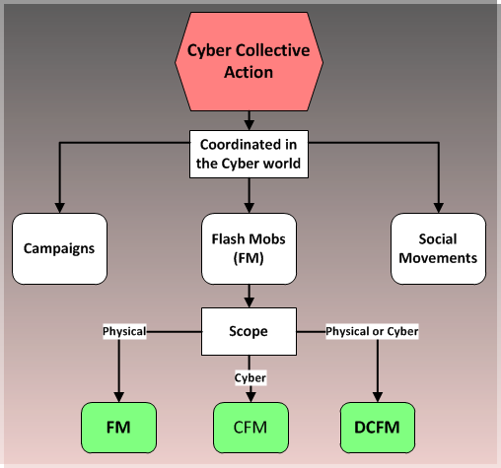
Fig 4: Different Forms and Scopes of Cyber Collective Action, i.e., Flash Mobs (FM), Cyber Flash Mobs (CFM), and Deviant Cyber Flash Mobs (DCFM).

Slide 10
Research Questions
How decentralized online individual actions transform into collective actions resulting in Deviant Cyber Flash Mob (DCFM) behaviors?
What are the necessary conditions that lead to the emergence of these phenomena?
Can we explain the motivation needed for the subsistence of such coordinated acts?
How can we build predictive models of DCFM behaviors?

Slide 11
Contributions
1. We define an emerging socio-technical behavior, viz., Deviant Cyber Flash Mob (DCFM) observed among cyber crimes and networked violent groups.
2. We identified the factors that lead to the success or failure of the DCFM and developed postulates.
3. We designed a socio-computational model based on these postulates to predict the trajectory of a DCFM advancing our understanding of the emerging socio-technical behavior.
4. We used the hypergraph notation to represent the inherently multidimensional and supra-dyadic nature of the interactions manifested by the complex DCFM phenomenon.
5. We present a DCFM scenario to study the efficacy of the proposed model.

Slide 12
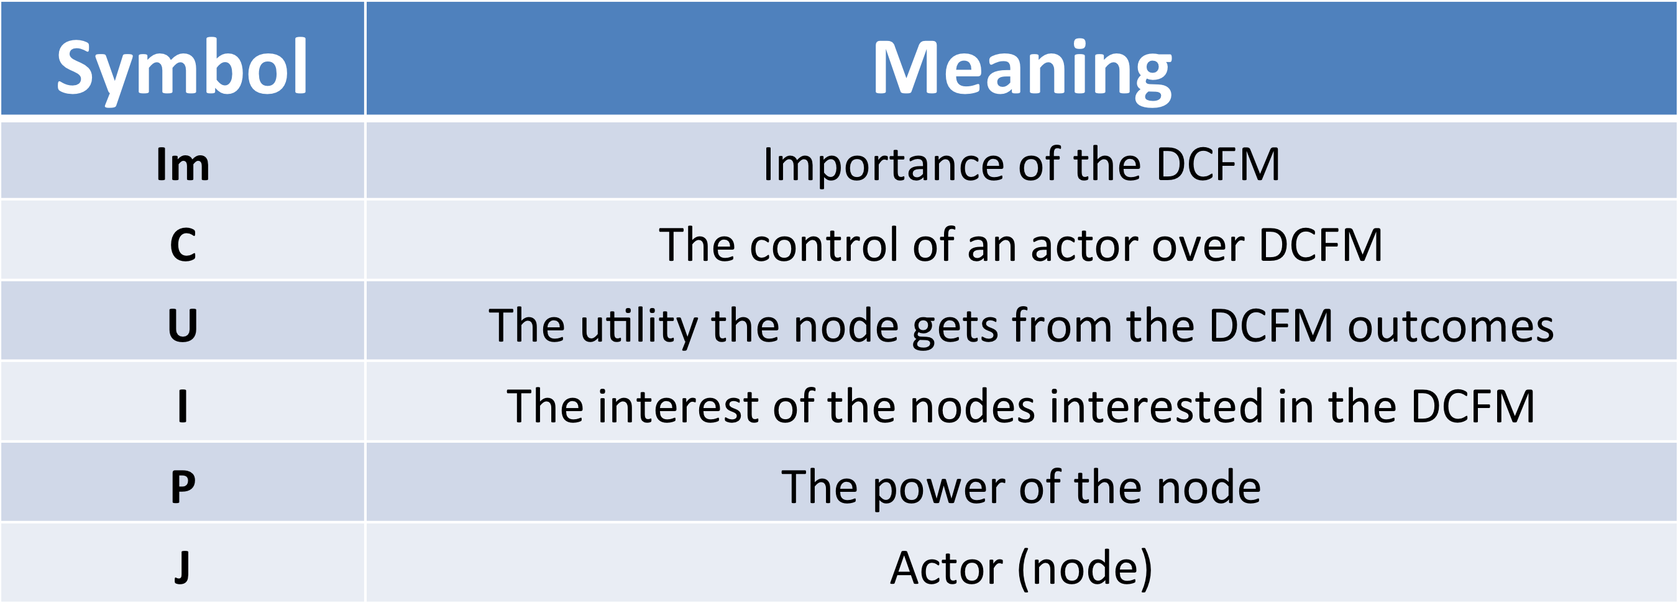
Methodology
Table 1: The Symbols Used in the Methodology With Their Meaning
Coleman, J. S. (1973). The mathematics of collective action. In (p. 61-90). Transaction Publishers.
Notes:
Methodology In the book by James S. Coleman “The mathematics of Collective Action” (Coleman, 1973), Coleman proposed a framework for collective action and provided 25 mathematical definitions. Concepts such as power, control, utility, and interest, defined by Coleman are borrowed in our proposed model. The concepts have been appropriately modified to suit the cyberspace, especially for the DCFM behavior.

Slide 13
1. Modeling DCFM
A DCFM is more important when many actors are interested in participating. On the same hand, more actors will be interested to participate in an important DCFM.
The interest of an actor in a DCFM increases as the utility gained by participating increases.
The actors who gain more utility will become powerful.
Powerful actors are interested in an important DCFM. On the same hand, important DCFMs grab the attention of powerful actors.
An actor needs control over the event to become powerful. On the same hand, a powerful actor would assert greater control over the DCFM.

Slide 14
2. Postulates
P1.
Importance(Im) → Interest(I) Interest(I) → Importance(Im)
∴ Importance(Im) ↔ Interest(I) ………..(1)
Notes:
Mutually reinforcing factors

Slide 15
2. Postulates
P1.
Importance(Im) → Interest(I) Interest(I) → Importance(Im)
∴ Importance(Im) ↔ Interest(I) ………..(1)
P2.
Utility(U) → Interest(I)

Slide 16
2. Postulates
P1.
Importance(Im) → Interest(I) Interest(I) → Importance(Im)
∴ Importance(Im) ↔ Interest(I) ………..(1)
P2.
Utility(U) → Interest(I)
P3.
Utility(U) → Power(P)

Slide 17
2. Postulates
P4.
Power(P) → Importance(Im)
Importance(Im) → Power(P)
∴ Power(P) ↔ Importance(Im) ………(2)

Slide 18
2. Postulates
P4.
Power(P) → Importance(Im)
Importance(Im) → Power(P)
∴ Power(P) ↔ Importance(Im) ………(2)
P5.
Power(P) → Control(C)
Control(C) → Power(P)
∴ Power(P) ↔ Control(C) ………(3)

Slide 19
2. Postulates
∵ Power(P) = f(C,Im)

Slide 20
2. Postulates
∵ Power(P) = f(C,Im)
∵ Importance(Im) = f(Interest)

Slide 21
2. Postulates
∵ Power(P) = f(C,Im)
∵ Importance(Im) = f(Interest)
∵ Interest(I) = |Uoutcome1 − Uoutcome0|

Slide 22
2. Postulates
∵ Power(P) = f(C,Im)
∵ Importance(Im) = f(Interest)
∵ Interest(I) = |Uoutcome1 − Uoutcome0| ∴Power(P)=f(C,|Uoutcome1 −Uoutcome0|)

Slide 23
2. Postulates
∵ Power(P) = f(C,Im)
∵ Importance(Im) = f(Interest)
∵ Interest(I) = |Uoutcome1 − Uoutcome0| ∴Power(P)=f(C,|Uoutcome1 −Uoutcome0|)
Or
∴ Power(P) = f(C,I)………..(4)

Slide 24

2. Postulates
∵ Power(P) = f(C,Im)
∵ Importance(Im) = f(Interest)
∵ Interest(I) = |Uoutcome1 − Uoutcome0| ∴Power(P)=f(C,|Uoutcome1 −Uoutcome0|)
Or
∴ Power(P) = f(C,I)………..(4)

Slide 25
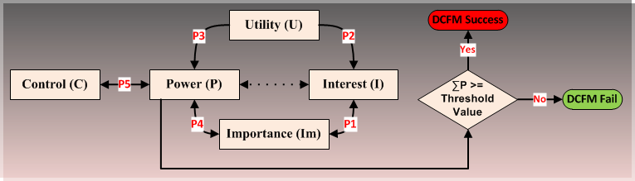
2. Postulates
Fig 5: Postulates Showing all the Factors that Help in Determining the Outcome of a DCFM, i.e., Success or Failure.

Slide 26
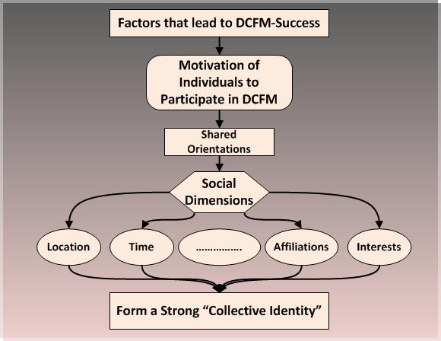
3. The Case of DCFM-Success
Fig 6: Factors That Lead to The Case of DCFM-Success.
Hypergraph will be used here to capture the multidimensional relations i.e. social dimensions
Notes:
DCFM Success: it is essential to understand the source of motivation of the individuals that coordinate the act. Shared orientations among individuals often form the basis for motivation resulting in collective actions. Shared orientations among individuals induce a sense of belongingness to the group-giving rise to the group’s collective identity. Social dimensions (Tang & Liu, 2010), such as affiliations, interests, time, location, among others, are the shared orientations that govern the relationships among individuals coordinating a DCFM. Individuals may be connected along one or more social dimension, resulting in multiple shared orientations and hence a stronger collective identity

Slide 27
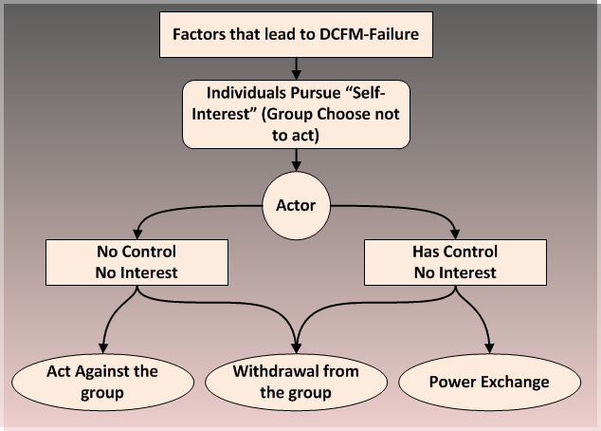
3. The Case of DCFM-Failure
Fig 7: Factors That Lead to The Case of DCFM-Failure.
Notes:
DCFM Failure: In his book entitled, “The Logic of Collective Action”, Mancur Olson (Olson, 1977) put forward a single basic premise of collective action: “...individual rationality is not sufficient for collective rationality...” (Sandler, 1992). Olson’s classic book (Olson, 1977) is mostly concerned with explaining and illustrating how collective failure results when individuals pursue self-interest.
Power exchange: to gain control over other events (DCFMs) or to gain social capital.

Slide 28
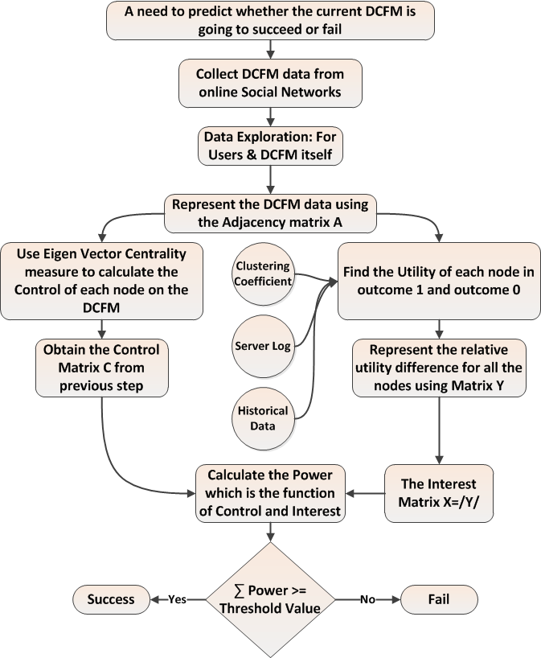
4. Proposed Conceptual Framework
Fig 8: Proposed Conceptual Framework Illustrating a Step-wise Methodology to Predict the Outcome of DCFMs.

Slide 29
Conclusion
We developed a conceptual model for the deviant cyber flash mob (DCFM) grounded in the theories of collective action and collective identity formation.
Mathematical constructs of hypergraph are leveraged to represent the complex multi-dimensional and supra-dyadic relations manifested in the DCFM social networks.
We identified the necessary conditions and motivations that lead to the emergence of these phenomena such as interest and control.
By studying the factors that lead to the success and failure of a DCFM, we envision the development of a predictive model. To the best of our knowledge, this is the first study examining the DCFM behavior with groundings in social science theories.

Slide 30
Future Work
Targeting Real World DCFM data.
Model refinement and evaluation to the conceptual model using empirical data the model refinement will be used to accurately:
Model the formation of deviant CFMs and
Predict the outcome (“agenda-setting” or proceeding to a cyber-attack) by considering collective failure/success factors (e.g., group size, group composition, asymmetry in resource distribution, critical mass, etc.).

Slide 31
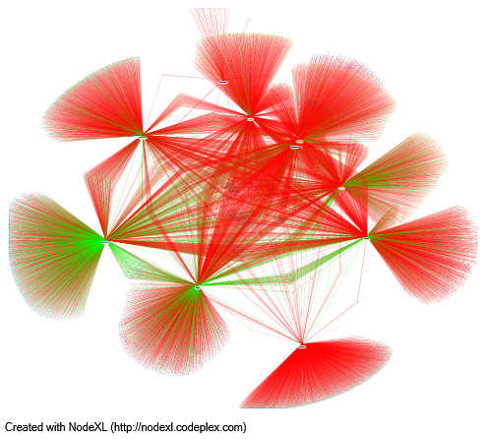
Preliminary Work in This Direction
1. Monitoring and analyzing ISIL network group activity using Twitter friends/followers data.
Foreign fighters & disseminators
ISIL Data From ICSR Report
ahmadMusaJibri1
musaCerantonio
shamiwitness
abusiqr
saqransaar
ash_shawqi
troublejee
khalid_maqdisi
nasserjan2
jabhtanNusrah
Just Disseminators
Green edges =ISIL nodes following others. Red edges = other nodes following ISIL nodes
ICSR: International Centre for the Study of Radicalization
Notes:
disseminator accounts which spread information from the battlefield in real-time, publishing links to new videos and official statements, spreading photographs of battles, equipment, meetings, and ‘martyrs.’
These disseminators are not foreign fighters nor do they have any official links to jihadist organizations. Instead, they broadly support the Islamist project in Syria and, in that respect, provide both moral and political support to the cause by establishing themselves as reliable sources of information

Slide 32
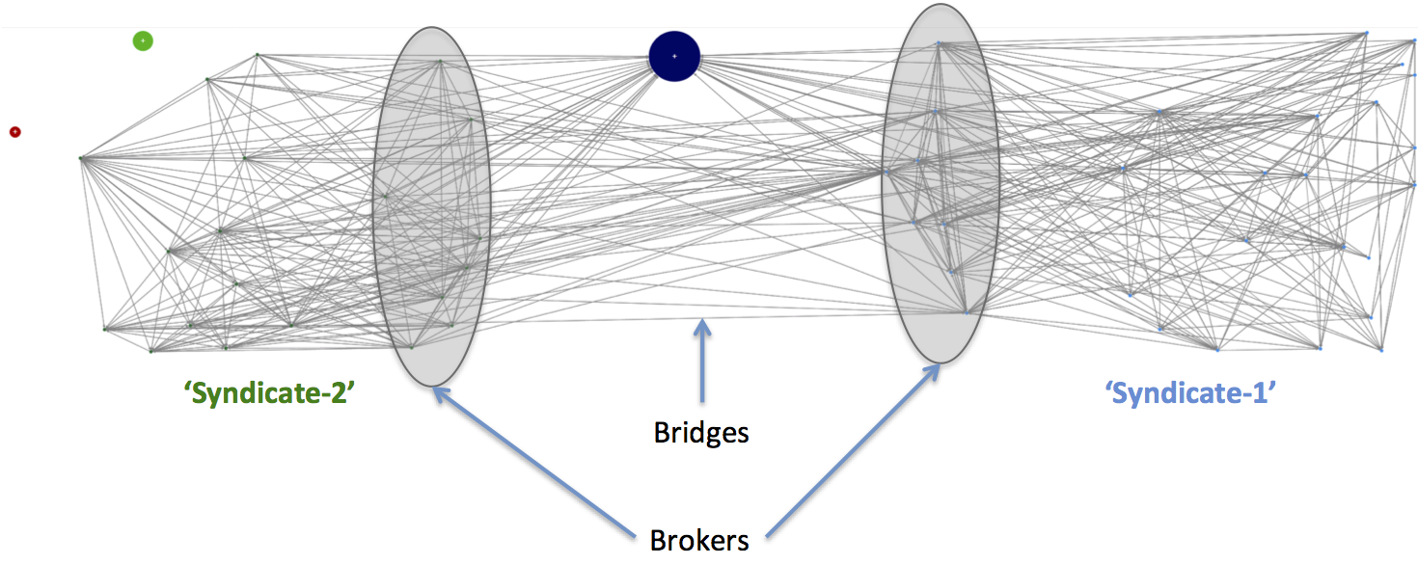
Preliminary Work in This Direction
2. Monitoring and analyzing Russian Botnet for Ukrainian Water Crisis on Twitter.
Real Person Network (actual identity concealed)
This research is being conducted in collaboration with NATO and US Office of Naval Research.

Slide 33
Acknowledgment
This research is supported in part by grants from,
The U.S. Office of Naval Research (ONR) under Grant Number N000141410489.
The U.S. National Science Foundation’s (NSF) Social Computational Systems and Cyber Human Systems programs under Award Numbers IIS-1110868 and IIS- 1110649.
Samer Al-khateeb and Nitin Agarwal. Modeling Flash Mobs in Cybernetic Space: Evaluating Threats from Emerging Socio-Technical Behaviors to Human Security. In Proceedings of the IEEE Joint Intelligence and Security Informatics Conference (JISIC 2014), September 24-26, 2014, Hague, Netherlands.

Slide 34
Publication
Samer Al-khateeb and Nitin Agarwal. Modeling Flash Mobs in Cybernetic Space: Evaluating Threats from Emerging Socio-Technical Behaviors to Human Security. In Proceedings of the IEEE Joint Intelligence and Security Informatics Conference (JISIC 2014), September 24-26, 2014, Hague, Netherlands.

Slide 35
Thanks
Questions?

