Slide 1
Topic Modeling For Associated Press Articles Using Latent Dirichlet Allocation [LDA]
Final Project Presentation
Name: Samer Al-Khateeb
Instructor: Dr. Xiaowei Xu
Class: Information Science Principal/ Theory (IFSC 7321)

Slide 2
Outline
Introduction
Methodology
Data Collection and Software used
Data Pre-Processing
Experiment and Evaluation
Selecting the Optimal Model Parameter
Training and Testing
Results
Summary and Future Work
References

Slide 3
Introduction
What is topic modeling? “A topic modeling tool takes a single text (or corpus) and looks for patterns in the use of words; it is an attempt to inject semantic meaning into vocabulary” so words like :Computer, Laptop will be in the same Topic”.
What is LDA?
Vector Space Model (VSM)
Latent Semantic Analysis (LSA)
Probabilistic Latent Semantic Analysis (pLSA)
Latent Dirichlet Allocation: “It is an important hierarchical Bayesian model for probabilistic topic modeling”.
Types of LDA-based topic Models:
Document-Topic Model
Author-Topic Model (ATM)
Relational-Topic Models (RTM)
Labeled LDA ( LaLDA)
Approximate inference methods:
Variational Bayes (VB)
Gibbs Sampling (GS)
Belief Propagation (BP)

Slide 4
Methodology
Stanford Topic Modeling Toolbox (TMT).
Associated Press Articles: 2250 sample with 2 features
For Data Pre-processing :
Removing all markup tags using Microsoft Excel
Case folder: for Lower/Upper Case words (The=tHE=ThE=thE=tHe→the)
Filtering:
WordsAndNumbersOnlyFilter
MinimumLengthFilter (3)
TermMinimumDocumentCountFilter(4)
TermDynamicStopListFilter(30)
DocumentMinimumLengthFilter (5)
StopWordFilter("en")
No Stemming Although TMT provide Porter Stemmer

Slide 5
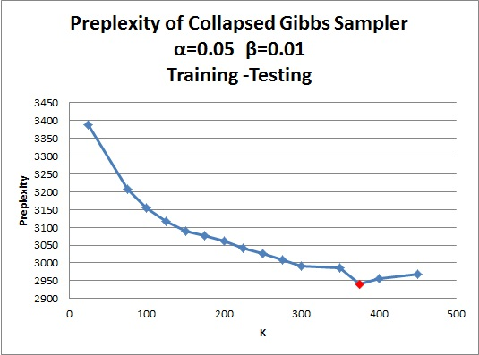
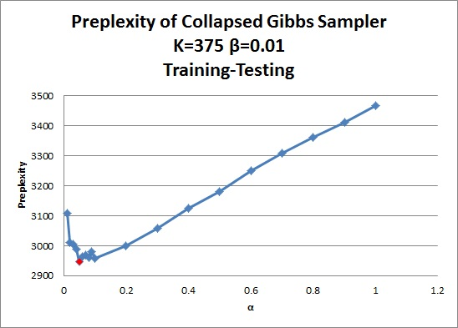
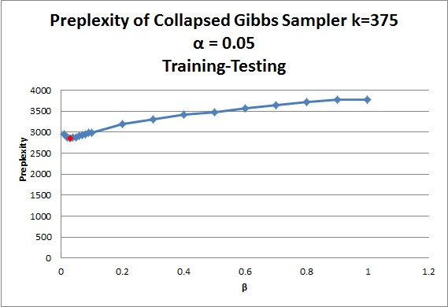
Experiment and Evaluation
Selecting The Optimal Model Parameters ( K, α, β ).

Slide 6
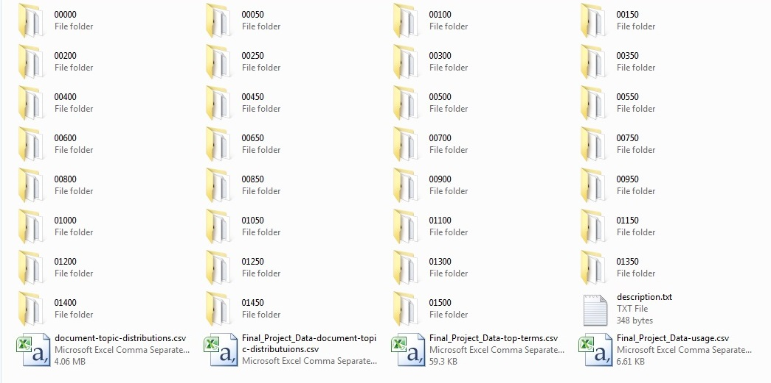
Experiment and Evaluation continue ….
Training and Testing
Obtained the document-topic distributions for the trained model.
To test I used the same dataset.
I used Collapsed Gibbs Sampler with 1500 iterations because it is faster than the other method (Collapsed Variational Bayes Approximation).

Slide 7
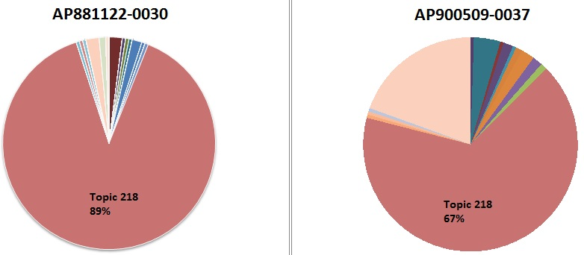
Experiment and Evaluation continue ….
Results

Slide 8
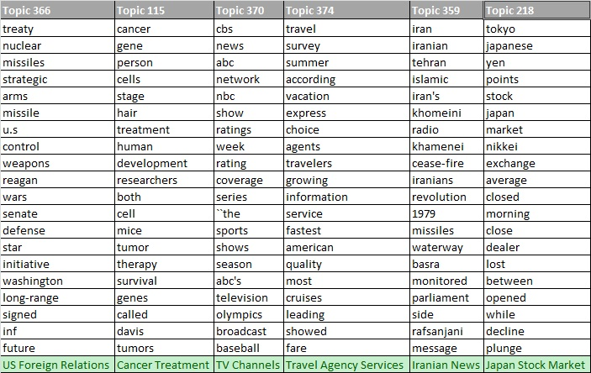
Experiment and Evaluation continue ….
Results Continue…

Slide 9
Summary and Future work
Stanford Topic Modeling (TMT)
2250 Associated Press Articles
Collapsed Gibbs Sampler
Optimal Paramter (K = 375, α = 0.05, β =0.03)
The top 20 words of each document
Try another inference method such as Variational Bayes (VB) or Belief Propagation (BP) using the same dataset and compare the optimal parameters obtained from all methods.
Test the results of training and testing to see what is the more accurate inference method and which one is faster in giving the results.

Slide 10
References
[1] “Topic model,” Wikipedia, the free encyclopedia. 30-Mar-2014.
[2] K. Christidis, D. Apostolou, and G. Mentzas, “Exploring Customer Preferences with Probabilistic Topics Models.”
[3] D. M. Blei, A. Y. Ng, and M. I. Jordan, “Latent dirichlet allocation,” J. Mach. Learn. Res., vol. 3, pp. 993–1022, 2003.
[4] “Latent Dirichlet Allocation in C,” 2003. [Online]. Available: http://www.cs.princeton.edu/%7Eblei/lda-c/. [Accessed: 25-Apr-2014].
[5] D. Ramage and E. Rosen, “Stanford Topic Modeling Toolbox,” The Stanford Natural Language Processing Group, Sep-2009. [Online]. Available: http://nlp.stanford.edu/software/tmt/tmt-0.3/. [Accessed: 25-Apr-2014].
[6] “Scala (programming language),” Wikipedia, the free encyclopedia. 28-Apr-2014.
[7] J. Zeng, “A topic modeling toolbox using belief propagation,” J. Mach. Learn. Res., vol. 13, no. 1, pp. 2233–2236, 2012.

Slide 11
Thanks
Questions?!

