Slide 1
Capstone Project: Optimizing Traffic Flow
By Angelo Samson

Slide 2
Dataset Overview
Dataset Overview
Source: Austin Open Data Portal (Traffic Detectors)
Size – 5352 entries, 15 columns long
Key features –
Detector_type
Detector_status
Location – (Coordinates in longitude and latitude
Detecter_direction and detecter_movement
Limitations –
Missing data in key columns
Sparse columns

Slide 3
Question(s) and Objective(s)
Question(s)
How can traffic congestion be minimized by leveraging real-time detector data?
Objectives
Analyze traffic Detector data to reduce congestion
Suggest optimal routes based on intensity (RL)

Slide 4
Exploration and Approaches
Exploration
Visualize detector locations and their operational status
ID congestion hotspots based on traffic data
Initial Approaches –
Clustering (K-Means)
Group detectors by location to find congestion clusters.
Time-series Analysis (LSTM)
Predict traffic patterns over time using ARIMA/LSTM.

Slide 5
Final Approach – Reinforcement learning
Why?
Simulates a driver (Agent) learning to navigate through traffic
Considers feedback from traffic intensity
How it works
Environment
Agent starts at a predefined location
States: latitude, longitude, and traffic intensity
Actions: moves in 8 directions (N, NE, E, SE, S, SW, W, NE)
Reward
Negative of traffic intensity
Training
Q-learning: tabular RL algorithm
Balance exploration and exploitation

Slide 6
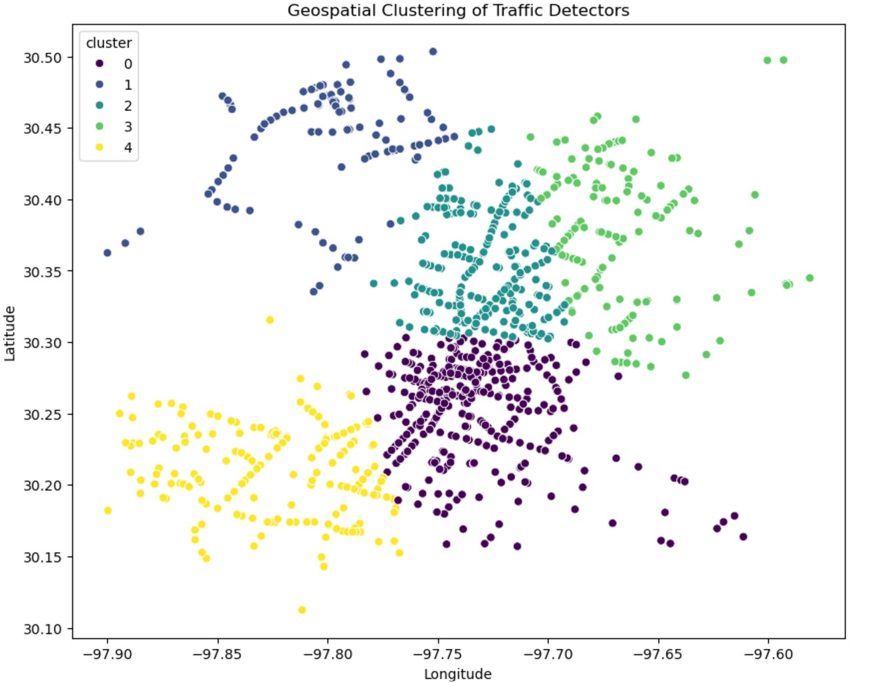
Results
Visualizations
Locations of Traffic Detectors
Timeseries of traffic detectors
Heatmap showing traffic intensity

Slide 7
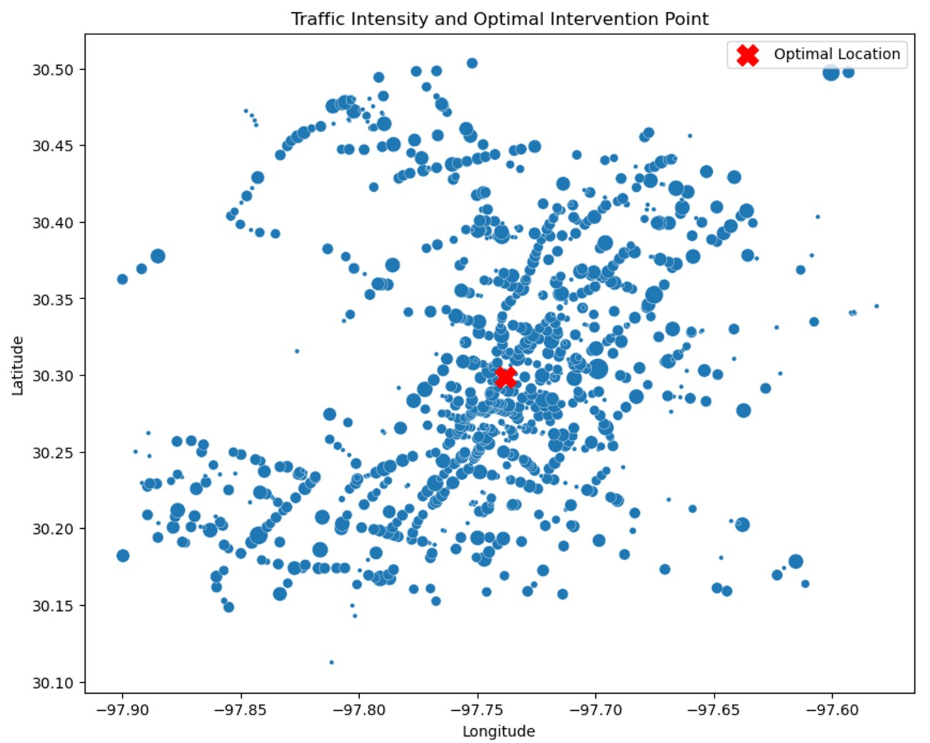
Results (continued)
Visualizations
Plots traffic intensity and optimal point

Slide 8
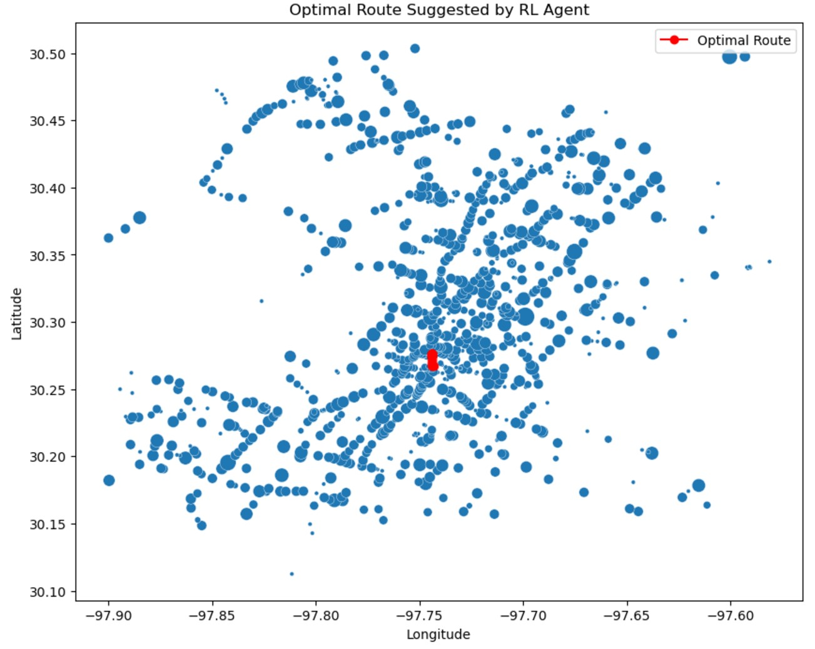
Results (Continued)
Metrics
Total Reward
Evaluated 1000
Achieved 0.0
Agent behavior
route_latitudes = [30.2672]
route_longitudes = [-97.7431]

Slide 9
Conclusion
Reinforcement learning can optimize traffic routes to reduce congestion
Sparse data for some detectors can reduce precision
Current model doesn’t consider driver preferences (yet)

