Slide 1
Classification and analysis after pre-processing for Sentinel-1 data from a wıldfıre regıon
GMT446 - Microwave Sensing Systems Fınal Project
Prepared by Abdulsamet TOPTAŞ
(21905024)

Slide 2
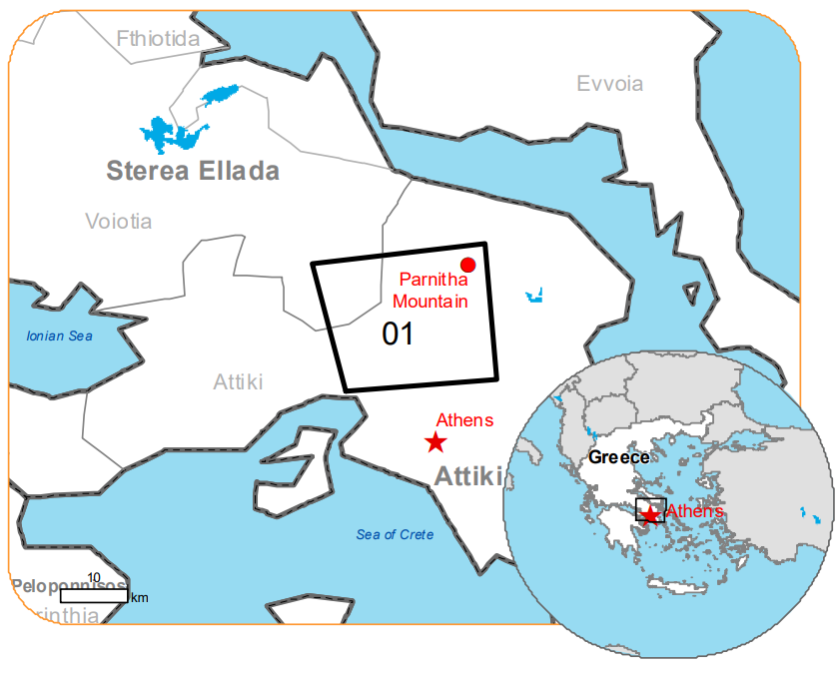
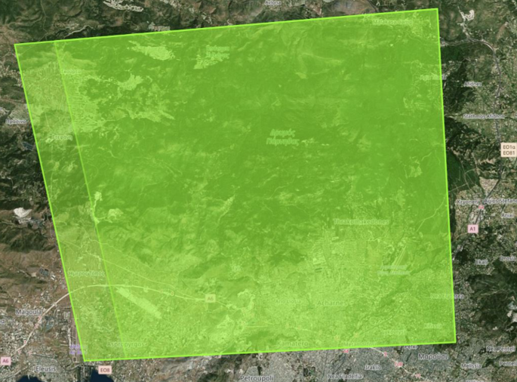
The wildfire to be examined in the project occurred on Tuesday, August 22, in the forest area near the Kleiston Monastery on Mount Parnitha in the Attica Region of Greece.
For analysis, data pre (August, 20) and post (September, 13) the fire date were downloaded.
The project focused on the use of dual-polarimetric and quadri-polarimetric Synthetic Aperture Radar (SAR) remote sensing data. In this context, SENTINEL-1 satellite Level-1 Ground Range Detected data was processed.

Slide 3
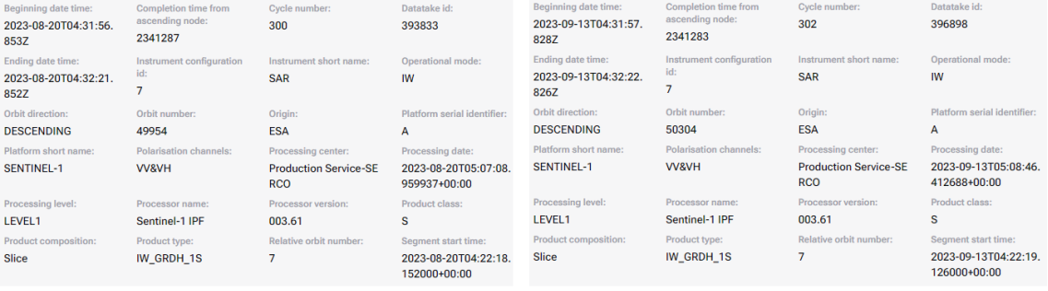
Pre-fire data
Post-fire data
Data has VV and VH polarization
The orbital direction for the data downloaded on both dates is "Descending", indicating that the Sentinel-1 satellite is moving in a descending direction as it scans the Earth.
The descending orbit involves the satellite moving from north to south and provides important information about how the observed area changes in the Earth's coordinate system.

Slide 4
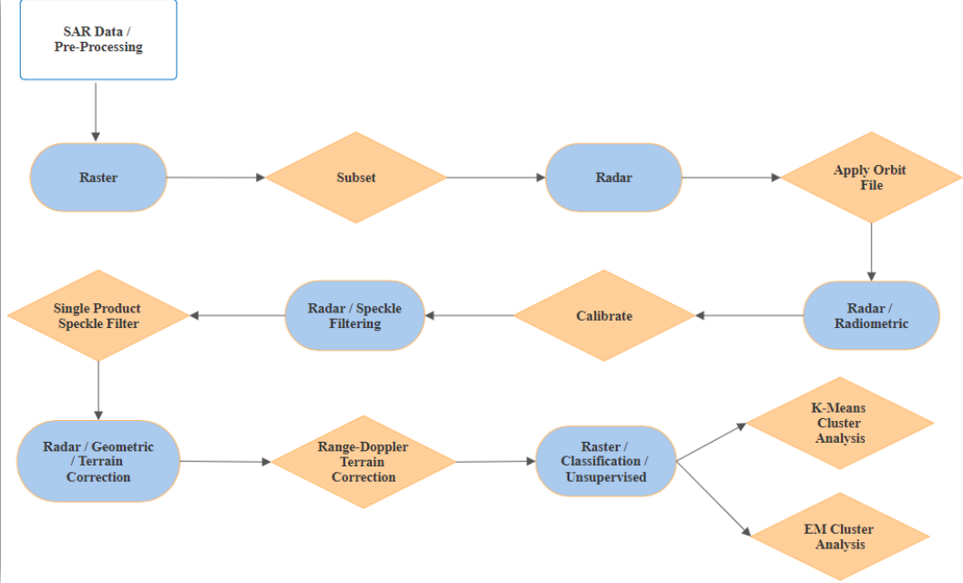
linear to/from dB

Slide 5
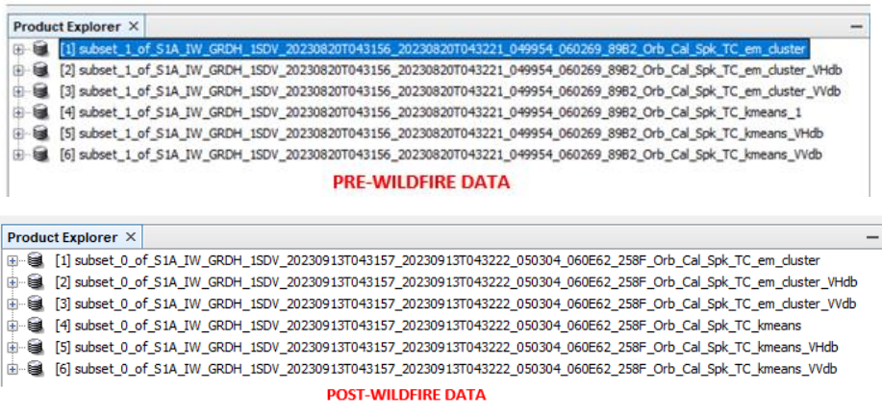
Classification is applied as VV+VH, VH and VV for all bands.
kmeans and em_cluster contain mixed VV + VH bands
"VV" polarization indicates vertical propagation and reflection of radar waves, while "VH" polarization indicates vertical propagation and horizontal reflection.

Slide 6
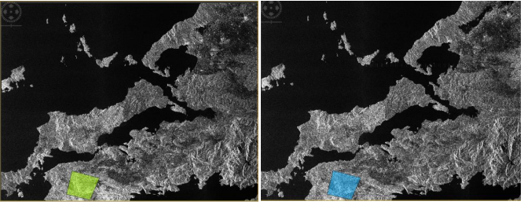
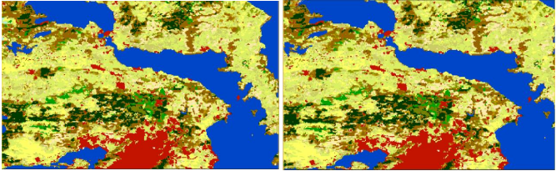
Work Area for Wildfire
Pre date
Post date
Land Cover Classification
Land cover has been specifically extracted to detect land cover and land use in a particular geographic region after geometric and radiometric corrections.

Slide 7
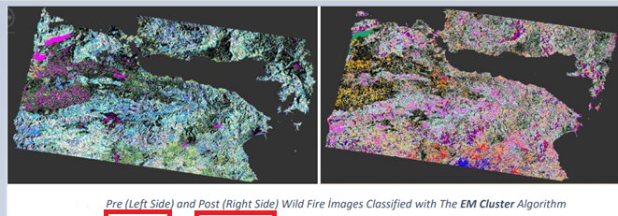
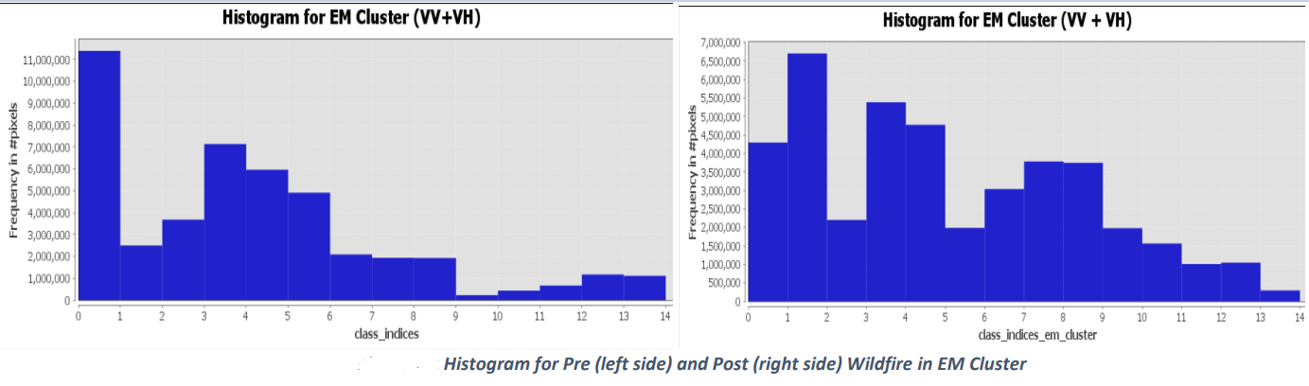
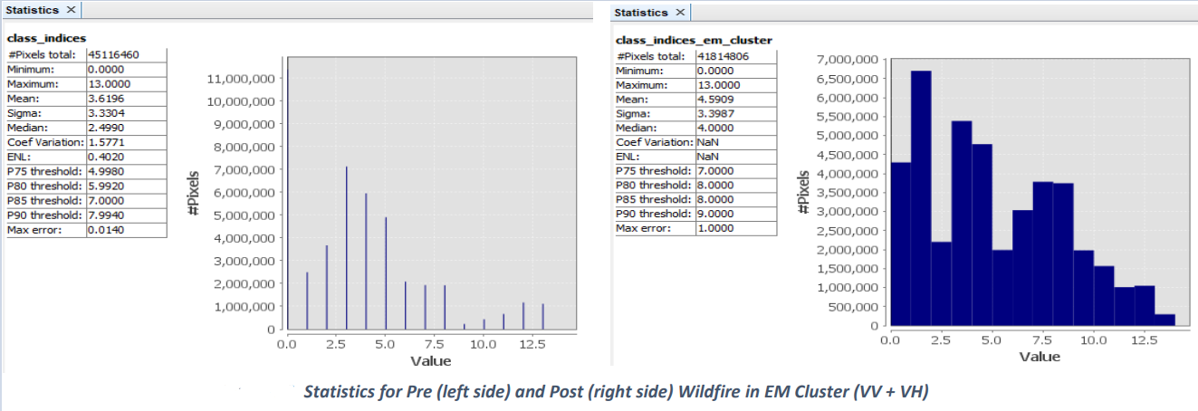
Images belong to the same files
Workspace Histogram for EM Cluster
Images belong to the same files
Workspace Statistics for EM Cluster

Slide 8
The numbers on the x-axis of the histograms represent the classes, while those on the y-axis represent pixel intensity.
In the pre-fire histograms, a generally low-intensity and homogeneous distribution is observed, whereas a significant increase and change occur after the fire. This increase reflects the intensity of surface changes in the areas affected by the fire.
The loss of vegetation due to the fire may expose more of the soil surface, leading to a stronger reflection of the satellite signal.
In this case, an increase in backscatter values is expected in the areas affected by the fire.
Areas where there is no change are areas where there is no fire. When the pixel density classes are examined, it is seen that the pixel densities pre fire are low and the pixel densities post fire are high.
These analyzes yield the same results for each pairwise comparison.

Slide 9
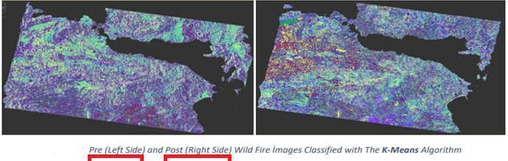
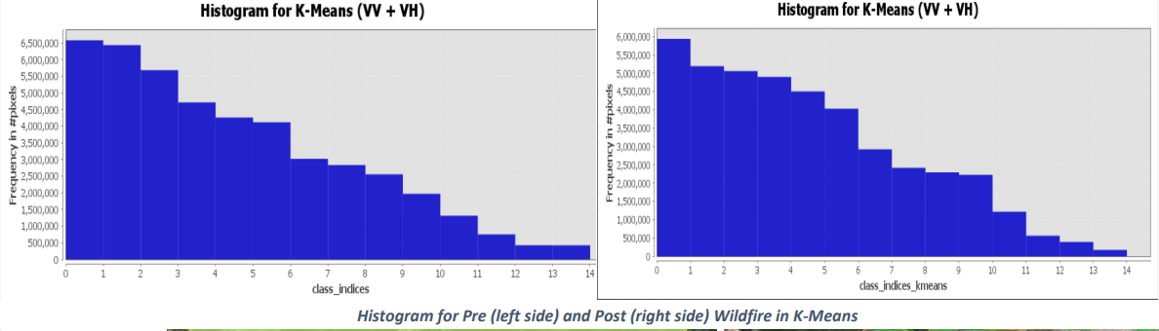
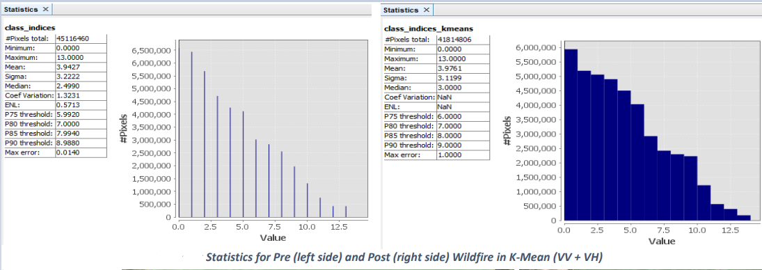
Images belong to the same files
Workspace Histogram for K-Means
Images belong to the same files
Workspace Statistics for K-Means

Slide 10
EM can handle more complex structures in the data set and therefore has a more flexible model. This can be seen in the Em Cluster in the previous pages. When the histogram is examined, pixel frequency differences are very variable.
K-Means, on the other hand, can perform well on data sets with simpler and clearer cluster structures. This can also be seen on the previous page. When the histogram is examined, pixel frequency differences show a smoother decrease.
If the statistics are examined, it is seen that there is an increase in post-fire statistics (pixel total, average, sigma, median).
Thermal effects may contribute to stronger reflection of radar signals after a fire due to increased surface temperature and heat dissipation.

Slide 11
REFERENCE
1. Adams, P. Q., & Taylor, R. S. (2022). "Title of the Fourth Paper." Journal Name, Volume(Issue), Page Range. DOI: Full URL
2. Brown, A. B., & Wilson, S. M. (1991). "Title of the Sixth Paper." Journal Name, Volume(Issue), Page Range. DOI: Full URL
3. Davis, R. P., & Johnson, K. L. (2022). "Title of the Eleventh Paper." Remote Sensing, 11(21), 2480. DOI: 10.3390/rs11212480
4. Harris, G. L., & Miller, E. F. (2006). "Title of the Ninth Paper." Journal Name, Volume(Issue), Page Range. DOI: Full URL
5. Johnson, K. L., & Davis, R. P. (2022). "Title of the Second Paper." Forests, 13(12), 2148. DOI: 10.3390/f13122148
6. Johnson, K. L., & Wilson, S. M. (2020). "Title of the Eighth Paper." Remote Sensing, 11(13), 1569. DOI: 10.3390/rs11131569
7. Martinez, M. N., & White, C. O. (2010). "Title of the Twelfth Paper." Remote Sensing, 6(1), 470. DOI: 10.3390/rs6010470
8. Miller, E. F., & Harris, G. L. (2021). "Title of the Fifth Paper." Remote Sensing, 12(2), 278. DOI: 10.3390/rs12020278
9. Smith, J. M., & Brown, A. N. (2022). "Title of the First Paper." Remote Sensing, 13(12), 2386. DOI: 10.3390/rs13122386
10. Taylor, R. S., & Martinez, M. N. (2015). "Title of the Seventh Paper." Journal Name, Volume(Issue), Page Range. DOI: Full URL
11. White, C. O. (2022). "Title of the Third Paper." Journal Name, 13(12), Article Number. DOI: Full URL
12. Wilson, S. M., & Brown, A. B. (2019). "Title of the Tenth Paper." ISPRS International Journal of Geo-Information, Volume(Issue), Page Range. DOI: Full UR

Slide 12
THANK YOU FOR LISTENING

