Slide 1
R’s Kickstart : a gentle introduction
UNIVERSITY OF LUXEMBOURG C²DH
Elisabeth Guerard Ismail AHOUARI & Mehdi MOUALIM

Slide 2
Who's who?

Slide 3
Practical information
Workshop material including
R scripts, data, presentation sheets a collection of cheat sheets
are available from
https://github.com/SameulAH/R-s-Kickstart

Slide 4
Today's agenda

Slide 5
Learning outcomes
Today you will work on:
R architecture R universe
Basic object types and syntax
Data wrangling
Data Visualization
Generating R Reports
You will cover examples and work with R challenges.

Slide 6
Get started - explore the R architecture

Slide 7
What is R?
The R is like any other programming language — just with a keen focus towards statistical analysis of data faciliting for data manipulation, calculation and graphical display.
A brief history:
R is a dialect of the S language.
R was written by Robert Gentleman and Ross Ihaka in 1992.
The R source code was first released in 1995.
In 1998, the Comprehensive R Archive Network CRAN was established.
The first official release, R version 1.0.0, dates to 2000-02-29.

Slide 8
R & Rstudio Installation Guide
R
1.Visit R Project Website :
www.r-project.org
2.Select your operating system:
• Windows: Click "Download R for Windows"
• Mac: Click "Download R for macOS"
• Linux: Choose your distribution
1.Follow the standard installation steps
2.Launch R to verify installation
RStudio
1.Visit RStudio Website : www.r-project.org
2.Download RStudio Desktop for your operating
system
3.Install RStudio:
Double-click the downloaded file
Follow installation prompts
Launch RStudio

Slide 9
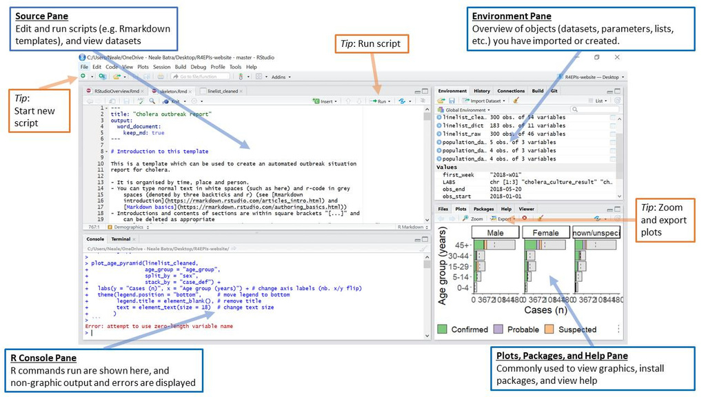
RStudio

Slide 10
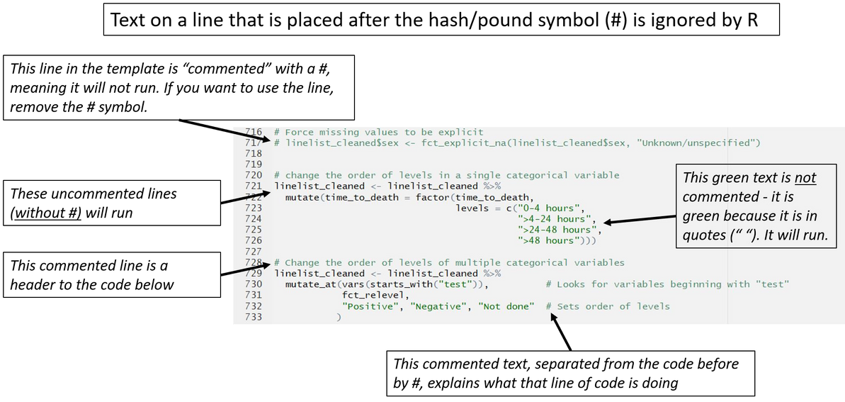
RStudio

Slide 11
Why R for Historians & Their Research?
Main Points:
Data Cleaning and Transformation
Historians now have access to vast amounts of digital data from archives, publications, census records, and social media, requiring effective tools for analysis.
Complexity of Historical Data
Historical datasets often involve diverse, unstructured data types, like text, dates, locations, and sometimes uncertain or missing data points, as we explore later in this workshop!

Slide 12

Textual Analysis
R has packages like “TM” and “Tidytect” that can be used to ewpower historians to process and analyze big chuncks of text such : Newpapers, Books, and letters to look for trends and word usage and setiment which shifts in language, public opinion, and themes over time
Sentimal analysis in R wiht TM package

Slide 13
Build-In Help
?[funtion] / ?[package]
e.g «?plot» or «?mean»
Help(function/package)
e.g «help(summary)»
Check the Index for user guides
Check Manuals, R FAQ, R journal.
Check also Online Communities in Stackoverflow : others must have had this problem too
Data <- rhelp(merge) # get help page for 'merge’
?merge # lookup 'merge' from installed pkgs
??merge # vague search
example(merge) # show code examples

Slide 14

How do I code in R?
Keep in mind:
R packages extend the functionality of R by providing additional functions,
and can be downloaded for free from the internet.
R packages are collections of functions, data, and compiled code bundled together to extend R's capabilities.
ggplot2 for visualization
dplyr for data manipulation
caret for machine learning

Slide 15
Install and load an R package
The ggplot2 package is a very popular package for data visualisation. Install the package
install.packages("ggplot2")
Load the installed package
library(ggplot2)
And give it a try
head(diamonds) qplot(clarity, data = diamonds, fill = cut, geom = "bar")
Packages are developed and maintained by R users worldwide, and shared with the R community through CRAN

Slide 16
Variables
Variables are containers for storing data values. use this variable’s name to easily access the value or the object that is stored within this variable.
A variable is created the moment you first assign a value to it.
Assign value 4 to variable, use the <- sign
a <- 4
and verify the variable stored
a
[1] 4

Slide 17
R challenge
Verify the following instructions
a*5 (a+10)/2 a <- a+1

Slide 18
Data types
R works with numerous data types: e.g.
Decimal values like (4.5, 1.65, ...) are called numerics Natural numbers like (4, 2, ..) are called integers Boolean values (TRUE or FALSE) are called logical
Date or POSIXct for time-based variables; Date stores just date and POSIXct stores a date and time.
Text (or string) values are called characters.

Slide 19
R challenge
For you to try, Let’s assign these values of the following variables such that:
my_numeric equals 42 . my_character is now "universe" my_logical becomes TRUE
# Note that the quotation marks indicate that "universe" is a character.

Slide 20
R challenge
Run the following instructions and pay attention to the code:
my_numeric <- 42 my_character <- "universe" my_logical <- TRUE the_date <- as.Date("05/29/2018", "%m/%d/%Y")
Verify the data type of a variable with the
class()
function: e.g.
class(my_numeric)
[1] "numeric"
class(my_date)
[1] "Date"

Slide 21
Everything is an object
The fundamental design principle underlying R is “everything is an object” and all objects stored in R's memory.
Run
ls()
to list all objects stored in R's memory. Use rm() to remove an object from R's memory, e.g.
rm(a) rm(my_character, my_logical) rm(list = c('my_date', 'my_numeric')) rm(list = ls())
# remove a single object # remove multiple objects # remove a list of objects # remove all objects

Slide 22
Objects
Objects in R are essential for efficient data management and analysis. They allow to store results from calculations, making it easy to access and manipulate data without retyping commands.
R is CASE SENSITIVE, meaning that ‘Data’ , ‘data’ and ‘DATA’ are considered three different objects.
Objects are created by using this assignment operator :
<-
Object_name <- value_to_assign_to_object
myData<-c(1, 2, 3)
# This will result in an error
print(mydata)

Slide 23
Basic data structures in R

Slide 24
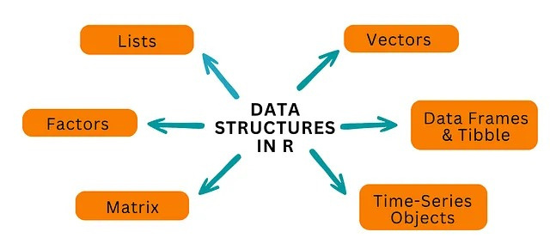
A data structure is a way of organizing, managing, and storing data in a computer so it can be accessed and used efficiently.

Slide 25
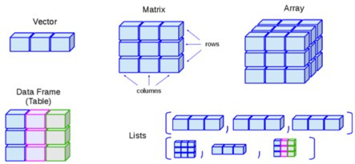
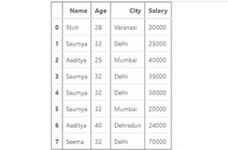
Types of Data Structures
2D array with elements of the same type
mat <-matrix(1:9,nrow=3,ncol=3)
# [,1] [,2] [,3]
# [1,] 1 4 7
# [2,] 2 5 8
# [3,] 3 6 9
1D array of elements of the same type
cities <-c("Paris","London","Rome")
Multi-dimensional data, same type
arr<-array(1:27, dim = c(3, 3, 3))
# Creates a 3x3x3 array
2D, different types
Container that holds any Type

Slide 26
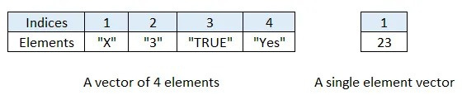
Vectors
A vector is a simple tool to store data:
One-Dimensional collection of data of the same data type. The data is indexed i.e. every element in a vector is numbered
and in R the count starts from ‘1’.
you create a vector with the combine function combing <- c
or Assign()
Syntax for assign()
— assign(“variable_name”, c(element 1, element 2,…..)
Syntax for c() — variable_name<-c(element 1,element 2,…….)
Syntax for seq() — seq(first_number,last_number,by=number_of_steps)

Slide 27
Vectors
You can give a name to the elements of a vector with the
names()
my_vector <- c("Katrien Antonio", "teacher") names(my_vector) <- c("Name", "Profession") my_vector
"Katrien Antonio"
Name
Profession
"teacher"
Now, Let’s try some examples:
assign("my_vector_2 ",c(0, 3:5, 20, 0)) my_vector_2 <- c(0, 3:5, 20, 0) my_vector_2[2] my_vectors_3 <- seq(1,10,by=2)) length(my_vector_2)
# inspect entry 2 from vector my_vector_2 # a squence # get vector length
my_family <- c("Katrien", "Jan", "Leen") my_family

Slide 28
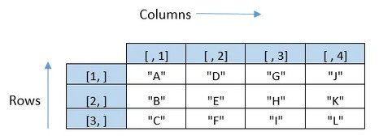
Matrices
A matrix is:
Two-Dimensional collection of data of the same type(Homogeneous). It has rows and columns.
fixed number of rows and columns. Syntax — matrix(data=, nrow=, ncol=, byrow= ) the data is a data vector, nrow is the number of rows and ncol is the number of columns. Also byrow=TRUE will fill data row wise and byrow=FALSE will fill data column-wise.
Example:
matrix(c("A","B","C","D", "E","F","G","H", "I","J","K","L"),nrow = 3,ncol =4, byrow=FALSE)

Slide 29
Matrice
A first example
my_matrix <- matrix(1:12, 3, 4, byrow = TRUE) my_matrix
Naming Matrix dimensions
x <- c(R1, R2, R3) y <- c(X,Y,Z,T) my_matrix <- matrix(1:12, 3, 4, byrow = TRUE, dimnames=list(x,y)) my_matrix
We can also do the indexing in Matrix
my_matrix[1, 3]
Extract the entire 1st row
my_matrix[1, ]
Extract the entire 2nd column
my_matrix[ ,2 ]

Slide 30
Lists
A list allows you to
store a 1-dimensional Heterogeneous data structures. It can contain all and any of the datatypes-numeric,logical,character,complex.
objects can be matrices, vectors, data frames, even other lists
a list is some kind super data type you can store practically any piece of information in it!
Syntax — list(data) where data is an R object(s)

Slide 31
Lists
A first example of a list:
my_list <- list(one = 1, two = c(1, 2), five = seq(1, 4, length=5),
six = c("Katrien", "Jan"))
names(my_list)
[1] "one" "two" "five" "six"
str(my_list)
List of 4
$ one : num 1
$ two : num [1:2] 1 2
$ five: num [1:5] 1 1.75 2.5 3.25 4
$ six : chr [1:2] "Katrien" "Jan"

Slide 32
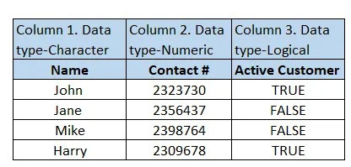
Dataframes
A dataframe is:
2 Dimensional Heterogeneous data structures. You can imagine it as
something similar to what we see in MS-Excel.
It has rows and columns and every column will have elements that
are of same data type.
So we can think of columns as vectors(1 D and Homogeneous).
Rows can have elements of different data types.
Creating a Dataframe in R- Using the data.frame() function
Syntax: data.frame(vector1,vector2…), Where vector 1, vector2.. are all of the same lengths.

Slide 33

Dataframes
Example: Let’s create a dataframe
data.frame(LETTERS [1:4],c(1,2,3,4))
Naming Dataframe Dimensions data.frame(Alphabets=LETTERS[1:4],Numbers=c(1,2,3,4))
Or
my_df <- data.frame(LETTERS[1:4],c(1,2,3,4))
colnames(my_df) <- c("Letters", "Digits")
rownames(my_df) <- c("Row1", "Row2", "Row3", "Row4")
str(my_df)

Slide 34
R challenge
1- Create a vector city_names with the names of your favorite cities.
Use: "Mumbai", "Delhi", "Bangalore", "Hyderabad".
2-Create a vector city_population with the population of each of these
cities in millions (or approximate numbers if exact data is unavailable).
Use: 12442373, 11007835, 8436675, 6809970.
3- Create a data frame using the two vectors above and assign it the name
city_info.
4- Change the column labels in the data frame to City_Name and
Population, and set the row names to (Rank 1, Rank 2, Rank 3, and Rank 4),
assuming rank corresponds to the order of cities in terms of population.
5- Extract the Population column from the city_info data frame.
6- Calculate the total population of all cities combined.
7- Verify the structure of the data frame using a suitable function and
request a summary of the data.

Slide 35
R challenge solved
Here is my solution
Create city_names
city_names <- c("Mumbai", "Delhi", "Bangalore", "Hyderabad")
Create city_population
city_population <- c(12442373, 11007835, 8436675, 6809970)
Create the city_info data frame
city_info <- data.frame(city_names, city_population)
Rename columns and rows
colnames(city_info) <- c("City_Name", "Population") rownames(city_info) <- c("Rank 1", "Rank 2", "Rank 3", "Rank 4")
Extract the Population column
population_column <- city_info$Population

Slide 36
R challenge solved
Calculate total population
total_population <- sum(city_info$Population)
Check structure and summary
str(city_info)
summary(city_info)
Print the results for clarity
print(city_info)

Slide 37
Getting started with data in R

Slide 38
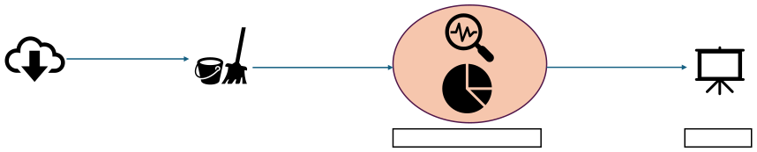


Essential Steps in R Data Analysis journey
Import/Read
Organize, clean, and transform
Anlyze & Visualize
Show & Use
• • •
Load the data Preview data Inspect structure
• • • • •
Check Data quality (NA) Data Cleaning Detect anomalies Transform Data Detect Outliers
• • • • •
Descriptive Statistics Explore Relationships Create Plots Explore Trends Document Analysis Steps
•
Create Report/Presentation

Slide 39
Data wrangling in R

Slide 40
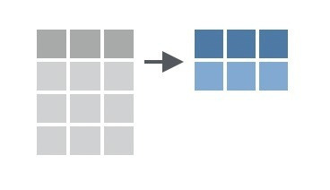

dplyr
dplyr is based on the concepts of functions as verbs that manipulate data frames
dataframe
dataframe(tibble)
The first argument is always a data frames
dplyr say what to do with that data frame Always returns a data frame
(technically a tibble)

Slide 41

Data manipulation verbs
The dplyr package holds many useful data manipulation verbs: Reading
read_csv(): load .csv files
install.packages("readr")
read_csv() and read.csv() are not the same thing!

Slide 42
Package | Function | Type of files
readxl | Read_excel() | Reads Excel files (.xls and .xlsx)
 | Excel_Sheets() | Lists the names of sheets in excel file
readr | Read_table() | Reads tabular data, columns separated by whitespace
 | Read_csv() | Reads CSV files
DBI | dbReadTable() | Reads tables from DB (MySQL, PostgreSQL)

Slide 43
Data Inspection
Data Inspection involves understanding the Structure, size, content and also summary statistics of the dataset.
It is a critical step before analysis to ensure data integrity and identify potential issues to ensure that is ready for future manipulation or visualization.
Lets consider that our dataset is ‘Data’ and also in order to know that the import was done successfully.
Function | Explantion
Head ( Data) | Previewing the first 6 rows of data
Tail (Data) | Previewing the last 6 rows of data
str(Data) | Shows structure (type of the dataset, first few values)
Class(Data) | Shows Object Class (df,vector,..)
Dim(Data) | The dimensions (row x columns)
Sort(Data) | Ascending sort ( adding decreasing = TRUE for descending)
names(Data) | Print names of variables in dataframe
Summary(Data) | Shows Descriptive Statistical Summary

Slide 44
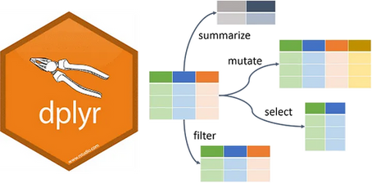
Data manipulation verbs
%>% pipe data through the functions mutate() adds new variables that are functions of existing variables select() picks variables based on their names filter() picks cases based on their values summarise() reduces multiple values down to a single summary arrange() changes the ordering of the rows.
These all combine naturally with group_by() which allows you to perform any operation “by group”.

Slide 45

Pipes in R
In R, the pipe operator is %>%. It takes the output of one statement and makes it the input of the next statement.
When describing it, you can think of it as a “THEN”.
Let’s consider a squence of actions:
Writing it out using pipes looks like:
1. find key
2. unlock car
3. start car
4. drive to uni
5. park
find("keys") %>% unlock (which= 'car') %>%
start_car() %>%
drive(to= “campus”) %>%
park()
Expressed as a set of nested functions in make- believe R code this could look like:
park( drive( start_car (unlock (find("keys"), which 'car')), to="campus"))

Slide 46
Pipes in R
N.B. Remember to specify the data argument only once when creating pipe statement
Best Practices examples
Yes:
subset(yourdata, variable_a > 3)
Yes:
yourdata %>%
subset(variable_a > 3)
Yes:
yourdata %>%
subset(. ,variable_a > 3)
No:
yourdata %>%
subset(yourdata ,variable_a > 3)

Slide 47
Pipes in R
A first example of %>% in R
take the diamonds data (from the ggplot2 package)
then subset
diamonds %>% filter(cut == "Ideal")

Slide 48
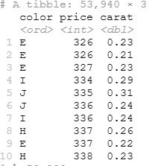
select()
Extract rows that meet logical criteria. Here you go:
Inspect the diamonds dataset by selecting only the cut and price columns. Extract only the columns that are relevant for analysis.
select(data, column1, column2, ...)
selected_diamonds <- select(diamonds, color, price, carat)
OR
selected_diamonds <- diamonds %>% select(color, price, carat)
Output

Slide 49
filter()
Extract rows that meet logical criteria. Here you go:
inspect the diamonds data set filter
observations with cut equal to Ideal
filter(table, column_name > value)
We filter by relational expressions to filter rows:
== equal
!- < >
does not equal
less than greater than
<= less than or equal to >= greater than or equal to

Slide 50
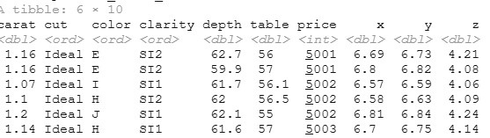
filter()
Ex.
filter(diamonds, cut == "Ideal")
Or
diamonds %>% filter(cut == "Ideal")
diamonds %>% filter(cut == "Ideal", price > 5000)
Output

Slide 51
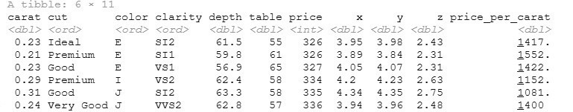
mutate()
Create new columns. Here you go:
inspect the diamonds data set
create a new variable
price_per_carat
mutate(table, new_column = column1 + column2)
Ex.
mutate(diamonds, price_per_carat = price/carat)
Or
diamonds %>%
mutate(price_per_carat = price/carat)
Output

Slide 52

summarise()
Compute table of summaries. Here you go:
inspect the diamonds data set
calculate mean and standard deviation of
price
summarise(data, new_column = summary_function(column_name))
Ex.
diamonds %>% summarise(mean = mean(price), std_dev = sd(price))
Output

Slide 53
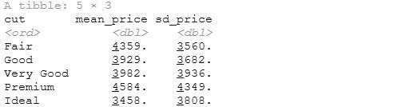
group_by()
Groups cases by common values of one or more columns. Here you go:
inspect the diamonds data set
calculate mean and standard deviation of price by level of
cut
group_by(data, column_name1, column_name2)
Ex.
diamonds %>% group_by(cut) %>% summarise( mean_price = mean(price), sd_price = sd(price))
Output

Slide 54
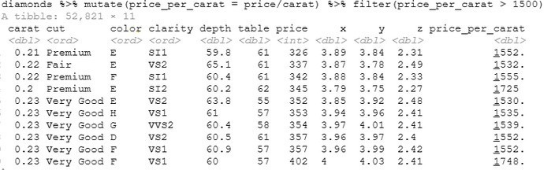
Multistep operations
Use the %>% for multistep operations. Passes result on left into first argument of function on right. Here you go:
diamonds %>%
mutate(price_per_carat = price/carat) %>%
filter(price_per_carat > 1500)
Output

Slide 55
Data Visualization

Slide 56
Data Visualization
Why We Use Plots in Research
Plots as Communication Tools: Visualizations are essential for effectively conveying research findings to diverse audiences. Whether in a poster presentation, a journal publication, or a conference talk, well-crafted plots enhance understanding and engagement.
Purpose of Visualization :
To highlight key patterns, trends, and relationships in your research.
To provide a clear narrative that supports your conclusions.
To simplify complex datasets into intuitive visuals.
Explanatory Analysis :
This stage of data analysis focuses on communicating results rather than just exploring data.
It emphasizes clarity, precision, and impact to ensure your findings resonate with your audience.
Why It Matters:
Visuals can breakdown barriers for non-technical audiences.
They make your work more accessible and memorable, leaving a lasting impression.

Slide 57
Data Visualization - Bonus
Visualizations are tailored to the nature of your data and the story you want to tell. They fall into distinct categories based on their purpose.
From data to Viz | Find the graphic you need:Choosing the Right Visualization : is a structured tool that helps you determine the most suitable type of visualization based on your Data Type and structure ( categorical, numerical, time-series) and alsowhat you want to Show: Relationships, comparisons, distributions,
The R Graph Gallery –Help and inspiration for R charts : A Comprehensive Visualization Resource : Is a great collection of R visualizations that suggests the best plot type based on your goals and provides an extensive library of visualizations tailored for specific data scenarios. Without forgetting also offering fully functional R code for each plot, enabling easy replication and adaptation.

Slide 58
How to use ggplot2
Basic structure for beginning almost all plots:
ggplot(data, aes(x, y)) + geom_something()
We tell ggplot:
1
2
3
What data to use when plotting
What variables will go on the x-axis (horizontal) and (usually) on the y-axis (vertical)
What kind of plot to create (using a “geom_” function)

Slide 59
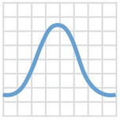
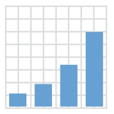

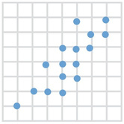
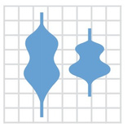



+ geom_density()
+ geom_bar()
+ geom_point()
+ geom_violin()
+ geom_smooth()
+ geom_boxplot()

Slide 60
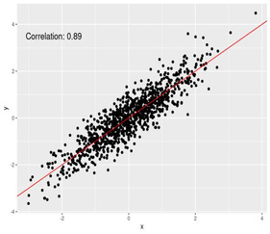
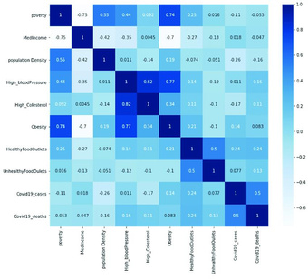
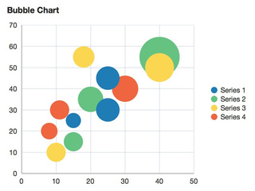
Correlation
Correlation visualizations show the relationship between two or more variables.Ideal for exploring dependencies, trends, and clustering.
We have
Scatter Plot
Heatmap (Correlation Matrix)
Displays pairwise correlations using colors.
Bubble Chart
Visualize relationships between two continuous
Adds a third dimension using the size of points.
variables.

Slide 61
Scatter Plot :
# library library(ggplot2)
# The iris dataset is provided natively by R
#head(iris)
# basic scatterplot
ggplot(iris, aes(x=Sepal.Length, y=Sepal.Width)) + geom_point()
Heatmap
ggplot(mtcars, aes(x = cyl, y = mpg, fill = wt)) + geom_tile()
Bubble Chart
library(ggplot2)
library(dplyr)
# The dataset is provided in the gapminder library
library(gapminder)
data <- gapminder %>% filter(year=="2007") %>% dplyr::select(-year)
# Most basic bubble plot
ggplot(data, aes(x=gdpPercap, y=lifeExp, size = pop)) +
geom_point(alpha=0.7)

Slide 62
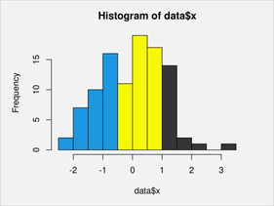
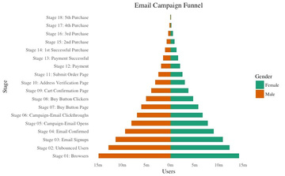
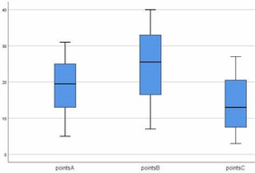
Distribution
Charts help visualize the spread, variation, and shape of a dataset.
Useful for identifying skewness, modality, and outliers.
We have
Histogram
Population Pyramid
Box Plot
Frequency distribution
visualizing how much population or what percentage of population fall under a
Displays quartiles
of a single variable.
and highlights outliers.
certain category

Slide 63
Histogram
# Basic Histogram
ggplot(data, aes(x = lifeExp)) + geom_histogram()
Population Pyramid
ggplot(data, aes(x = age, y = population, fill = gender)) + geom_bar(stat = "identity") + coord_flip() + scale_y_continuous(labels = abs) # Remove negative signs
Box Plot
# A really basic boxplot.
ggplot(mtcars, aes(x=as.factor(cyl), y=mpg)) + geom_boxplot(fill="slateblue", alpha=0.2) + xlab("cyl")

Slide 64
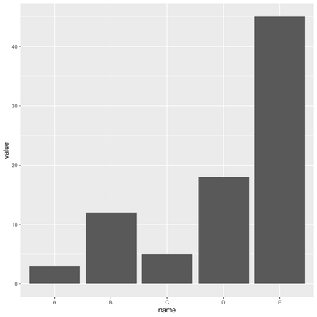
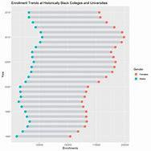
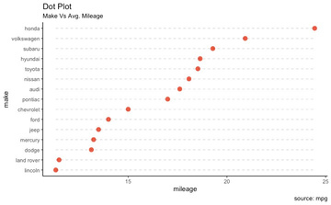
Ranking Visualizations
Used to compare the position or performance of multiple items with respect to each other. Actual values matters somewhat less than the ranking.
We have
Bar Chart
Dot plot
is used to display the relationship between a numeric and a categorical variable
Dumbbell charts
1. Visualize relative positions (growth and decline) between two points in time. 2. Compare distance
are like lollipops, but without the line and is flipped to horizontal position. a minimalist
alternative
between two categories.

Slide 65
Bar plot
ggplot(data, aes(x=name, y=value)) + geom_bar(stat = "identity")
Population Pyramid
# Create a dot plot
ggplot(data, aes(x = category, y = value)) +
geom_point(size = 4, color = "blue") +
theme_minimal() +
labs(title = "Dot Plot", x = "Category", y = "Value")
Dumbbell Chart
ggplot(data, aes(x = before, xend = after, y = category)) + geom_dumbbell(color = "gray", size = 2, size_x = 4, size_xend = 4) + theme_minimal() + labs(title = "Dumbbell Chart", x = "Value", y = "Category")

Slide 66
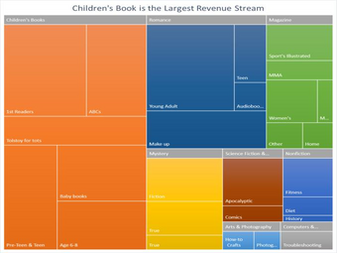
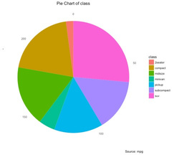
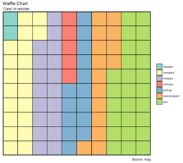
Composition Visualizations
Composition charts show how parts contribute to a whole, either at a single point in time or over time. They are particularly useful for visualizing proportions and distributions.
We have
Pie Chart
Waffle Chart
Tree Chart
Circular chart divided into slices
each square represents a fixed percentage
A hierarchical visualization where
rectangles represent proportionsand
to illustrate proportions.
(e.g., 1% or 10%) of the whole.
their sizes indicate value.

Slide 67
Pie Chart
ggplot(data, aes(x = "", y = value, fill = category)) + geom_bar(stat = "identity", width = 1) + coord_polar(theta = "y") + # Convert to pie chart
theme_void() + # Remove background grid and axis
labs(title = "Pie Chart")
Waffle Chart
# Create a waffle chart
ggplot(data, aes(fill=group, values=value)) + geom_waffle(color = "white") + scale_fill_manual(values = c("#999999", "#E69F00", "#56B4E9")) + theme_void()
Tree Map
# library
library(treemap)
# Create data
group <- c("group-1","group-2","group-3")
value <- c(13,5,22)
data <- data.frame(group,value) # treemap
treemap(data, index="group", vSize="value", type="index" )

Slide 68
Documentation
R Markdown is a tool for combining:
Markdown: Simple, plain-text formatting for creating content.
R Code Chunks: Embedded R code for analysis and visualization.
Output Formats: Automatically rendered to HTML, PDF, Word, or other formats.
How It Works?
1.Start with an .Rmdfile:
Write a mix of markdown text and R code chunks.
2.KnitrProcesses .Rmd:
Executes R code and creates a .md file.
3.PandocConverts .md:
Generates a polished document in the desired output format
(HTML, PDF, Word, slides, etc.).

Slide 69
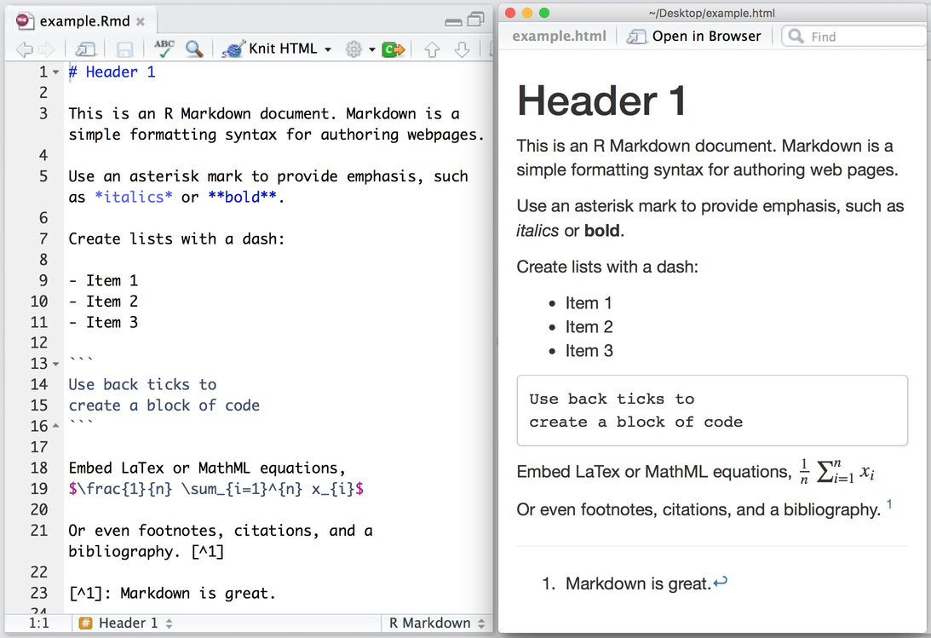

Slide 70
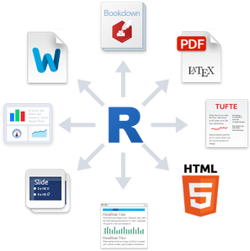
Concept of Knitting in RMarkdown
What is Knitting in RMarkdown?
Knitting is the process of combining R code, text, and outputs (tables, plots) into a single, polished document (usually in latex for pdf).
The result can be exported as:
HTML: For web-friendly documents.
PDF: For print-ready materials.
Word: For editable reports.
Why is Knitting Important?
Automates the generation of reports by embedding R code in a markdown file.
Ensures the code and results are integrated seamlessly in one document.
Allows you to write narrative and analysis together, improving clarity and communication.

Slide 71
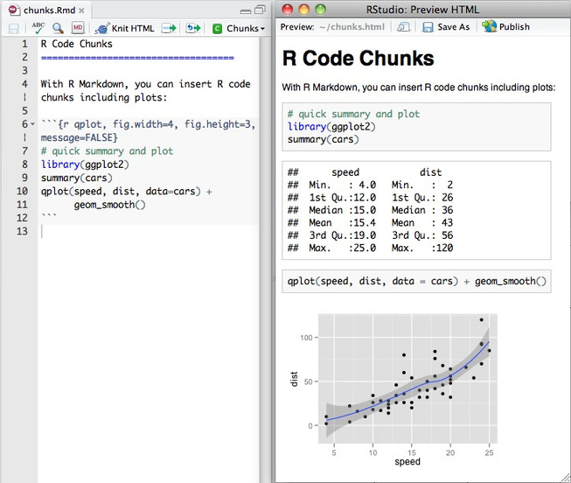
How it works
Within an R Markdown file, R Code Chunks can be embedded with the native Markdown syntax for fenced code regions. For example, the following code chunk computes a data summary and renders a plot as a PNG image:

Slide 72

To transform your markdown file into an HTML, PDF, or Word document, click the “Knit” icon that appears above your file in the scriptseditor.
A drop downmenu will let you select the type of output that you want.
You can create many types of output from a single .Rmd file. R Markdown has built in support for HTML, PDF, MS_Word, ODT, RTF, Markdown, and Github flavored Markdown documents; Beamer, slidy.js, ioslides, and reveal.js slideshows; and websites, dashboards, books, handouts, package vignettes, and Shiny apps.

Slide 73
Thank you!

