Slide 1
Discussion for Prof. Cohen
Squeeze-angle control of Néel-odd second-harmonic response
An eight-band PT antiferromagnet driven by a low-occupation displaced squeezed state. Working wavelength 24.8 μm. Mean occupation 0.34 photons per mode.
Frozen Q6 numbers after Fourier-endpoint repair: finite-window 2D amplitude ratio 4.98, covariance-reversal Jx phase 110.6 degrees. Retired values 5.80 and 106.9 degrees.
This briefing states a candidate theoretical mechanism. Mapping onto 1600 nm bright squeezed vacuum and bilayer CrI₃ remains an open next question.
29 October 2026
Notes:
Open by stating the protocol: 24.8 μm, α = 0.5, r = 0.3, one k/−k pair, truncated QED.
Do not present 4.98 as a harmonic yield or as a 1600 nm prediction.
Sun et al., Nature 572, 497 (2019). Rasputnyi et al., Nat. Phys. 20, 1960 (2024).

Slide 2
Scientific question
If the mean field and the mean photon number stay fixed, and only the squeeze axis rotates, how does the Néel-odd H2 current change, and which pieces of that change belong to the magnet?
Causal chain under test
Input statistics (α, M, θ), then a Néel/SOC-gated electronic kernel, then the Néel-odd H2 complex current.
What we can defend
What we leave aside
α² and the anomalous correlator M(θ) can compete inside a magnetic odd channel.
The control parameter is R = |M| / α².
Néel order and SOC open that channel. Finite-time dynamics set most of arg(B).
Whether squeezed light beats a coherent drive in HHG yield.
Whether an antiferromagnet can produce SHG. Sun 2019 already showed that for bilayer CrI₃.
Whether the output field itself is nonclassical.
Cohen briefing 29 Oct 2026 Q6 finite-time Néel-odd H2
2
Notes:
The magnet supplies a domain-odd readout. The light supplies a rotatable second-order correlator.
Do not claim quantum advantage at this stage.

Slide 3
Three optical protocols
Keep these columns separate. The main result lives in the Q6 column.
Quantity | Q6 eight-band (main) | 1600 nm M0 scout | Published BSV-HHG
Wavelength | 24.8 μm | 1600 nm | 1600 nm
Photon energy | 0.05 eV | 0.775 eV | about 0.775 eV
State | D(0.5)S(0.3 exp(iθ))|0> | Idealized high-gain DS, BSV, coherent | Bright squeezed vacuum
Mean occupation | 0.343 per mode | Macroscopic | about 2e12 per pulse
Squeezing | r = 0.3, ideal 2.61 dB | Formal r about 11 | High-gain BSV
Time protocol | 1+4+1 coupling switch, 496 fs | 25 fs Gaussian | 25 fs BSV
Intensity | No W/cm² calibration | 10¹⁰ W/cm² theory filter | Experimental strong field
Method | Truncated QED and GH5 | Wigner SBE, quadrature open | Experiment
Momentum | One k / -k pair | BZ scouts | Real crystal
Cohen briefing 29 Oct 2026 Q6 finite-time Néel-odd H2
3
Notes:
Rasputnyi et al., Nat. Phys. 20, 1960 (2024): 1600 nm, 25 fs BSV in LN and a-Si.
Qin_a2_141: a2 is lattice polarization, not α = 1.41.
Do not copy the experimental intensity onto CrI₃.

Slide 4
Literature boundaries
Sun et al., Nature 572, 497 (2019). Giant nonreciprocal SHG of bilayer AFM CrI₃ comes from layered magnetic order. We borrow a Néel-odd SHG readout.
Gorlach et al., Nat. Phys. 19, 1689 (2023). Driving-field quantum states enter extreme nonlinear optics.
Rasputnyi et al., Nat. Phys. 20, 1960 (2024). 1600 nm, 25 fs BSV drives nonperturbative HHG in LiNbO3 and amorphous silicon. High-gain pure BSV in nonmagnetic solids.
Li et al., Phys. Rev. A 112, 033507 (2025). Quantum-optical features of solid HHG driven by squeezed coherent states.
Prabhu and Dixit, Phys. Rev. B 114, L140301 (2026). Forbidden harmonics in graphene as a sensor of squeezing fluctuations.
A remaining question, if any, is the mapping of Δn = 0 and Δn = ±2 coherence blocks onto Néel-odd finite-time coefficients A, B, C, with an explicit split among input geometry R, magnetic gating, and finite-time dynamics. Squeezed light changing solid harmonics already exists in the literature.
Cohen briefing 29 Oct 2026 Q6 finite-time Néel-odd H2
4
Notes:
Do not tutorial BSV-HHG. Cohen already knows this literature.
Do not cite an unverified 1550 nm, 5 dB displaced-squeezed solid SHG experiment.
Method background: de-la-Pena et al., JCTC 21, 283 (2025). Kane-Mele PRL 95, 226801 (2005). Walls and Milburn 2008.

Slide 5
Eight-band PT-AFM Hamiltonian
Two layers, two sublattices, two spins. In-plane hopping t_h = 1 eV. Interlayer same-site and opposite-site couplings u, v.
Kane-Mele-type next-nearest-neighbor SOC. Opposite-sign exchange fields on the two layers.
One photonic mode shared by k = (0.173, 0.271) and its inversion partner. Electronic sector 36-dimensional. Photon cutoff n_max = 8. Joint space 11664-dimensional.
Peierls substitution shifts crystal momentum by g s(t) ê_X, with g = 0.005 Å⁻¹ and ω₀ = 0.05 t_h.
M0 is a phenomenological PT-AFM model. Filling its gap, exchange, or SOC with CrI₃ numbers leaves it a model Hamiltonian.
The Wannier line M52 / M88 / full112 / WINDOW144 is a later material check, not a downfolding of this eight-band Hamiltonian.
Cohen briefing 29 Oct 2026 Q6 finite-time Néel-odd H2
5
Notes:
Q6 was chosen for Hilbert-space size, R of order one, deep detuning, and a nonzero mean field.
Local gap at the production k point is about 1.91 eV. 2ω₀ = 0.10 eV.

Slide 6
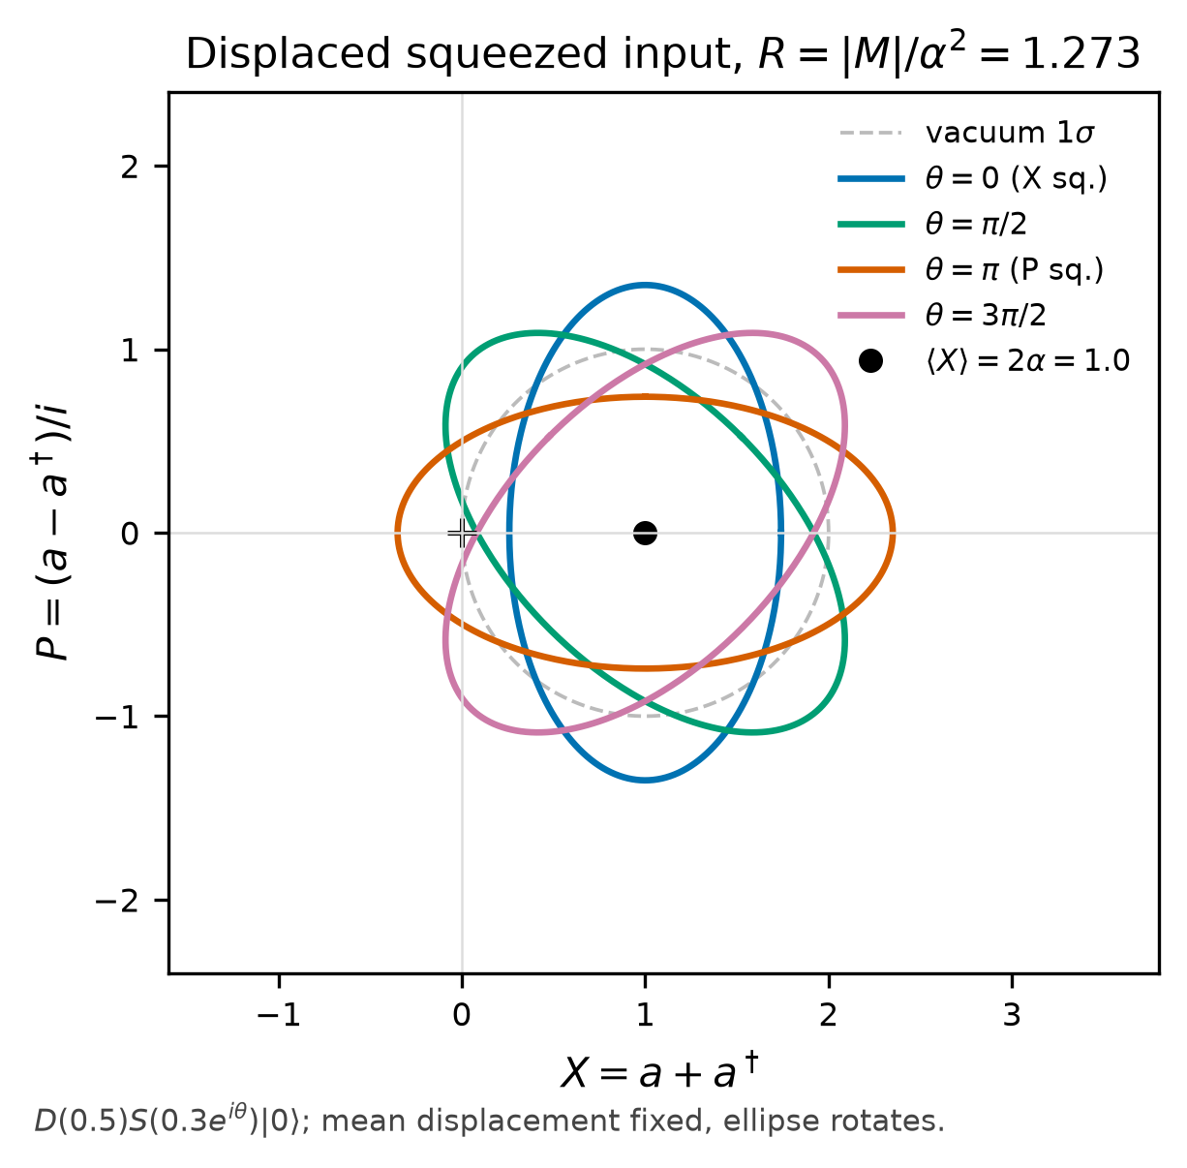
Displaced squeezed drive
|ψ(θ)> = D(0.5) S(0.3 exp(iθ)) |0>
Coherent displacement contribution α² = 0.25. Squeeze-vacuum contribution sinh² r = 0.0927. Mean occupation 0.343.
Anomalous correlator |M| = 0.318. Control ratio R = |M| / α² = 1.273.
Ideal squeeze-quadrature noise reduction about 2.61 dB. Modest squeezing, low occupation.
The mean displacement stays fixed. Only the noise ellipse rotates with θ.
Pure BSV has vanishing mean field, so α² and M cannot interfere in phase. Q6 needs the displacement.
Cohen briefing 29 Oct 2026 Q6 finite-time Néel-odd H2
6
Notes:
Fig.1: mean displacement unchanged, fluctuation ellipse rotated.
X = a + a^dagger, P = (a - a^dagger)/i, vacuum variance 1.
This protocol was chosen because R is of order one, not because it matches experimental BSV.

Slide 7
Observable and analysis window
The same incident light, polarization, and time reference drive two static Hamiltonians that differ only by a global flip of the layer exchange fields, +N and -N.
The difference current is Néel-odd. Odd and even refer to the Néel vector, so H2 can still carry an odd piece.
s(t) is a one-cycle rise, four-cycle plateau, one-cycle fall coupling switch, about 496 fs. It is a model switch, distinct from a free-space experimental envelope.
Main Fourier window [2 T_0, 4 T_0]. Neighboring windows still change the complex amplitude by 16% to 39%.
The reported object is a positive-frequency projection of the odd current near q = 2. The two-dimensional amplitude is sqrt(|Jx|^2 + |Jy|^2).
Treat this as a finite-time complex response. This briefing withholds a far-field harmonic yield and a photon count.
Cohen briefing 29 Oct 2026 Q6 finite-time Néel-odd H2
7
Notes:
N is a static label. The light and the two domains are not placed in a superposition.
About 1859 time steps per cycle. Current saved every 32 steps in the original archive.

Slide 8
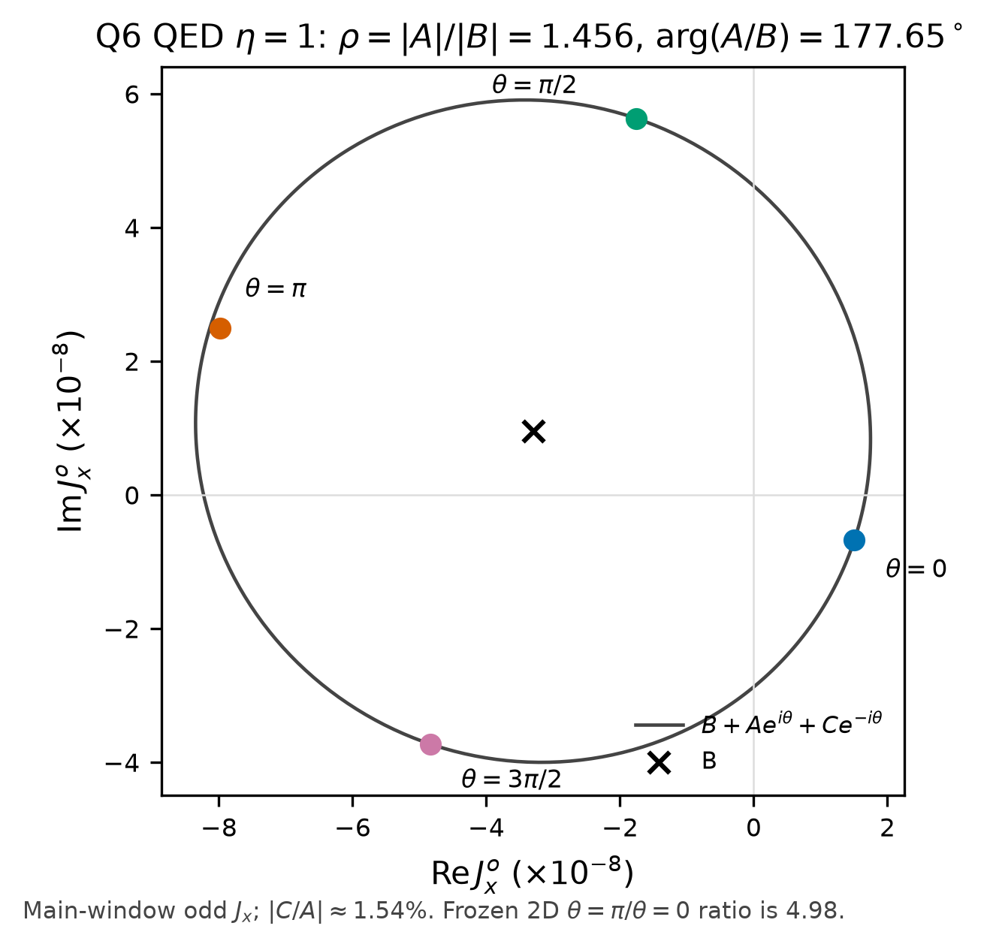
QED Néel-odd H2 trajectory
Truncated QED propagates the joint electron-photon state, including back-action.
GH5 samples the input Wigner function on a 5 by 5 Gauss-Hermite grid. GH5 is a quadrature order.
Finite-window 2D amplitude ratio for θ = π versus θ = 0 is 4.98.
Covariance-reversal Jx phase, θ = π/2 versus 3π/2, is 110.6 degrees.
A held-out θ = π/4 prediction misses by 0.667%, 0.425%, and 1.037% of |A|.
Cohen briefing 29 Oct 2026 Q6 finite-time Néel-odd H2
8
Notes:
Six analytic tests pass after the Fourier-endpoint repair.
4.98 is a finite-window complex amplitude ratio, not a yield.

Slide 9
Frozen headline numbers
Quantity | Value | How to read it
2D odd amplitude, π / 0 | 4.98 | Finite-window complex amplitude
Covariance-reversal Jx phase | 110.6 deg | Same initial variance, opposite covariance
R = |M| / α² | 1.273 | Displacement and M already compete
ρ = |A| / |B| (QED) | 1.456 | Use the QED ρ, not the GH5 ρ
arg(A/B) | 177.65 deg | Nearly diametric, mostly input geometry
|C/A| | 1.54% | Counter-rotating term remains small
Neighbor-window change | 16% to 39% | Unstable as a far-field harmonic
SOC span of arg((A+C)/B) | 4.37 deg | Negative result inside the gap
Finite-time kernel fraction | 73.7% | Share of the original 79 deg gap
Main-window QED/GH5 K_B | 0.868 | Odd-channel suppression about 13%
Main-window QED/GH5 K_M | 1.003 | No enhancement of the M readout
Cohen briefing 29 Oct 2026 Q6 finite-time Néel-odd H2
9
Notes:
B = (-3.3006 + 0.9537 i) e-8. A = (+4.7434 - 1.5839 i) e-8.
Kick on/off = -16.54 deg. K_M/K_B on the SOC scan = 0.975 to 1.008.
Max distance from π = 4.52 deg.

Slide 10
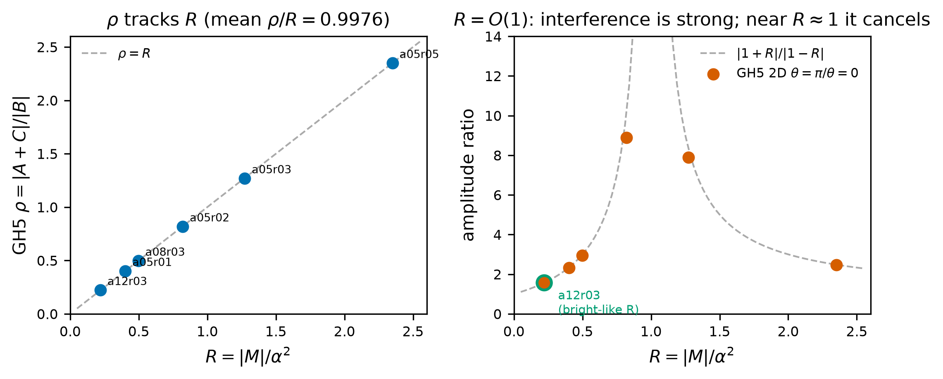
A/B/C formula and the R window
J₂ᵒ(θ) ≈ B + A exp(iθ) + C exp(-iθ)
For fixed electronic dynamics, J = Tr(ρ_ph K). B reads Δn = 0. A reads +2. C reads −2.
B is the number-diagonal block. The effective form K_B α² remains an approximation.
Interference is strong when R = O(1). Cancellation is strongest near R ≈ 1. Small R makes θ a perturbation.
On GH5, K_M / K_B ≈ 1, so ρ ≈ R. QED moves ρ/R to 1.144 because K_B is suppressed.
For an ideal high-gain single-mode state, R ≈ n_s / n_d. Keeping R of order one is input-statistics feasibility, not a certified source.
Cohen briefing 29 Oct 2026 Q6 finite-time Néel-odd H2
10
Notes:
External review asked to write R = O(1) for strong interference, and strongest cancellation near R ~ 1.
Do not write that larger R always means stronger interference.

Slide 11
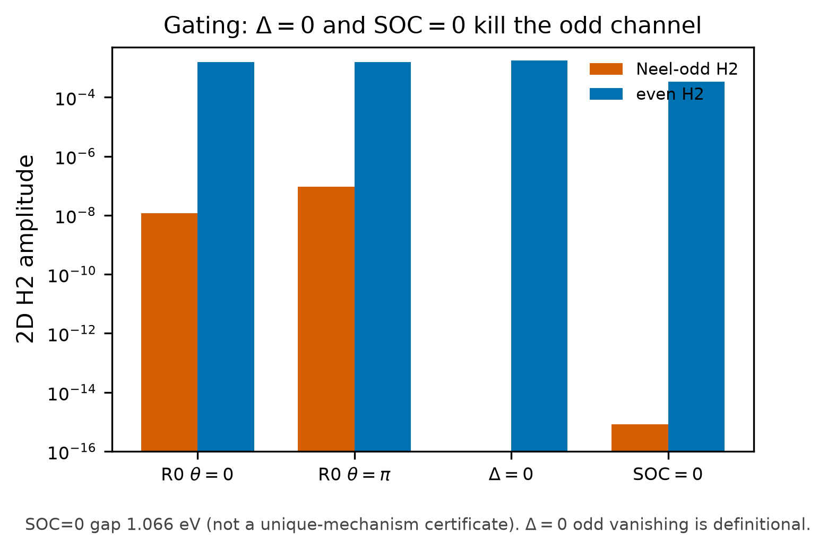
Néel and SOC gating
Néel order and SOC together open the odd channel and rescale the kernel.
Δ = 0 makes +N and −N identical, so the odd current vanishes by definition. This is a code-consistency check.
SOC = 0 closes the odd channel in this M0 Hamiltonian. The gap also drops to 1.066 eV. First-principles CrI₃ work shows some AFM stackings still have SHG with SOC off.
Inside the insulating window, an SOC scan leaves arg(A/B) near π. Span 4.37 degrees. Maximum distance from π 4.52 degrees.
The scan is a negative result: no magnetic phase fingerprint in this window.
Cohen briefing 29 Oct 2026 Q6 finite-time Néel-odd H2
11
Notes:
Li et al. PRB 2022 on bilayer CrI₃: some AFM configurations remain SHG-active without SOC.
Do not promote SOC = 0 in M0 into a universal selection rule.

Slide 12
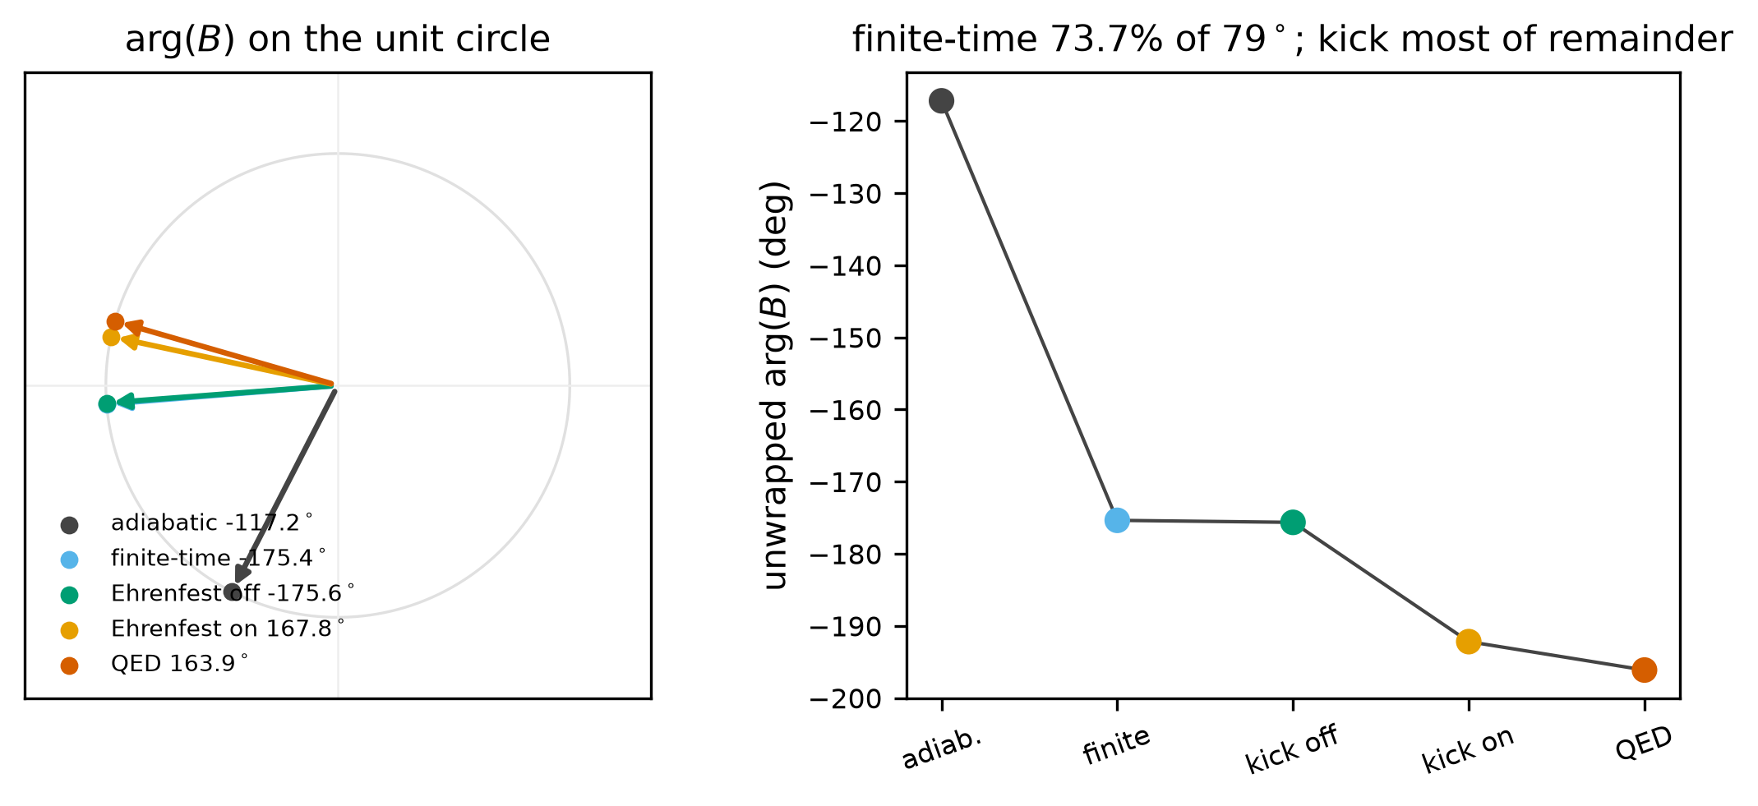
Absolute phase of B
Equilibrium χ⁽²⁾ fails to predict Q6 arg(B). The original mismatch was about 79 degrees.
A finite-time Peierls kernel with the same 1+4+1 switch and the same window accounts for 73.7% of that gap.
An Ehrenfest kick on/off comparison contributes -16.54 degrees and covers most of the remainder.
The kick leaves a GH5-QED residual of about 4 degrees, so the pieces stop short of a strict additive identity.
Exchange strength η rescales |A| and rotates arg(B), while arg(A/B) stays pinned near π by the input geometry.
Cohen briefing 29 Oct 2026 Q6 finite-time Néel-odd H2
12
Notes:
External review: Fig.5 kick does not precisely close the remaining phase.
Write switch-related transient contribution, not a unique proven origin of the front-window anomaly.

Slide 13
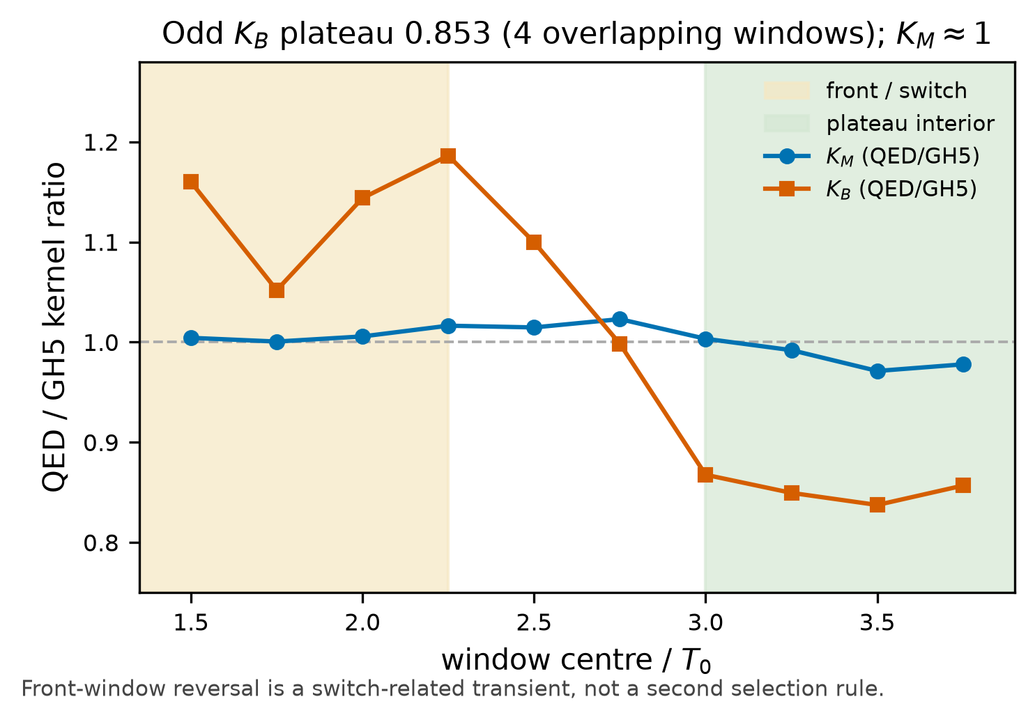
Quantum mapping of K_B and K_M
Effective readout: J ≈ K_B α² + K_M M(θ).
Main-window QED/GH5: K_B = 0.868, K_M = 1.003. The odd channel suppresses the displacement readout and leaves the anomalous correlator unenhanced.
About 15% of the remaining QED correction lives in the Δn = 0 block.
A reported 0.853 with 1.3% spread comes from four overlapping time windows. Treat that spread as window sensitivity, not an independent statistical error or a strict convergence bound.
The front-window anomaly is compatible with a switch-related transient. The archive still leaves the rise as one candidate cause.
Cohen briefing 29 Oct 2026 Q6 finite-time Néel-odd H2
13
Notes:
External review of Fig.6: overlapping windows cannot be sold as independent error bars.
pi_dev() in the SOC scanner misclassifies 0 degrees as on-π. Actual SOC data sit near 180 degrees, so the published scan numbers stand. Repair the helper before any new scan.

Slide 14
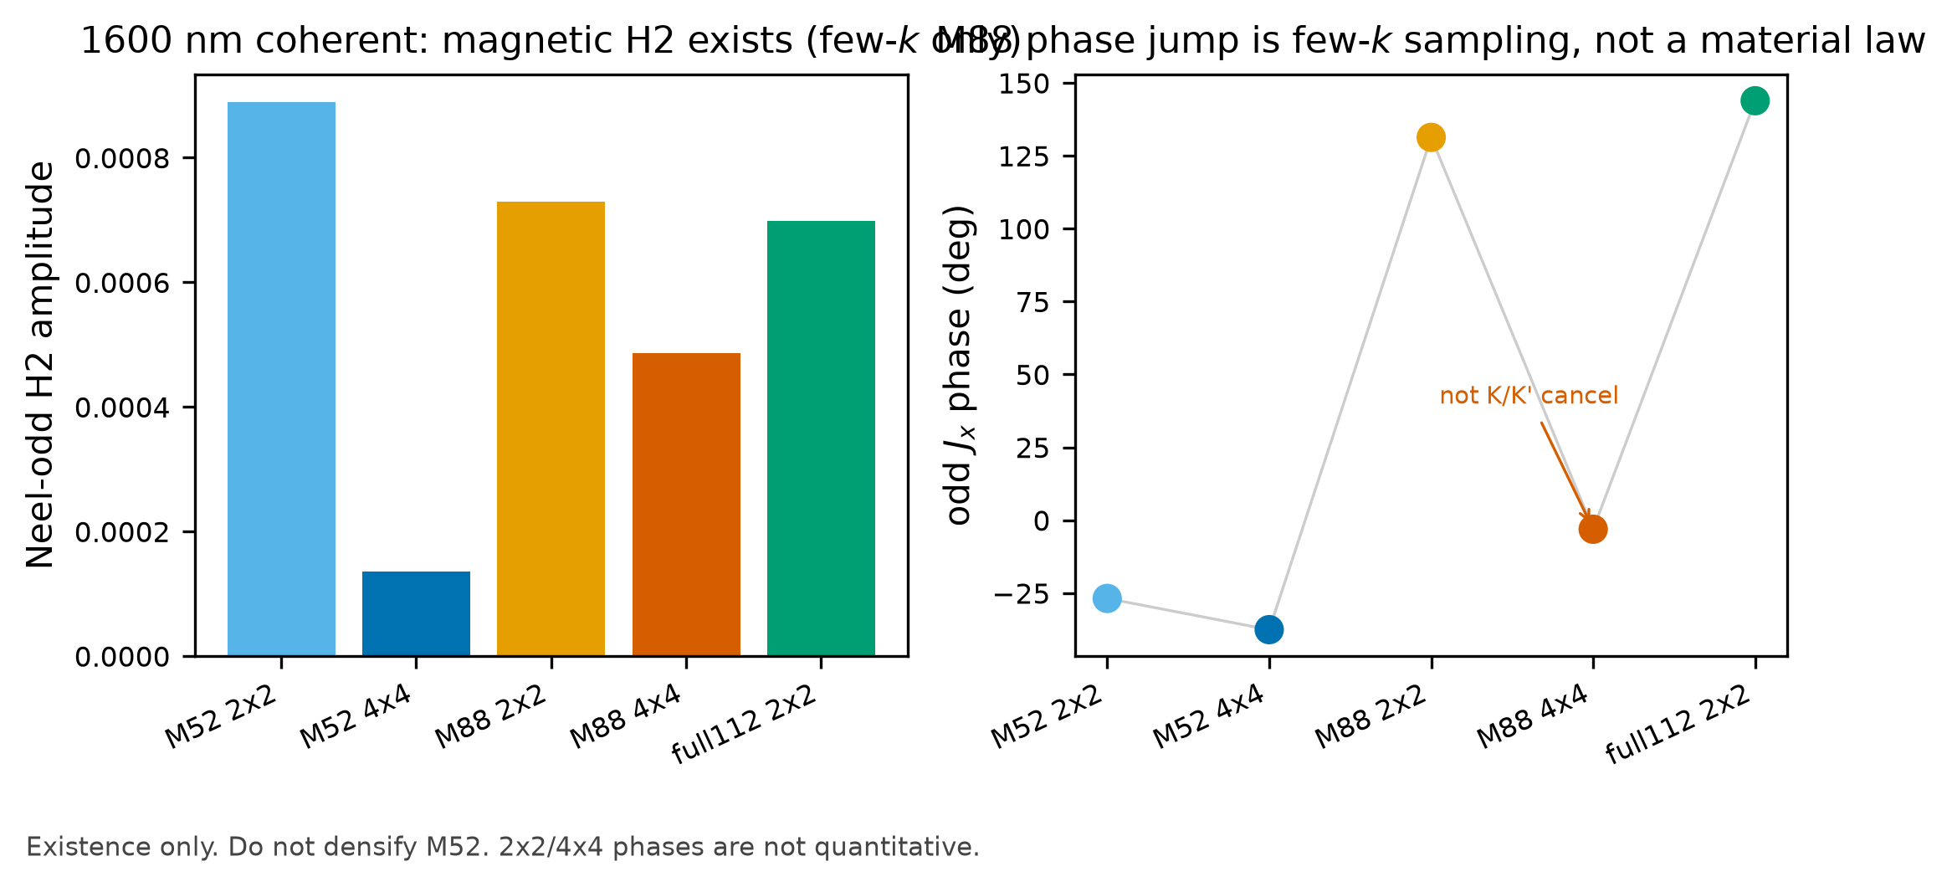
1600 nm few-k material check
Coherent 1600 nm, 25 fs, 10¹⁰ W/cm² on Wannier M52 shows a Néel-odd H2 current at a few k points.
From 2×2 to 4×4 the odd amplitude drops by about 6.6. Polarization ratios also move. Absolute size and polarization on a full BZ remain open.
Two domains differ by about 180 degrees, and the odd piece dominates. That matches known AFM SHG symmetry rather than a new quantum-light effect.
M52 is an interface-orbital contrast model. M88 and full112 still need the same protocol. WINDOW144 raised a completeness question on full112, with interpolation artifacts unresolved.
Dense M52 meshes are the wrong main line. Writing M0 as CrI₃ would mix two models.
Cohen briefing 29 Oct 2026 Q6 finite-time Néel-odd H2
14
Notes:
Fig.7 only proves that a magnetic H2 channel exists at a few k points.
1600 nm DS scouts used a 80/20 energy split, hence R ≈ 0.25, and missed the 110 degree rotation.

Slide 15
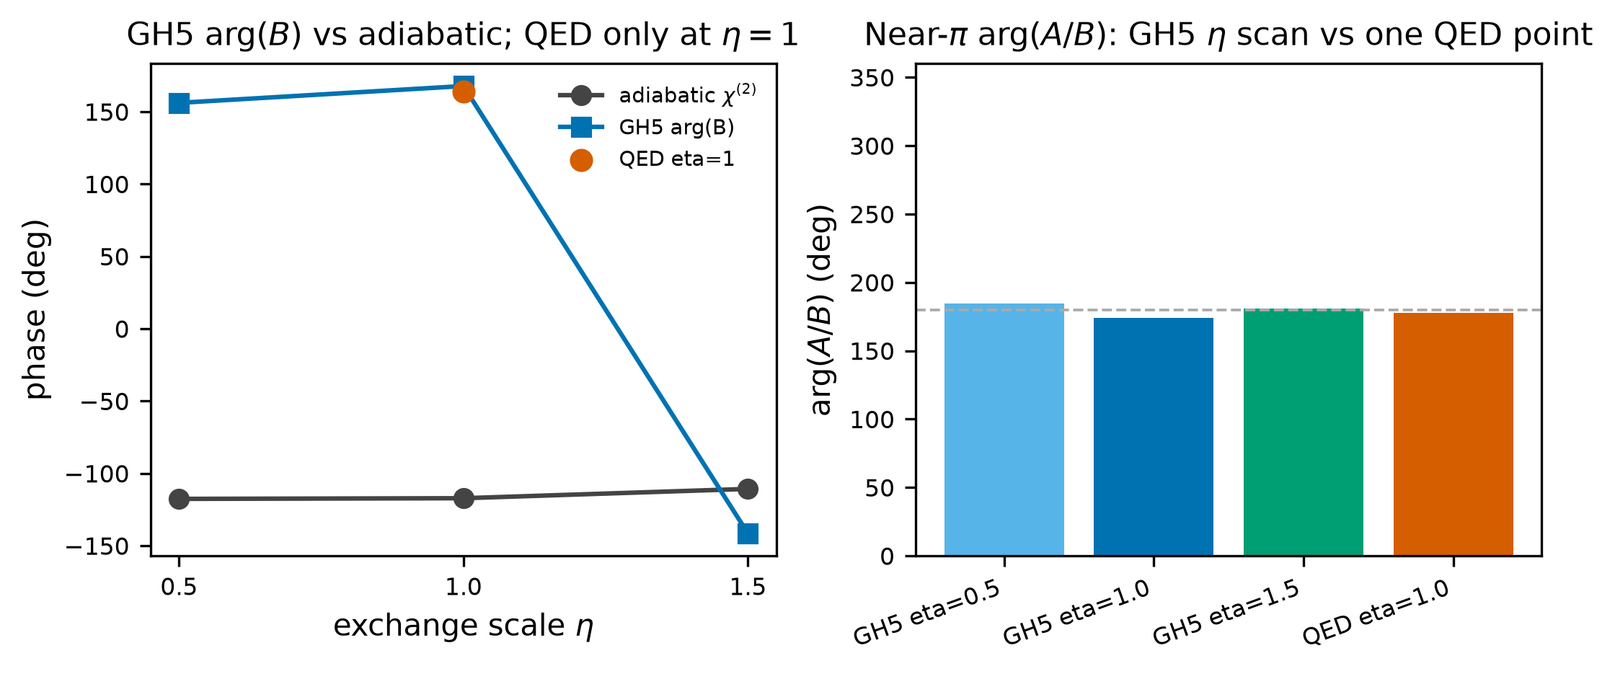
Claims withheld
4.98 reports a finite-window amplitude. This briefing withholds an experimental enhancement factor.
This briefing withholds a quantum-advantage claim. A classical field with the same second moments may still reproduce the mean current.
arg(A/B) near π follows mostly from input geometry. The material shows no preferential readout of M.
1600 nm has missed the 110.6 degree rotation. Q6 g has no W/cm² map.
SOC = 0 in M0 stays a model-channel result. Mean current and output g⁽²⁾ remain distinct observables.
Cohen briefing 29 Oct 2026 Q6 finite-time Néel-odd H2
15
Notes:
Fig.8: keep GH5 and QED phase data distinct. Do not claim a universal material phase law.
The non-negative P bound |M_cl| <= n_fl constrains the input, not output nonclassicality.

Slide 16
Questions for discussion
Against Gorlach 2023, Rasputnyi 2024, squeezed-coherent solid HHG, and the 2026 graphene work, does an A/B/C split on a Néel-odd channel still add a distinct theoretical question?
Is a 24.8 μm, sub-photon main calculation acceptable if R is the transferable control, or does the paper need 1600 nm high-gain dynamics first?
If the observable stays a finite-time complex current rather than far-field harmonic photons, what is the largest scientific risk?
For an experimental next stage, would you keep a high-brightness displaced squeezed state at R ≈ 1, or move to pure BSV and two-time correlators?
For bilayer CrI₃, magnetic SHG is already strong. If quantum statistics were to control it, is the realistic readout phase, polarization, or domain contrast?
Cohen briefing 29 Oct 2026 Q6 finite-time Néel-odd H2
16
Notes:
Copy of briefing section 11.
Preferred next step after this discussion: either write the eight-band mechanism manuscript, or audit 1600 nm high-gain quadrature at R ≈ 1. Do not restart SOC or M52 mesh scans tonight.

