Slide 1
INCREMENT-1
SUBMITTED BY:
KUSHAL
SAMHITHA
SWATI
ZEENAT

Slide 2
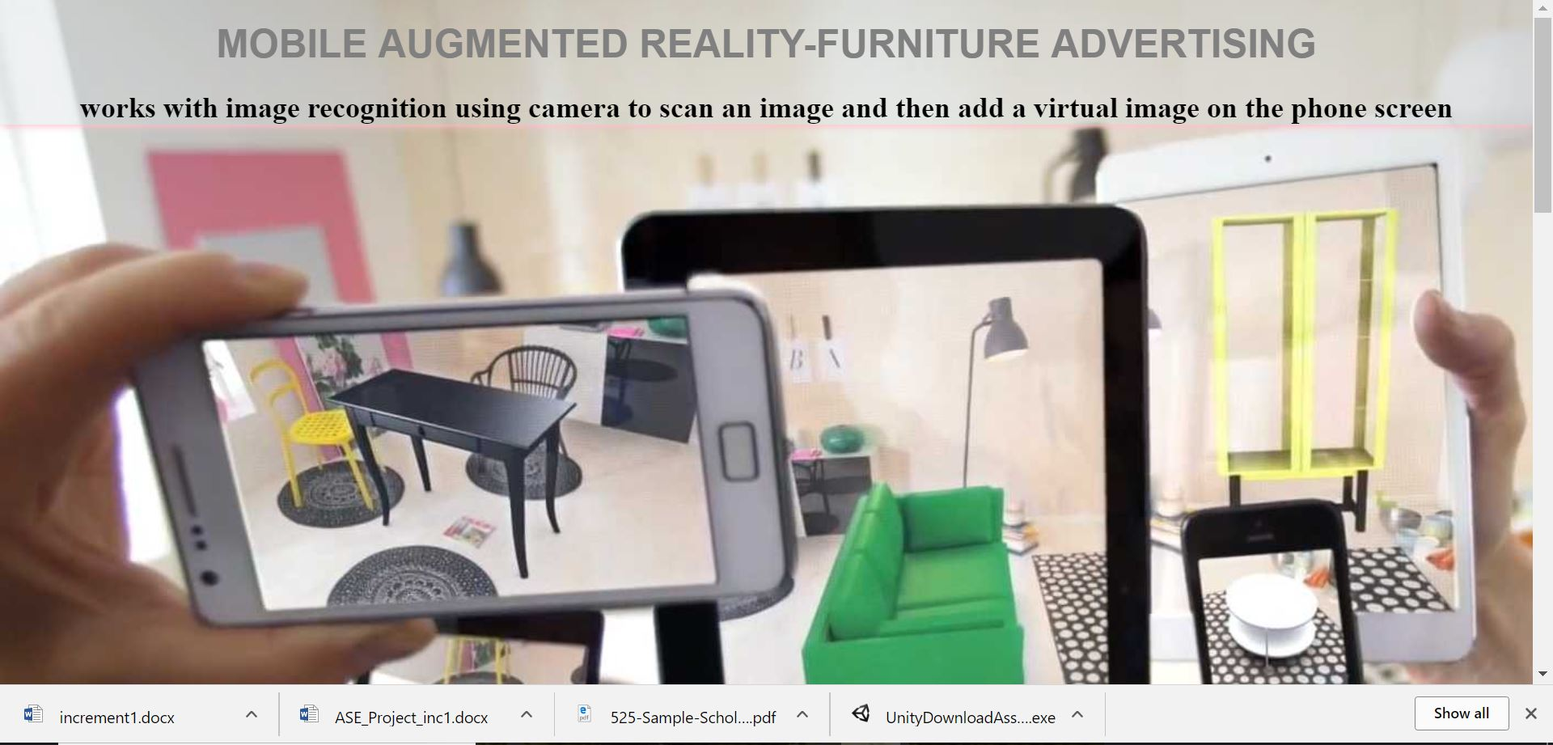
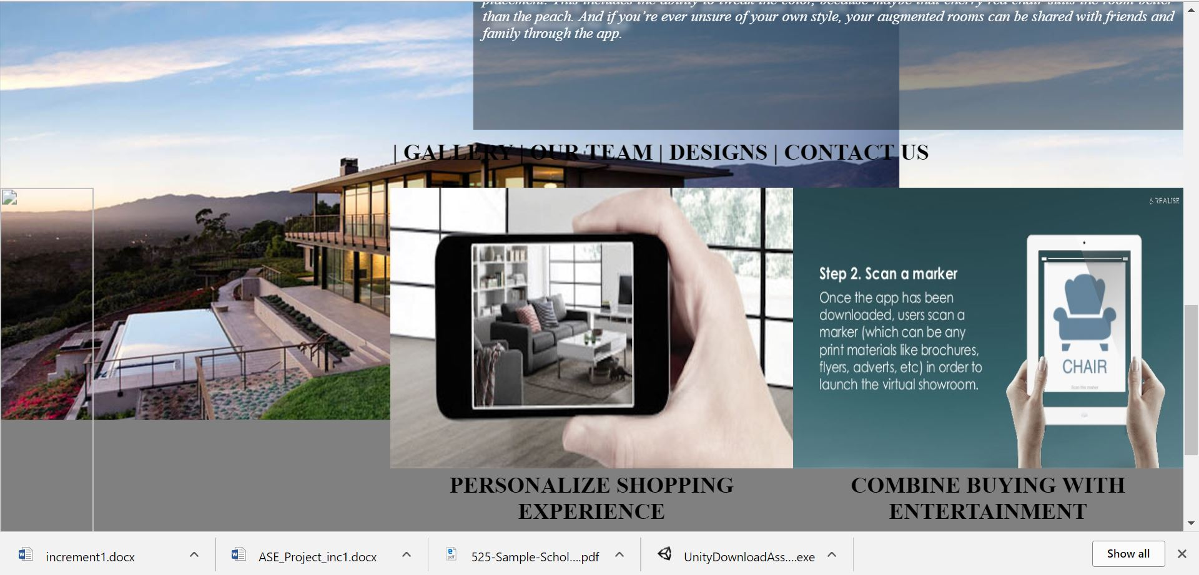
AIM : Is to introduce Augmented reality in Advertising which would help the companies to market their product. We chose Furniture Design as our field of Advertising
• IKEA place: Furniture placement app
• Amazon Shopping: Furniture placement , product recognition using camera/barcode, and product search Initially we have started with the front end development of our web application.
Did some coding using HTML, CSS and js to give a overview of how and what our app will do.

Slide 3
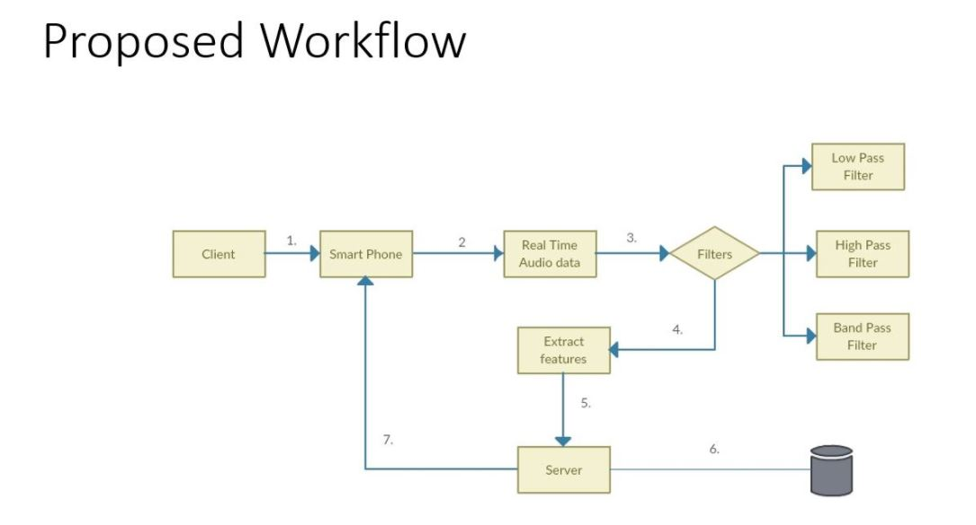
Added a video as well to get a better understanding of our project features.

Slide 4
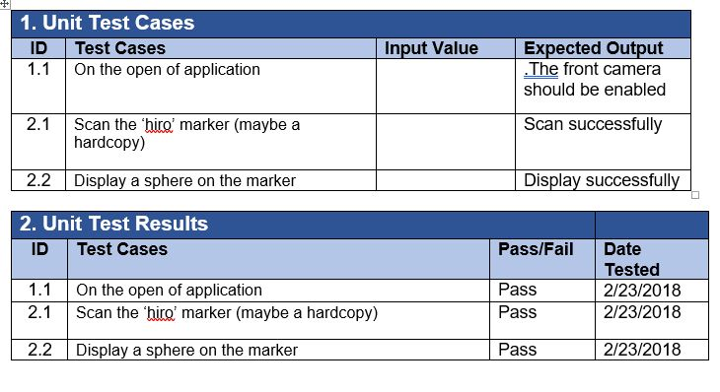
TESTING

Slide 5
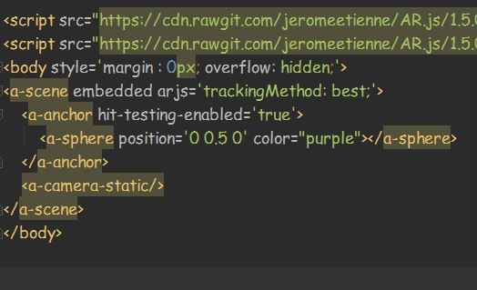
IMPLEMENTATION
We have implemented the application using AR.js on web in this increment. Some of the code snippets are as follows:
ARToolKit is an open-source library that we use to localize it through the phone camera.

Slide 6
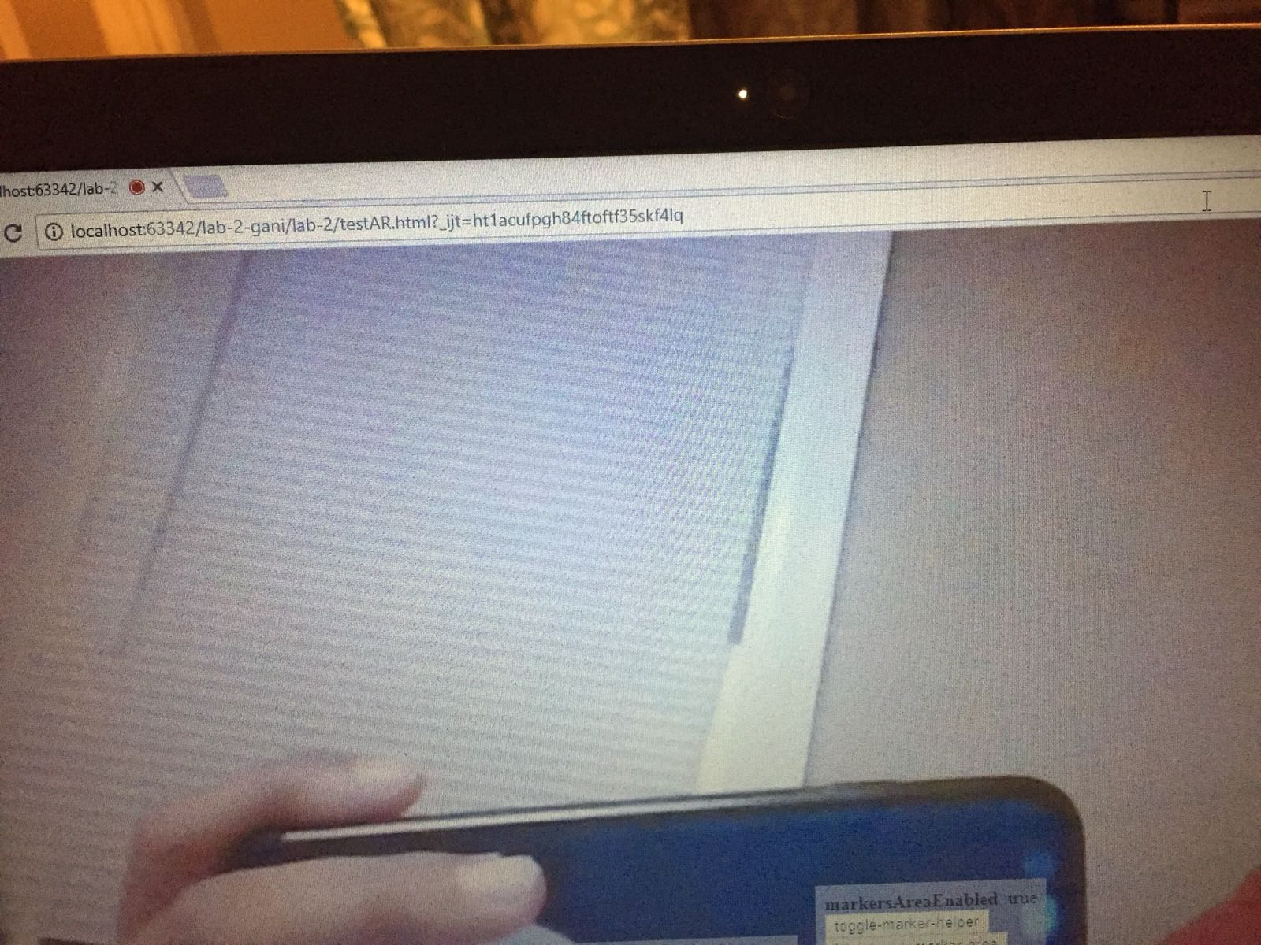
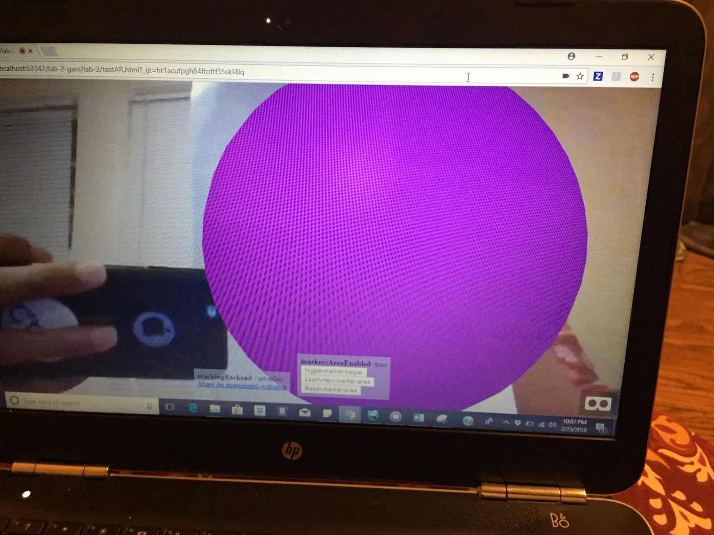
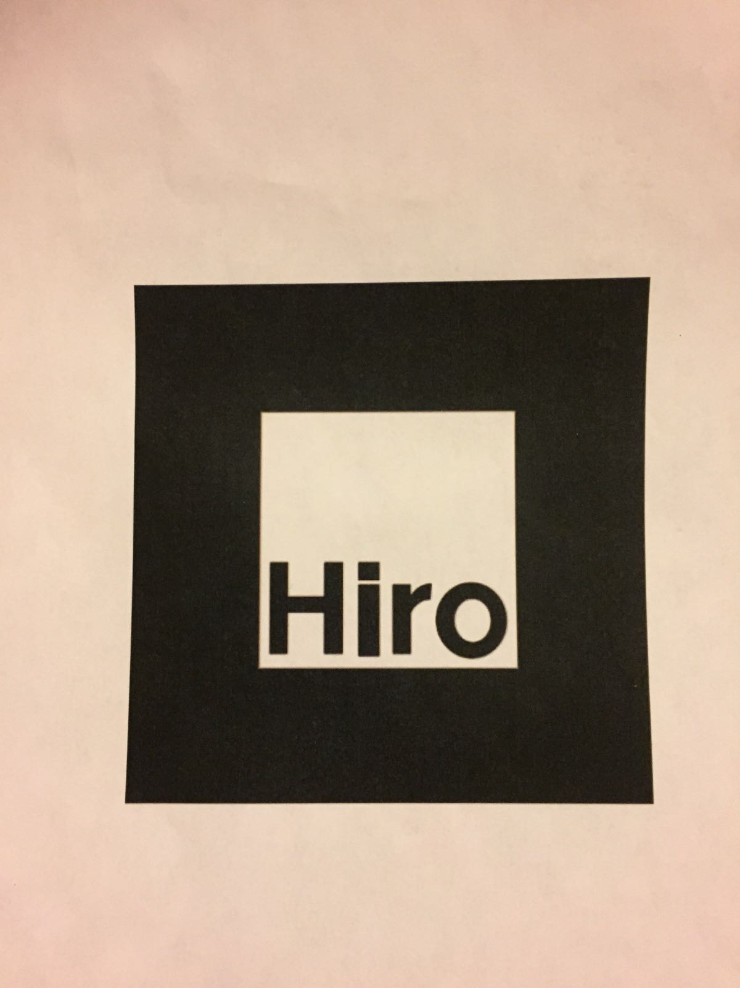
DEPLOYMENT
We can experience efficient augmented reality for the web directly on your phone without installing any applications. We can host it on a server so that it can be accessible on phone. Here are the screenshots of the working application:
The first image shows the activation of the web camera once the application is opened.
This image shows the marker which we have used to scan.
The next image displays the sphere on the scan of the marker.
image displays the sphere on the scan of the marker.

Slide 7
PROJECT STATUS
Work completed:
We have began writing the code for the project. We were able to run the application on web successfully. As of now, the application is able to scan the ‘hiro’ marker and successfully display the sphere on top of it. https://github.com/Samhitha1193/ase-project/blob/master/increment1/documentation/increment1.JPG
Work to be completed:
We have to still work on the display of furniture instead of sphere. Design of an intelligent audio recognition model will help the specially abled people who are not able to hear properly The model will also have the features for advertisement of Online products.https://github.com/Samhitha1193/ase-project/blob/master/increment1/documentation/increment2.JPG
Issues:
We’re still figuring out to host the same application on the server and to display the furniture images instead of the sphere in this case. We hope to complete the same by next increment.

