Slide 1
UE24CS341A Software Engineering · Mini Project · Team 5
Railway Reservation System
Route search, fares with an eco-score, booking with a waitlist, in a terminal app written in C/C++
Ridhima Jain
S S Adhithya Sriram
Saathvik Shenoy Padubidri
Samhitha S
PES1UG24CS373
PES1UG24CS393
PES1UG24CS394
PES1UG24CS411
Auth, RBAC & audit
Inventory, CI, TUI
Booking & waitlist
Search, fare & eco · QA lead
13 November 2026
Notes:
Presenter: Samhitha. Introduce the team and who owned which module. Total talk about 12 minutes plus demo.

Slide 2
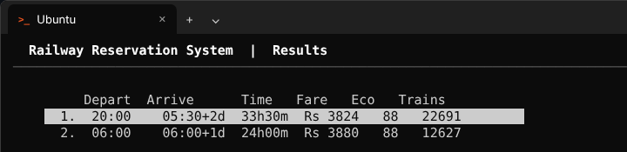
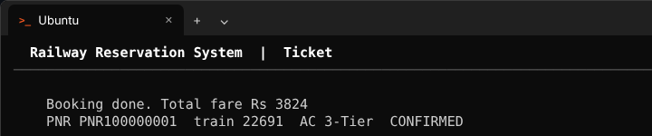
What we built
Passengers register, search trains between two stations, compare fares and CO2, and book a seat
If a class is full the booking joins a waitlist and is promoted automatically when someone cancels
Admins add, edit and retire trains; every admin action is written to an audit log
Payment is a mock gateway: success or failure only, no card data stored
Runs as an ncurses terminal app (TUI) on Linux / WSL
Search results: fare and eco-score for each journey
Ticket: PNR issued after the mock payment succeeds
Notes:
Presenter: Samhitha. One-line goal: a reservation system that also tells you the greener option. Keep it short, the demo shows the rest.

Slide 3
Requirements (SRS v1.1)
24
9
6
functional requirements
non-functional
security
FR-001 to FR-024
performance, availability, scalability, integrity
SEC-001 to SEC-006, 4 security objectives
Four modules, one owner each
Module | Requirements | Owner
User access & profile (auth, RBAC, sessions) | FR-001 to FR-006 | Ridhima
Inventory & schedule (admin) | FR-007 to FR-011 | Adhithya
Search, fare & eco-optimisation | FR-012 to FR-017 | Samhitha
Booking & queue management | FR-018 to FR-024 | Saathvik
Notes:
Presenter: Samhitha. Every requirement is measurable, e.g. NFR-001: 95% of searches within 2 s; NFR-009: no seat sold twice. The SRS also has a use case diagram.

Slide 4
Architecture: layered, with a facade
ncurses TUI
screens only, no business logic
Why this design
One place to check login and role before anything runs (SEC-002)
Each module is its own library with its own tests, so it can be tested without the UI (NFR-006, NFR-007)
The UI can change without touching the engine
Every function returns a status code, so bad input never crashes the app
Facade API
checks the session, computes the fare, books every leg
Auth & RBAC
Ridhima
Inventory
Adhithya
Search, fare, eco
Samhitha
Booking & waitlist
Saathvik
Audit log
data/audit.log
Mock payment
success / fail only
Notes:
Presenter: Adhithya. Walk top to bottom: TUI calls only the facade; the facade calls the modules. Booking talks to inventory through train_get, inventory to search through the graph loader.

Slide 5
How we worked: GitHub Project, sprints, PRs
42
143
28
70+
backlog items from the SRS
story points
pull requests merged
CI runs, main never red
Every change followed the same path
1
2
3
4
5
6
Issue on the board (story points, owner, sprint)
Feature branch
Pull request by the owner
CI: build, 266 tests, cppcheck
Review by the repo owner
Merge to main
Reviews were real: a ThreadSanitizer run on #70 found a data race, changes were requested, and it was fixed before merge.
Notes:
Presenter: Samhitha (repo owner). Show the GitHub Project board if asked. Story points per member: Saathvik 37, Samhitha 34, Ridhima 31, Adhithya 24, shared infra 17.

Slide 6
Sprints
Sprint 1
Sprint 2
Sprint 3 (spill-over)
PRs 24 Oct to 1 Nov · 62 pts
PRs 1 Nov to 6 Nov · 81 pts
PRs 6 Nov to 12 Nov
Registration, login, RBAC
Admin create / edit / retire train
Direct and multi-leg route search
CI pipeline and CMake build
1-minute demo video
Fare, eco-score, sort and filter
Booking, PNR, waitlist, cancel
Session expiry, audit log, input fuzzing
Search performance test (NFR-001)
Booking thread safety (NFR-009)
Facade and ncurses TUI
Retry, availability, scalability tests
Security validation, test reports
Sprint 2/3 demo video
Notes:
Presenter: Saathvik. Planned four sprints in the SRS; the course used two. Booking and the TUI spilled over, so we ran an optional Sprint 3 as Part-3 of the course sheet allows. Blocker example: the data race in booking found in review.

Slide 7
What each module does
Auth & RBAC · Ridhima
Inventory · Adhithya
PBKDF2 salted password hashes (100,000 rounds)
Sessions with a 15-minute idle timeout
Role checked on every protected call
Audit log: failed logins, denied and admin actions
Admin creates, edits and retires trains
Halts validated as a connected path (FR-010)
Capacity can't drop below confirmed seats (FR-011)
Facade + TUI; CI workflow
Search, fare & eco · Samhitha
Booking & waitlist · Saathvik
Graph of stations; direct + up to 3-train journeys
Fare = reservation charge + km x class rate − concession
CO2 per passenger vs a car → 0-100 eco-score
Sort by time, fare or CO2; filters
PNR only after mock payment succeeds
Full class → FIFO waitlist, auto-promotion on cancel
Idempotency key: a retry never books twice
Mutex: 50 threads, 1 seat → exactly 1 confirmed
Notes:
Each owner speaks to their own box (about 1 minute each). Samhitha: example fare, 2400 km in AC 3-Tier = 40 + 2400 x 1.60 = Rs 3880.

Slide 8
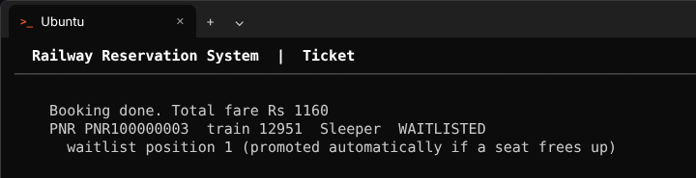
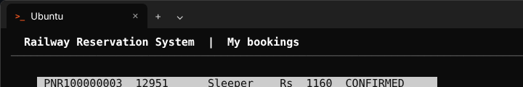
Demo: book, waitlist, auto-promotion
1. Train has one seat. Riya books it; Arjun is WAITLISTED, position 1
2. Riya cancels. Arjun is promoted to CONFIRMED automatically
Live demo (./build/rrs_app)
Register a passenger and log in
Search SBC → NDLS in AC 3-Tier, sort by cheapest, book and get a PNR
Admin adds a one-seat train; two passengers book it; one cancels and the other is promoted
Admin retires a train and it disappears from search
Notes:
Presenter: Adhithya drives the live demo, Saathvik explains the waitlist. Backup: demo-videos/sprint2_tui_demo.mp4. Admin login: admin@rrs.in / Adm1nPassw0rd.

Slide 9
Testing
266
Measured against the NFRs
Search, 200 stations / 500 trains: p95 46 ms (limit 2 s)
Booking confirmation: p95 under 1 ms (limit 1 s)
10,000 bookings over 500 trains in 0.4 s
50 threads for 1 seat: exactly 1 confirmed
ThreadSanitizer, AddressSanitizer, cppcheck: clean
automated tests, all passing
95%
line coverage of the engine
86%
branch coverage
Unit, integration, system (9 TUI tests), performance, load and security tests · reports in docs/
Notes:
Presenter: Samhitha (QA lead). Test Plan exit criteria: 70% unit coverage per module - every module is 87% or more. System testing found defect D-01 (a train with no seats in the chosen class is still offered); it is documented and nothing gets booked or charged.

Slide 10
Security validation (Test Plan §5.1)
ID | Requirement | How we tested it | Result
SEC-001 | Passwords stored only as salted hashes | Two users, same password → different hashes | Pass
SEC-002 | Passengers can't call admin functions | train_create as passenger → ERR_FORBIDDEN | Pass
SEC-003 | All input validated | Fuzzed with long strings, symbols, random bytes | Pass
SEC-004 | Expired or fake tokens rejected | Every protected call checked | Pass
SEC-005 | No payment data stored | Booking keeps only a success flag | Pass
SEC-006 | Failed logins and admin actions audited | 3 failed logins, 1 admin action, 1 denied try → 5 log lines | Pass
Two bugs found and fixed during this pass: admin actions were not audited, and the waitlist was capped at 4,096 instead of 10,000.
Notes:
Presenter: Ridhima for SEC-001/003/004/006 (auth), Samhitha for the validation pass.

Slide 11
Where we changed the design, and why
Change | Why
booking_create books one train; the facade books each leg of a journey | A connecting journey is separate tickets with separate seats
eco_score also takes the travel class | CO2 per passenger is different for Sleeper and AC
New search_rank for sort and filter | SRS says sort/filter without searching again
No database or file storage yet (in memory) | Time went into the TUI; modules are ready for a store
TUI has no profile, edit-train or filter screens | These work and are tested through the API
Optional Sprint 3 | Booking and TUI spilled over from Sprint 2
All deviations are written up in docs/design_deviations.md
Notes:
Presenter: Samhitha. The FAQ says deviations are fine if documented and explained - this is that slide.

Slide 12
Who did what
Member | Module and extra work | Story points | PRs merged
Ridhima Jain | Auth, sessions, RBAC, profiles, audit log, security tests | 31 | 5
S S Adhithya Sriram | Inventory, CI workflow, facade and TUI, NFR-003/005/006 tests | 24 | 12
Saathvik Shenoy Padubidri | Booking, PNR, waitlist, cancel, thread safety | 37 | 3
Samhitha S | Search, fare, eco-score, ranking; repo owner, reviews, QA and test reports, demo videos | 34 | 8
Shared infrastructure items (CI, CMake, security pass, integration) carried another 17 points.
Notes:
Each member: be ready to open your own PRs on GitHub and explain one function line by line.

Slide 13
What we learned
Writing measurable requirements first made testing straightforward: every test points back to an SRS ID
Code review and CI caught real bugs (a data race, a cppcheck finding, a missing audit entry) before they reached main
Small PRs per requirement were much easier to review than big ones
Next: file storage, the missing TUI screens, and fixing defect D-01
Thank you · Questions?
github.com/Samhitha1504-007/Railway_Reservation_System_SE
Notes:
Presenter: Ridhima. Keep to 1 minute, then questions.

