Slide 1
SPECIFYING REQUIREMENTS
Topic -16

Slide 2
Aim of the session
To familiarize students with the process of specifying the requirements.
Instructional Objectives
This Session is designed to:
Demonstrate the basic elements of requirement model
List out the types of elements of requirement model
Learning Outcomes
At the end of this session, you should be able to:
Summarize the types of elements of requirement model.

Slide 3
AGENDA
Elements of the Requirements Model
Types of Elements of the requirements
Scenario-based elements
Class-based elements
Behavioral elements
Flow-oriented elements
Analysis Patterns

Slide 4
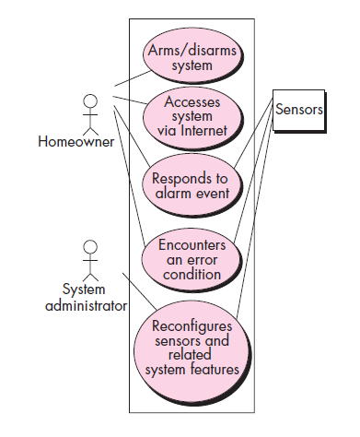
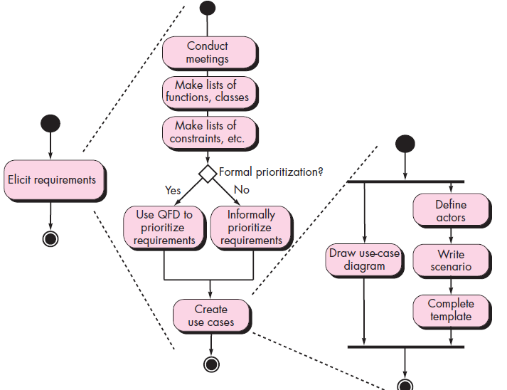
1.Scenario-based elements
Use Case Diagram for Safe home
Activity Diagram for safe home

Slide 5
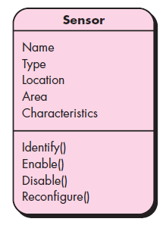
2. Class-based elements
Class Diagram for Sensor

Slide 6
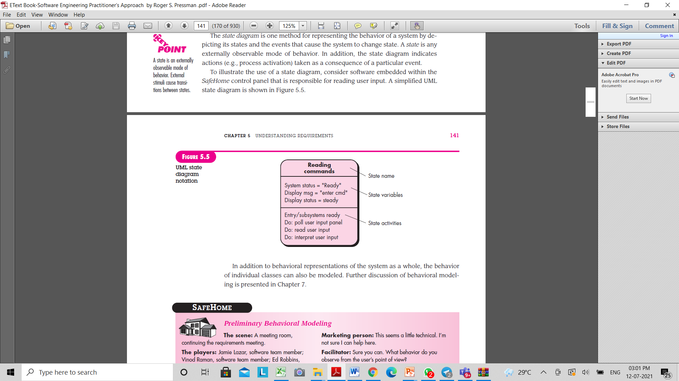
3. Behavioural Elements
State Representation for Sensor

Slide 7
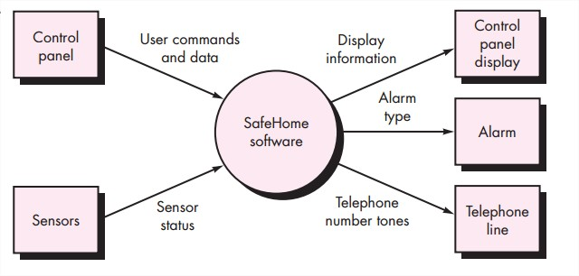
4. Flow-oriented elements:
Information is transformed as it flows through a computer-based system.
The system accepts input in a variety of forms; applies functions to transform it; and produces output in a variety of forms.

Slide 8
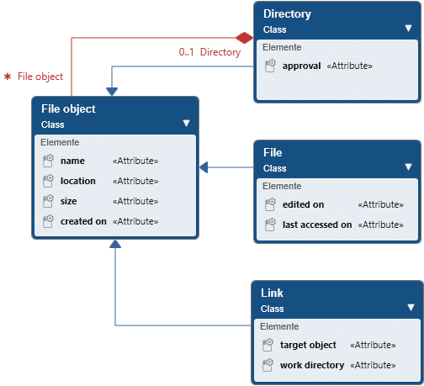
4.Analysis Patterns (Contd.)

Slide 9
Self Assessment Questions
What are different types elements of requirement model.
2. Illustrate Scenario based elements in detail with an example.
Differentiate Class-based and behavioral elements.
Explain about Analysis Pattern.

Slide 10
TEXT BOOKS:
Roger S.Pressman, “Software Engineering – A Practitioner’s Approach” 7th Edition, Mc Graw Hill,(2014).
Ian Sommerville, “Software Engineering”, Tenth Edition, Pearson Education, (2015).
Reference Book
Agile and Iterative Development: A Manager's Guide, Craig Larman, Addison-Wesley
WEB REFERNCES/MOOCS:
https://www.digite.com/kanban/what-is-kanban/
http://www.scaledagileframework.com
https://www.guru99.com/test-driven-development.html

Slide 11

THANK YOU
Team – Adaptive Software Engineering

