Slide 1
NLP Classification Model
Toxic Comments Dataset

Slide 2
Problem Statement
This is a multi label classification challenge with each of the targets being binary in nature. We need to classify if a comment belongs to one or more categories and predict the probability.
The training dataset shape is (159571, 8)
Following are the targets:
Toxic
Severe_toxic
Obscene
Threat
Insult
Identity_hate

Slide 3
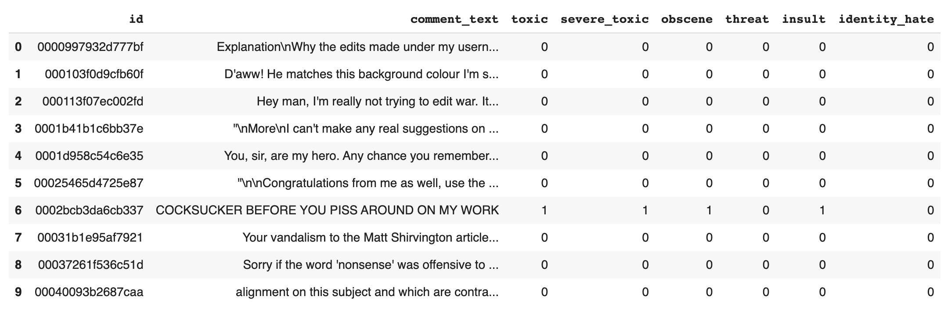
Top 10 columns in the data

Slide 4
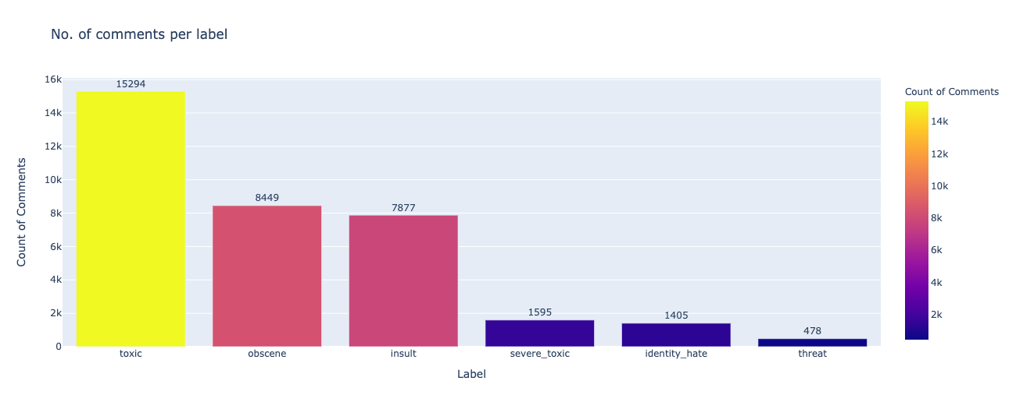
Exploratory Data Analysis
This figure represents how many number of comments are in one label.
We can observe that most of the comments are toxic and least are in threat.

Slide 5
Few comments
Explanation \nWhy the edits made under my username Hardcore Metallica Fan were reverted? They weren't vandalisms, just closure on some GAs after I voted at New York Dolls FAC. And please don't remove the template from the talk page since I'm retired now.89.205.38.27
D'aww! He matches this background colour I'm seemingly stuck with. Thanks. (talk) 21:51, January 11, 2016 (UTC)
Hey man, I'm really not trying to edit war. It's just that this guy is constantly removing relevant information and talking to me through edits instead of my talk page. He seems to care more about the formatting than the actual info.

Slide 6
Pre-processing Steps:
Removes urls from the text
Substitutes the html text with space
Substitutes the special characters with space
Converts uppercase to lowercase
Tokenize the text
Removes stopwords in english
Lemmatize the words in text

Slide 7
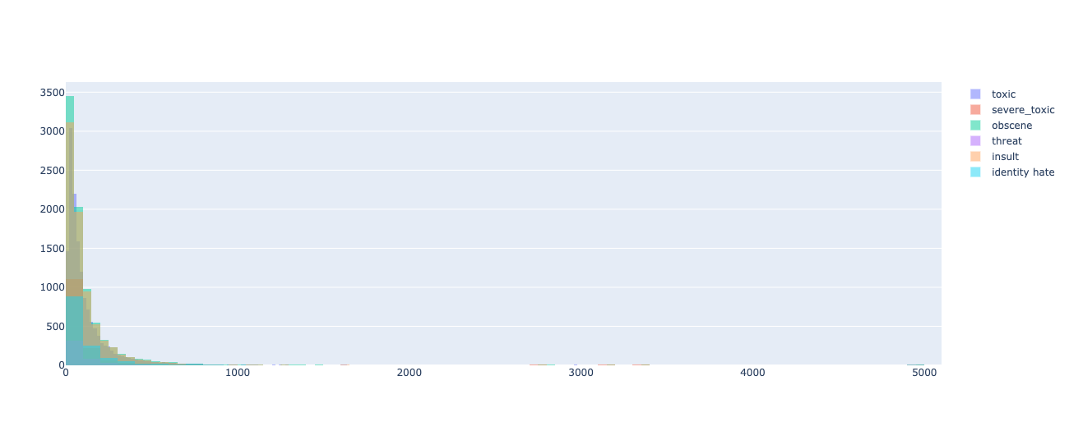
Length of comments for all labels
Overlayed the histograms of all labels
The highest length of comment is around 3500 letters for obscene label after pre-processing
Around 1100 for severe_toxic

Slide 8
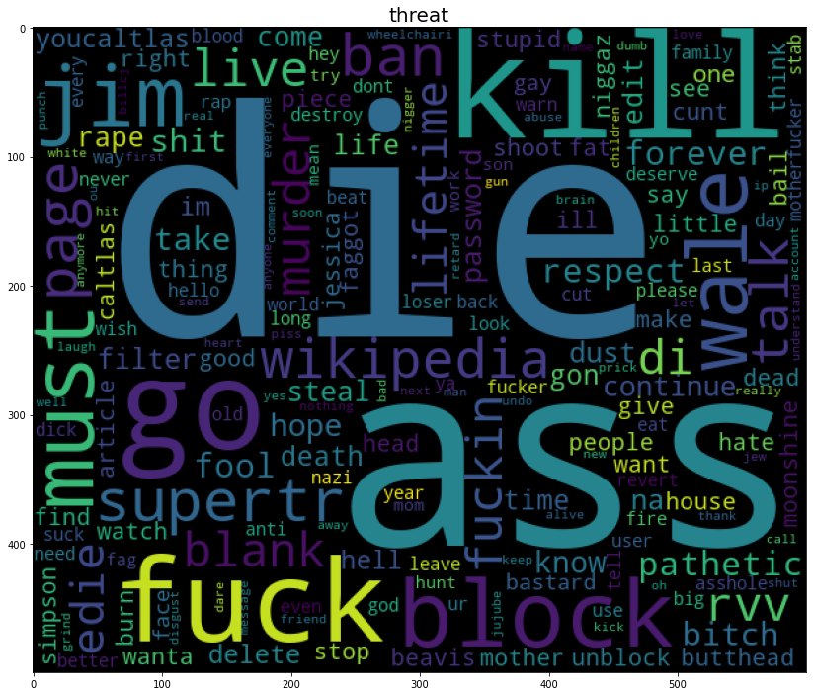
Word Cloud for Threat

Slide 9
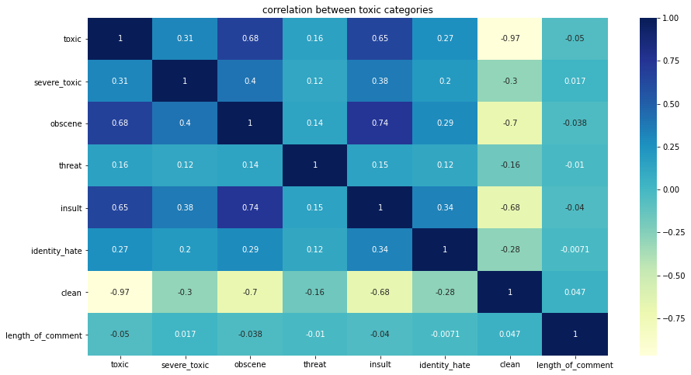
Correlation between labels, length of comments
We can observe that the toxic and obscene , obscene and insult are highly correlated.
Interestingly, toxic and severe_toxic are only weakly correlated.
Obscene comments and insult comments are also highly correlated, which makes perfect sense.

Slide 10
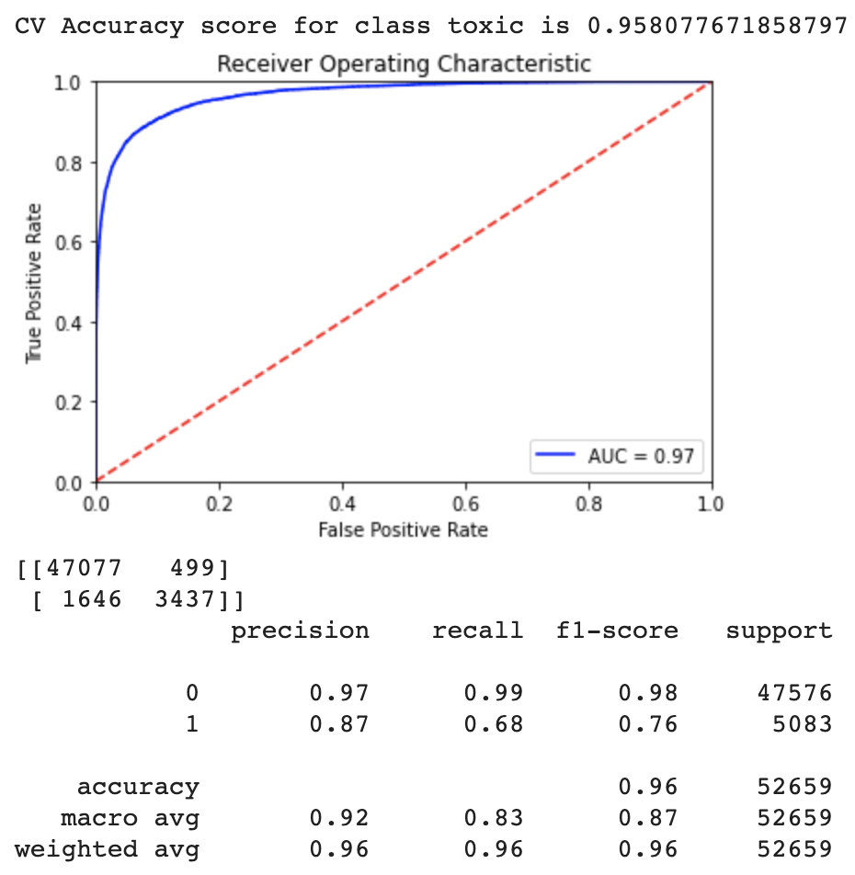
Feature Engineering and Applying Model
We want to summarize text using a few keywords only, some method to compute the importance of each word.
One way to approach this would be TF-IDF Vectorization.(Limitation: It does not capture the position in the text (syntactic) It does not capture meaning in the text (semantics)
Later, I have used Logistic Regression model (reason for using is because a Classification problem)

Slide 11
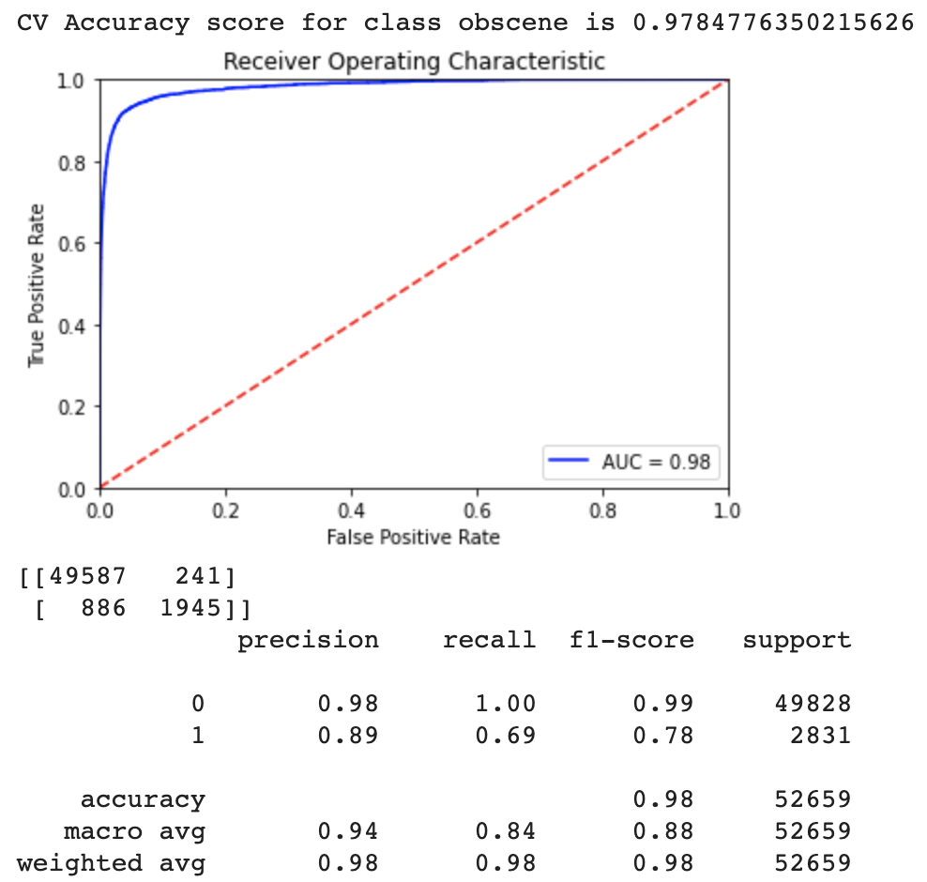
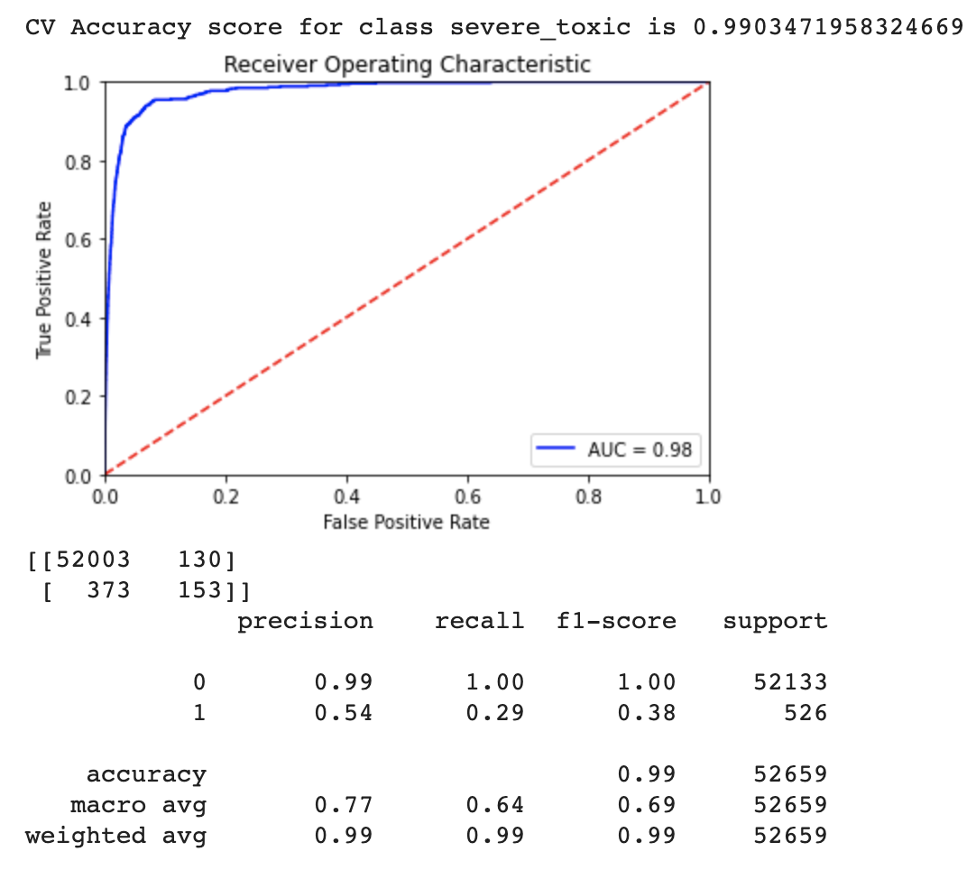
Performance Metrics

Slide 12
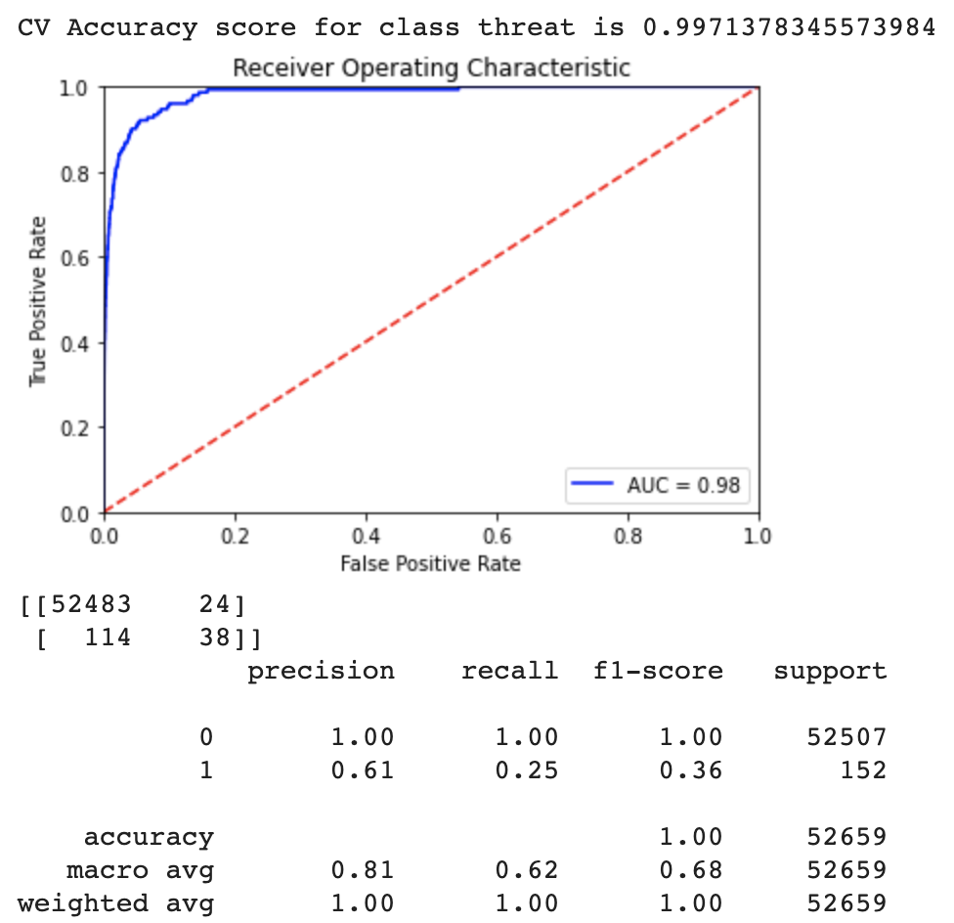
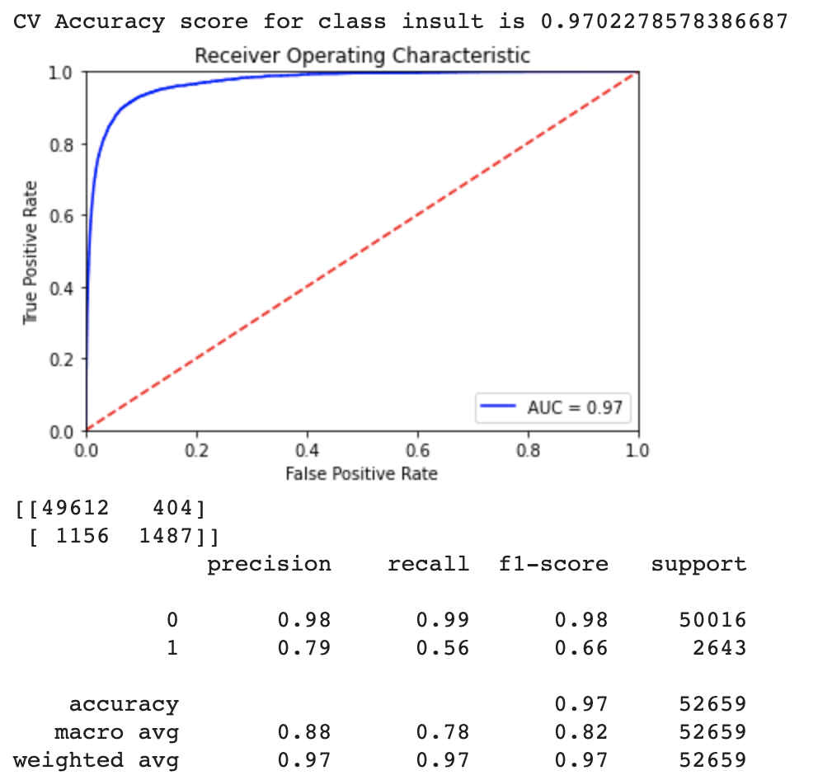
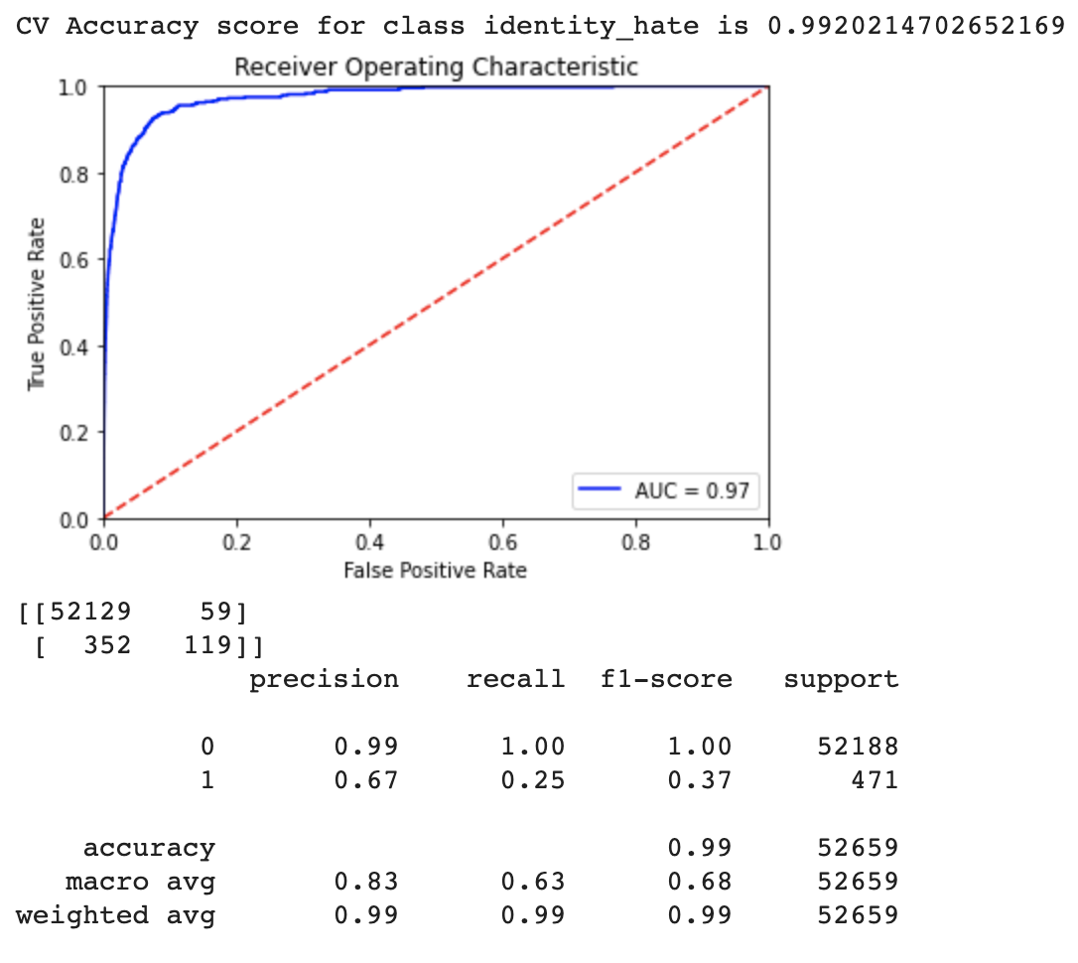
Performance Metrics

Slide 13

Thank you

