Slide 1

REAL ESTATE MARKET ANALYSIS IN SAN FRANCISCO BAY AREA
BAN 612 : DATA ANALYTICS
Samhitha Pallelamudi

Slide 2
Project Overview
Web Scraping
Visualization
DATA COLLECTION
Data Cleaning
DATA ANALYSIS
Statistical Analysis
Organizing data
Prediction

Slide 3

Data Collection

Slide 4
Web Scraping
Data scraped from homes.com
Data scraped from AreaVibes.com
Data ready for Cleaning & Analysis

Slide 5
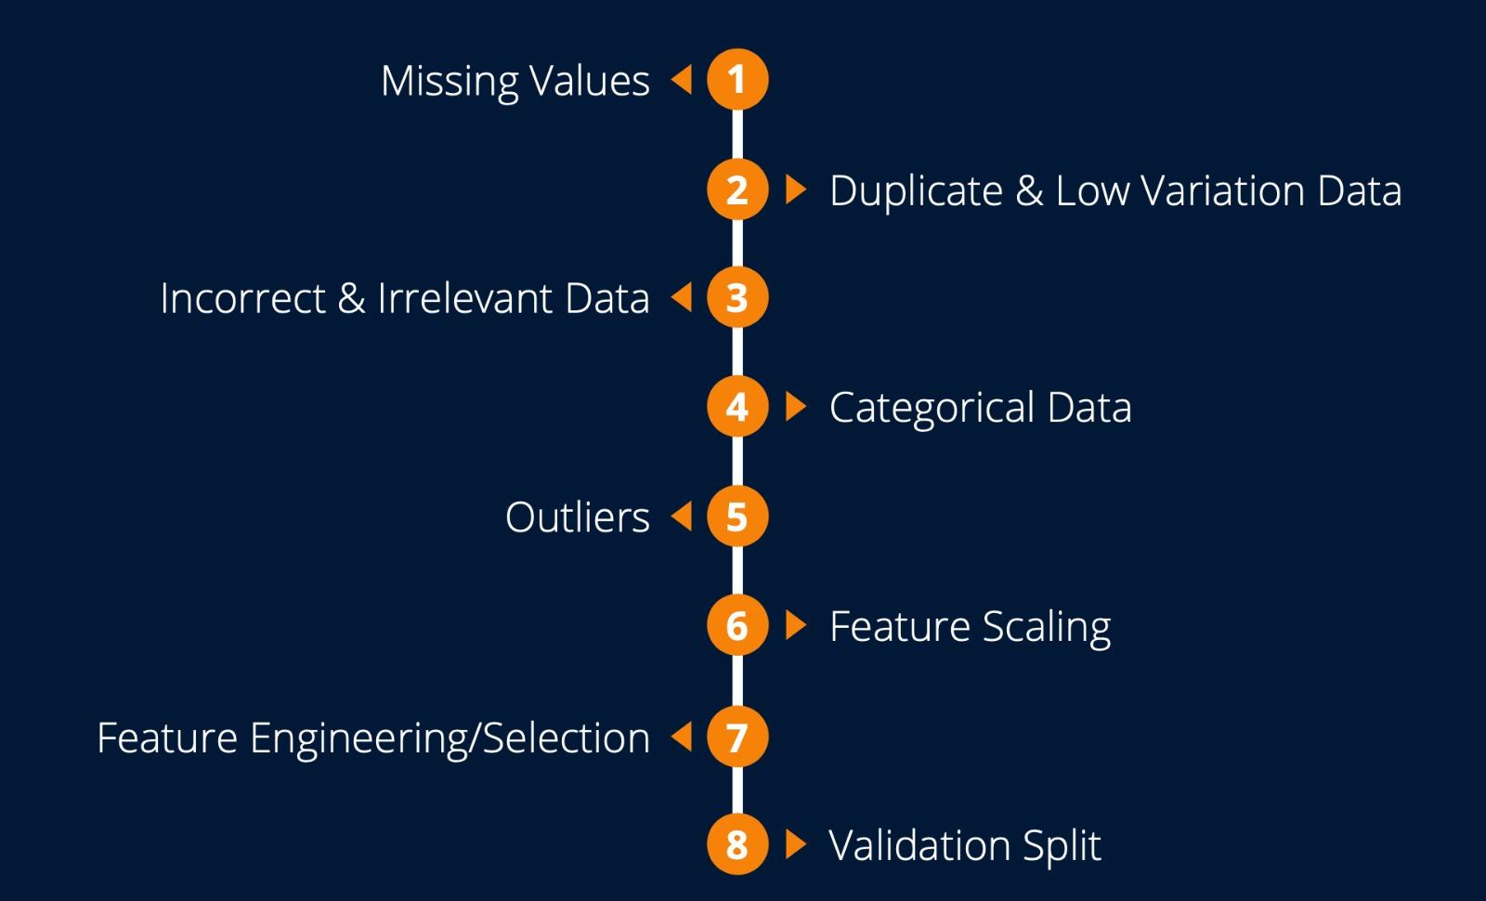
Data Preparation

Slide 6
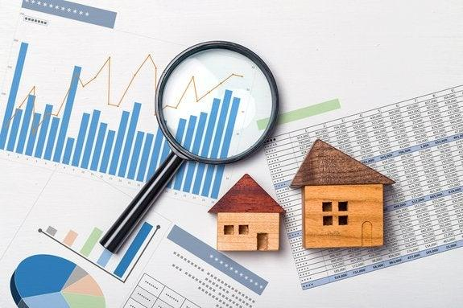
Data Analysis

Slide 7
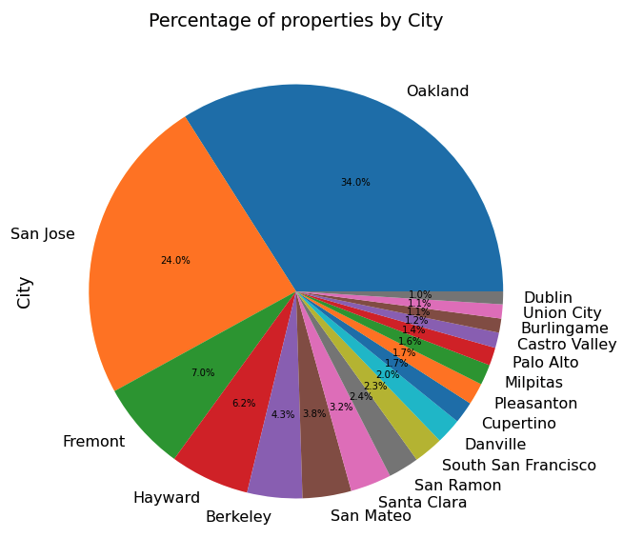
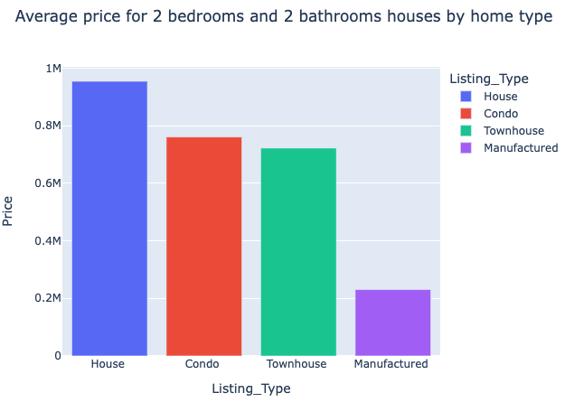
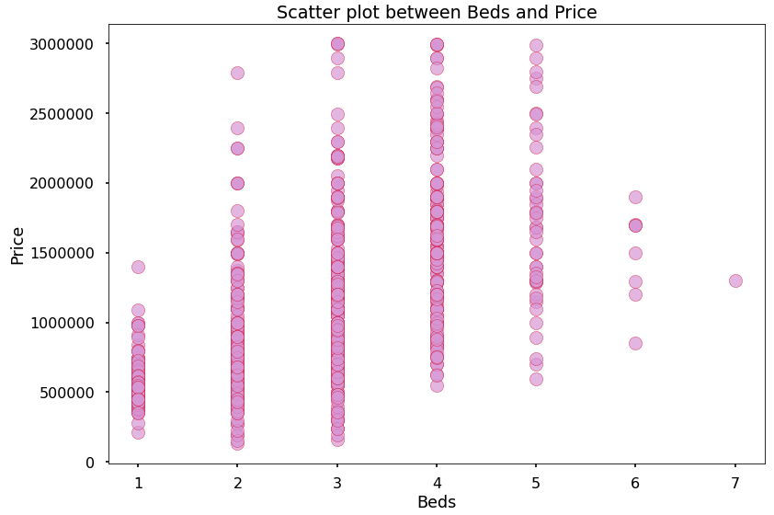
High Level Analysis
For a property having 2 beds and 2 baths,
A house costs an average
~ $ 1M
Townhouse and condo costs ~ $ 0.75M
High number of properties were found in Oakland & San Jose
High prices are observed for properties with beds between 3 to 5

Slide 8
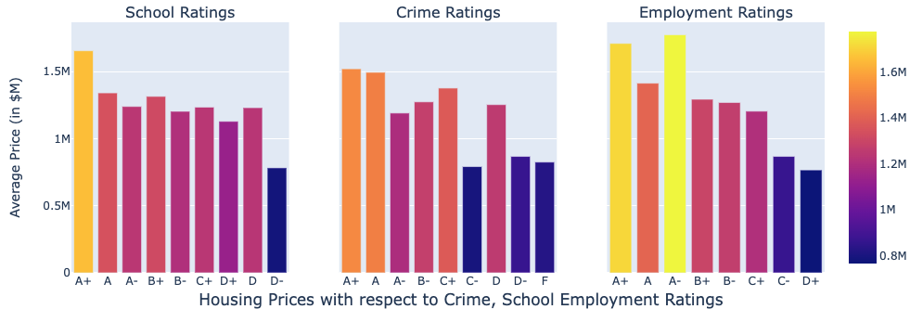
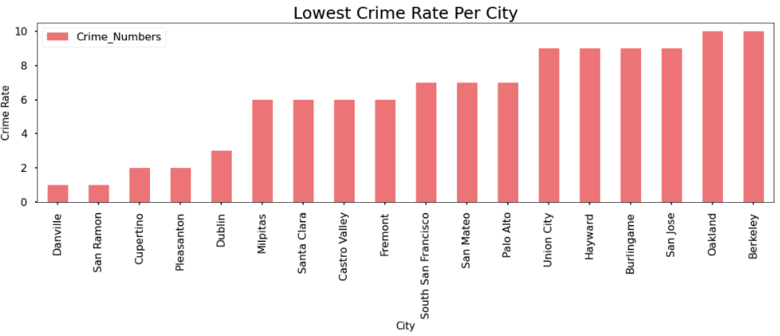
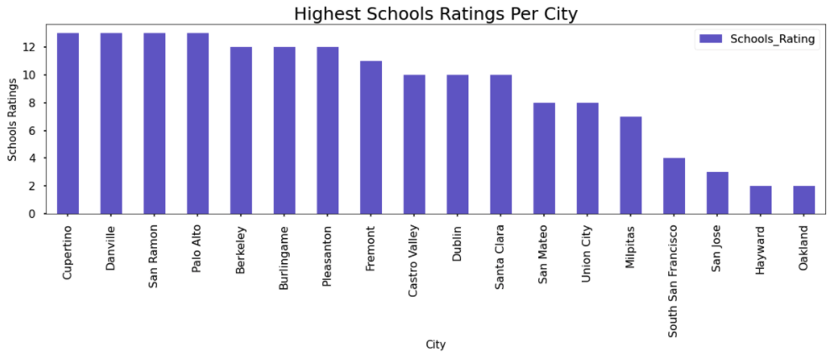
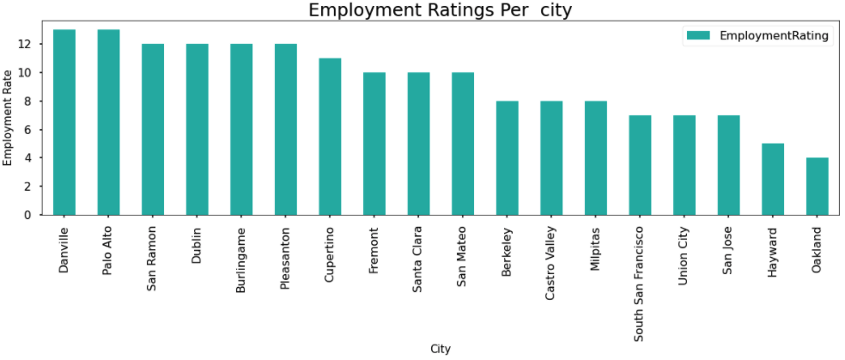
Vibes Across Cities
House prices are directly proportional to vibes of a city
Top Ratings | Areas
Schools | Cupertino, Danville, San Ramon, Palo Alto, Berkeley, Burlingame
Employment | Danville, San Ramon, Palo Alto, Burlingame, Dublin, Pleasanton
Safest | Danville, San Ramon, Cupertino, Pleasanton, Dublin

Slide 9
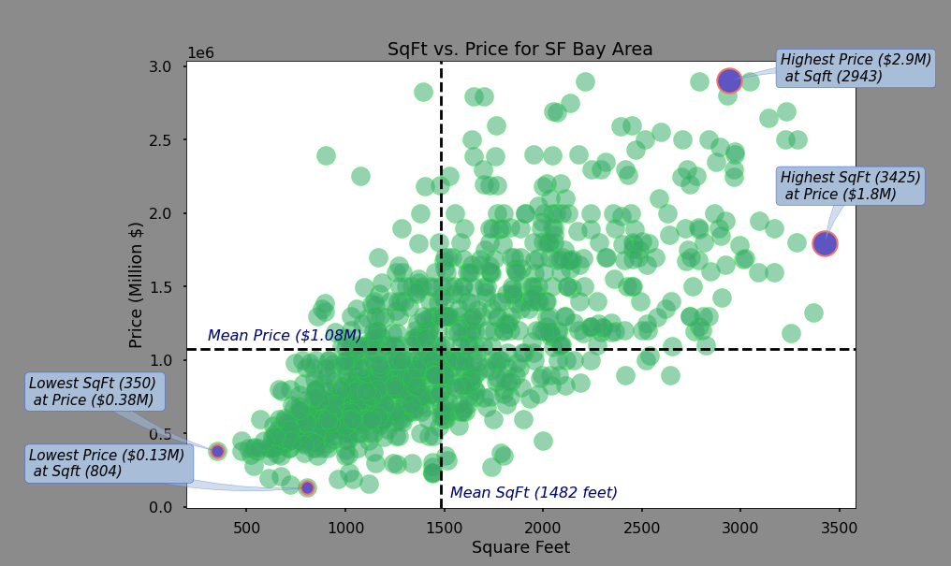
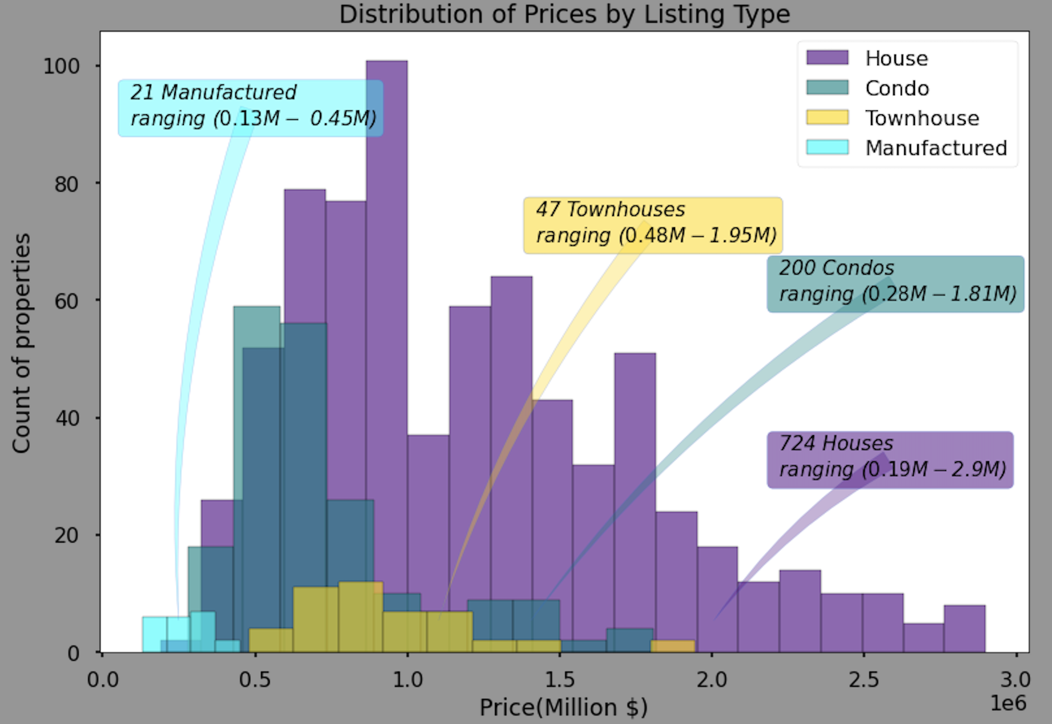
Curious Cases . . .
How much space do we get for the lowest price ?
What is the price of the smallest space?
What is the price range of different types of properties?

Slide 10
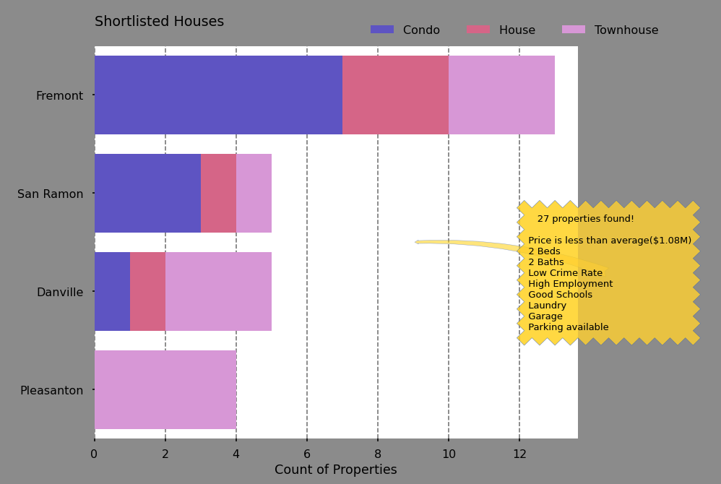
Curious Cases
Buyers on Homes.com are looking for . . .
The cities with:
Low crime rate
High employment
Good schools nearby
House price < average Price.
Customer needs minimum of
2 Beds
2 Baths
Parking
Garage
Laundry

Slide 11
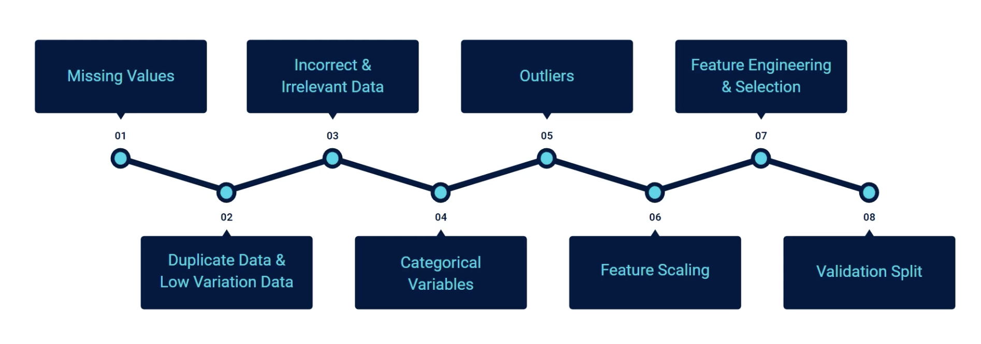

Build Model

Slide 12
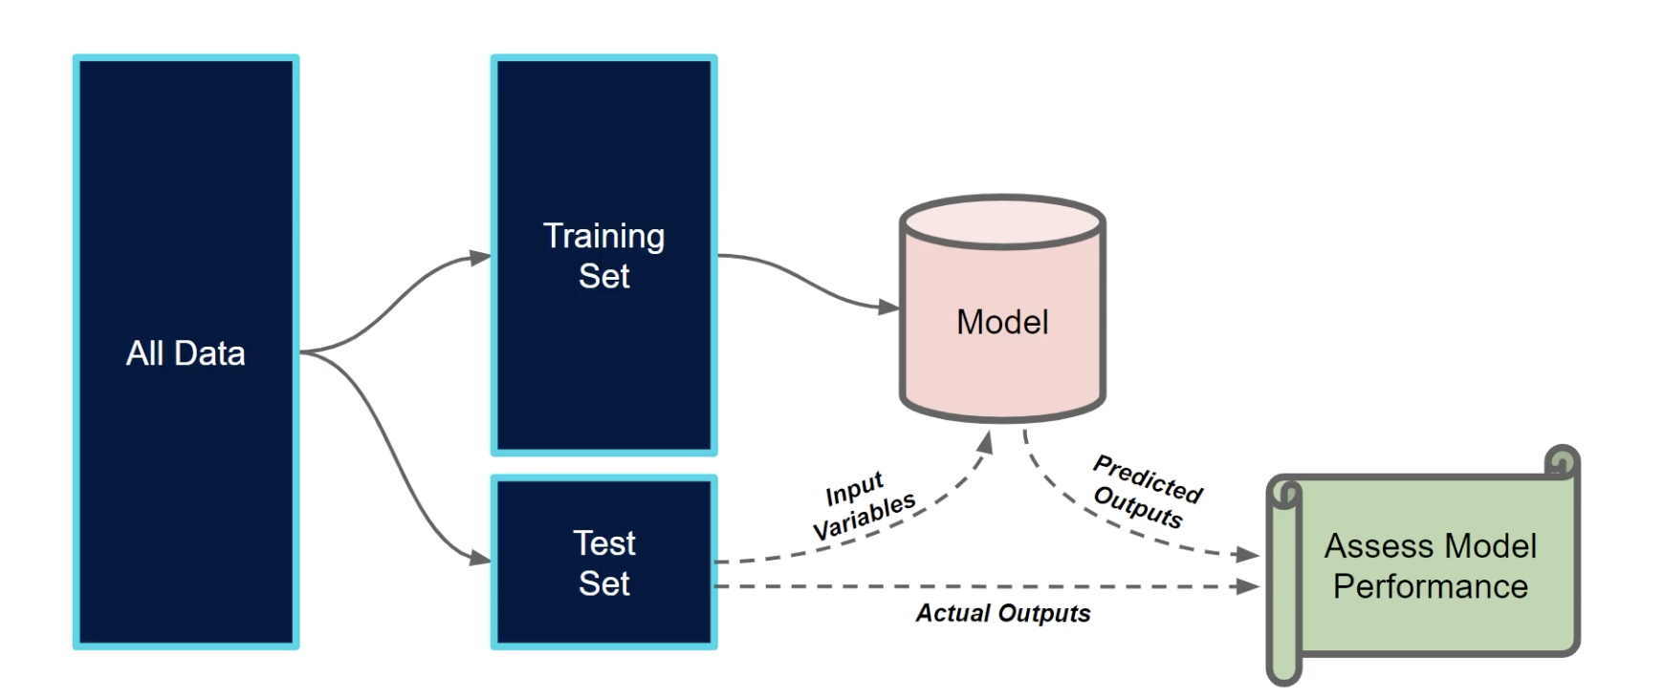
Model Validation

Slide 13
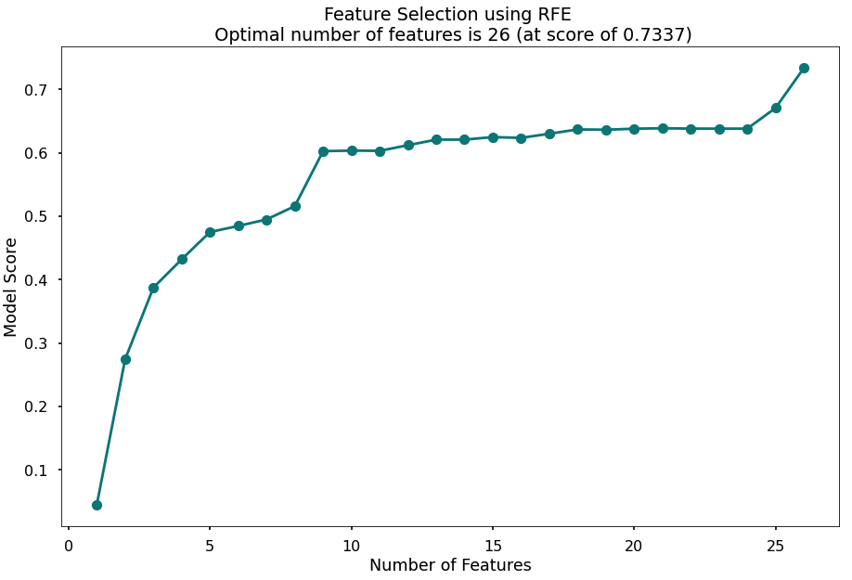
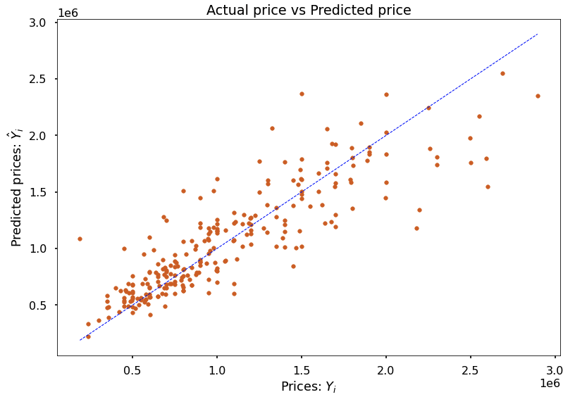
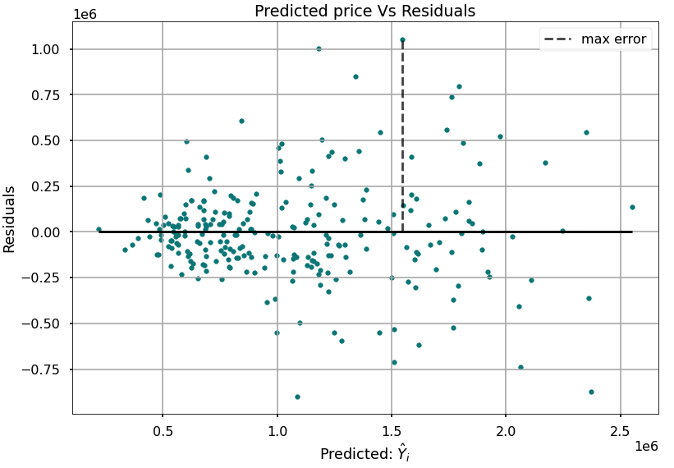
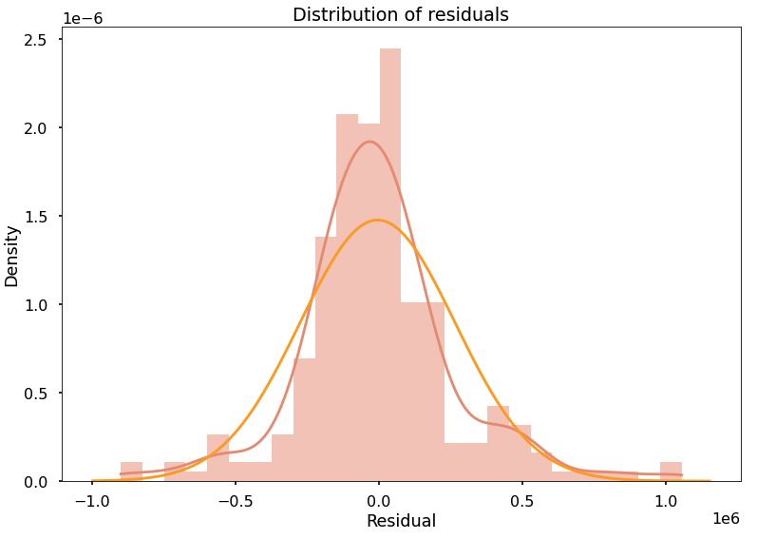
Model Analysis

Slide 14
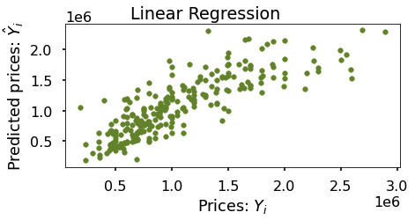
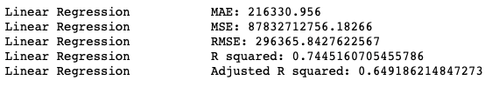
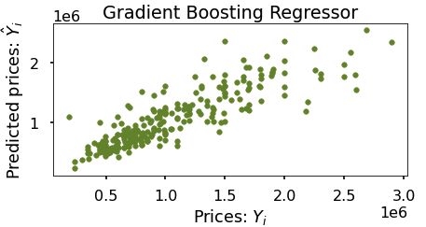

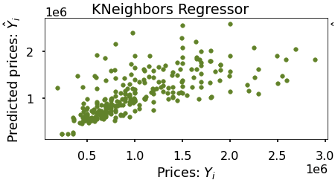

Model Selection

Slide 15
Thank you! Open for Questions . . .

