Slide 1
PREDICTIVE LL(1) PARSING
PRESENTED TO :-
PRATIK N. PATEL
PRESENTED BY :-
PATEL KHYATI (170050107079)
PATEL NIRMOHI (170050107084)

Slide 2
PARSING
The process of deriving the string from the given grammar is known as parsing (derivation).
Depending upon how parsing is done we have two types of parser :
Top Down Parser
→ Back Tracking
→ Predictive Parser
Bottom Up Parser
→ Shift – Reduce Parser
→ LR Parser

Slide 3
L L (1) PARSER
scanning the input from left to right
leftmost derivation
using only one input symbol at a time
scanning the input from left to right
leftmost derivation

Slide 4
Steps to convert LL(1) parser
Firstly check if the grammars contain -
      Left Recursion
      Left Factoring
Then go for –
    FIRST
    FOLLOW
    Predictive Parsing Table
    String (if given)

Slide 5
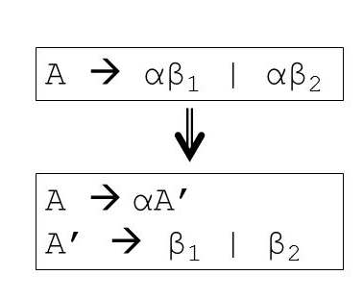
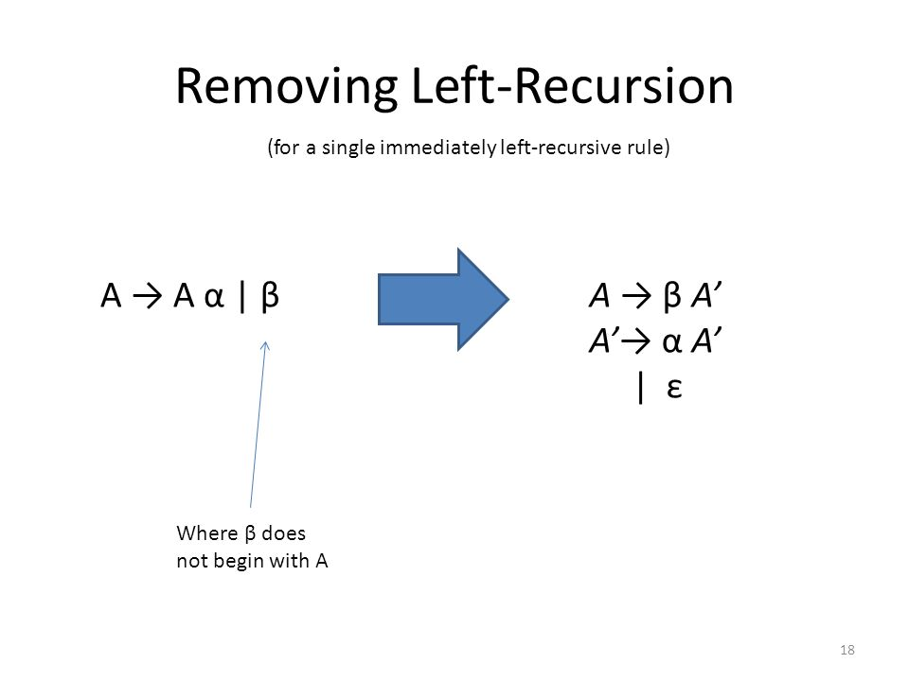
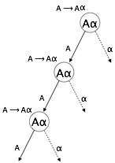
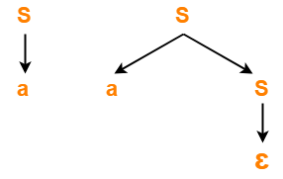
Left Recursion
Left Factoring

Slide 6

EXAMPLE
E → TA
A → +TA /
T → VB
B → *VB /
V → id / (E)
NOTE :- Here we can see that there is no left recursion or left factoring in this example so now we will find first() .

Slide 7
FIRST
FIRST is applied to the R.H.S. of a production rule :
If first symbol is terminal then put into first(non-terminal).
If non-terminal then go to that non-terminal production and continue above step.
If → directly then put in first(non-terminal).
→ indirectly then put & check again.

Slide 8
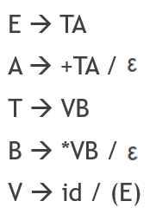
first (E) = { id , ( }
first (A) = { + , }
first (T) = { id , ( }
first (B) = { * , }
first (V) = { id , ( }

Slide 9
FOLLOW
For starting symbol put always $.
Find the non-terminal in R.H.S. whose follow has to be found in the grammar.
If its’s next element is
➔ terminal then put into follow(non-terminal).
➔ no terminal then copy follow(non-terminal) from which it is found.
ie. E → TE’ follow(E’)=follow(E)
➔ non-terminal then check the value of first(next)
-> if it is terminal then put into follow(non-terminal).
-> if then put back & check again.

Slide 10
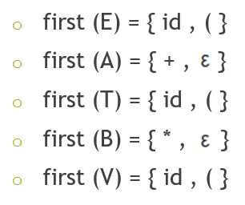
follow(E) = { $ , ) }
follow(A) = { $ , ) }
follow(T) = { + , $ , ) }
follow(B) = { + , $ , ) }
follow(V) = { * , + , $ , ) }

Slide 11
Predictive Parsing Table
Form a table whose
➔ row1 contain all terminal from grammar set including $ and excluding .
➔ column1 contains all non-terminals from grammar set.
For non-terminal ie. n1 (n1→A) , if A is -
➔ terminal then put that production in row(terminal),column(n1).
➔ non-terminal then check first(n1) & put production rule in that symbol.
➔ then check follow(n1) & put into that symbol.
If in any cell , we get two production then that grammar set will not be parsed by LL(1) grammar & so it should be solved by Recursive Decent Parsing.

Slide 12
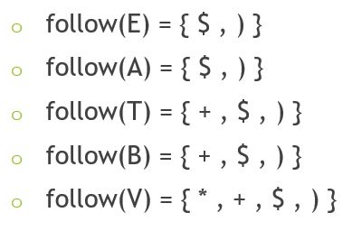
Symbol | id | ( | ) | + | * | $
E | E→TA | E→TA
A |  |  | A→ | A→+TA |  | A→
T | T→VB | T→VB
B |  |  | B→ | B→ | B→*VB | B→
V | V→id | V→(E)

Slide 13
Parse Input String
(optional)
Parse given string from left to right.
Start from $ and starting symbol.
Replace symbol with it’s production, from which we can form the given input string.
Also write the action which we performed in stack.
Continue till we are left with $ in stack and input.

Slide 14
String :- id * id
String :- id * id
Stack | Input | Action
$ E | id * id $
$ A T | id * id $ | E → TA
$ A B V | id * id $ | T → VB
$ A B id | id * id $ | V → id
$ A B | * id $ | POP
$ A B V * | * id $ | B → *VB
$ A B V | id $ | POP
$ A B id | id $ | V → id
$ A B | $ | POP
$ A | $ | B →
$ | $ | A →

Slide 15


