Slide 1
Scalable Real-time Detection of AI-Generated Arabic Text A Distributed Data Pipeline Approach
Course: MSBDA-801 Big Data Analytics
Project Type: Final Course Graduation Team Project
Technologies: PySpark, Spark MLlib, Structured Streaming
Presented By:
Sami Ruzeq M. Almoadawi
4714252
Supervisor:
DR. Mohammed Al-sarem

Slide 2
Problem Statement
Rapid growth of AI-generated Arabic text.
Challenges in detecting machine-generated content.
Risks related to:
Academic integrity
Misinformation
Automated content generation
Plagiarism

Slide 3
Problem Statement
Objective
Develop a scalable distributed pipeline capable of detecting AI-generated Arabic abstracts using Big Data technologies.

Slide 4
Project Objectives
Build distributed Arabic NLP pipeline.
Perform Arabic-specific preprocessing.
Implement scalable feature engineering.
Train multiple machine learning models.
Deploy best model using Spark Structured Streaming.
Compare batch vs stream processing.
Benchmark scalability and performance.

Slide 5
Dataset Description
Source
KFUPM-JRCAI Arabic Generated Abstracts Dataset (Hugging Face)
Dataset Size
Total subsets: 3
Final combined samples: ~41,940

Slide 6
Dataset Description
Data Classes
Human-written abstracts
AI-generated abstracts
AI Models Included
OpenAI
JAIS
LLaMA
ALLAM

Slide 7
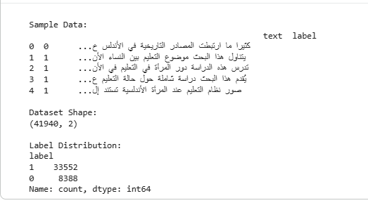
Dataset Description

Slide 8
Big Data Architecture
Distributed Pipeline Architecture
Technologies Used
Google Colab
Apache Spark
PySpark
Spark MLlib
Spark Structured Streaming

Slide 9
Big Data Architecture
Pipeline Stages
Data Acquisition
Preprocessing
Feature Engineering
Distributed Modeling
Streaming Deployment
Evaluation & Benchmarking

Slide 10
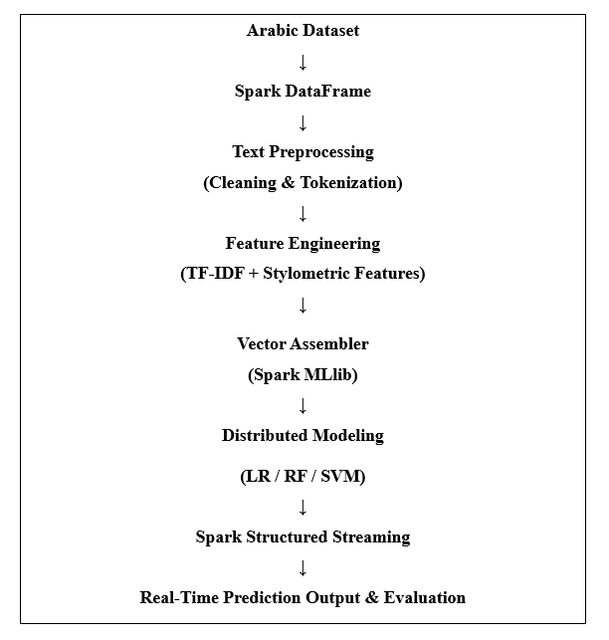
Big Data Architecture

Slide 11
Arabic Text Preprocessing
Arabic NLP Preprocessing
Applied Techniques
Arabic normalization
Diacritics removal
Stopword removal
Basic stemming
Special character cleaning

Slide 12
Arabic Text Preprocessing
Distributed Processing
Implemented using Spark DataFrames and UDFs.

Slide 13
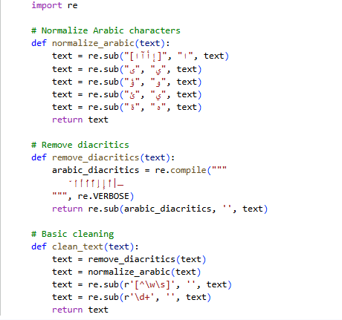
Arabic Text Preprocessing

Slide 14
Exploratory Data Analysis
Exploratory Data Analysis
Performed Analysis
Word frequency analysis
N-gram frequency analysis
Vocabulary richness (TTR)
Corpus statistics

Slide 15
Exploratory Data Analysis
Results
Total Words: 3,937,653
Unique Words: 23,130
TTR: 0.00587

Slide 16
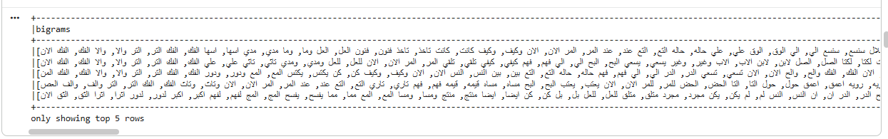
Exploratory Data Analysis
.

Slide 17
Feature Engineering
Feature Engineering
Stylometric Features
Feature 6 → Multiple elongations
Feature 29 → Semicolon frequency
Feature 52 → Arabic interjections
Feature 75 → Active voice approximation
Feature 98 → Simplified BERT representation

Slide 18
Feature Engineering
Advanced Feature
TF-IDF representation
Final Feature Vector
10,000 TF-IDF features
5 stylometric features
Total = 10,005 features

Slide 19
Machine Learning Models
Distributed Machine Learning Models
Models Implemented
Logistic Regression
Random Forest
Support Vector Machine (SVM)

Slide 20
Machine Learning Models
Dataset Split
Training = 70%
Validation = 15%
Testing = 15%
Spark MLlib
Models implemented using Spark MLlib distributed framework.

Slide 21
Model Performance Results
Performance Evaluation
Model | Accuracy | F1-score | ROC-AUC
Logistic Regression | 0.965 | 0.966 | 0.982
Random Forest | 0.801 | 0.714 | 0.946
SVM | 0.973 | 0.973 | 0.991

Slide 22
Model Performance Results
Best Model
Support Vector Machine (SVM)

Slide 23
Confusion Matrix Analysis
Confusion Matrix Analysis
Observations
SVM produced lowest false positives.
Logistic Regression also performed strongly.
Random Forest underperformed on sparse TF-IDF vectors.

Slide 24
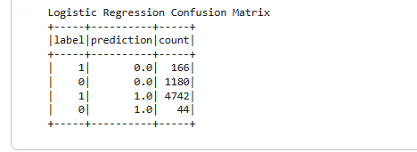
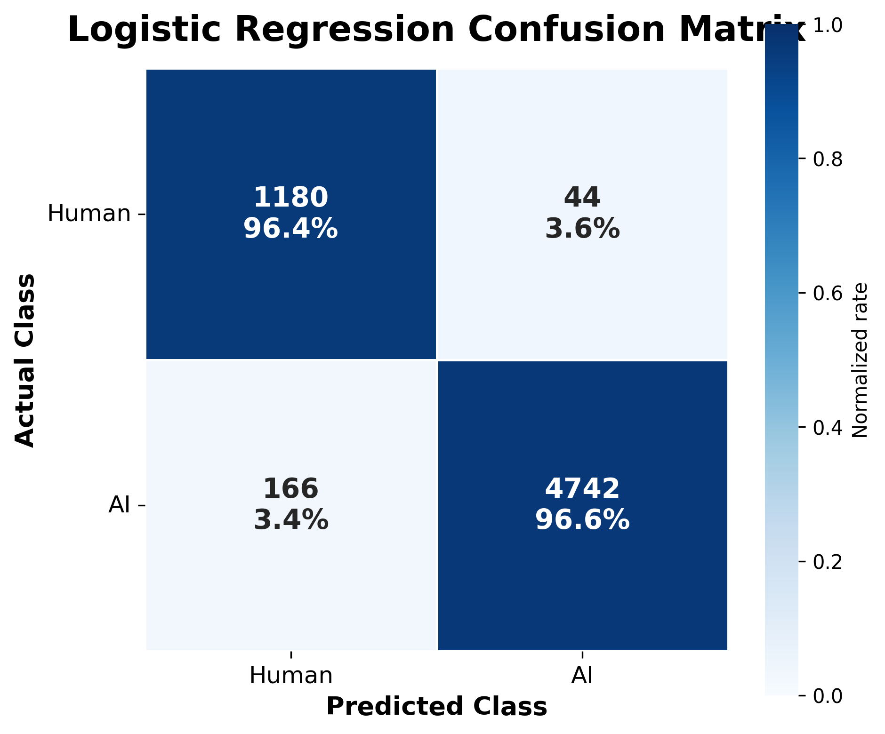
Confusion Matrix Analysis

Slide 25
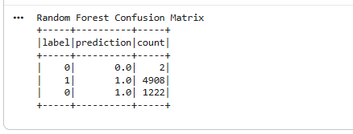
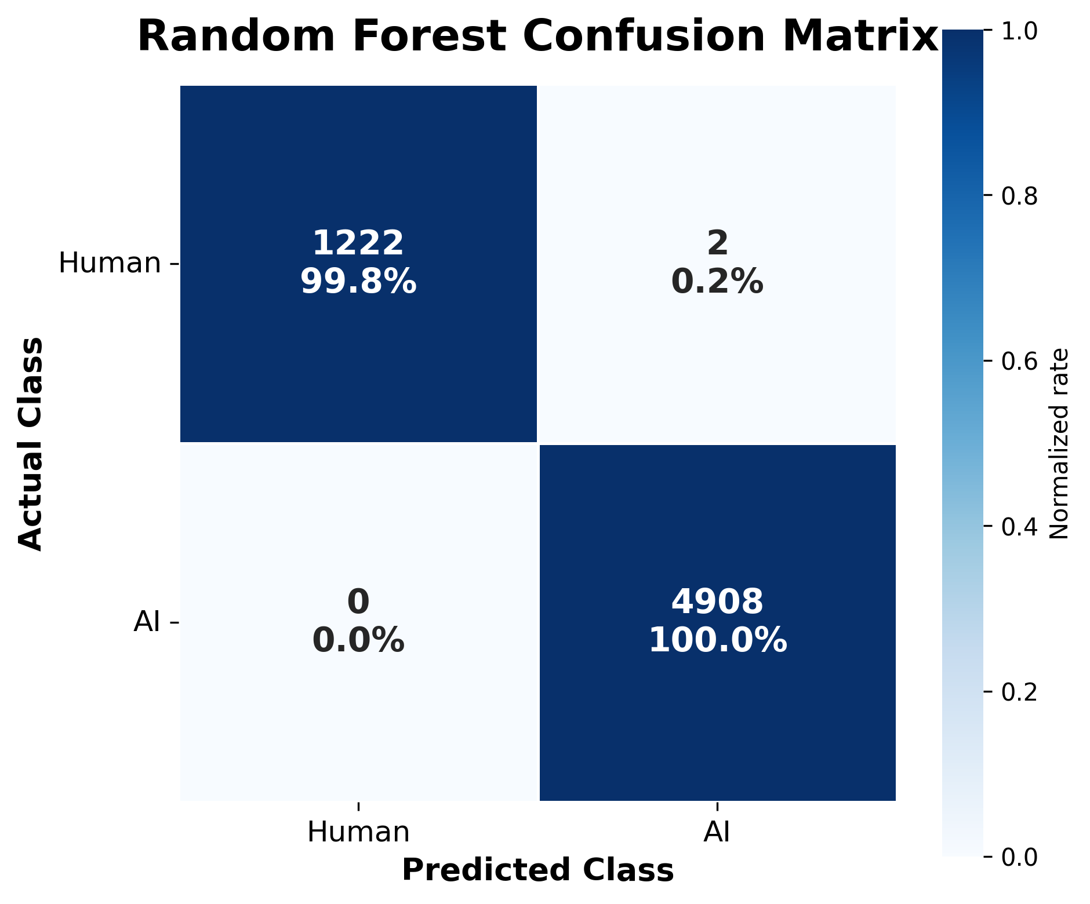
Confusion Matrix Analysis

Slide 26
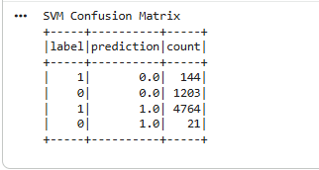
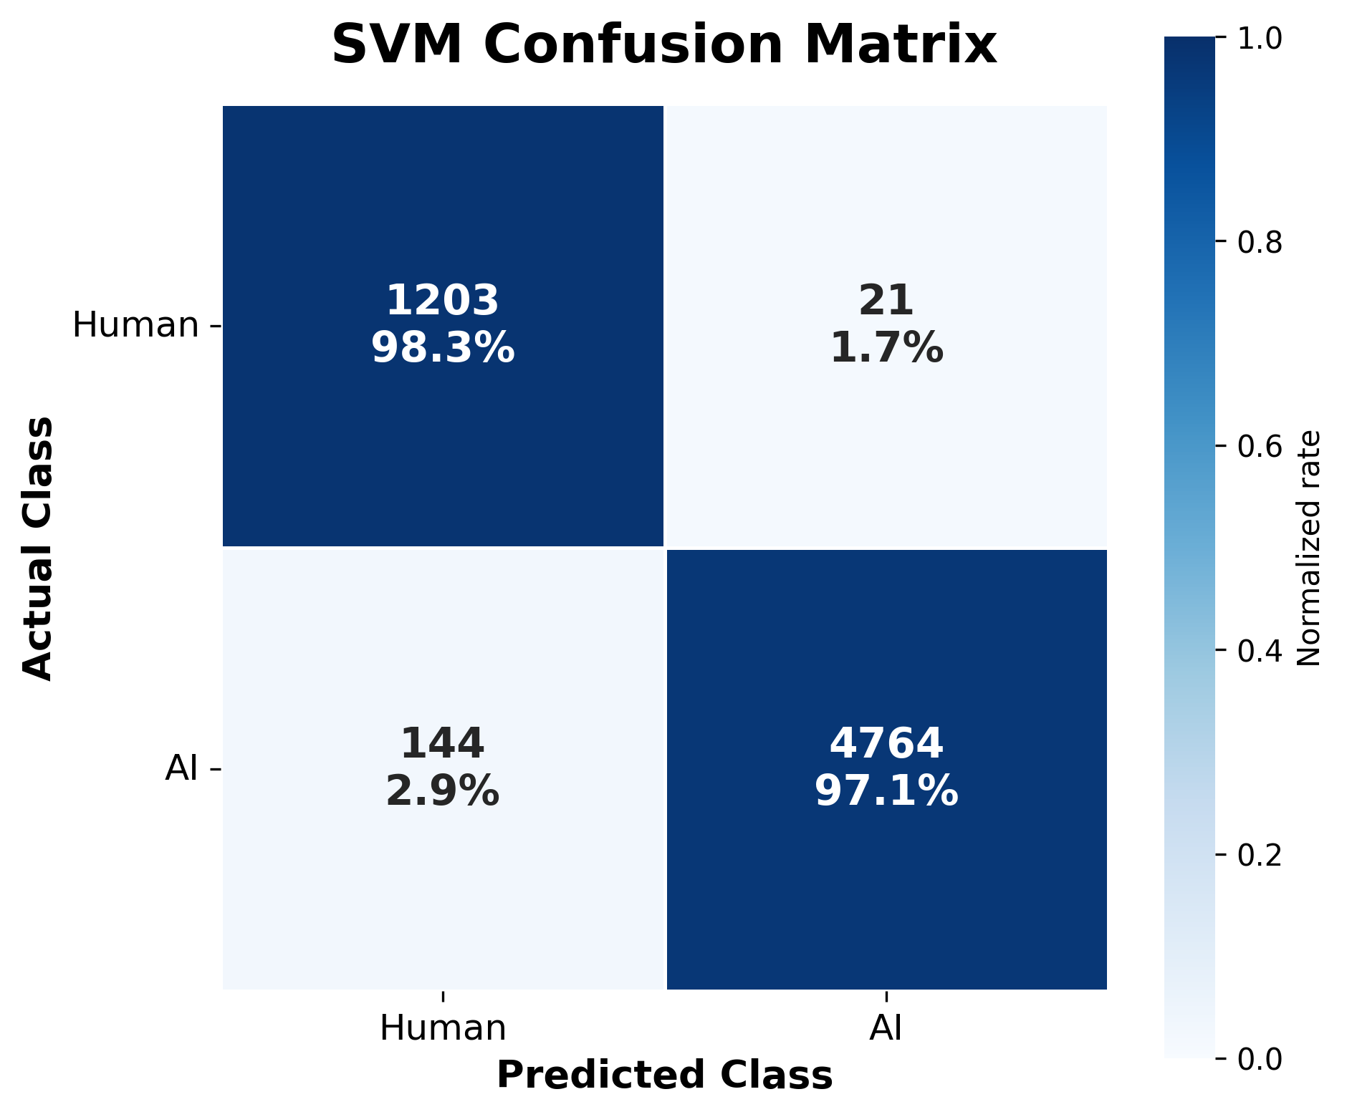
Confusion Matrix Analysis

Slide 27
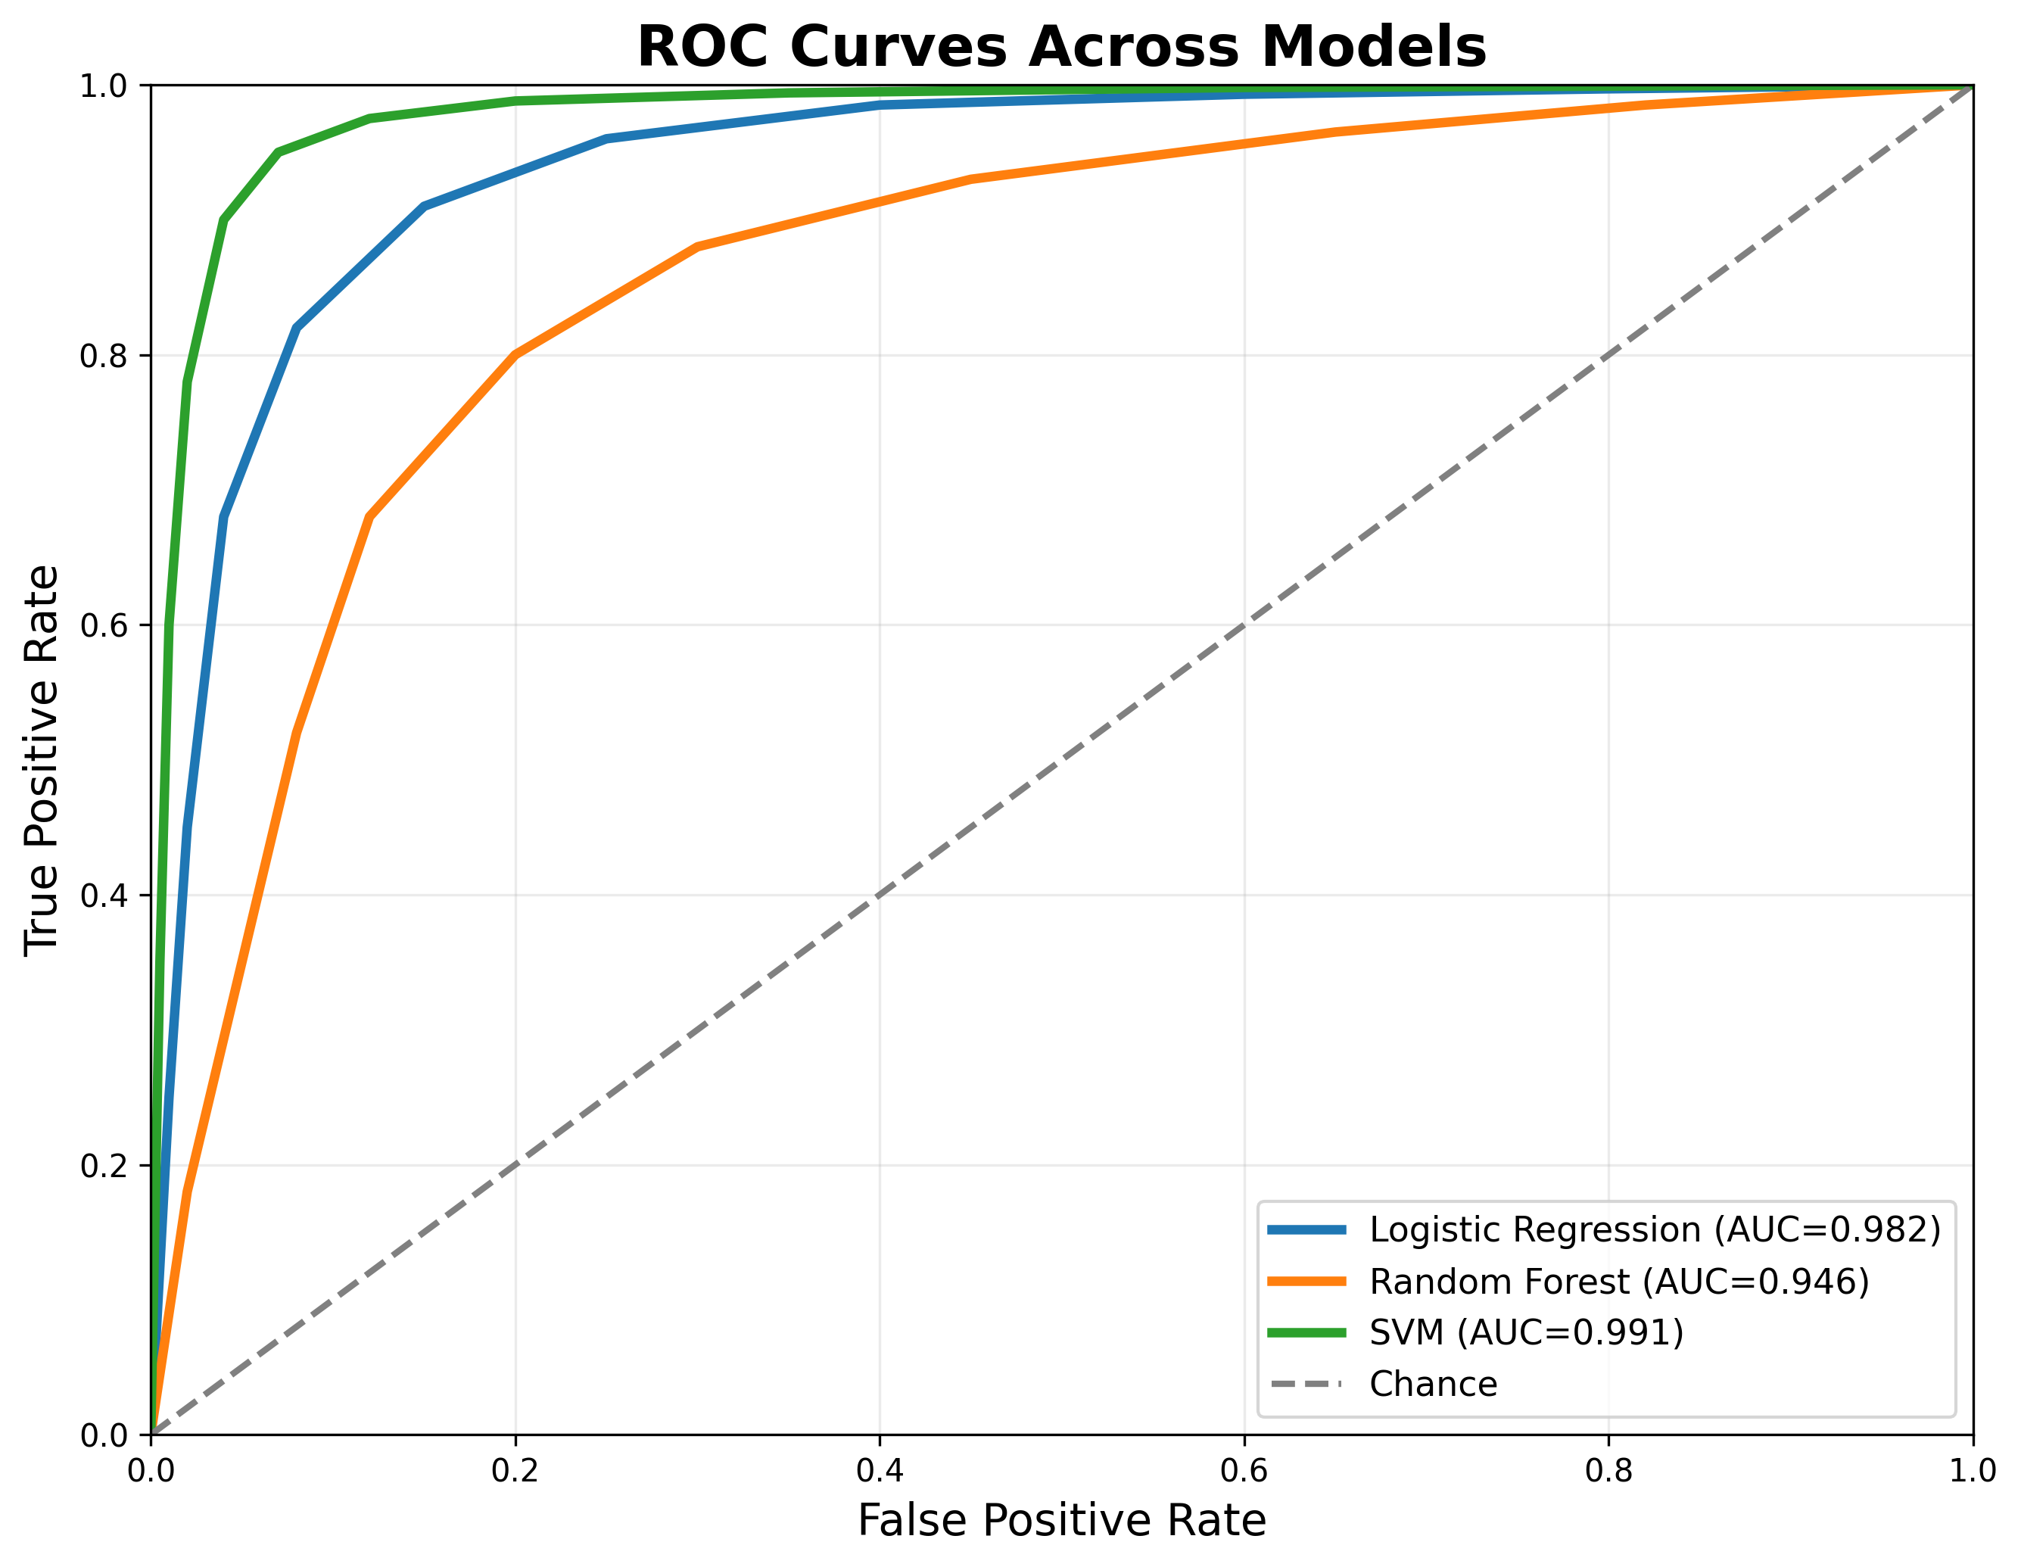
ROC curve

Slide 28
Real-Time Streaming Pipeline
Spark Structured Streaming
Stream Simulation
File-based streaming source.
Real-time Arabic text ingestion.
Real-Time Deployment
SVM model deployed for live prediction.
Spark Structured Streaming pipeline implemented.

Slide 29
Scalability & Batch vs Stream Comparison
Scalability Analysis
Batch Processing
High throughput for large datasets.
Batch prediction time ≈ 32 seconds.
Stream Processing
Near real-time prediction.
Micro-batch latency observed.

Slide 30
Scalability & Batch vs Stream Comparison
Comparison
Batch Processing | Stream Processing
Offline analytics | Real-time analytics
Higher throughput | Lower latency
Large-scale execution | Continuous prediction

Slide 31
Feature Importance Analysis
Feature Importance
Logistic Regression Coefficients
Feature coefficients extracted.
Positive coefficients linked with AI-generated text.
Negative coefficients linked with human-written text

Slide 32
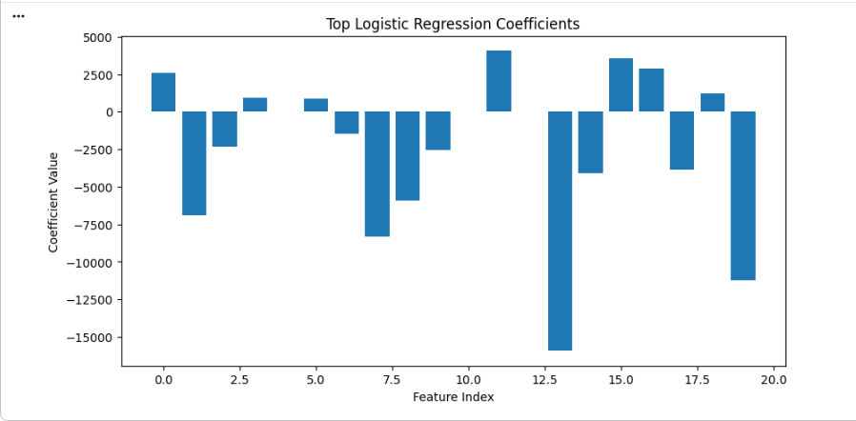
Feature Importance Analysis

Slide 33
Challenges & Limitations
Challenges & Limitations
Challenges
Arabic NLP complexity
Sparse high-dimensional vectors
Streaming environment setup
Distributed processing overhead

Slide 34
Challenges & Limitations
Limitations
Simplified BERT approximation
File-based streaming instead of Kafka cluster
Limited advanced Arabic parsing

Slide 35
Conclusion
Successfully developed scalable Arabic AI-text detection pipeline.
Integrated distributed preprocessing and machine learning.
Implemented Spark Structured Streaming.
SVM achieved best overall performance.

Slide 36
Conclusion
Final Best Results
Accuracy = 97.3%
F1-score = 97.3%
ROC-AUC = 99.1%

Slide 37
Future Work
Apache Kafka integration
Full transformer embeddings
Deep learning architectures
Real distributed cluster deployment
Advanced Arabic morphological analysis

Slide 38
References
Apache Spark Documentation. https://spark.apache.org/docs/latest/
Bird, S., Klein, E., & Loper, E. (2009). Natural language processing with Python: analyzing text with the natural language toolkit. " O'Reilly Media, Inc.".
Breiman, L. (2001). Random forests. Machine learning, 45(1), 5-32.
Cortes, C., & Vapnik, V. (1995). Support-vector networks. Machine learning, 20(3), 273-297.
Dean, J., & Ghemawat, S. (2008). MapReduce: simplified data processing on large clusters. Communications of the ACM, 51(1), 107-113.
Devlin, J., Chang, M. W., Lee, K., & Toutanova, K. (2019, June). Bert: Pre-training of deep bidirectional transformers for language understanding. In Proceedings of the 2019 conference of the North American chapter of the association for computational linguistics: human language technologies, volume 1 (long and short papers) (pp. 4171-4186).
Hugging Face Datasets Documentation. https://huggingface.co/docs/datasets/
Jurafsky, D., & Martin, J. H. (2023). Speech and language processing. 3rd edn. draft.

Slide 39
References
KFUPM-JRCAI Arabic Generated Abstracts Dataset. https://huggingface.co/datasets/KFUPM-JRCAI/arabic-generated-abstracts
Manning, C. D. (2008). Introduction to information retrieval. Syngress Publishing.
Mikolov, T., Chen, K., Corrado, G., & Dean, J. (2013). Efficient estimation of word representations in vector space. arXiv preprint arXiv:1301.3781.
Pedregosa, F., Varoquaux, G., Gramfort, A., Michel, V., Thirion, B., Grisel, O., ... & Duchesnay, É. (2011). Scikit-learn: Machine learning in Python. the Journal of machine Learning research, 12, 2825-2830.
Salloum, S., Dautov, R., Chen, X., Peng, P. X., & Huang, J. Z. (2016). Big data analytics on Apache Spark. International Journal of Data Science and Analytics, 1(3), 145-164.
Salton, G., & Buckley, C. (1988). Term-weighting approaches in automatic text retrieval. Information processing & management, 24(5), 513-523.
Zaharia, M., Chowdhury, M., Franklin, M. J., Shenker, S., & Stoica, I. (2010). Spark: Cluster computing with working sets. In 2nd USENIX workshop on hot topics in cloud computing (HotCloud 10).

Slide 40
Thank You
Questions & Discussion

