Slide 1
Electric Vehicle (EV) Ownership Distribution in Australia
By
Bradley Fisher
Michelle Harris
Priyanshu Rana
Rhea Pius

Slide 2
Types of Vehicles
Internal Combustion (ICE)
Hybrid
Electric (Battery)
Hydrogen Cell

Slide 3
What We Wanted To Know
What proportion of the Australian market is EV?
What is the trend for EV ownership for the 3 years up to 31 Jan 2023? How does EV ownership trend compare to ICE ownership trend?
What geographical location has the greatest ownership?
What is the demographic for those that own EV?

Slide 4
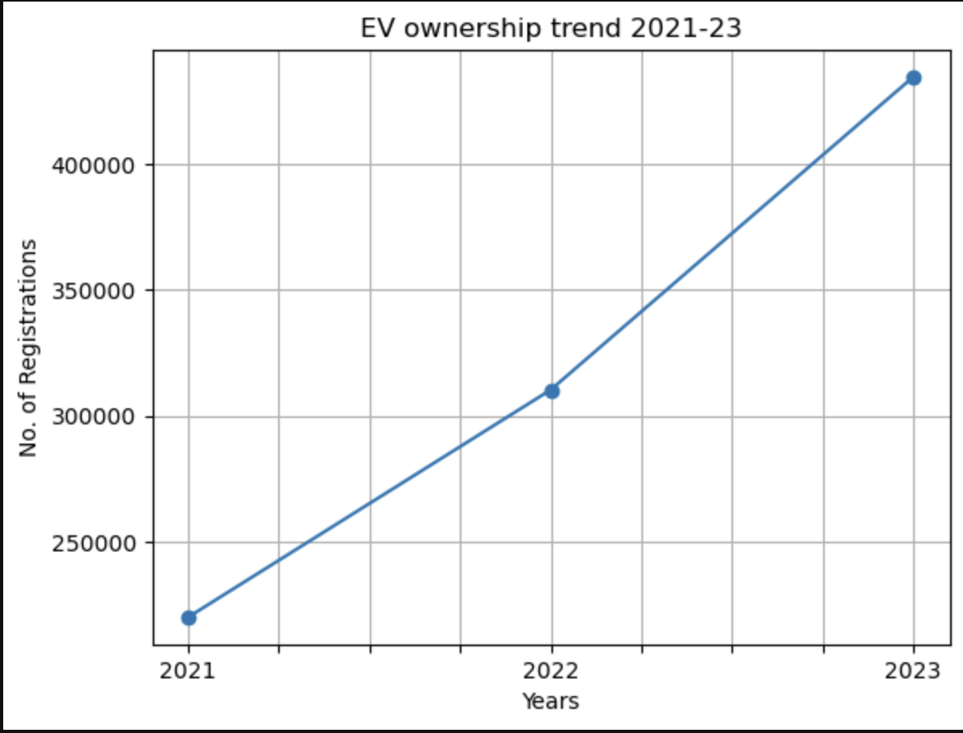

Slide 5
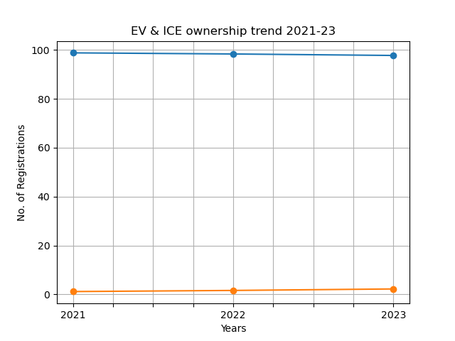

Slide 6
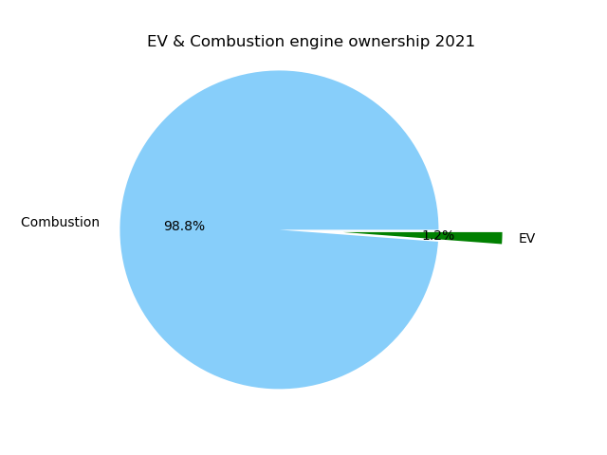
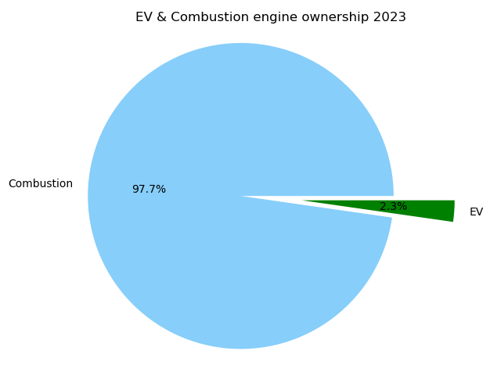

Slide 7
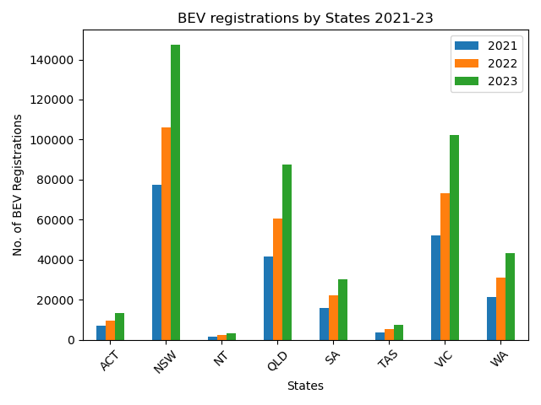
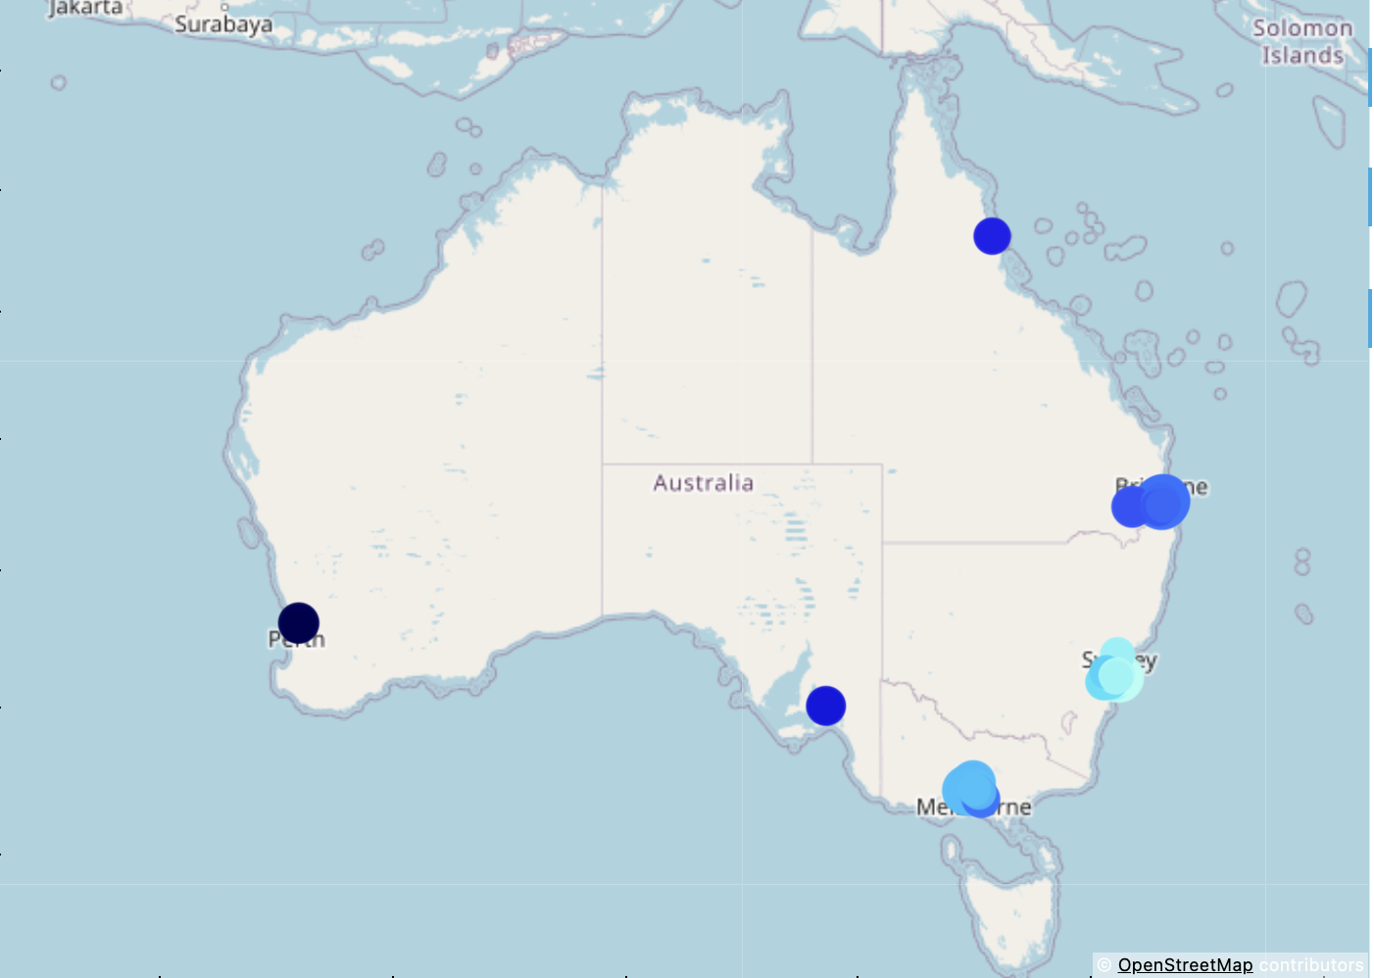

Slide 8
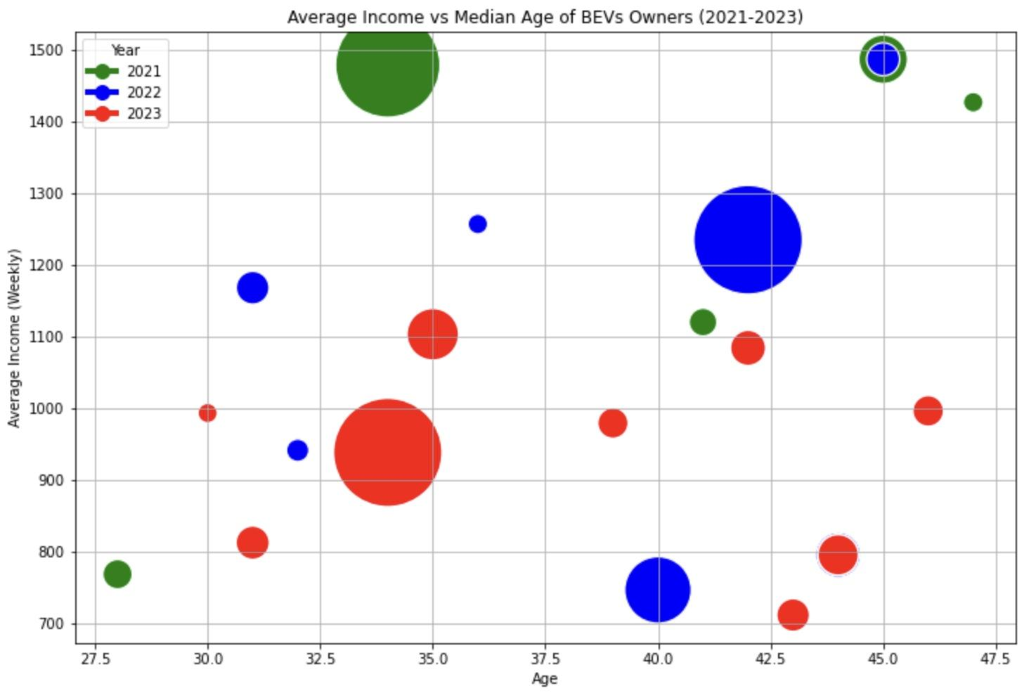

Slide 9
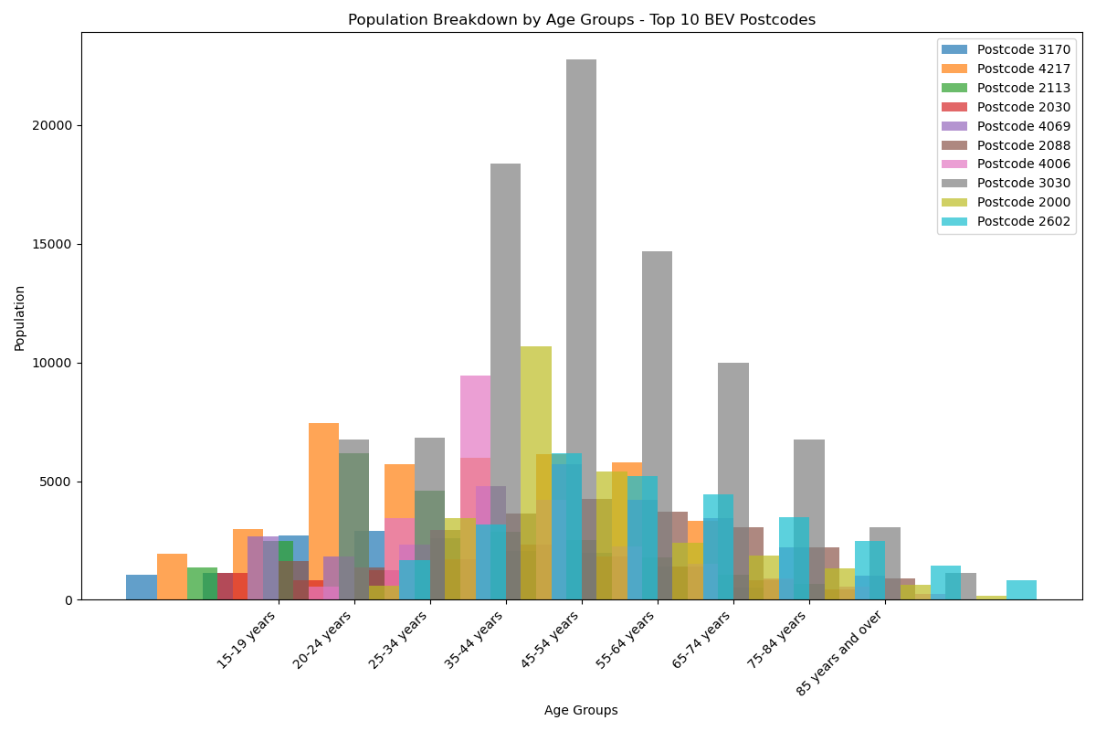
Notes:
The suburb/postcode with the most EV registrations (Mulgrave, Vic) has a population of 20,218 with a median age of 39

Slide 10
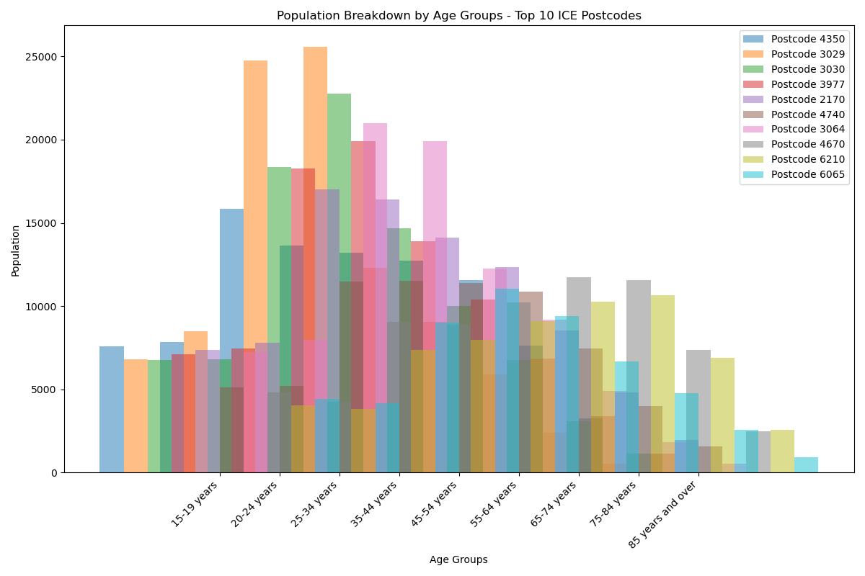
Notes:
The suburb/postcode with the most Internal Combustion Engine registrations (Toowoomba, Qld) has a population of 134,037 with a median age of 39

Slide 11
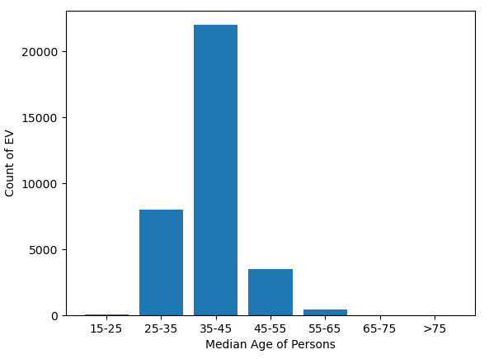
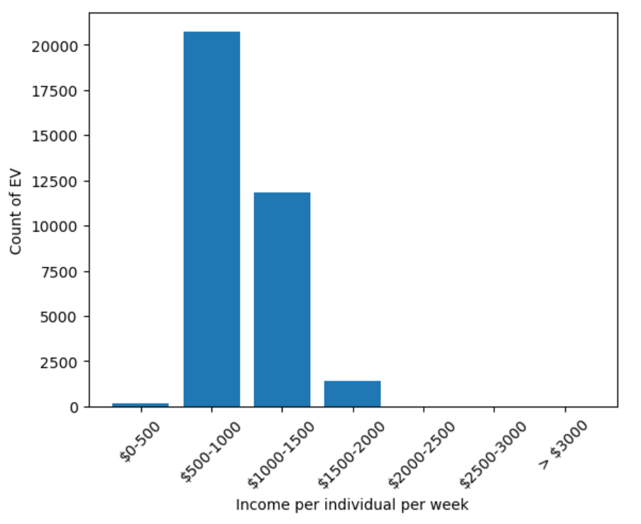

Slide 12
References
Australian Automobile Association. (2023, January 31). Electric Vehicle Index. Retrieved from Australian Automobile Association: Data Reports: https://data.aaa.asn.au/ev-index/
Australian Bureau of Statistics. (2021). Find Census data. Retrieved from Australian Bureau of Statistics: https://www.abs.gov.au/census/find-census-data
Toyota. (n.d.). Toyota Hybrids. Retrieved from Toyota Australia: https://www.toyota.com.au/electrified/hybrid
U.S. Department of Energy. (n.d.). Alternative Fuels Data Center: How Do All-Electric Cars Work? Retrieved from U.S. Department of Energy: Energy Efficiency & Renewable Energy: https://afdc.energy.gov/vehicles/how-do-all-electric-cars-work
https://explore.data.abs.gov.au/vis?tm=personal%20income&pg=0&df[ds]=C21_POA&df[id]=C21_G17_POA&df[ag]=ABS&df[vs]=1.0.0, accessed 04 January 2024
Australian Postcodes a free and downloadable file of Australian Postcodes and their Lat, Lon https://www.matthewproctor.com/australian_postcodes - Free to use, donation to charity or contribution to dataset is encouraged

Slide 13
Questions?

