Slide 1


Slide 2
CRIMES IN INDIA
.An action or omission which constitutes an offence and is punishable by law.
'an offence which goes beyond the personal and into the public sphere, breaking prohibitory rules or laws, to which legitimate punishments or sanctions are attached, and which requires the intervention of a public authority. '

Slide 3
FACTORS AFFECTING CRIME
Poverty
Drugs
Peer Pressure
Politics
Family Conditions
Unemployment
Deprivation
Unfair judicial system
Religion

Slide 4
ASSIGNMENT QUESTION
What is the major reason people being kidnapped in each and every state?
Offenders relation to the rape victim
Juveniles family background, education and economic setup.
Which state has more crime against children and women?
Age group wise murder victim
Crime by place of occurrence.
Anti corruption cases vs arrests.
Which state has more number of complaints against police?
Which state is the safest for foreigners?

Slide 5
1.What is the major reason people being kidnapped in each and every state?
ANS. SELECT * from(select Area_Name,Group_Name,sum(Cases_Reported) as total_case from Specific_purpose_of_kidnapping_and_abduction GROUP by Area_Name, Group_Name order by sum(Cases_Reported) DESC) group by Area_Name order by total_case desc;

Slide 6
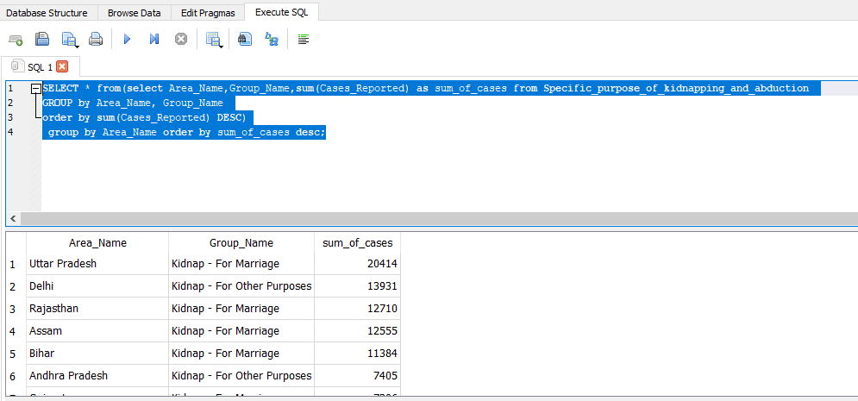
RESULT

Slide 7
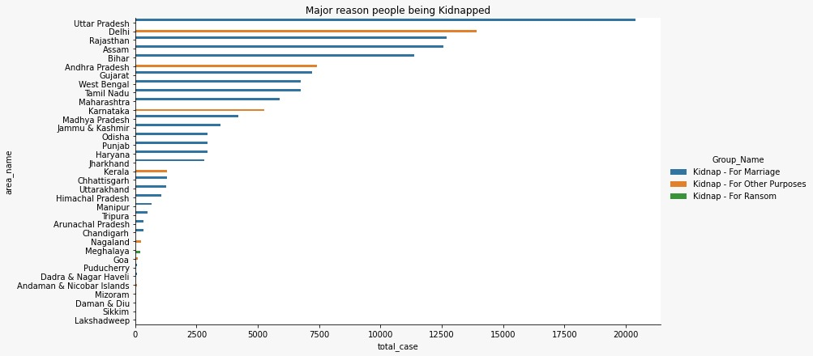
visualization
Conclusion:
1.We can see by this graph ,highest numbers case of kidnapping in Uttar Pradesh.

Slide 8
2.Offenders relation to the rape victim?
ANSWER-SELECT sum(No_of_Cases_in_which_offenders_were_Neighbours) as Neighbour,sum(No_of_Cases_in_which_offenders_were_Other_Known_persons) as known,sum(No_of_Cases_in_which_offenders_were_Parentsclose_family_members) as Parentsclose_family_members ,sum(No_of_Cases_in_which_offenders_were_Relatives) as offenders_were_Relatives,sum(No_of_Cases_in_which_offenders_were_known_to_the_Victims) as known_to_the_Victims from Offenders_known_to_the_victim

Slide 9
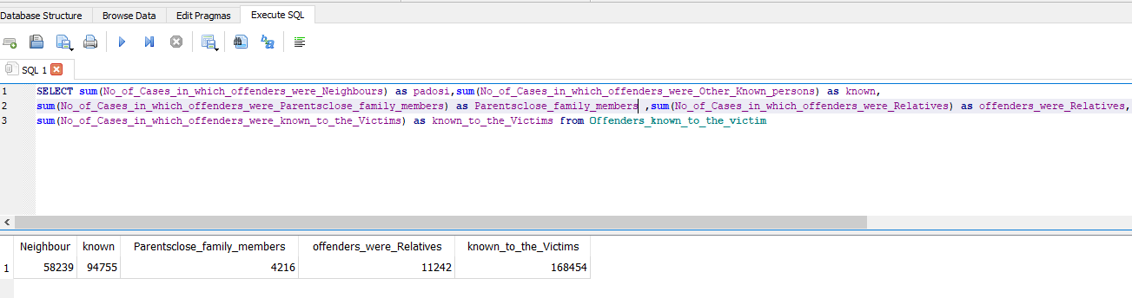
RESULT

Slide 10
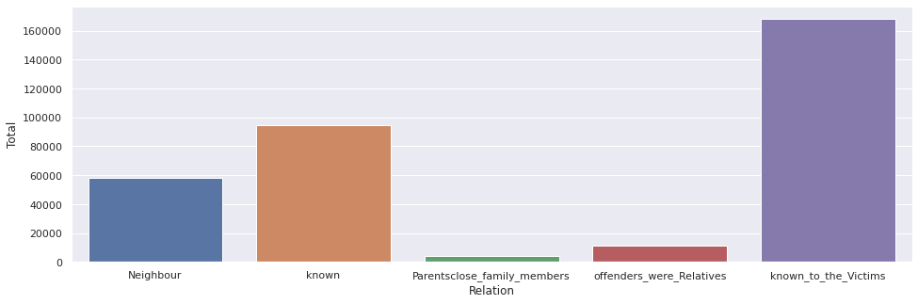
VISUALIZATION
CONCLUSION
As per the above observation most number of offenders were known to victims with number as high as 168454 and in the second place comes the neighbours.

Slide 11
3.Juveniles family background, education and economic setup
SELECT d.Area_Name , e.income_upto_25k , e.income_25k_50k , e.income_50k_1L ,e.income_1L_2L , e.income_2L_3l , e.income_above_3L , f.homless , f.living_wd_guardians , f.living_wd_parents , d.illetrate , d.upto_Primary , d.below_higerSecondary , d.higher_secondary_above
FROM (SELECT sum(Family_back_ground_Homeless) as homless,
sum(Family_back_ground_Living_with_guardian) as living_wd_guardians,
sum(Family_back_ground_Living_with_parents) as living_wd_parents ,
Area_Name
FROM EBJuveniles_arrested_Family_background
GROUP BY Area Name ) as f
join
(SELECT
sum(Economic_Set_up_Annual_Income_250001_to_50000) as income_25k_50k,
sum(Economic_Set_up_Annual_Income_upto_Rs_25000) as income_upto_25k,
sum(Economic_Set_up_Middle_income_from_100001_to_200000) as income_1L_2L,
sum(Economic_Set_up_Middle_income_from_50001_to_100000) as income_50k_1L ,
sum(Economic_Set_up_Upper_income_above_Rs_300000)as income_above_3L,
sum(Economic_Set_up_Upper_middle_income_from_200001_to_300000)as income_2L_3l,

Slide 12
Area_Name
FROM ESJuveniles_arrested_Economic_setup
GROUP BY Area_Name ) as e
ON
f.Area_Name = e.Area_Name
JOIN
(SELECT sum(Education_Illiterate) as illetrate ,
sum(Education_Upto_primary) as upto_Primary,
sum(Education_Above_Primary_but_below_Matric_or_y) as below_higerSecondary,
sum('Education_Matric_or_Higher_Secondary_&_above') as higher_secondary_above,
Area_Name
FROM EJuveniles_arrested_Education
GROUP BY Area_Name
) as d
ON
e.Area_Name = d.Area_Name

Slide 13
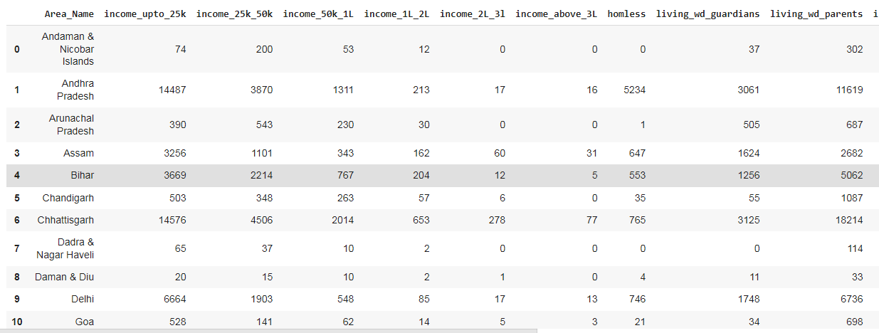

Slide 14
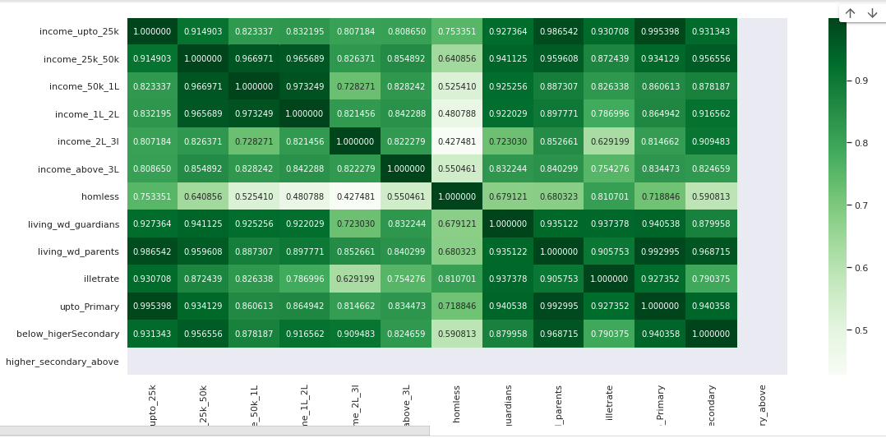
Heatmap

Slide 15
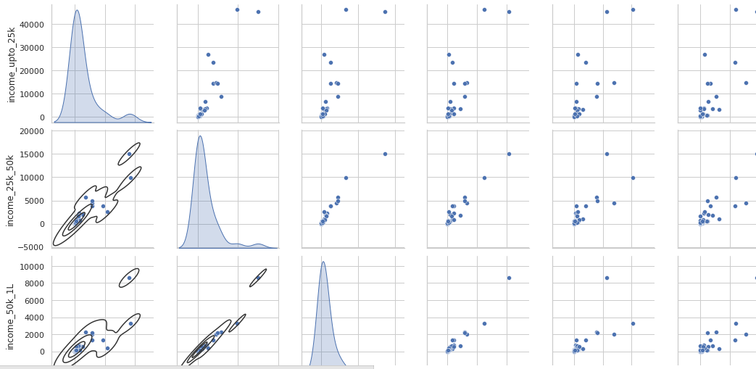
Kde with respect to income

Slide 16
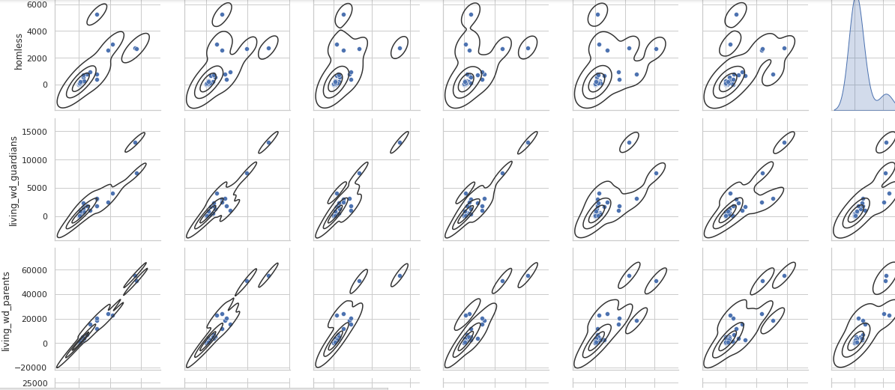
Kde with respect to shelter

Slide 17
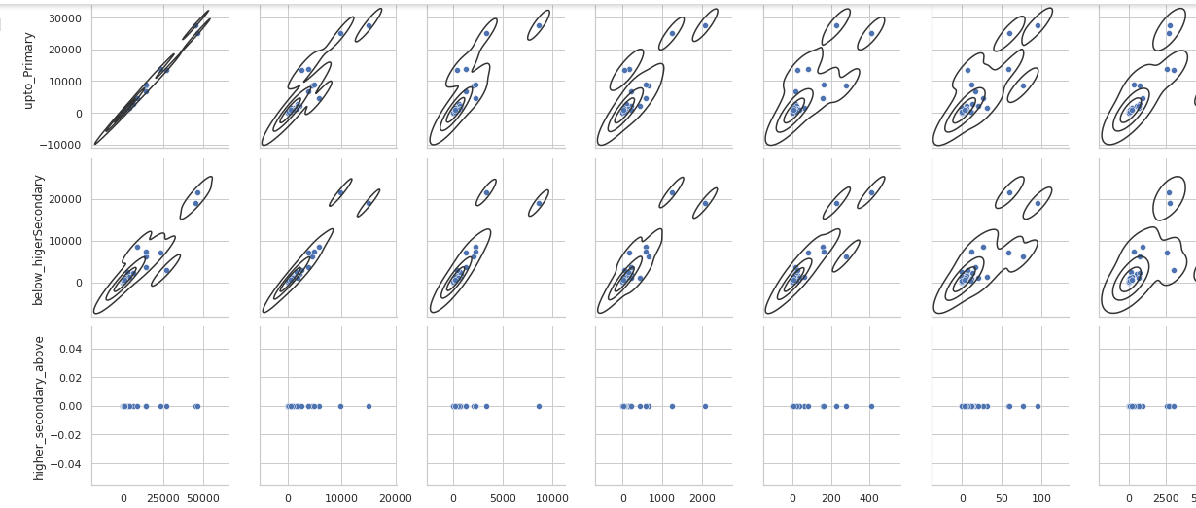
Kde with respect to education

Slide 18
4.Which state has more crime against children and women?
ANSWER - SELECT c.STATE_UT,(w.total_crime_on_women+c.total_crime_on_children) as Total_Crime from(SELECT STATE_UT,(sum(rape)+sum(KidnappingandAbduction)+sum(DowryDeaths)+sum(Assaultonwomenwithintenttooutragehermodesty)+sum(InsulttomodestyofWomen)+sum(CrueltybyHusbandorhisRelatives)+sum(ImportationofGirls)) as total_crime_on_women from District_wise_crimes_committed_against_women_2001_2012 GROUP by STATE_UT order by total_crime_on_women DESC) as W join (SELECT STATE_UT,sum(total) as total_crime_on_children from District_wise_crimes_committed_against_children_2001_2012 GROUP by STATE_UT order by sum(total) desc)as C on c.STATE_UT=W.STATE_UT ORDER by (w.total_crime_on_women+c.total_crime_on_children) DESC limit 5;

Slide 19
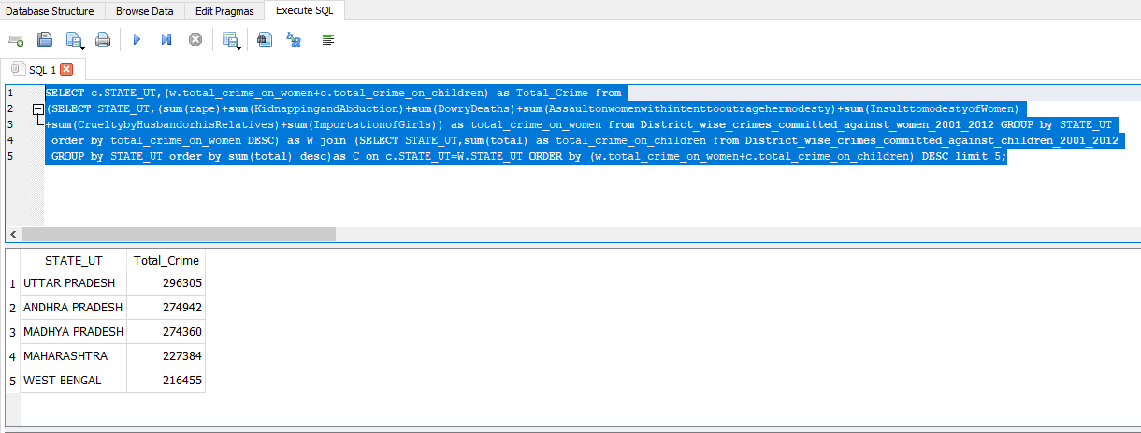
RESULT

Slide 20
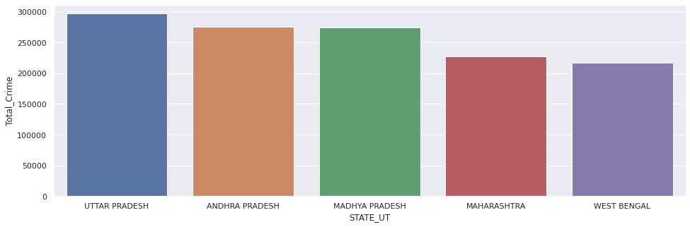
VISUALIZATION
CONCLUSION
from the above data it is clearly visible here here that uttar pradesh has the highest crime rate against children and woman

Slide 21
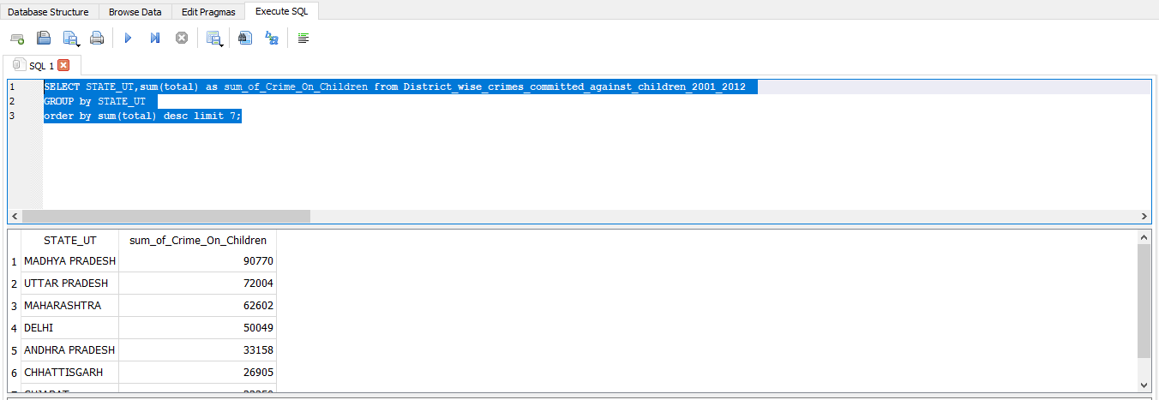
CRIMES ON CHILDREN
ANSWER-SELECT STATE_UT,sum(total) as Total_Crime_On_Children from District_wise_crimes_committed_against_children_2001_2012 GROUP by STATE_UT order by sum(total) desc limit 5;
RESULT-

Slide 22
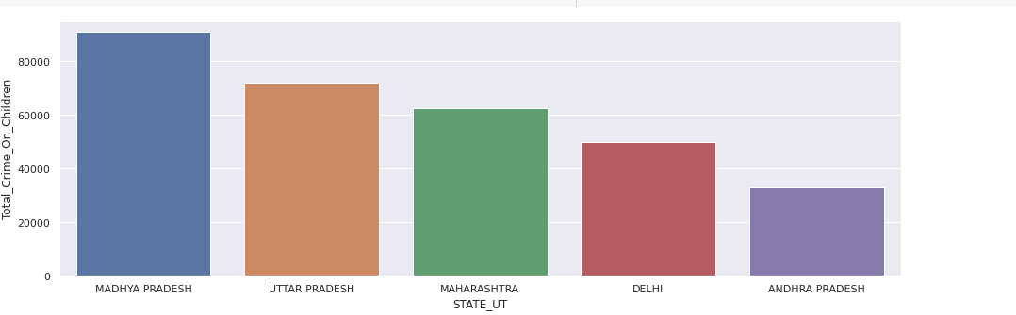
VISUALIZATION
CONCLUSION
here we can analyze from the above plot that Madhya pradesh have the highest number of crimes against children i.e 90770

Slide 23
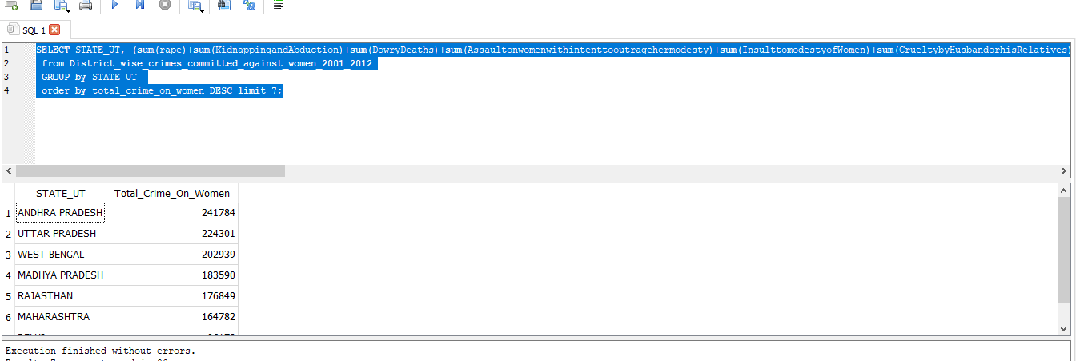
CRIME ON WOMEN
SELECT STATE_UT, (sum(rape)+sum(KidnappingandAbduction)+sum(DowryDeaths)+sum(Assaultonwomenwithintenttooutragehermodesty)+sum(InsulttomodestyofWomen)+sum(CrueltybyHusbandorhisRelatives)+sum(ImportationofGirls)) as Total_Crime_On_Women from District_wise_crimes_committed_against_women_2001_2012 GROUP by STATE_UT order by total_crime_on_women DESC limit 5;
RESULT

Slide 24
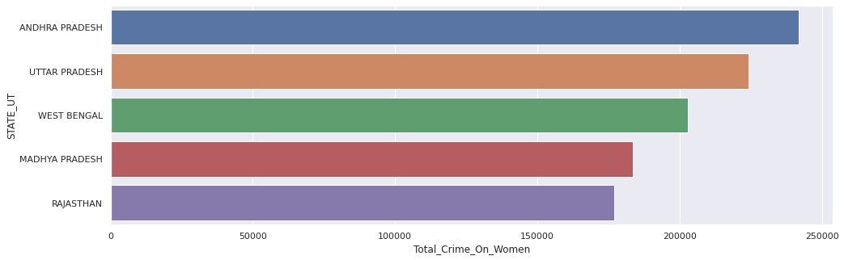
VISUALIZATION
CONCLUSION
Here we can See from the above plot that Andrapradesh have the highest number of crimes against woman i.emore then 2.4 lakhs

Slide 25
5.Age group wise murder victim
ANSWER-select sum(Victims_Above_50_Yrs)as total_Above_50Yrs,sum(Victims_Upto_10_15_Yrs) as total_Victims_between_10to15Yrs,sum(Victims_Upto_10_Yrs) as total_Victims_Upto_10_Yrs,sum(Victims_Upto_15_18_Yrs) as total_Victims_Upto_15_18_Yrs,sum(Victims_Upto_18_30_Yrs) as total_Victims_Upto_18_30_Yrs,sum(Victims_Upto_30_50_Yrs) as total_Victims_Upto_30_50_Yrs from Murder_victim_age_sex ;

Slide 26
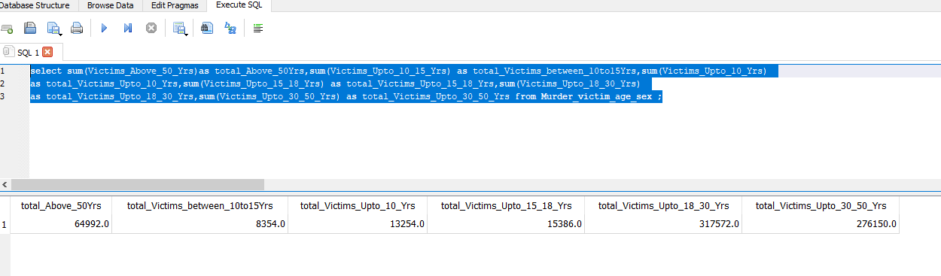
RESULT
CONCLUSION
Here from the above data its clearly visible that most murder victims fall in the age bracket of 18-30yrs, followed by age group of 30-50yrs

Slide 27
6.Crime by place of occurrence
ANSWER –
SELECT sum(RESIDENTIALPREMISES_Dacoity) as Total_RESIDENTIALPREMISES_Dacoity,sum(RESIDENTIALPREMISES_Robbery)
as Total_RESIDENTIALPREMISES_Robbery,sum(RESIDENTIALPREMISES_Theft)as Total_RESIDENTIALPREMISES_
Theft,sum(RESIDENTIALPREMISES_Burglary) as Total_RESIDENTIALPREMISES_Burglary,sum(HIGHWAYS_Burglary)
as Total_HIGHWAYS_Burglary,sum(HIGHWAYS_Dacoity)as Total_HIGHWAYS_Dacoity,sum(HIGHWAYS_Robbery)
as Total_HIGHWAYS_Robbery,sum(HIGHWAYS_Theft)as Total_HIGHWAYS_Theft,sum(RIVERandSEA_Theft) as
Total_RIVERandSEA_Theft,sum(RIVERandSEA_Burglary) as Total_RIVERandSEA_Burglary,sum(RIVERandSEA_Dacoity)
as Total_RIVERandSEA_Dacoity,sum(RIVERandSEA_Robbery) as Total_RIVERandSEA_Robbery,sum(RAILWAYS_Burglary)
as Total_RAILWAYS_Burglary,sum(RAILWAYS_Dacoity) as Total_RAILWAYS_Dacoity,sum(RAILWAYS_Robbery)
as Total_RAILWAYS_Robbery,sum(RAILWAYS_Theft) as
Total_RAILWAYS_Theft,sum(BANKS_Burglary)as Total_BANKS_Burglary ,
sum(BANKS_Dacoity) as Total_BANKS_Dacoity,sum(BANKS_Robbery)
as Total_BANKS_Robbery,sum(BANKS_Theft) as
Total_BANKS_Theft,sum(COMMERCIALESTABLISHMENTS_Burglary) as
Total_COMMERCIALESTABLISHMENTS_Burglary,sum
(COMMERCIALESTABLISHMENTS_Dacoity) as Total_COMMERCIALESTABLISHMENTS_
Dacoity,sum(COMMERCIALESTABLISHMENTS_Robbery) as
Total_COMMERCIALESTABLISHMENTS_Robbery,sum
(COMMERCIALESTABLISHMENTS_Theft)as Total_COMMERCIALESTABLISHMENTS_
Theft,sum(OTHERPLACES_Burglary)as Total_OTHERPLACES_Burglary,sum
(OTHERPLACES_Dacoity) as Total_OTHERPLACES_Dacoity,sum
(OTHERPLACES_Robbery) as Total_OTHERPLACES_Robbery,sum
(OTHERPLACES_Theft) as Total_OTHERPLACES_Theft from
Crime_by_place_of_occurrence_2001_2012

Slide 28
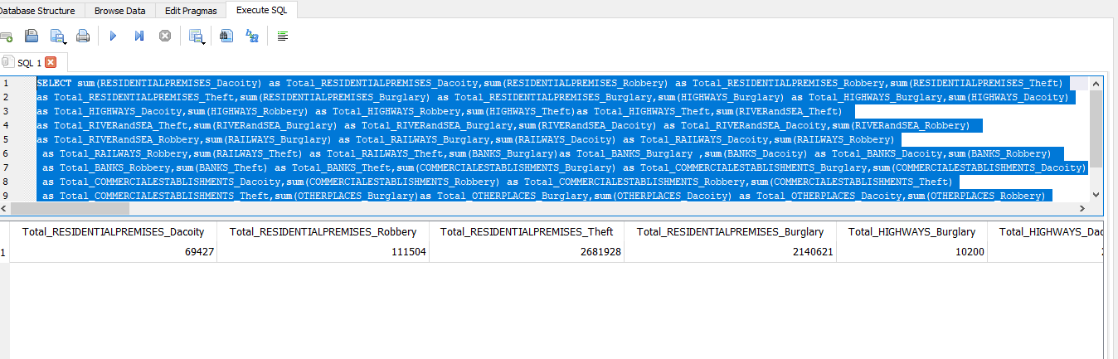
RESULT

Slide 29
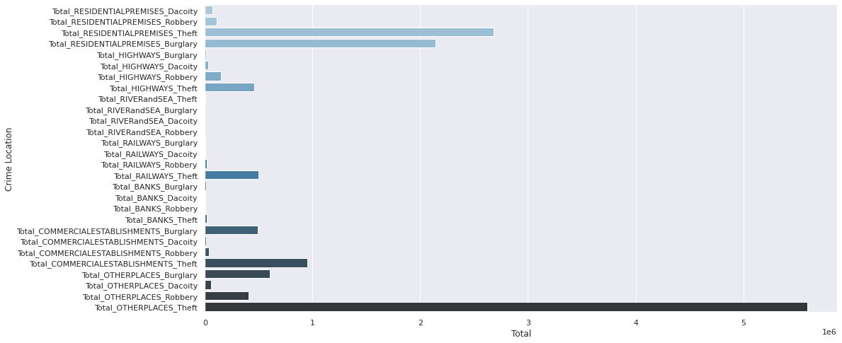
VISUALIZATION
CONCLUSION
From the above plot we can see that the most crimes took place in residences in the form of theft other then the unlisted places which amounts to the highest no.of crimes as per place of occurence

Slide 30
7.Anti corruption cases vs arrests
ANSWER-
SELECT a.Area_Name, a.Year, a.ACA01_No_of_persons_in_custody_or_on_bail_during_the_stage_of_investigation_at_the_beginning_of_the_year as Toatl_Jail, c.AC02_No_of_cases_registered_during_the_year as Total_Case
FROM Anti_corruption_arrests a join Anti_corruprion_cases c USING(Area_Name) group by a.Area_Name",conn)

Slide 31
8.Which state has more number of complaints against police?
ANSWER –
select Area_Name,Year,Cases_Registered from Complaints_against_police GROUP by Area_Name order by Cases_Registered DESC LIMIT 5;

Slide 32
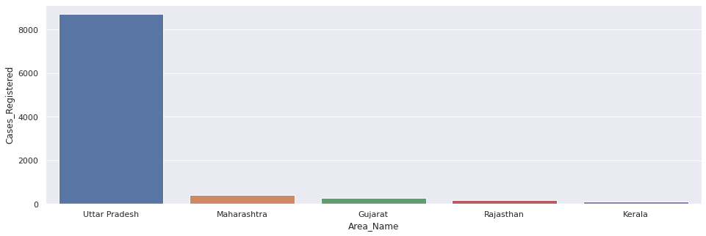
VISUALIZATION
CONCLUSION
We can see by this graph highest case against police is registered in Uttar Pradesh.

Slide 33
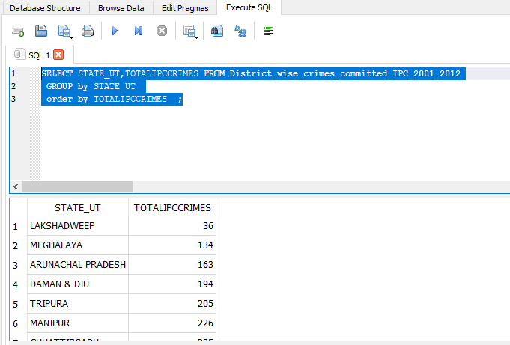
9.Which state is the safest for foreigners?
ANSWER
("SELECT STATE_UT,TOTALIPCCRIMES FROM District_wise_crimes_committed_IPC_2001_2012 GROUP by STATE_UT order by TOTALIPCCRIMES ;",conn)
RESULT

Slide 34
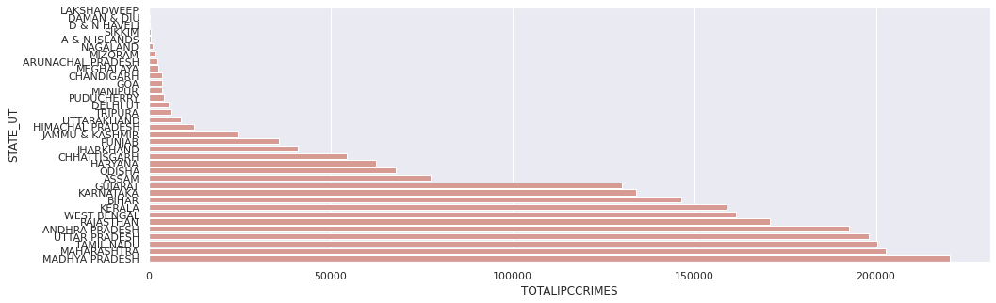
VISUALIZATION
CONCLUSION
According to IPC crime record Madhya Pradesh has highest case record and Lakshadweep is lowest .
So Lakshadweep is safest for foreigners.

