Slide 1
Safe.ly
theme-Women Safety
By
-Aditya Singhal(SRM)
-Samiksha Garg(BVCOE)
//Hacktllend

Slide 2
Safe.ly(Personal Safety App)
Safe.ly is a mobile application which can be used to aid personal safety. These include various features, which allows women to travel safely.
Features:
Emergency
Places Reviews
Fake a call
SOS
Pocket tools

Slide 3
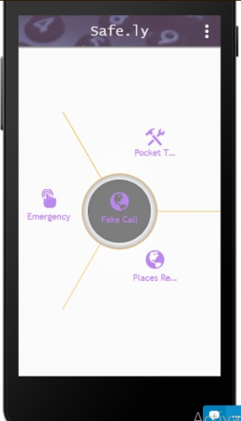
Features ...
Emergency (OneTouch)..
This feature enable the user
to make a call to their
closed ones by just a single
tap in case of emergencies.
Places Reviews..(User Rating)
User can use this feature
to see the review of the
nearby places given by the
users who have visited that
place before.

Slide 4
Fake a Call..
Fake a Call is a feature that rings the phone..that’s it.
The feature helps “polite introverts exit unwanted conversations or meetings” i.e. you can pretend to have a conversation with your family member so that the criminal gets cautioned.
SOS..(Save our Streets)
This feature allows you to send your location, voice and live video to the nearest police station and your relatives in just one tap.

Slide 5
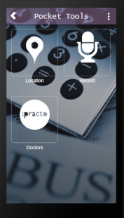
Pocket Tools..
Location: provides you with your current location in the maps.
Record: activates voice recording in suspicious cases that can be used by police or other authorities to know what actually happened and use it as an evidence.
Practo: provides you with the list of doctors in your area.

