Slide 1



STAKEHOLDER PRESENTATION
AI Client Onboarding &
Project Proposal Agent
Automating client requirement analysis and proposal generation — with a human always in the loop
Built with LangGraph + FastAPI
Human Approval on Final Output
Problem → Solution → Business Value → Results → Future
Notes:
Title slide: introduce the AI Client Onboarding & Project Proposal Agent, emphasize human-in-the-loop control and the tech stack.

Slide 2

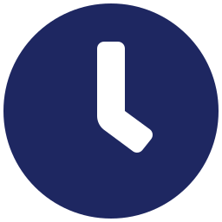
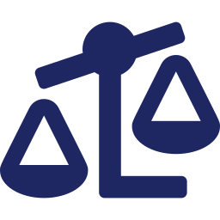
THE CHALLENGE
Business Problem
Why manual proposal workflows are holding teams back
Incomplete Requirements
Slow Turnaround
Client requirements are often incomplete, leaving gaps for downstream work.
Manual proposal creation takes significant time from sales and delivery teams.
Inconsistent Quality
Overlooked Risk
Proposal quality varies depending on who writes it and how much time they have.
Unrealistic budgets or timelines can slip through unnoticed until it is too late.
AI Client Onboarding & Project Proposal Agent
2
Notes:
Business problem: incomplete requirements, slow manual work, inconsistent quality, overlooked budget/timeline risk.

Slide 3




THE APPROACH
Proposed Solution
A six-step agentic workflow, from raw request to approved proposal
01
02
03
Validate Client Request
Analyze Requirements
Research Services
Confirm the request is well-formed and actionable.
Break down stated and implied needs.
Match needs to relevant service offerings.
04
05
06
Generate Proposal
Quality & Safety Check
Human Approval
Draft a tailored project proposal.
Screen for errors, gaps, and risk.
A person reviews and signs off before delivery.
AI Client Onboarding & Project Proposal Agent
3
Notes:
Six-step solution pipeline: validate, analyze, research, generate, quality-check, approve.

Slide 4
SYSTEM FLOW
How It Works
End-to-end pipeline powered by LangGraph orchestration
Start / End
Automated Stage
Human-in-the-Loop
1
2
3
4
5
6
7
8
Client
Request
Validation
Analysis
Research
Proposal
Quality
Check
Human
Approval
Final
Proposal
AI Client Onboarding & Project Proposal Agent
4
Notes:
Pipeline flow diagram: Client Request through Validation, Analysis, Research, Proposal, Quality Check, Human Approval, to Final Proposal.

Slide 5

VALIDATION
Results & Evaluation
Stress-tested across realistic and adversarial scenarios
8
Test Scenarios
6
Evaluation Criteria
4
Scenario Types
Normal
Incomplete
Unrealistic
Adversarial
Key Improvement Area
Response: Safeguards Added
Requirement and constraint handling identified as the primary area to strengthen.
Failure handling and human oversight layered in to reduce downstream risk.
AI Client Onboarding & Project Proposal Agent
5
Notes:
Results: 8 scenarios across 4 categories, evaluated on 6 criteria; requirement handling flagged as improvement area; added failure handling and human oversight.

Slide 6





WHAT IT MEANS
Business Value & Next Steps
BUSINESS VALUE
NEXT STEPS
Saves Preparation Time
Larger Knowledge Base
Cuts hours out of manual proposal drafting.
Broaden the service and reference catalog.
Better Clarification Mechanism
Improves Consistency
Ask sharper follow-up questions on gaps.
Every proposal follows the same rigorous process.
Production Monitoring Dashboard
Reduces Errors
Track performance and failures live.
Built-in quality and safety checks catch issues early.
Persistent Data Storage
Retain history across client sessions.
Controlled Automation
Expanded Evaluation
Human approval keeps final output accountable.
Grow scenario and criteria coverage further.
AI Client Onboarding & Project Proposal Agent
6
Notes:
Business value: time savings, consistency, error reduction, controlled automation. Next steps: bigger knowledge base, clarification, monitoring, persistence, expanded evaluation.

Slide 7

Thank You
Controlled, consistent, human-approved proposal automation
Problem
Solution
Business Value
Results
Future
AI Client Onboarding & Project Proposal Agent
7
Notes:
Closing slide reinforcing the stakeholder narrative arc: Problem to Solution to Business Value to Results to Future.

