Slide 1

Auto Category Detection and Items Prohibited Detection
Sami Aziz Alzahrani

Slide 2
Project Background
Project Goal
Personal Motivation
Find an auto and fast detection system to monitor and avoid prohibited items through product images and titles in marketplaces.
During developing my marketplace application, I had the idea to make a good experience for both sides (Customers & Company).

Slide 3
Project Plan
1.
Review the previous experiences of the leading companies in this field.
2.
Get the right and easier way to implement this approach from scratch.
3.
Select machine learning models can fit with this project.
4.
Deliver the project as a very light version, then improve it in the future during data expanding.

Slide 4
Deployment
I used Flask API as backend to deliver this project.
04
Create text classification model
03
I selected KNN model.
Project
Steps
Create image classification model
02
A quick headlines review of project steps from start to end.
As a best option, I have used CNN model.
Data Gathering
Since I created my own datasets.
01

Slide 5
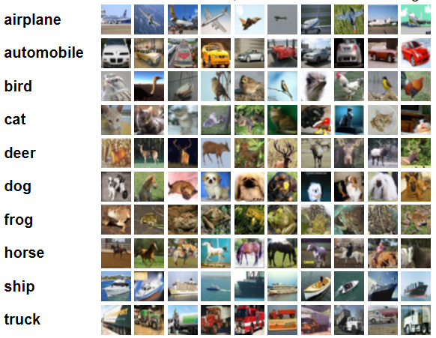
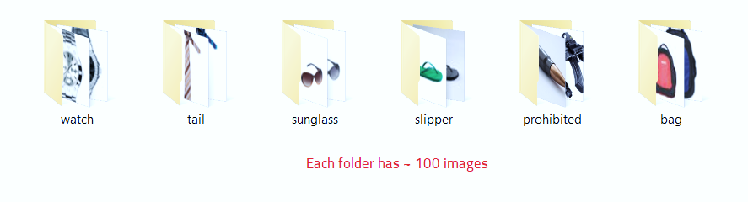
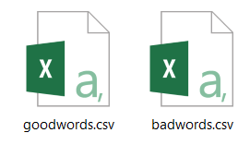
Data Sources
CIFAR 10
My Own Image data
My Own Text data
Consists of 60000 32x32 color images in 10 classes.
I collected ~ 600 60x80 color images.
I collected ~ 2800 words.
Image Classification
Image Classification
Text Classification

Slide 6
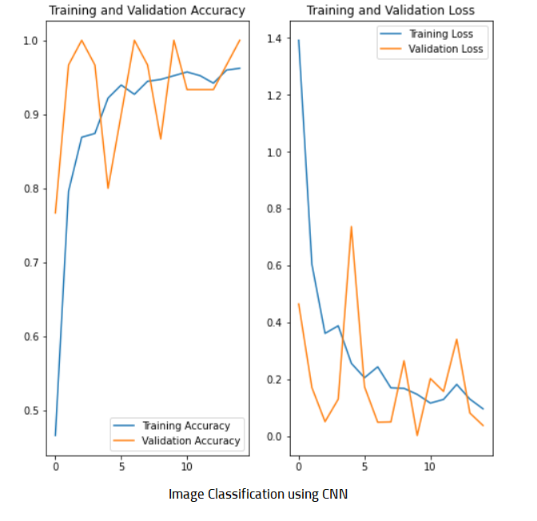
Image Classification Training and Validation

Slide 7
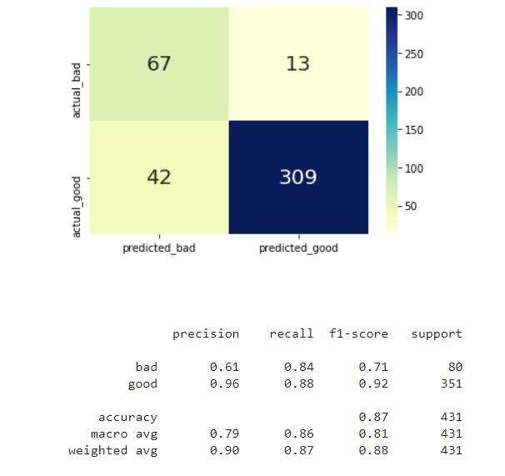
Text Classification Test
Text Classification using KNN

Slide 8
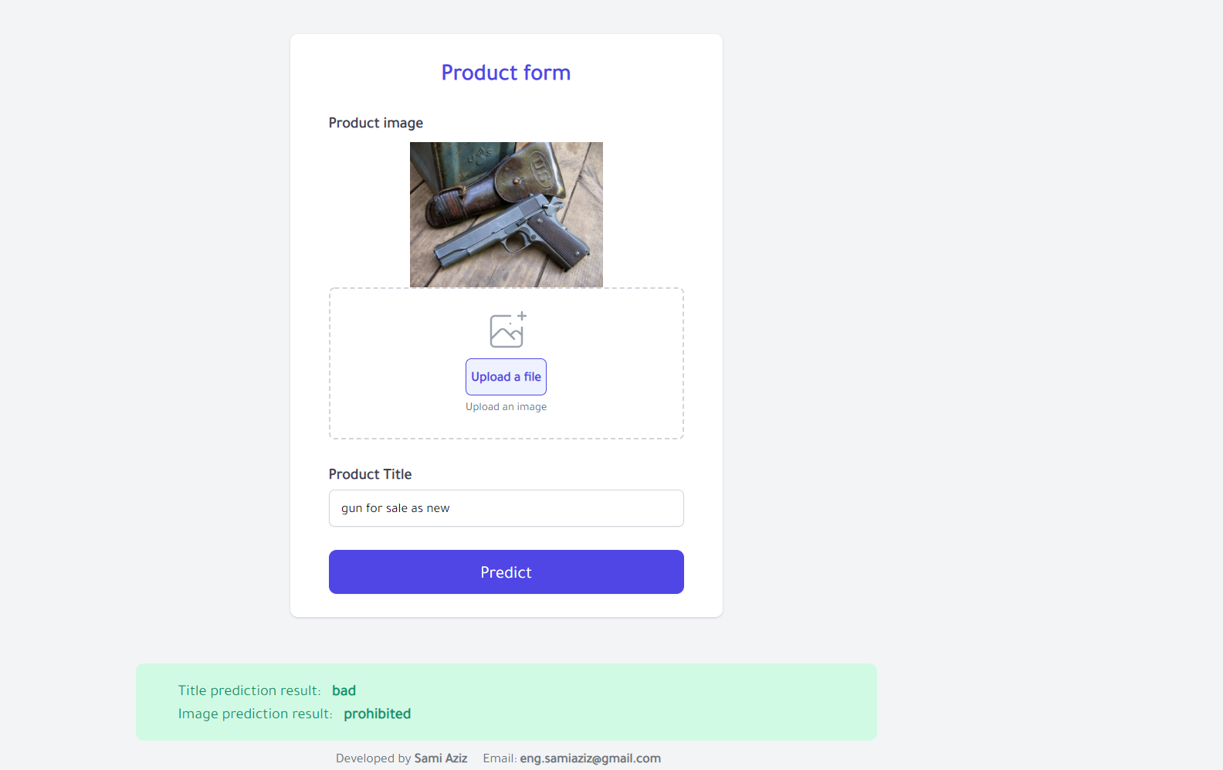

http://localhost:5000
Project Deployment
In this figure, I am displaying an example of models predicting in deployed project, using Flask.
This is a good example I implemented it in the deployment. As we can see the models predicted (Text as Bad and Image as Prohibited item)

Slide 9
Thank You!

