Slide 1
Case: PHP-Forum
Sami Outila

Slide 2
General requirements
Name of the app:
PHP-Forum
Users:
Forum visitors and commenters
Needs, purpose:
Sites purpose is to create an opportunity for discussion by allowing users to create topics and commenting on them.

Slide 3
User-stories for anonymous users
1. Registering Anonymous users can create new accounts in order to be able to create topics and add comments to existing ones. Registering only requires an username and a password.
2. Browsing topics and comments Anonymous users can see and browse all topics and comments created by the users with accounts.

Slide 4
User-stories for users with accounts
1. Logging in The user can log in using their login credentials.
2. Browsing topics and comments Any user can see and browse all existing topics and comments.
3. Creating a new topic Users with accounts can create new topic which other users can then see and add comments to.
4. Editing an existing topic Users can also edit existing topics created by them. Only description can be edites.
3. Add a comment to a topic Users can add topics to topics made by others or by themselves.
4. Edit old comments Users can edit old comments made by them.
3. Remove old topic Users can also choose to delete old topics made by them. This also deletes all comments posted to the topic.
4. Remove old comment Users can remove old comments made by them.

Slide 5
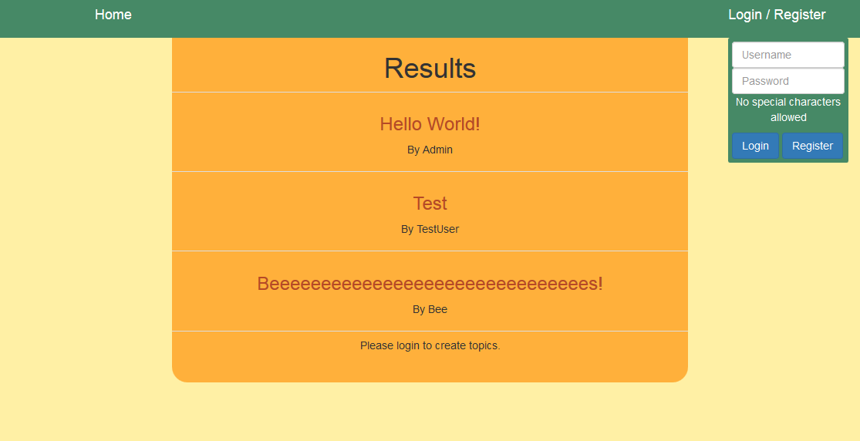
GUI - Homepage
Link for the form
Homebutton
List of topics
Form that drops
down after clicking
the link above

Slide 6
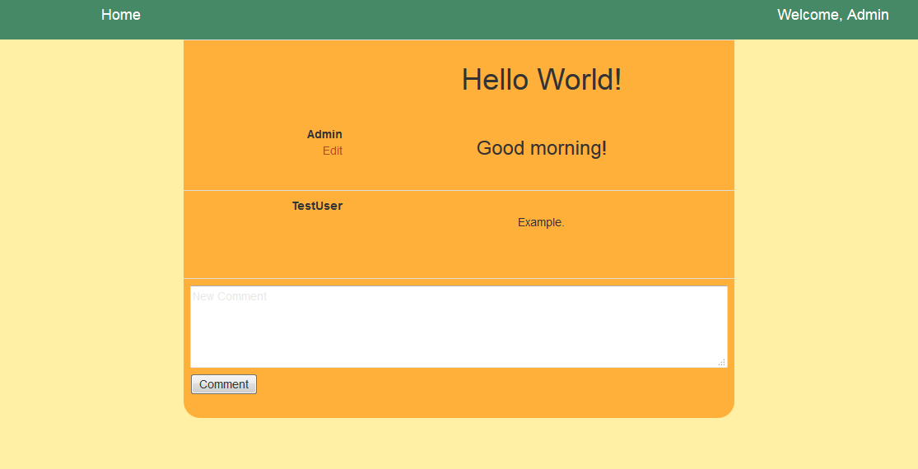
GUI – Single topic
Details of the
clicked topic
Form for adding a new comment
Link for editing your own topic

