Slide 1
Biometrics seminar
Hand Geometry-based Biometric Systems

Slide 2
Topics
What is hand geometry?
Why hand geometry?
How do hand geometry systems work?
  What features are used and how?
History
Commercial applications
Conclusions

Slide 3
Main Sources
Jain, Ross & Pankanti: A prototype Hand Geometry-based Verification system (AVBPA 1999)
Sanchez-Reillo et al: Biometric Identification through Hand Geometry Measurements (PAMI 2000)
Kumar et al: Personal Verification using Palmprint and Hand Geometry Biometric (AVBPA 2003)
Oden, Ercil & Buke: Combining implicit polynomials for hand recognition (PRL 2003)
Notes:
These are the main publications. There are a few more by Jain as well as Sanchez-Reillo et al. Most other cites are www-documents.

Slide 4
Hand Geometry
Biometric used in verification (and identification)
Verification: “Is this person who he claims to be?”
Identification: “Who is this person?”
Geometric features: finger widths, finger lengths, palm dimensions…
Hand feature templates stored in database

Slide 5
Advantages of Hand Geometry
User acceptance
Low to medium cost
Simple setup, simple equipment
Small template size (typically 9-25 bytes)
No association to criminal records (fingerprint)

Slide 6
Architecture
Enrollment phase: take images, compute features and store template (typically average features from a few images)
Comparison: take new image and compare to:
  One template (verification of given ID)
  All templates (identification)

Slide 7
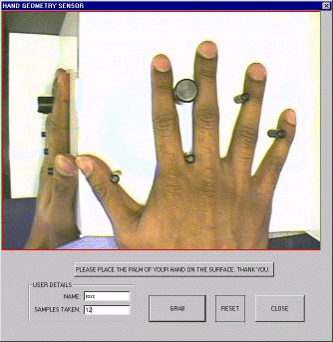
Imaging setup for
Hand Geometry Application
Jain, Ross & Pankanti:
A prototype hand geometry-based verification system
Camera
Platform + mirror
Guiding pegs (pressure sensors activate camera)

Slide 8
Image capturing and Preprocessing
Sanchez-Reillo et al.
Binarize color image
Eliminate background
Resize and rotate
Edge detection
Jain, Ross & Pankanti:
Gray-level image
Pegs serve as control points
Oden et al.
One view (backlighting)
No guiding pegs
Edge detection
Kumar et al.
No guiding pegs
Binarize with threshold
Align with best fitting ellipse
Erosion for palmprint image

Slide 9
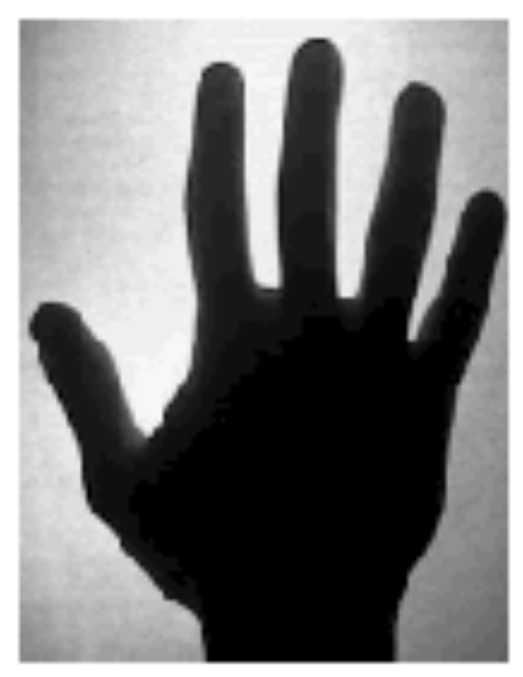
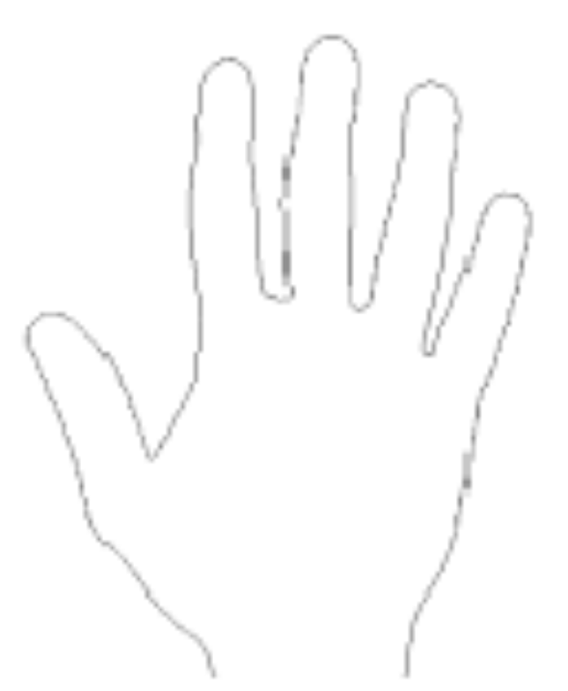
Preprocessing example
Find fingertips and interfinger points
Notes:
From Oden et al

Slide 10
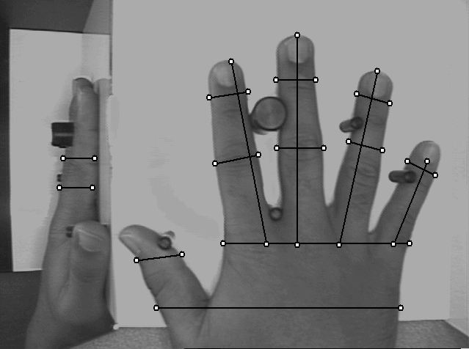
Feature selection
Typical features:
Finger lengths, widths, heights
Palm widths
Notes:
Jain, Ross & Pankanti

Slide 11
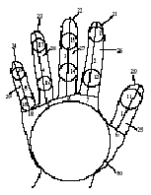
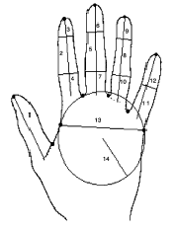
More examples of Features
Notes:
Left: Bulatov
Right: Kumar (geometric features used in addition to the implicit polynomials)

Slide 12
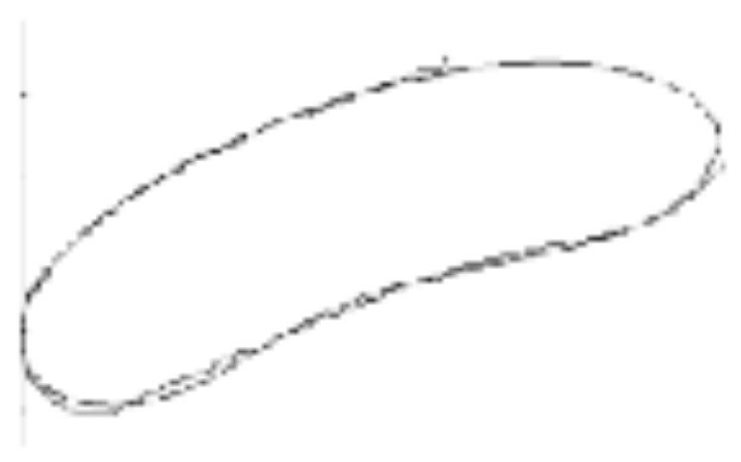

... and more features
Implicit polynomials (Oden):
Model shapes of fingers with implicit polynomials
Fitting is the main problem
Polynomial coefficients are features in classification

Slide 13
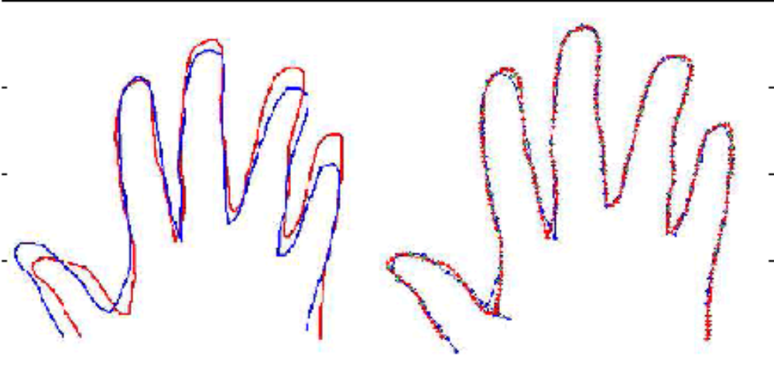
Shape alignment
Jain and Duta:
Deformable matching of hand shapes for verification
Mean Alignment Error

Slide 14
Selecting Significant Features
Statistical analysis to find significant features by
Sanchez-Reillo et al:
variability ratio = interclass variability
intraclass variability
Features not significant enough are eliminated

Slide 15
Classification and Verification
Feature vectors can be compared and classified with basic Pattern Recognition techniques
Almost any classifier could be used (Bayesian, kNN, SVM, GMM, neural networks...)
Classify to ”nearest” class or verify identity if feature values are close enough

Slide 16

Feature vector distances
Distance metrics:
  Euclidean distance (sum squared error)
  Hamming distance (with some variance)
  Absolute or weighted absolute distance

Slide 17
Classification using correlation
Kumar et al: Personal verification using palmprint and hand geometry biometrics:
Compute normalized correlation between sample and template
Match if correlation exceeds threshhold
Notes:
Kumar

Slide 18
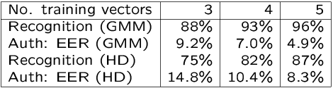
Example of Classification Results
Sanchez-Reillo:
Hand Geometry Pattern Recognition through Gaussian Mixture Modelling
GMM results
compared
with Hamming
distance

Slide 19
Bimodal Biometric Systems
Hand Geometry and Fingerprint
  frequent verification / infrequent identification
Hand Geometry and Palmprint (Kumar et al)
Information fusion at representation level:
  Concatenate feature vectors
Information fusion at decision level:
  Separate match scores + e.g. max rule

Slide 20
Smart cards
Hand geometry data can be stored on the user’s
own smart card (Sanchez-Reillo et al)
Personal data stays on the card
Increased security & confidentiality
The hand is the “PIN” associated with the card

Slide 21
Hand Geometry Applications
Commercial hand geometry applications have been in use since 1970’s
Widespread use since the 1990’s
Access control
Time and attendance
Recognition Systems Inc is the big vendor

Slide 22
Identimat
Identimat – pioneer in biometric systems
One of the very first commercial applications
Finger length and hand shape measurements
First application in Wall Street investment firm
Used in highly secure facilities (e.g. nuclear weapon industry) in 1970’s
Not used at the Moscow Olympics...

Slide 23
RSI HandReaders
Recognition Systems Inc. (Ingersoll-Rand)
ID3D in the 1990’s: daycare centers, airports, university cafeterias, hospitals (birth centers) ...
Prisons in Northern Ireland (Youth Offenders Centre in Belfast was first in 1994)
Sandia Laboratories reported 0.2 % equal error rate for RSI verification already in 1991
Superior in user acceptance

Slide 24
ID3D HandKey by RSI
PIN to provide identity (or magnetic stripe card)
Re-averaging with sample at verification
adjustable thresholds
  globally, per reader
  individually, per user
tradeoff between false rejects (usability suffers) and false accepts (security suffers)

Slide 25
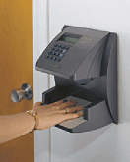
RSI HandReaders
Access control
Time and attendance (eliminates ”Buddy punching”)
Platform with pegs
> 90 measurements
9 byte feature vector
No cards or badges
PIN code to provide identity

Slide 26
INSPASS
INS Accelerated Service System
Inspection system used at airports in USA
Frequent business travelers can avoid long lines by checking in via RSI HandReader kiosks
PortPASS card, hand feature template
Processing times typically 15-20 seconds
Free enrollment, valid one year at a time

Slide 27
Finger Geometry at Disney World
Biomet partners (Switzerland)
The only major application not by RSI
Two-finger geometry (index and middle finger)
For season pass holders
Convenience: pass holders can avoid long lines
Deterrant: friends can not borrow passes

Slide 28
More application examples
Electronic voting in South Africa (1994)
Olympic Village security in Atlanta (1996)
BASEL: hand geometry integrated with face recognition at border between Israel and Palestina to check people who cross daily

Slide 29
Conclusions
Hand Geometry is simple, cheap and easy to use
Hardly any user objections
Discimination capability is low – but verification results are high ??
Hand geometry information may change (weight gain, weight loss, injuries, illness...)
Using the systems is easy, but the best way to reduce false rejections is user training…

Slide 30
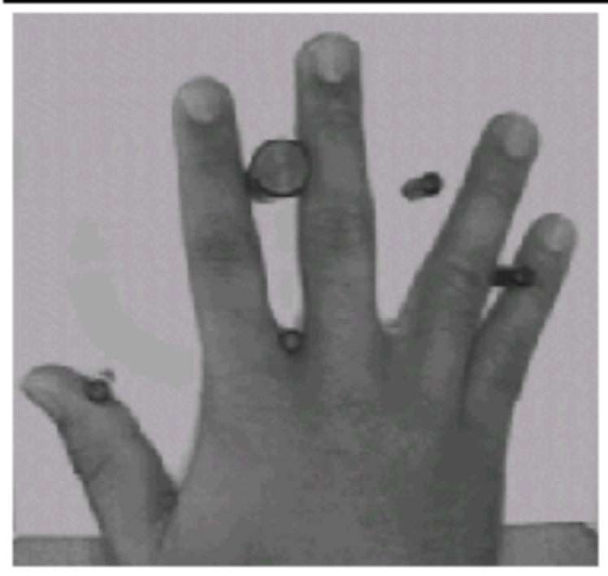
Easy is not always easy enough

Slide 31
Conclusions continued
Low identification (but high verification) capability can be a good thing
  low risk of privacy violations
  no association to criminal records
Physical size prevents use in some applications (e.g. laptop computers) – display scanners?

Slide 32
Problems with this review
Conflicting information
  not accurate – but results are excellent ??
  identification vs. verification
Mostly commercial material – companies do not reveal the algorithms behind their systems
Few research articles
Performance higher in commercial systems than in scientifically published applications

Slide 33
Acknowledgements
Thanks to Jani Peusaari, Esa Ruuth, Sami Seppänen and Petri Äijö for lending me their Machine Vision course project ”Identification by Hand Geometry”
Features: hand perimeter, area, compactness

