Slide 1
User Guide
Beyond Mean-Variance
Portfolio Optimiser
With Derivatives & Structured Products — A Mental Accounts Framework
Sami Jeddou | Senior Financial Services Executive | 2026
sami-jeddou-behavioral-portfolio-optimizer.streamlit.app

Slide 2
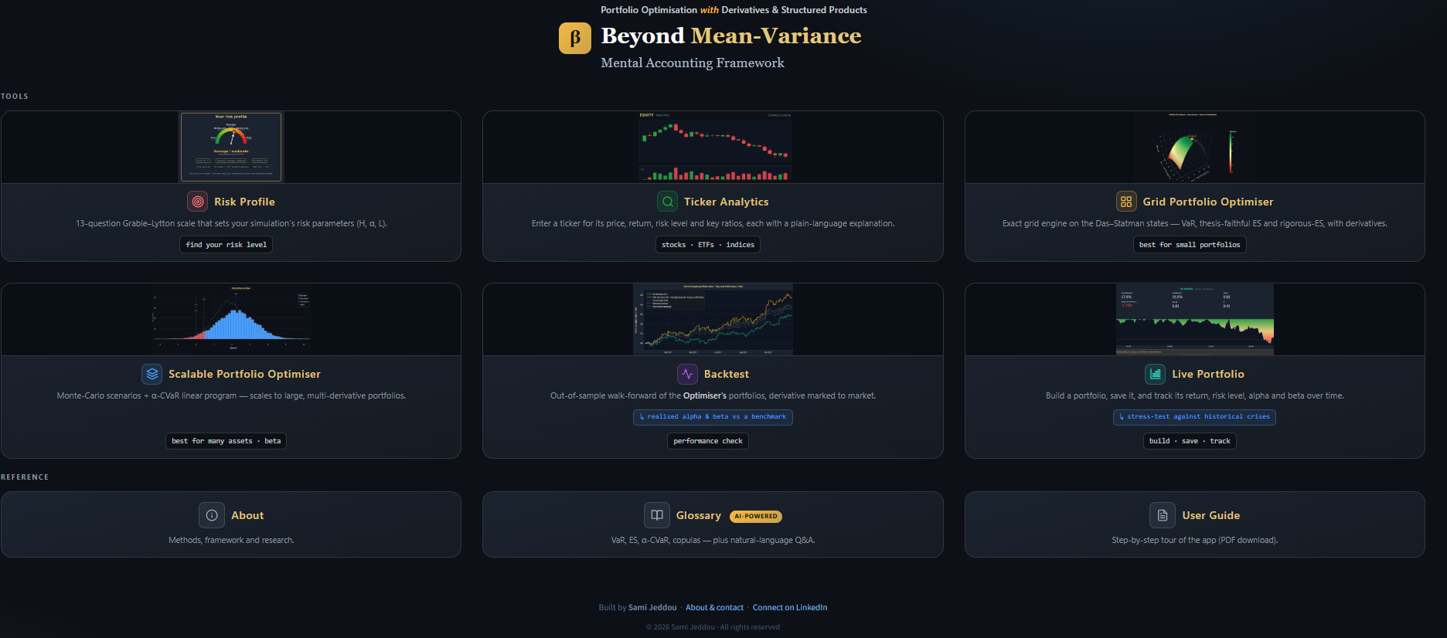
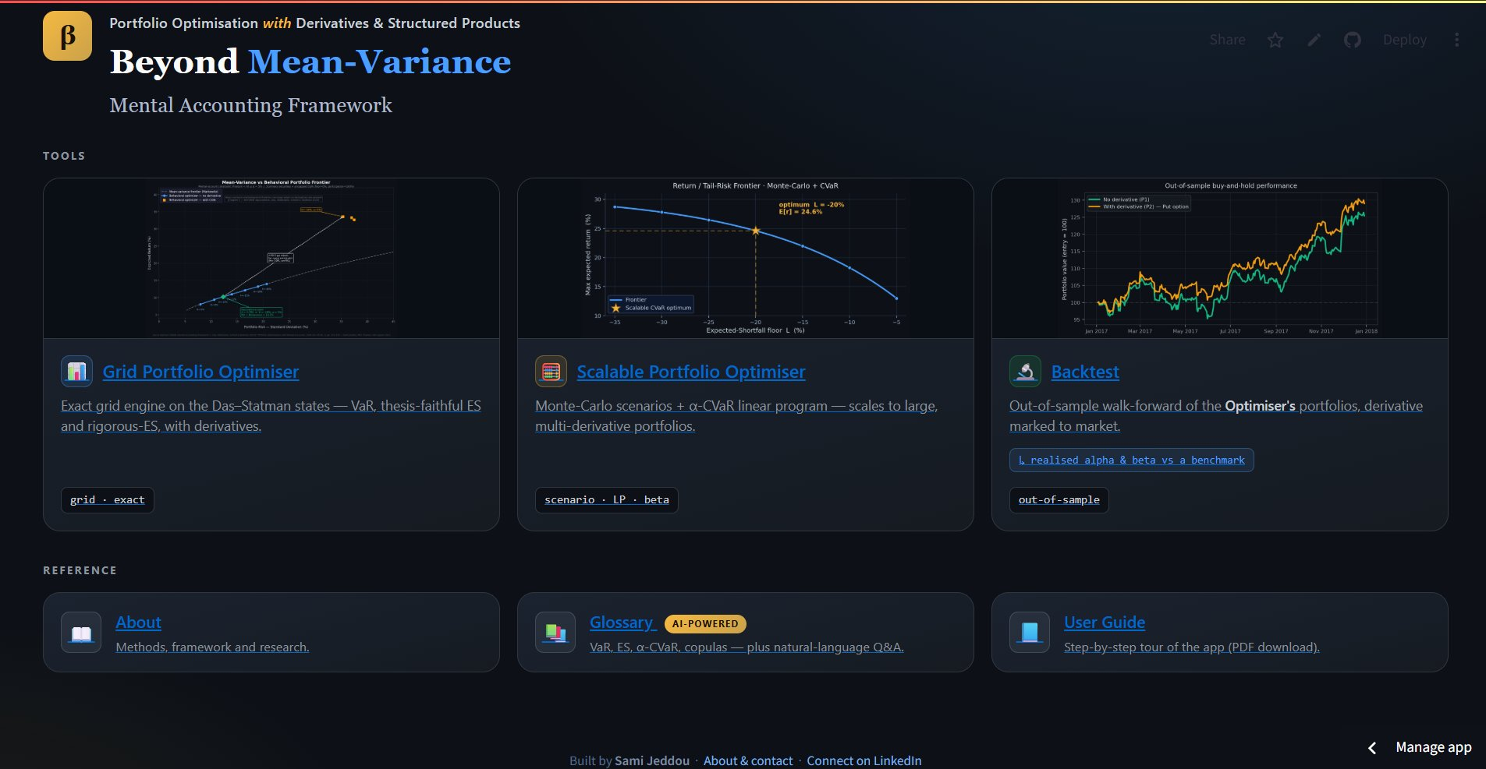
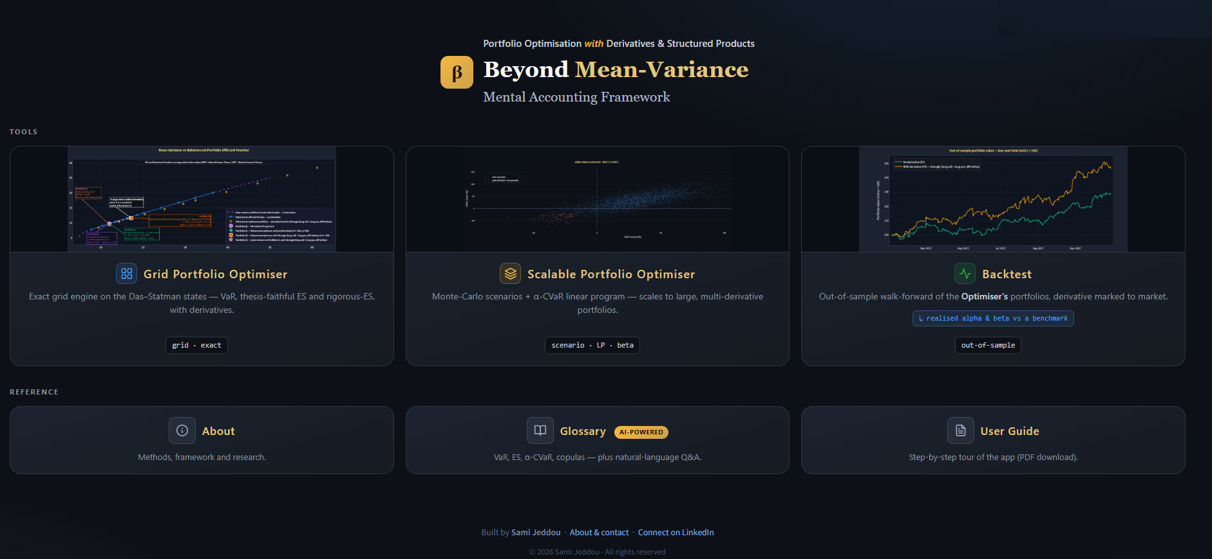
Home
The landing screen — your starting point: the six tools, with the reference shelf (About · Glossary · User Guide) below.
Beyond Mean-Variance Portfolio Optimiser — User Guide
2 / 22

Slide 3






Home — choose a tool
Grid Portfolio Optimiser
Scalable Portfolio Optimiser
Backtest
Exact grid engine on the Das–Statman states — VaR, thesis-ES and rigorous-ES, with derivatives.
Monte-Carlo scenarios + α-CVaR linear program — scales to large, multi-derivative portfolios.
Out-of-sample walk-forward — expected vs realised, plus realised alpha & beta.
Reference & navigation
About:
Methods, the mental-accounting framework and the research behind the app.
Glossary:
Plain-language, AI-powered definitions — VaR, ES, α-CVaR, copulas, alpha & beta.
Tip:
Each tile opens a tool; the Grid Portfolio Optimiser is the place to start.
Beyond Mean-Variance Portfolio Optimiser — User Guide
3 / 22

Slide 4



Grid Portfolio Optimiser — overview
Interactive Frontiers
Three Portfolios
AI-Powered
MV vs Behavioural vs Derivative frontier — visualised side by side on a single chart
No derivative / With derivative / Same risk — three perspectives for each optimisation run
On-demand explanations for every parameter, constraint, derivative type, and result
Portfolio perspectives (0–3)
0
Portfolio (0) — Markowitz MV optimum:
Classical mean-variance solution; Portfolio (1) coincides with it.
1
Portfolio (1) — No derivative:
Equivalent to MV optimum — confirms MVT/MAT equivalence. Most classical optimisers stop here.
2
Portfolio (2) — With derivative:
Same implied λ and downside constraint (H,α or H,α,L) — shows return uplift from derivatives.
3
Portfolio (3) — Same risk as (1):
Interpolated at P(1) std dev — direct comparison of return gain at equivalent risk (indicative).
Beyond Mean-Variance Portfolio Optimiser — User Guide
4 / 22

Slide 5
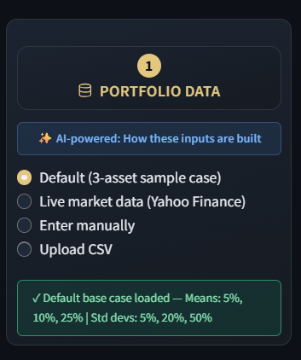
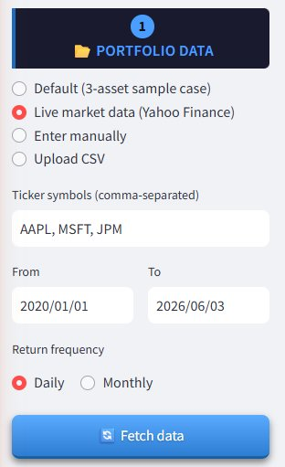
1
Step 1 — Portfolio Data
Default
Das & Statman (2009) base case — 3 securities, pre-calibrated. Reproduces thesis results.
Live market data
Any global ticker from Yahoo Finance — equities, ETFs, indices, crypto (BTC, ETH...)
Enter manually
Enter means, std devs, and correlation matrix directly. Supports 2–10 securities.
Upload CSV
First col = dates, remaining cols = asset prices. Returns computed automatically.
Important: with Live market data or CSV, click ‘Fetch data’ to load it before running the optimiser — it will not run on un-fetched tickers.
Beyond Mean-Variance Portfolio Optimiser — User Guide
5 / 22

Slide 6
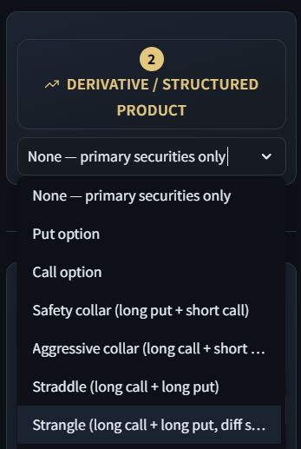
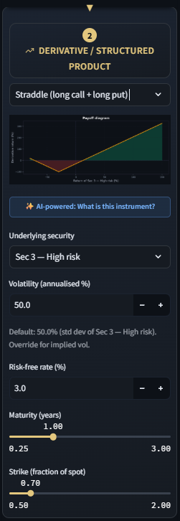
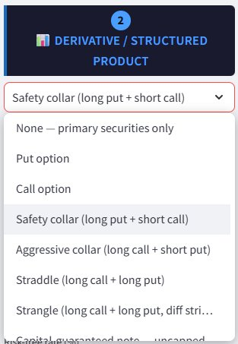
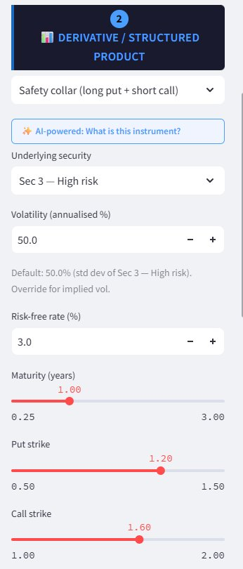
2
Step 2 — Derivative / Structured Product
Available instruments
▸ Vanilla options — put, call
▸ Collars — safety, aggressive
▸ Volatility — straddle, strangle
▸ Spreads — bull call, bear put
▸ Butterfly & condor — long butterfly, call condor
▸ Capital-guaranteed note — capped or uncapped
▸ Barrier-M note & reverse convertible
▸ Discount & outperformance certificates
💡 Select 'None' for no derivatives, or 'Custom' to build your own (calls, puts, digitals, ZCBs).
Beyond Mean-Variance Portfolio Optimiser — User Guide
6 / 22

Slide 7
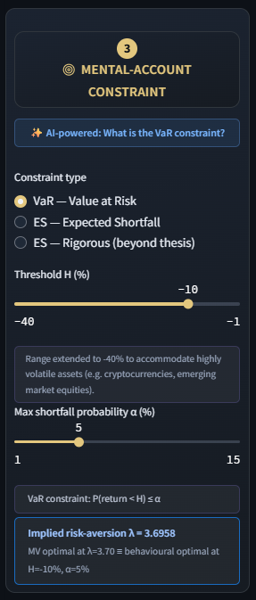
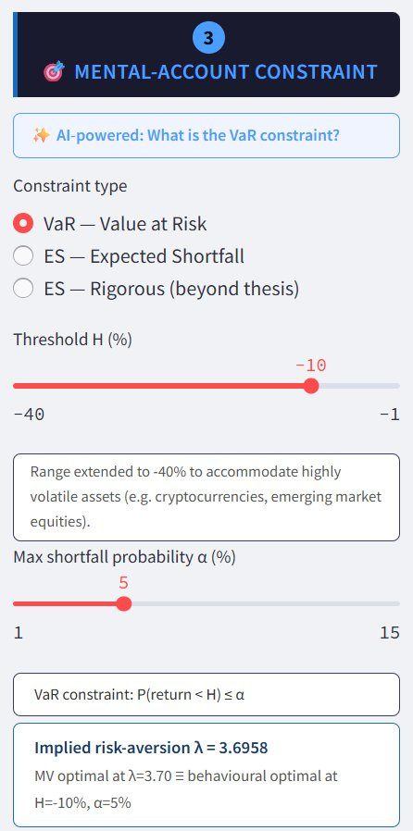
3
Step 3 — Mental-Account Constraint
VaR — Value at Risk
P(return < H) ≤ α
Caps the probability of finishing below H at α.
ES — Expected Shortfall
E[return | return < H] ≥ L
Floors the average tail loss below H at L (thesis).
ES — Rigorous (beyond thesis)
E[r | r < H] ≥ L (enforced in the solve)
Enforces the ES floor in the optimisation itself.
💡 Implied λ is computed dynamically — adjust H and α to see the equivalent risk-aversion coefficient update in real time, confirming MVT/MAT equivalence.
Beyond Mean-Variance Portfolio Optimiser — User Guide
7 / 22

Slide 8
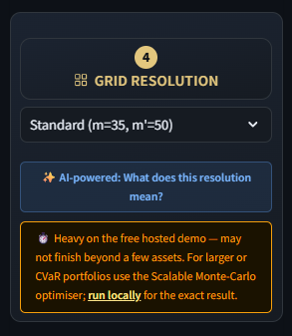





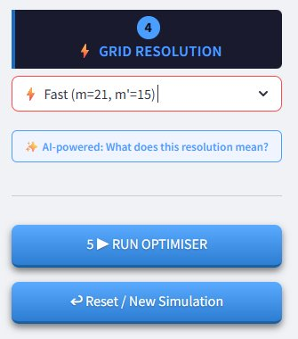
4
Step 4 — Grid Resolution
Fast (m=21, m'=15)
~1–2 min (or more depending on the portfolio size)
Quick preview and parameter exploration
Standard (m=35, m'=50)
~5–15 min (or more depending on the portfolio size)
Good balance — close to thesis results
Also available
High precision (m=51, m'=99)
Turbo — 4th resolution: High-precision VaR accuracy in ~seconds (VaR-only, ≤4 assets, no derivative).
1–2 hrs (or more depending on the portfolio size)
Publication-quality replication of thesis results
Rigorous ES: a fixed high-precision grid (m=51); chosen in the Risk-measure step.
Beyond Mean-Variance Portfolio Optimiser — User Guide
8 / 22

Slide 9

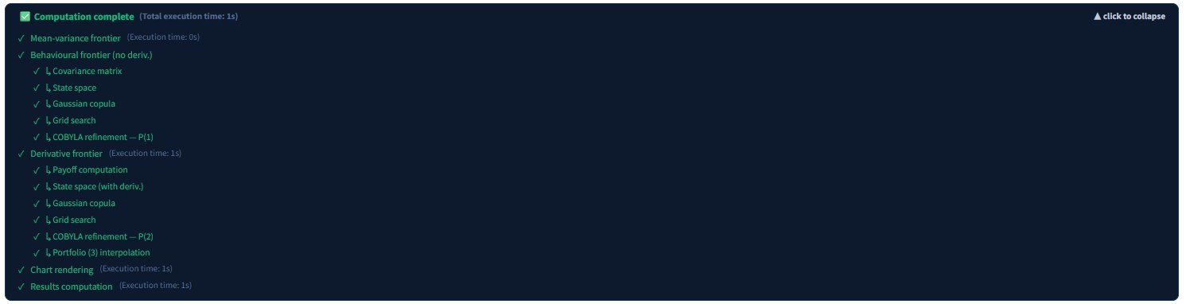
5
Step 5 — Run the Optimiser
Computation steps
1. Mean-variance frontier — Markowitz sweep (instant)
2. Behavioural frontier (no derivative) — State space, Gaussian copula, grid search, COBYLA
3. Derivative frontier — Same steps extended with derivative payoff (only if derivative selected)
4. Chart rendering + Results computation
Beyond Mean-Variance Portfolio Optimiser — User Guide
9 / 22

Slide 10
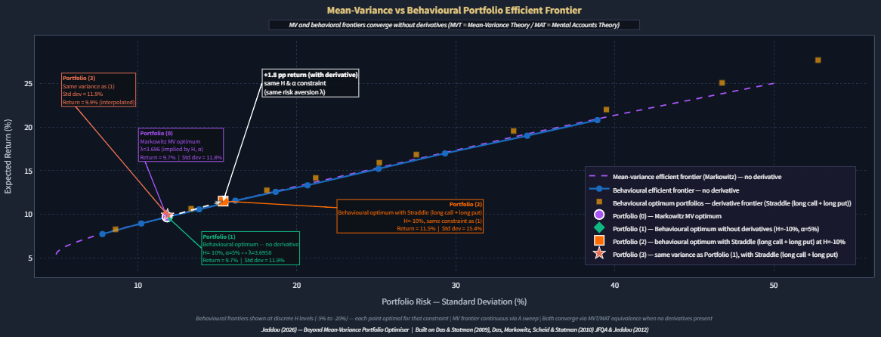
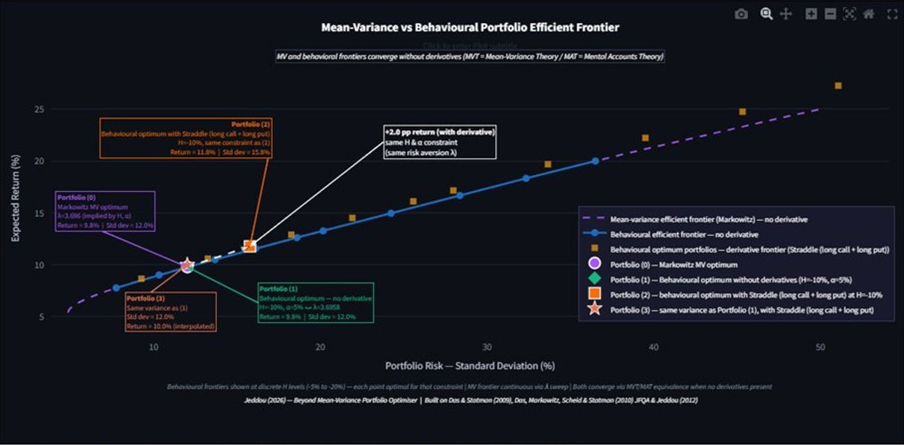
Reading the Chart
Chart legend
Purple dashed
Mean-variance efficient frontier (Markowitz)
Blue dots
Behavioural efficient frontier — no derivative
Gold squares
Behavioural optimum — derivative frontier
Green diamond
Portfolio (1) — no derivative optimum
Orange square
Portfolio (2) — with derivative, same λ
Coral star
Portfolio (3) — same variance as P(1)
Magenta circle
Portfolio (0) — Markowitz MV optimum
X-axis: Portfolio Risk (Standard Deviation %) | Y-axis: Expected Return (%)
Beyond Mean-Variance Portfolio Optimiser — User Guide
10 / 22

Slide 11
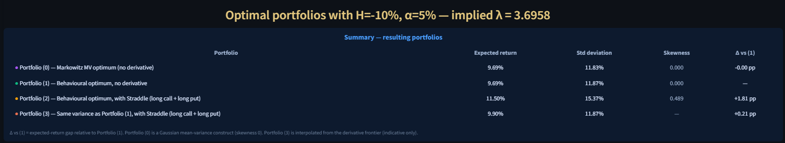
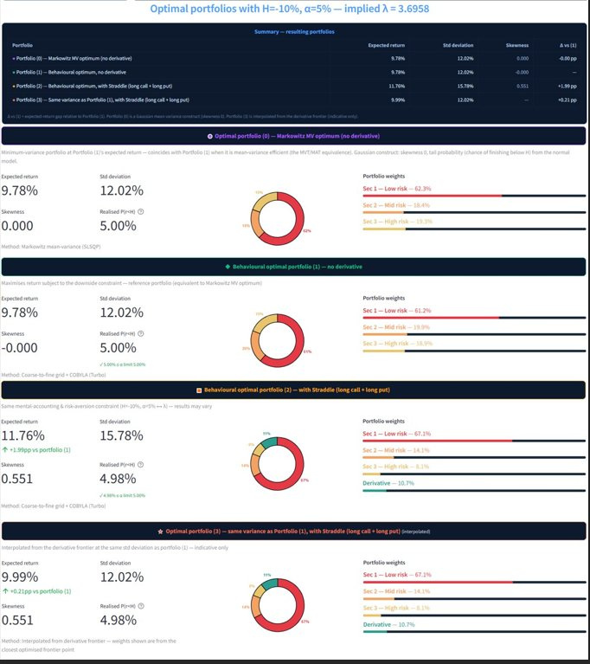
Portfolio Results
Key metrics
Expected return: Annualised mean return of the optimal portfolio
Shortfall / ES: Expected loss in the tail (ES constraint value)
Std deviation: Annualised portfolio volatility (risk measure)
Portfolio weights: Allocation to each security and derivative
Skewness: Asymmetry of return distribution — positive = upside skew
Beyond Mean-Variance Portfolio Optimiser — User Guide
11 / 22

Slide 12


PDF Export
PDF report includes
✓ Cover page with run parameters
✓ Full efficient frontier chart
✓ Portfolio (1), (2), (3) metrics
✓ Weight allocation bar charts
✓ Legal disclaimer
💡 The PDF is generated in-browser — no data is sent externally. Click 'Download PDF report' after the simulation completes.
Beyond Mean-Variance Portfolio Optimiser — User Guide
12 / 22

Slide 13


Scalable Portfolio Optimiser — Monte-Carlo + CVaR
Scenario engine
α-CVaR linear program
Institutional scale
Samples thousands of joint return scenarios through a Gaussian or Student-t copula.
Maximises return subject to a CVaR (Expected-Shortfall) floor — Rockafellar–Uryasev.
Cost grows linearly in the number of assets — dozens of holdings, several derivatives at once.
How to use it
1
Pick assets & scenarios:
Enter tickers and derivatives, choose the copula and the number of Monte-Carlo scenarios.
2
Set the ES floor:
Choose the loss level L; the engine sweeps the return / tail-risk frontier.
3
Read the optimum:
★ marks the chosen portfolio; weights, E[r], realised ES, vol and skew are reported.
Beyond Mean-Variance Portfolio Optimiser — User Guide
13 / 22

Slide 14
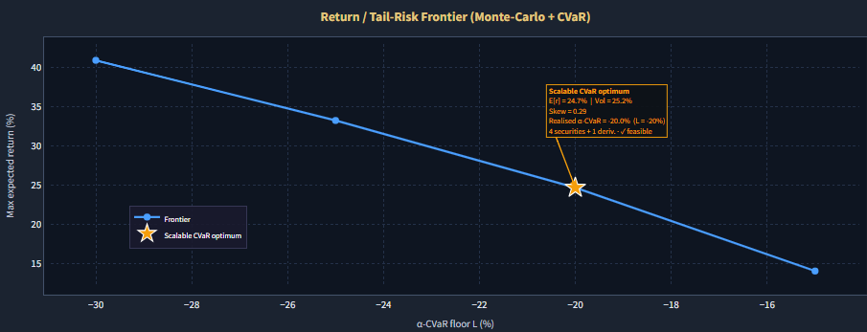
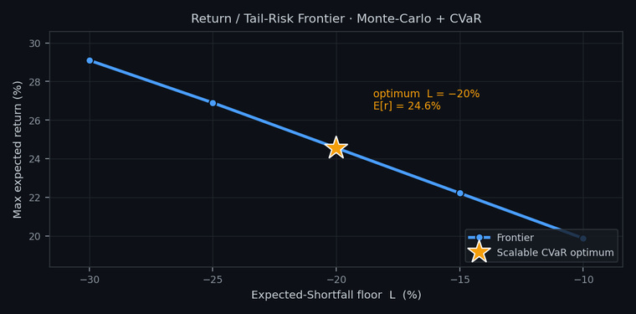
Reading the Scalable output
What you’re seeing
• Curve = the return / tail-risk frontier: the most expected return reachable for each Expected-Shortfall floor L.
• A tighter floor (toward −10%) allows less tail loss and lowers return; a looser one (toward −30%) raises it.
• The ★ is the optimum at your chosen floor (here L = −20%, E[r] = 24.6%).
• Built from Monte-Carlo scenarios solved by a CVaR linear program, so it scales to many assets.
Beyond Mean-Variance Portfolio Optimiser — User Guide
14 / 22

Slide 15
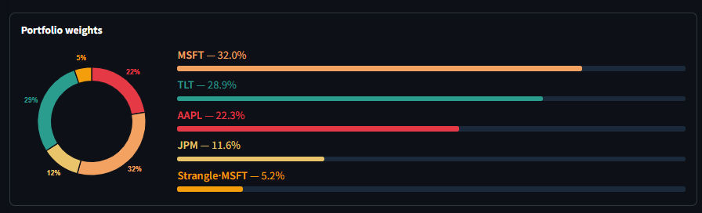
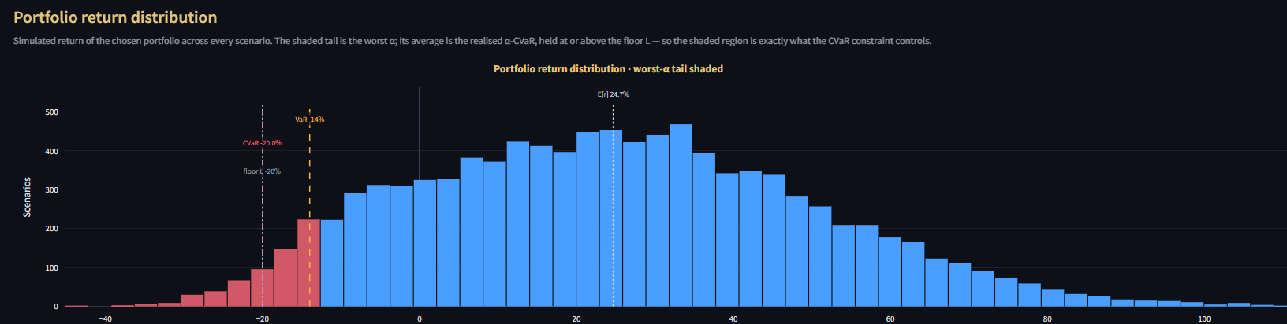
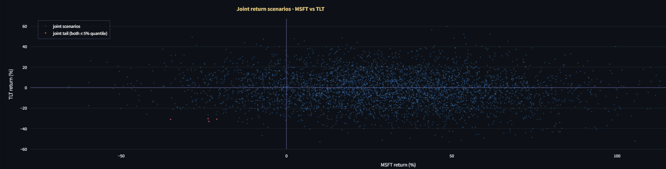
Reading the Scalable output — detail
Beyond Mean-Variance Portfolio Optimiser — User Guide
15 / 22

Slide 16


Out-of-sample back-test
Two windows
Marked to market
Alpha & beta
Build weights on a construction window, then buy-and-hold them through a later evaluation window.
The derivative is repriced each step with Black-Scholes, giving a full realised return path.
Realised alpha, beta and R² of each holding and of the portfolio vs a chosen benchmark.
What you get
1
Expected vs realised:
Return, volatility and the loss-threshold outcome, for P1 (no derivative) and P2 (with).
2
Alpha / beta table:
Per-security and portfolio beta (the regression slope) and annualised Jensen alpha, with R².
3
Optional CAPM:
Enter an expected market return E[Rm] to add a CAPM required return and an ex-ante alpha.
Beyond Mean-Variance Portfolio Optimiser — User Guide
16 / 22

Slide 17
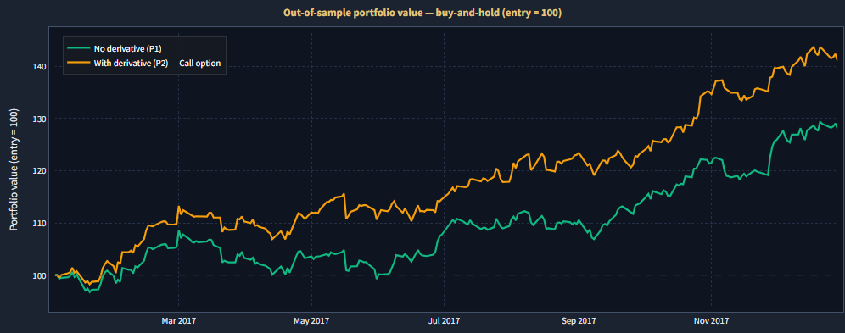
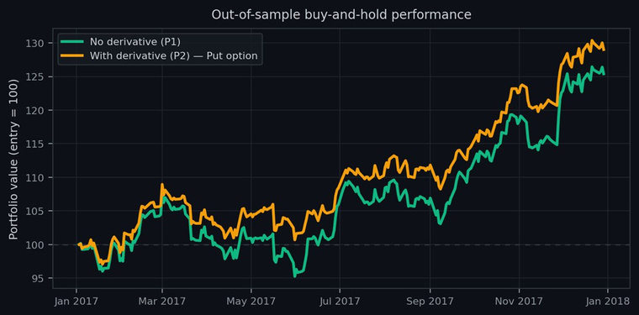
Reading the Backtest output
What you’re seeing
• Out-of-sample value of two optimiser portfolios, rebased to 100 at entry and marked to market.
• Green = Portfolio (1), no derivative; orange = Portfolio (2), with the chosen derivative (a put).
• The derivative line cushions drawdowns and ends higher — the realised hedging benefit on unseen data.
• Realised alpha & beta vs a benchmark are computed from these paths (table beneath the chart in the app).
Beyond Mean-Variance Portfolio Optimiser — User Guide
17 / 22

Slide 18
More tools — Profile, Ticker & Live Portfolio
Risk Profile
Ticker Analytics
Live Portfolio
13-question Grable–Lytton scale → your tolerance band and the parameters H, α, L, with a dated history.
Key figures and CFA-style ratios for any stock, ETF or index, each with a plain-language explanation.
Build and track a real book of securities and derivatives over time, marked to market.
How they fit together
Profile first:
size your risk before optimising.
Then build:
hold and monitor a real portfolio.
Tip:
the Live Portfolio is detailed next.
Beyond Mean-Variance Portfolio Optimiser — User Guide
18 / 22

Slide 19
Live Portfolio — build & track
Holdings + derivatives
Marked to market
Realised analytics
Add securities and option / structured-product positions (puts, calls, collars, spreads, CGN); each row is held from its entry date.
Derivatives are priced with real expiry on their underlying — the same engine as the Backtest.
Return, volatility, Sharpe, drawdown, daily VaR/CVaR, and CAPM alpha, beta and R² vs your benchmark.
Setting it up
Total 100%:
securities + derivatives must sum to 100%.
Inception:
earliest entry date; positions accumulate.
View range:
narrow the analytics to any date window.
Beyond Mean-Variance Portfolio Optimiser — User Guide
19 / 22

Slide 20
Live Portfolio — monitor & stress
Risk vs tolerance
Stress testing
Save to your Drive
Monitor against your limit with VaR (breaches ≤ α) or ES (tail ≥ L); a time-varying mode uses a dated tolerance timeline.
Historical crises (2008–2022) projected forward, custom β-shock paths, and a parametric (vol×, corr→1) stress — with charts.
Sign in with Google to store portfolios in your own Drive (drive.file), or export a portable JSON file.
Saving & privacy
Bundled:
holdings, benchmark, risk settings, profile & timeline.
Privacy:
the app only touches files it created.
Tip:
sign in first, then load your saved portfolio.
Beyond Mean-Variance Portfolio Optimiser — User Guide
20 / 22

Slide 21


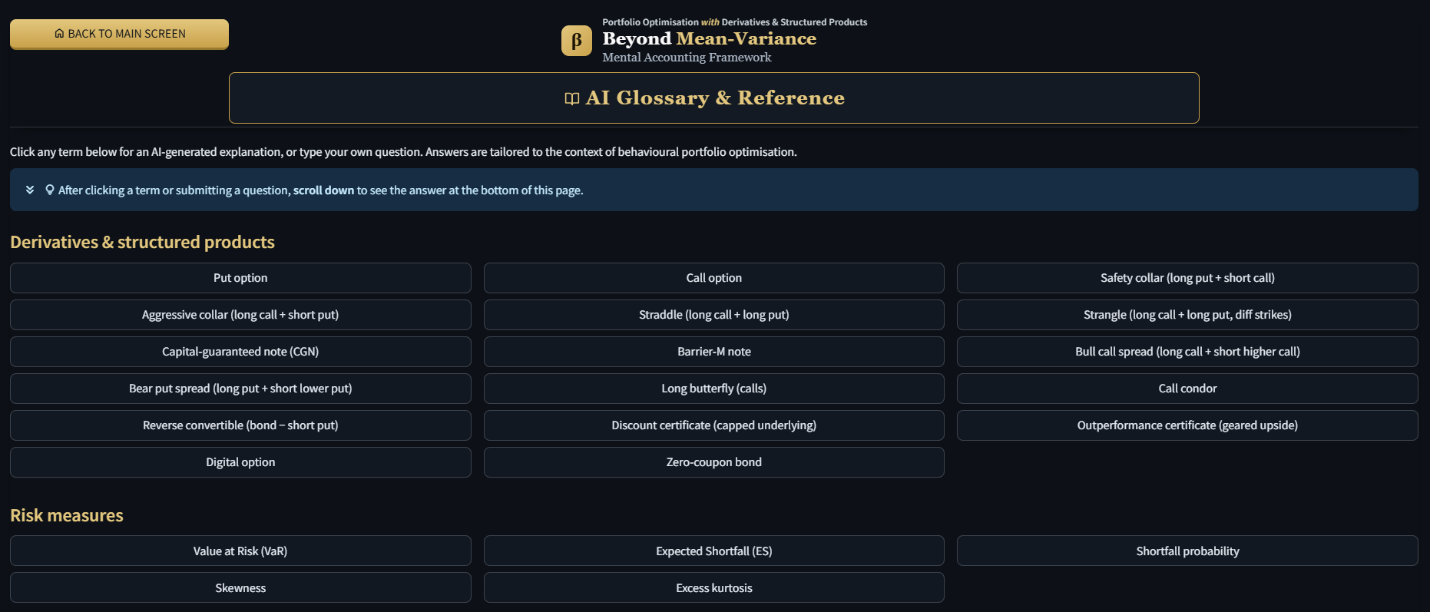
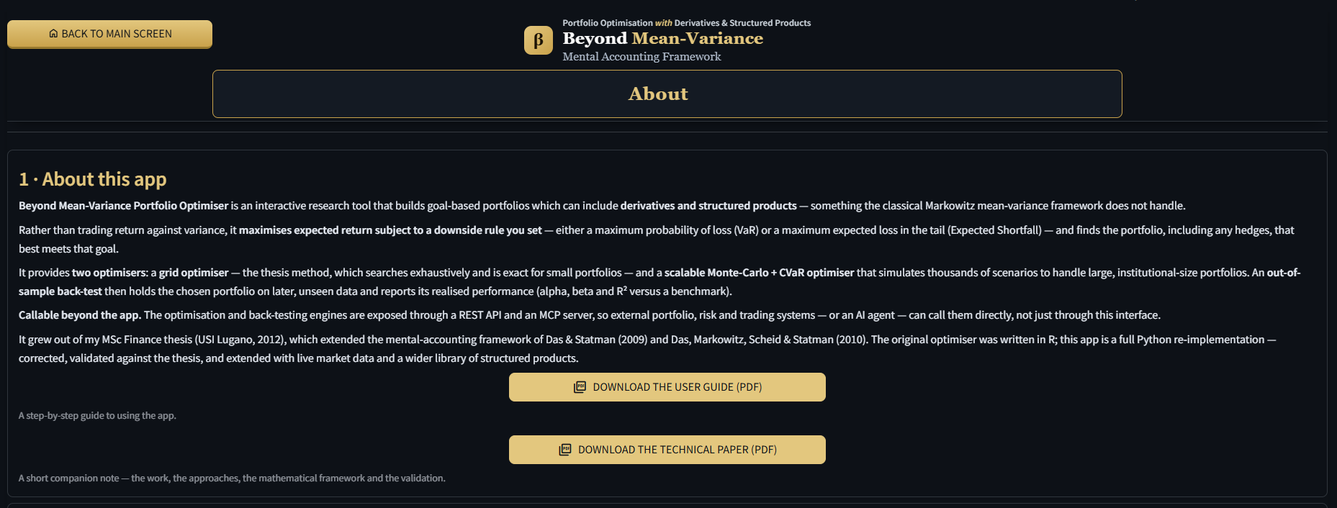
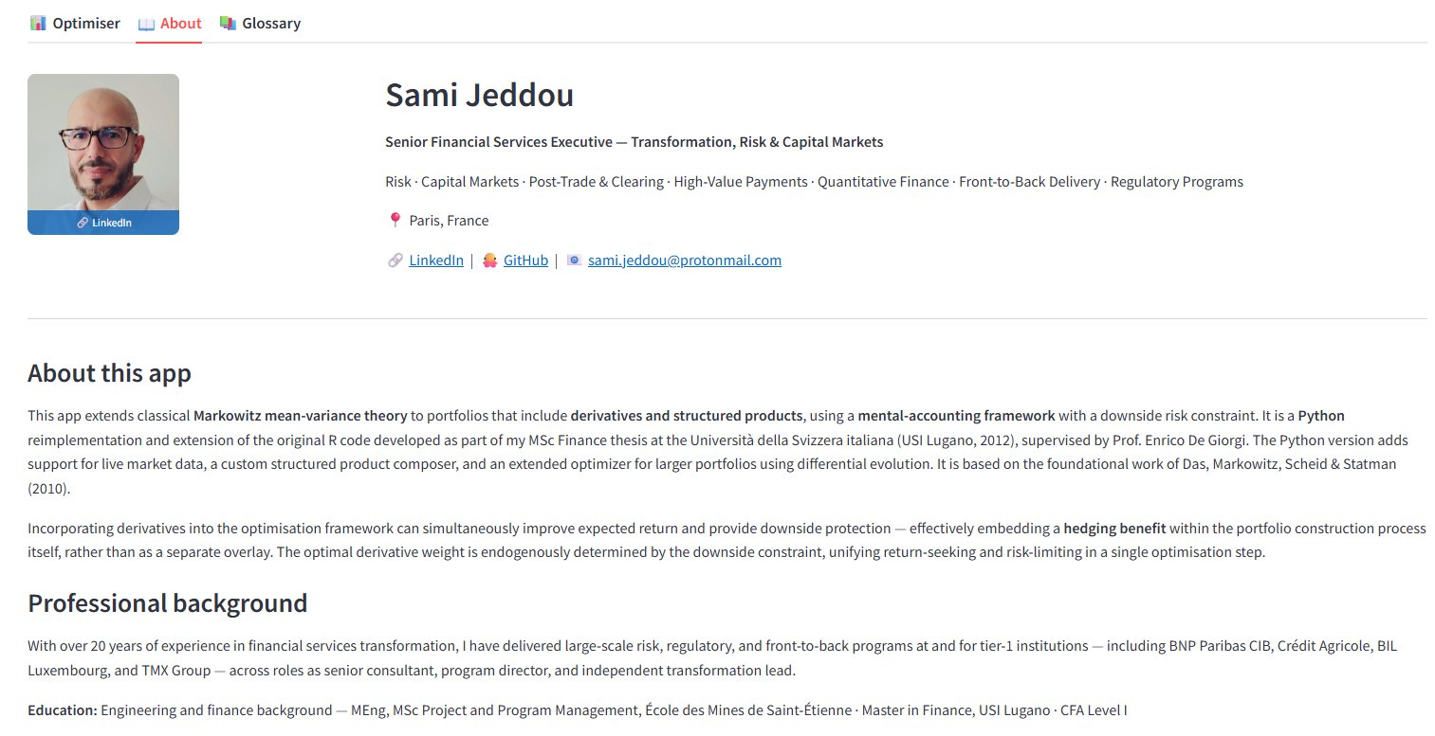
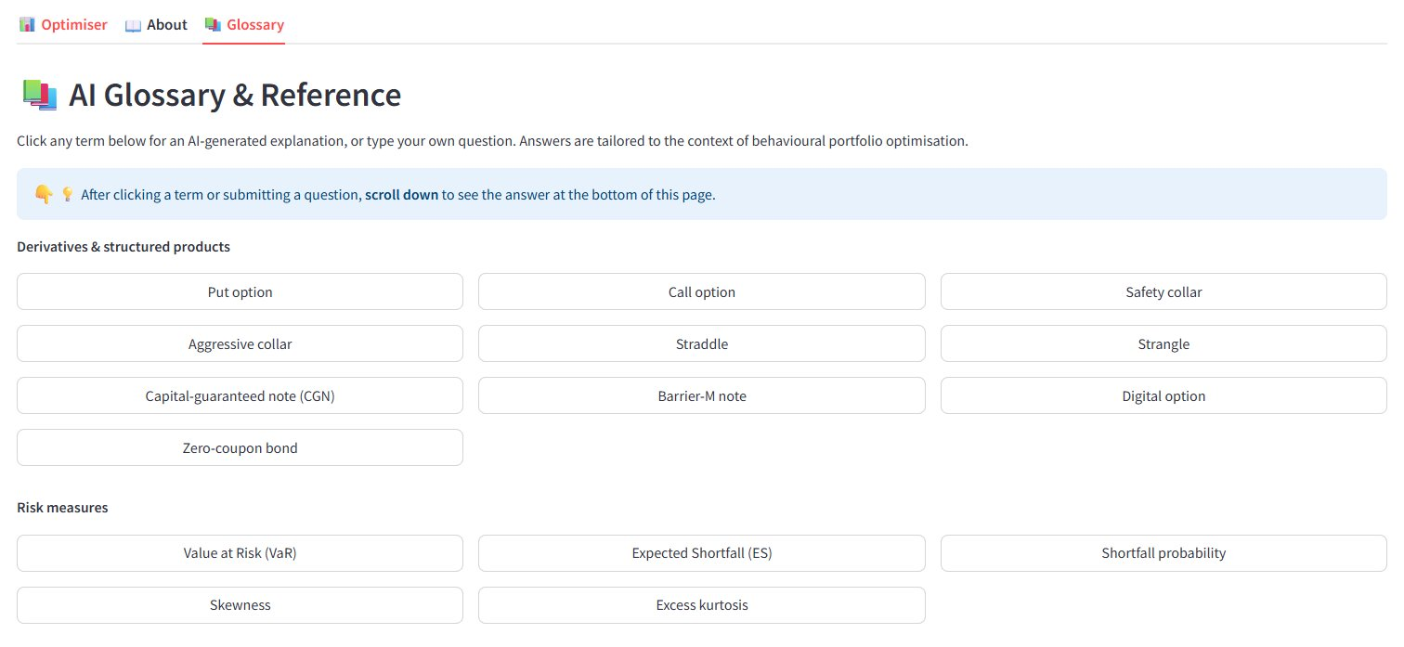
About & Glossary Tabs
About Tab
Glossary Tab
▸ Author background & contact
▸ Click any term for AI explanation
▸ App description & algorithm
▸ Covers derivatives, risk, portfolio theory
▸ Academic references
▸ Ask your own questions
▸ Legal disclaimer
▸ Tailored to behavioural portfolio context
Beyond Mean-Variance Portfolio Optimiser — User Guide
21 / 22

Slide 22
Disclaimer & Contact
⚠️ Legal Disclaimer
This application is based on the mental accounts portfolio optimisation framework of Das & Statman (2009) and Das, Markowitz, Scheid & Statman (2010), as extended in Jeddou (2012). It is provided for educational and research purposes only and does not constitute financial advice, investment recommendations, or a solicitation to buy or sell any financial instrument. Results are purely illustrative and should not be used as the basis for any investment decision.
Academic References
▸ Das, S. & Statman, M. (2009) — Beyond Mean-Variance: Portfolios with Derivatives and Non-Normal Returns in Mental Accounts
▸ Das, S., Markowitz, H., Scheid, J. & Statman, M. (2010) — Portfolio Optimization with Mental Accounts, JFQA Vol.45 No.2
▸ Jeddou, S. (2012) — Beyond Mean-Variance: Options and Structured Products in Behavioral Portfolios, MSc Finance, USI Lugano
🔗 sami-jeddou-behavioral-portfolio-optimizer.streamlit.app | 🔗 LinkedIn
Beyond Mean-Variance Portfolio Optimiser — User Guide
22 / 22

