Slide 1
19CSE342 Wireless and Mobile Communication Mobile IP
J.Govindarajan

Slide 2
Agenda
Optimization
- IP-in-IP Encapsulation
- Minimal Encapsulation
- Generic Routing Encapsulation
Reverse Tunneling
IPv6
IP-Micro Mobility Support
- Cellular IP
- Hawall
- Hierarchical Mobile IPv6
Requirements
Entities and Terminologies
IP Packet Delivery
Agent Discovery
Agent Advertisement
Agent Solicitation
Registration
Tunneling and Encapsulation

Slide 3


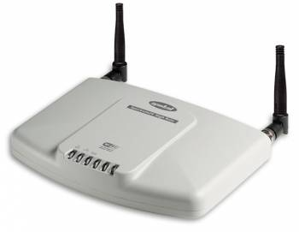



Traditional IP Packet Delivery to Mobile Device (destination)
160.5.10.0/16
IP Packet
Dst: 200.8.4.20
R1
R3
R4
Source
IP Address :
150.10.2.5
IP Packet
Dst: 200.8.4.20
Transmission is Successful
200.8.4.20/16
R5
IP Packet
IP Packet
Segment
Dst: 200.8.4.20
Dst: 200.8.4.20
IP header
IP Packet
Destination IP Address :
200.8.4.20
Dst: 200.8.4.20

Slide 4
Traditional IP Packet Delivery to Mobile Device (destination): Address has changed : Packet Drop
160.5.10.0/16
IP Packet
Dst: 200.8.4.20
R1
R3
Moved
R4
Destination IP Address :
160.5.10.5
Source
IP Address :
150.10.2.5
IP Packet
Destination is not available: Drop the packet
Dst: 200.8.4.20
200.8.4.20/16
R5
IP Packet
Segment
Dst: 200.8.4.20
IP header

Slide 5
Requirements : Mobile Device
To enable mobility in the internet
Mobility should remain invisible to the higher layer protocols (Example: TCP)
High layers (Example :TCP) should continue to work even if the mobile computer has changed its point of attachment
Remain compatible with all lower layers
Enhancing IP for mobility with minimal overhead in message exchange and flooding.

Slide 6
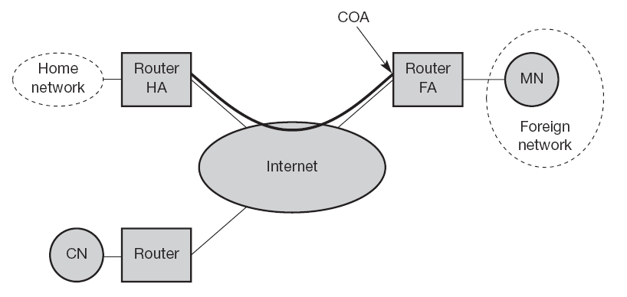
Mobile IP
current location of the MN
Care-Of-Address
Mobile node
Home Agent
Foreign Agent
COA types:
FA COA
Co-located COA
MN - Mobile node
CN - Corresponding Node
HA - Home Agent
FA - Foreign Agent
Correspondent Node

Slide 7
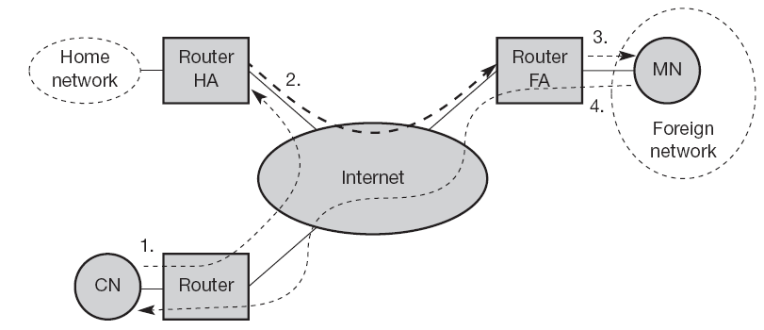
Mobile IP : Data delivery to and from mobile node

Slide 8
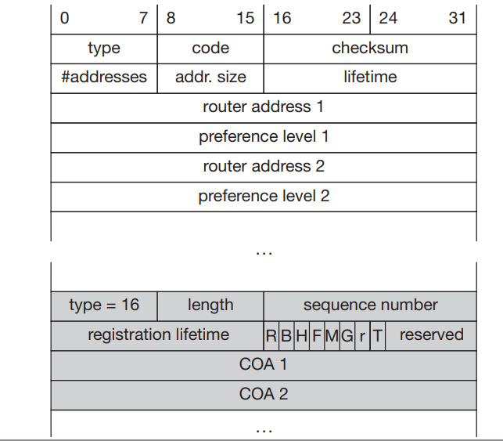
Agent discovery
1) Agent Advertisement
type=9
code=0, if the agent also routes traffic from non-mobile nodes,
code=16, if it does not route anything other than mobile traffic
Standard ICMP advertisement
R bit (registration)
B-Busy to accept the registration
H-Home Agent
F-Foreign Agent
M-Minimal Encapsulation
G-Generic Encapsulation
r-0 (ignored)
T-Reverse Tunnelling is supported by FA
ICMP advertisement - Mobility
type=9
length=6 + 4*(number of addresses)
mobile node can send out three solicitations, one per second, as soon as it enters a new network.
2) Agent solicitation:

Slide 9
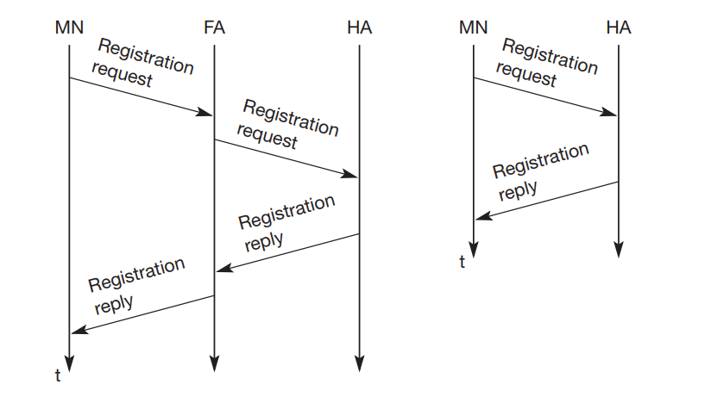
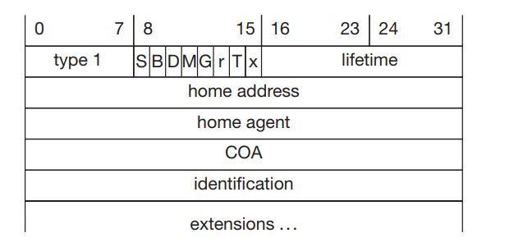
Registration
S bit an MN can specify if it wants the HA to retain prior mobility bindings
B bit -MN also wants to receive the broadcast packets of Home Network
D bit-decapsulation by MN if co-located COA
M-Minimal Encapsulation
G-Generic Encapsulation
r and x-0 (ignored)
Registration request
Registration If the COA is co-located
Registration If the COA is at the FA
Inform the HA of the current location for correct forwarding of pack

Slide 10
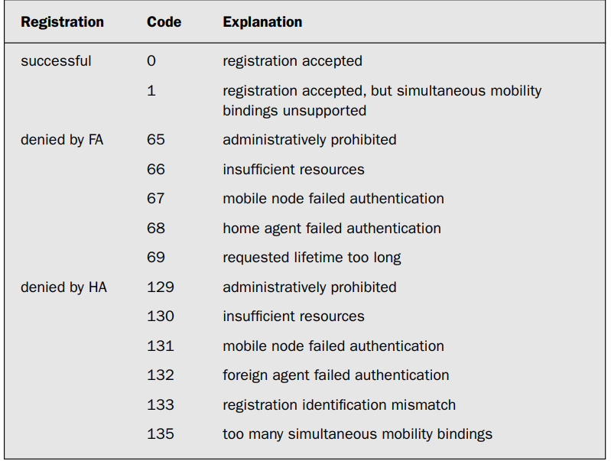
Registration Reply ICMP type =3

Slide 11
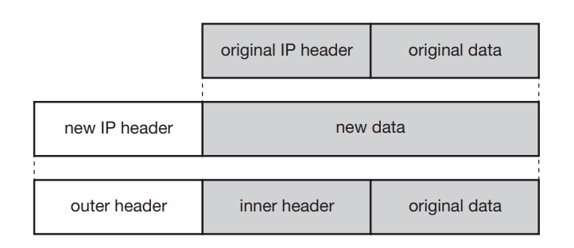
Tunneling and encapsulation
Encapsulation

Slide 12
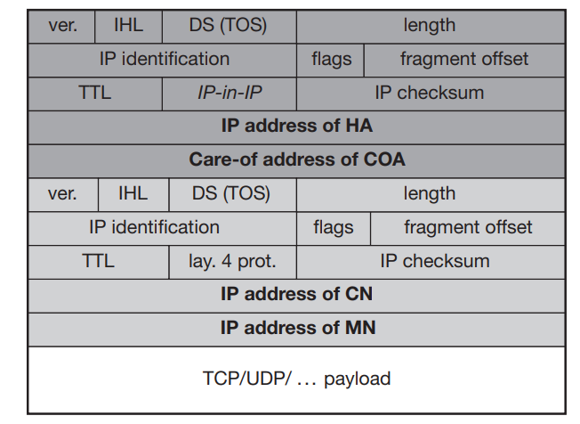
IP-in-IP encapsulation

Slide 13
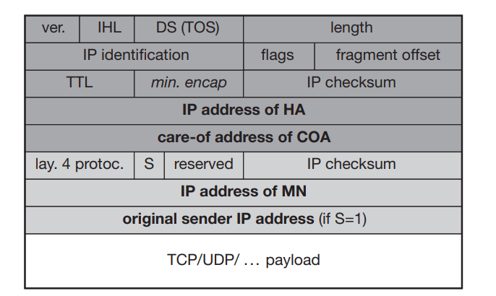
Minimal encapsulation

Slide 14
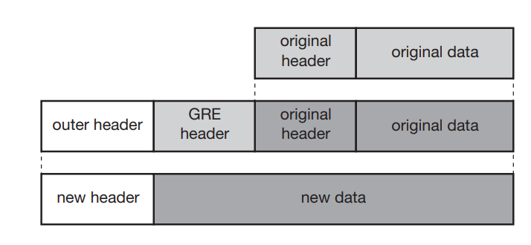
Generic Routing encapsulation

Slide 15
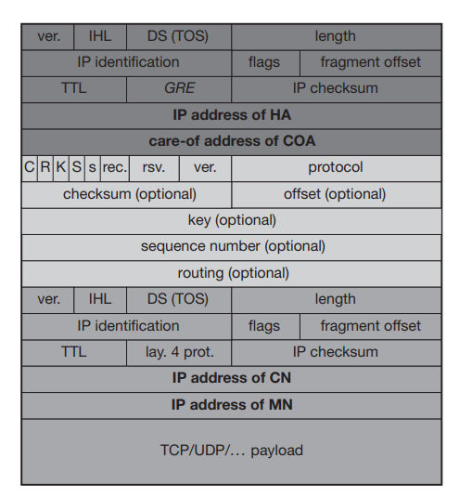
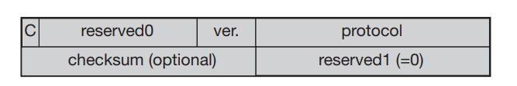
Protocol fields for GRE according to RFC 1701
Protocol fields for GRE according to RFC 2784

Slide 16
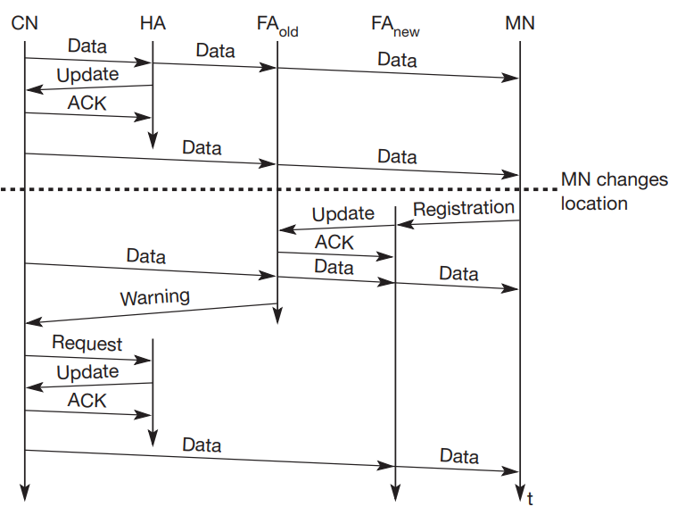
Optimizations
Change of the foreign agent with an optimized mobile IP

Slide 17
Reverse tunneling
Need for reverse tunneling
Firewalls
Multi-cast
TTL
Reverse tunneling creates triangle problem in reverse direction
Security problems related to reverse tunnelling need to be resolved.

Slide 18
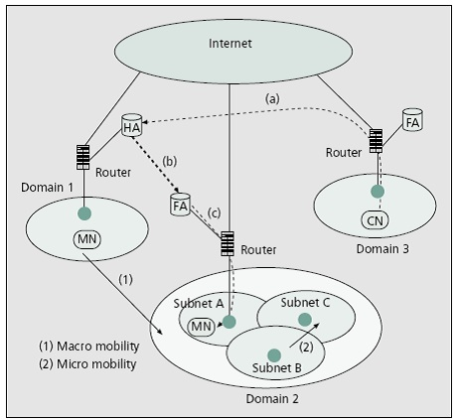
Micro mobility vs Macro mobility

Slide 19
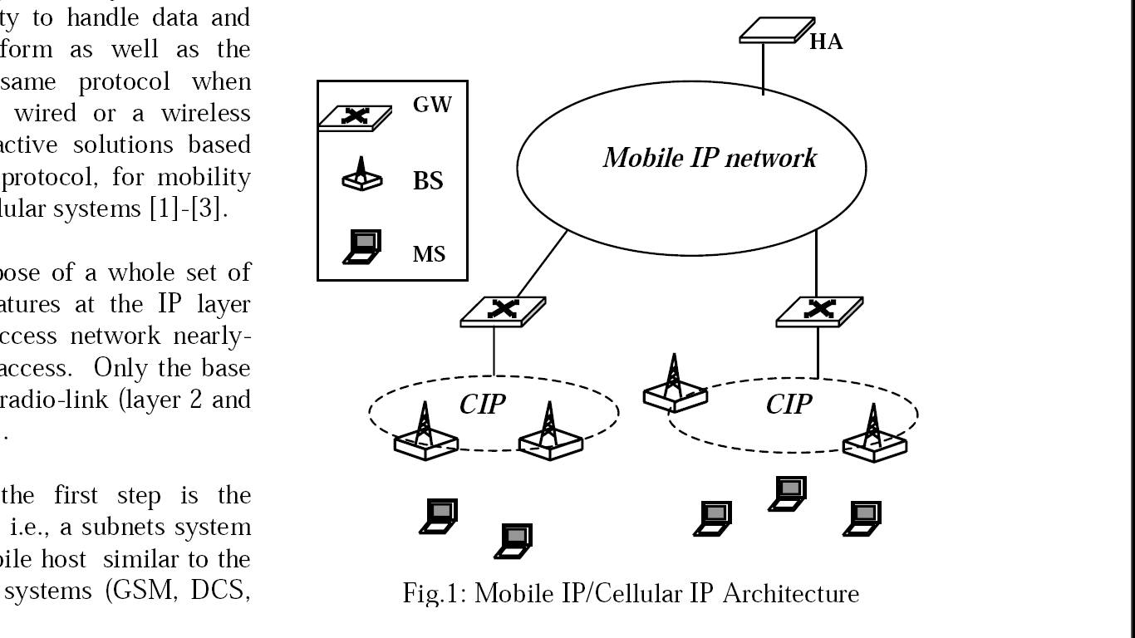
Mobile IP/Cellular IP Architecture

Slide 20
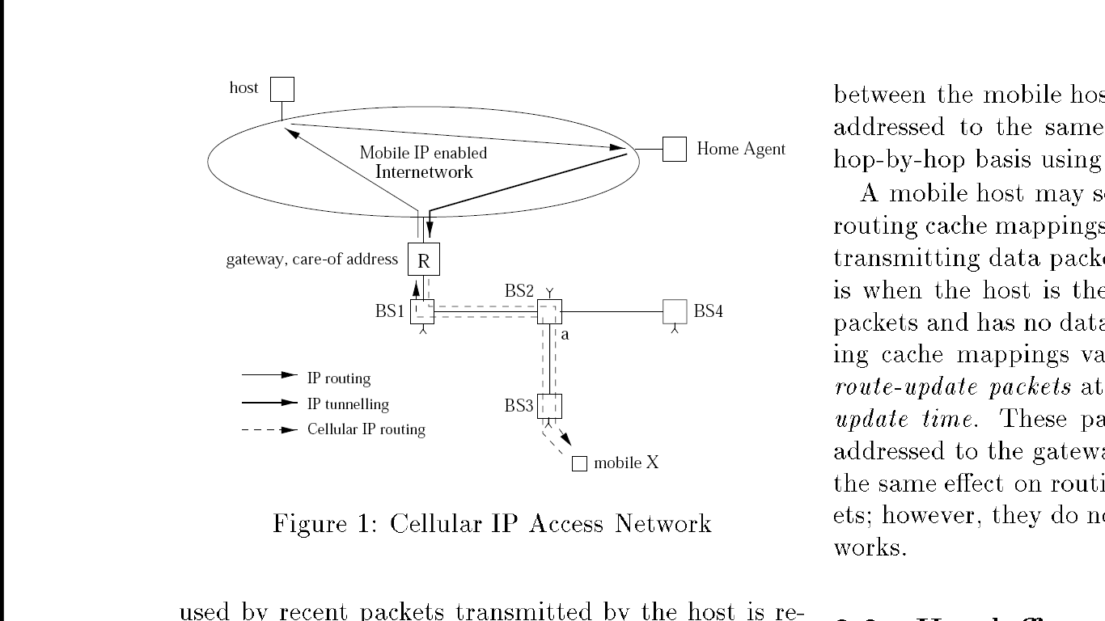
IP Micro-mobility

Slide 21
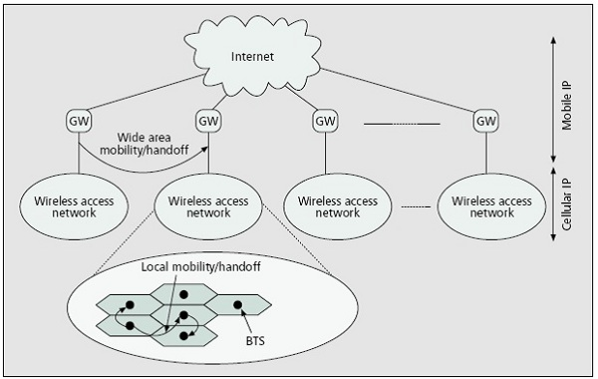
IP Micro-mobility : Cellular IP

Slide 22
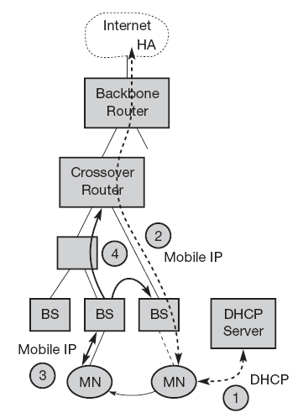
HAWAII
Architecture of HAWAII (Handoff-Aware Wireless Access Internet Infrastructure, Protocol)

Slide 23
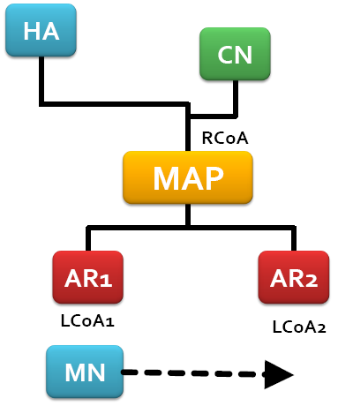
Hierarchical Mobile IP (MIPv6 )
Mobility Anchor Point
access routers

Slide 24
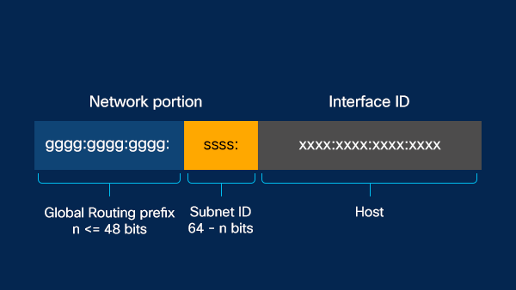
IPv6 and Mobility
Features of IPv6:
Stateless address autoconfiguration
Optional NAT (Network Address Translation)
Easier administration with DHCPv6
Improved quality of service with flow labeling
IP address Format

Slide 25
IPv6 address
Aggregatable Global Address
Link-Local Address
IPv4-Compatible IPv6 Address
Unique Local Address

Slide 26
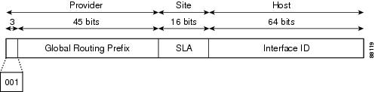
Aggregatable Global Address
Aggregatable global addresses are used on links that are aggregated upward through organizations, and eventually to the Internet service providers (ISPs).

Slide 27
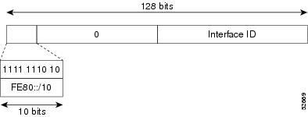
Link-Local Address

Slide 28
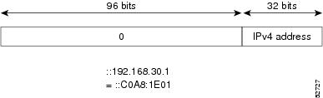
IPv4-Compatible IPv6 Address

Slide 29
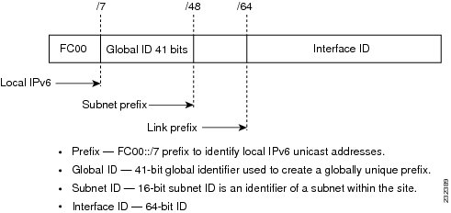
Unique Local Address

Slide 30
IPv6 and Mobile IP
Every mobile node is able to create or obtain a topologically correct address for the current point of attachment.
Every IPv6 node can send binding updates to another node, so the MN can send its current COA directly to the CN and HA.
A soft handover is possible with IPv6.
The FA is not needed any more.
CN only has to be able to process binding updates, i.e., to create or to update an entry in the routing cache
The MN itself has to be able to decapsulate packets, to detect when it needs a new COA, and to determine when to send binding updates to the HA and CN. A HA must be able to encapsulate packets.

Slide 31
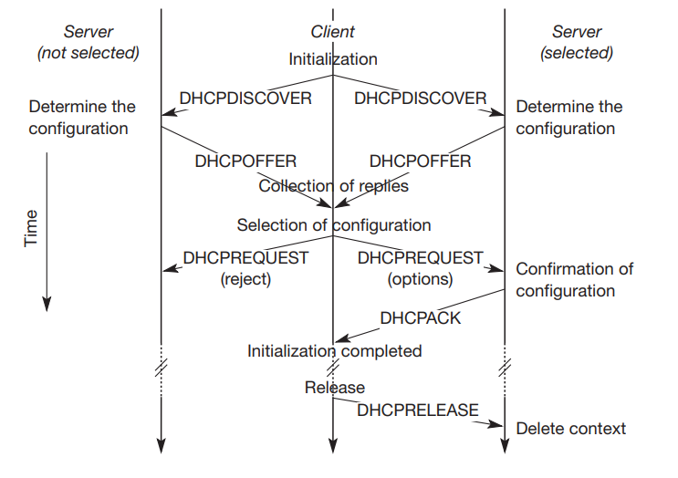
DHCP

