Slide 1
19CSE342 Wireless and Mobile Communication Mobile IP
J.Govindarajan

Slide 2
Agenda
Optimization
- IP-in-IP Encapsulation
- Minimal Encapsulation
- Generic Routing Encapsulation
Reverse Tunneling
IPv6
IP-Micro Mobility Support
- Cellular IP
- Hawall
- Hierarchical Mobile IPv6
Requirements
Entities and Terminologies
IP Packet Delivery
Agent Discovery
Agent Advertisement
Agent Solicitation
Registration
Tunneling and Encapsulation

Slide 3


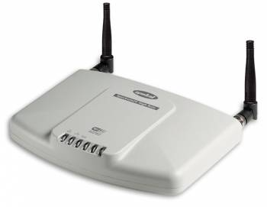



Traditional IP Packet Delivery to Mobile Device (destination)
160.5.10.0/16
IP Packet
Dst: 200.8.4.20
R1
R3
R4
Source
IP Address :
150.10.2.5
IP Packet
Dst: 200.8.4.20
Transmission is Successful
200.8.4.20/16
R5
IP Packet
IP Packet
Segment
Dst: 200.8.4.20
Dst: 200.8.4.20
IP header
IP Packet
Destination IP Address :
200.8.4.20
Dst: 200.8.4.20

Slide 4
Traditional IP Packet Delivery to Mobile Device (destination): Address has changed : Packet Drop
160.5.10.0/16
IP Packet
Dst: 200.8.4.20
R1
R3
Moved
R4
Destination IP Address :
160.5.10.5
Source
IP Address :
150.10.2.5
IP Packet
Destination is not available: Drop the packet
Dst: 200.8.4.20
200.8.4.20/16
R5
IP Packet
Segment
Dst: 200.8.4.20
IP header

Slide 5
Requirements : Mobile Device
To enable mobility in the internet
Mobility should remain invisible to the higher layer protocols (Example: TCP)
High layers (Example :TCP) should continue to work even if the mobile computer has changed its point of attachment
Remain compatible with all lower layers
Enhancing IP for mobility with minimal overhead in message exchange and flooding.

Slide 6
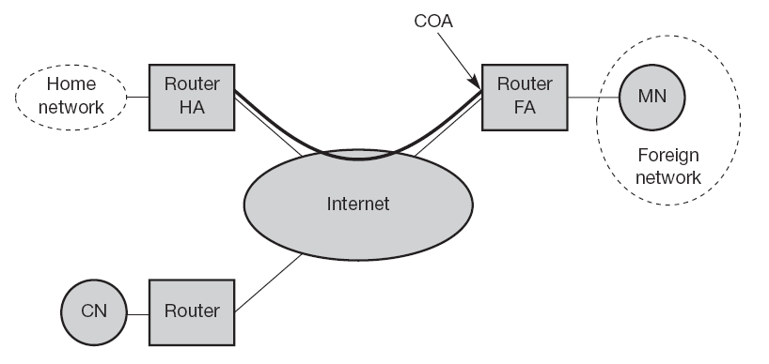
Mobile IP
current location of the MN
Care-Of-Address
Mobile node
Home Agent
Foreign Agent
COA types:
FA COA
Co-located COA
MN - Mobile node
CN - Corresponding Node
HA - Home Agent
FA - Foreign Agent
Correspondent Node

Slide 7
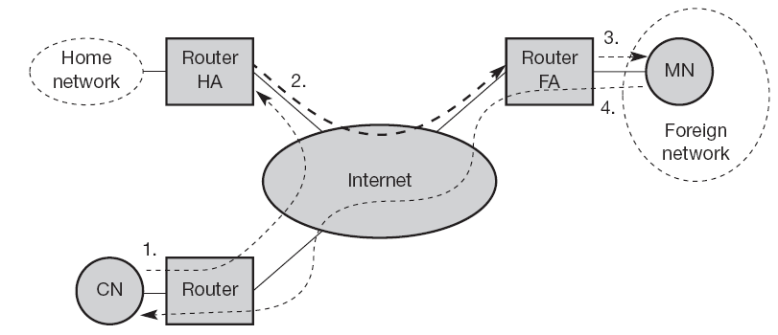
Mobile IP : Data delivery to and from mobile node

Slide 8
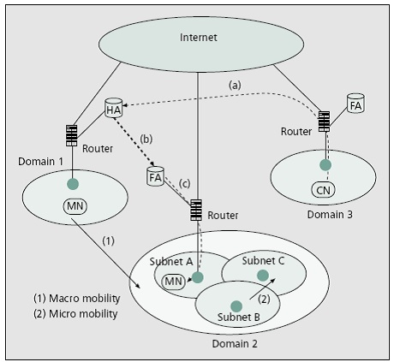
Micro mobility vs Macro mobility

Slide 9
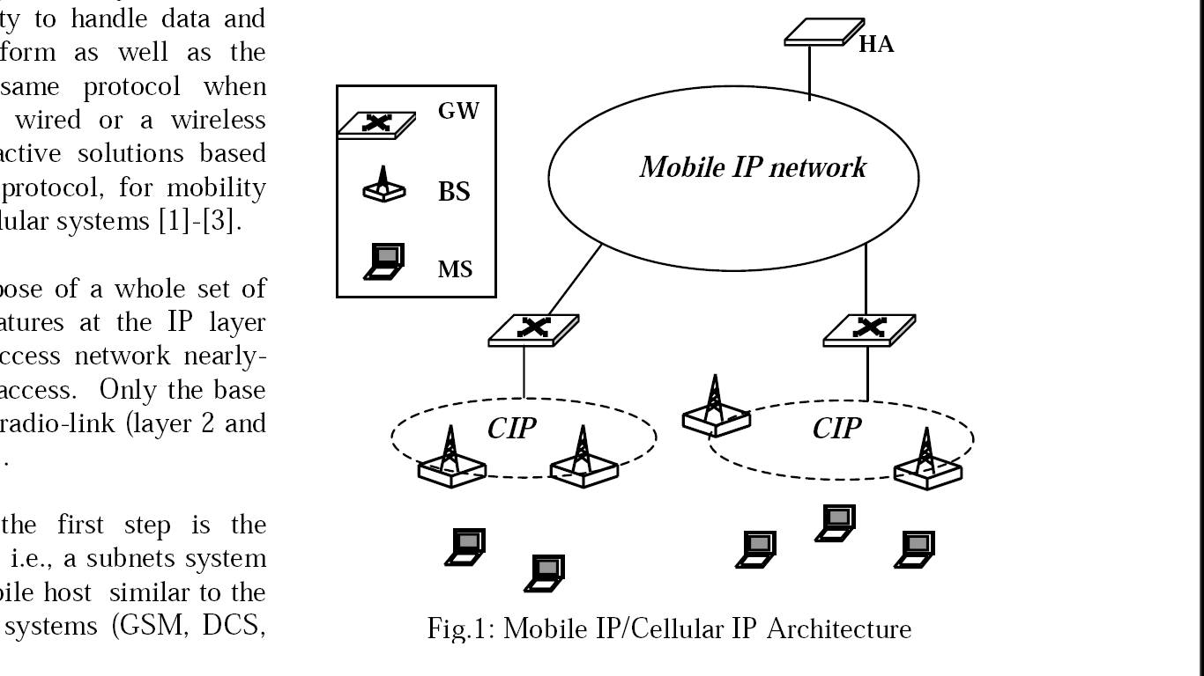
Mobile IP/Cellular IP Architecture

Slide 10
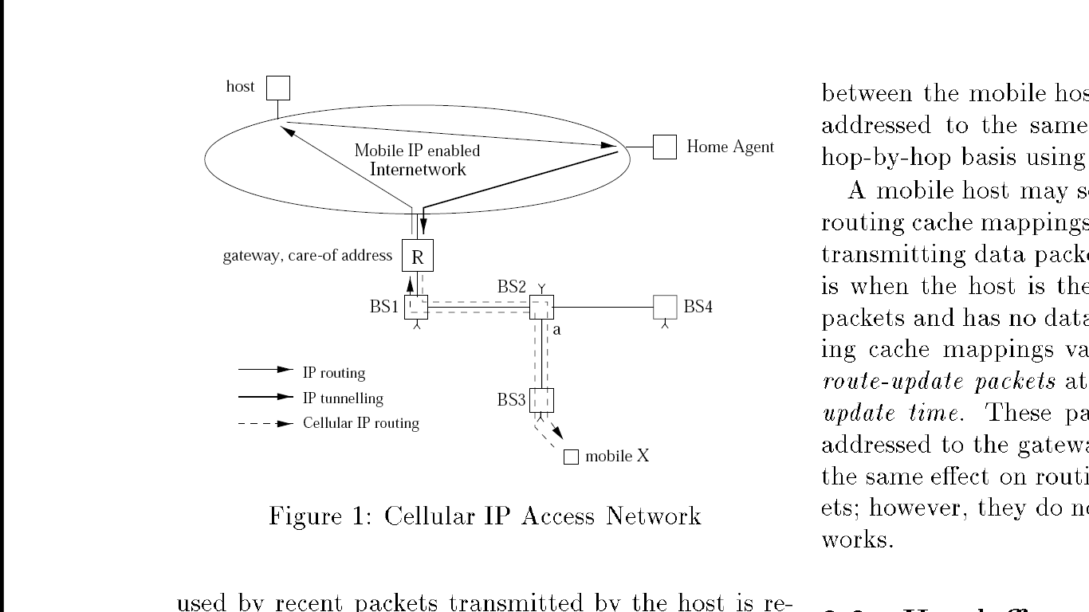
IP Micro-mobility

Slide 11
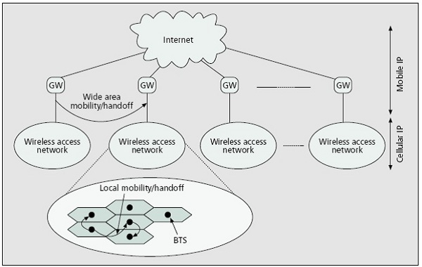
IP Micro-mobility : Cellular IP

Slide 12
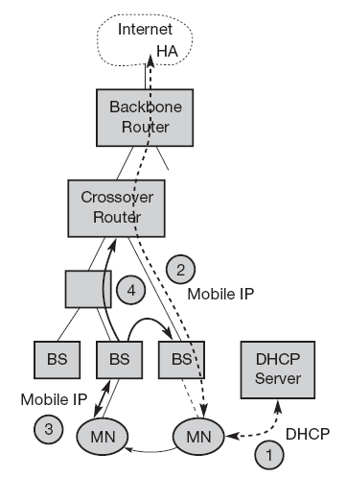
HAWAII
Architecture of HAWAII (Handoff-Aware Wireless Access Internet Infrastructure, Protocol)

Slide 13
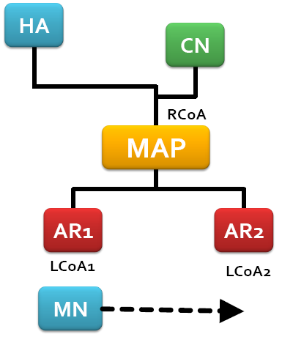
Hierarchical Mobile IP (MIPv6 )
Mobility Anchor Point
access routers

