Slide 1
19CSE342 Wireless and Mobile Communication Mobile Transport Layer
J.Govindarajan

Slide 2
Agenda
Traditional TCP
Congestion control
Slow start
Fast Retransmit/Fast Recovery
Implications of Mobility
Classical TCP improvements
Indirect TCP
Snooping TCP
Mobile TCP
Fast Retransmit/Fast Recovery
Transmission/Timeout Freezing
Selective Transmission
Transaction Oriented TCP

Slide 3
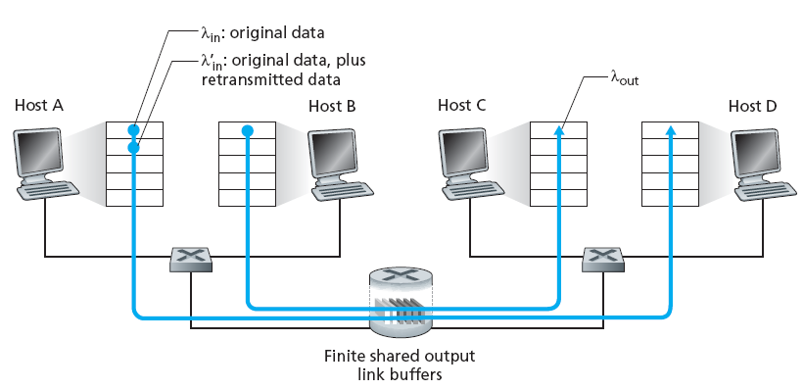
Routers with finite buffers : Congestion

Slide 4
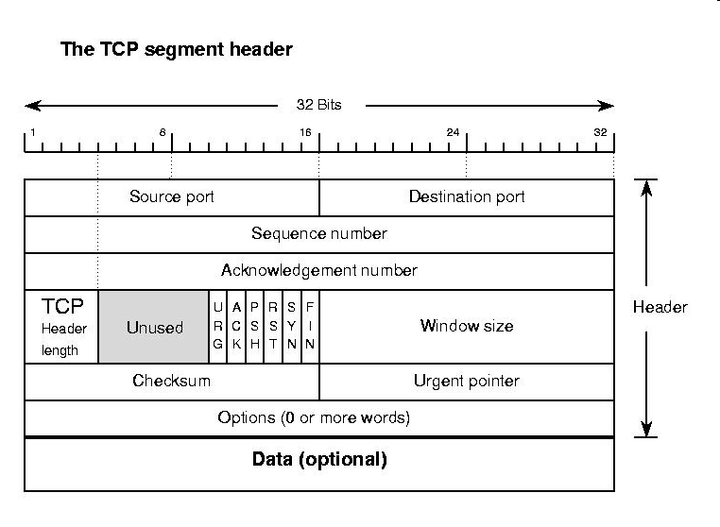
TCP segment Structure

Slide 5
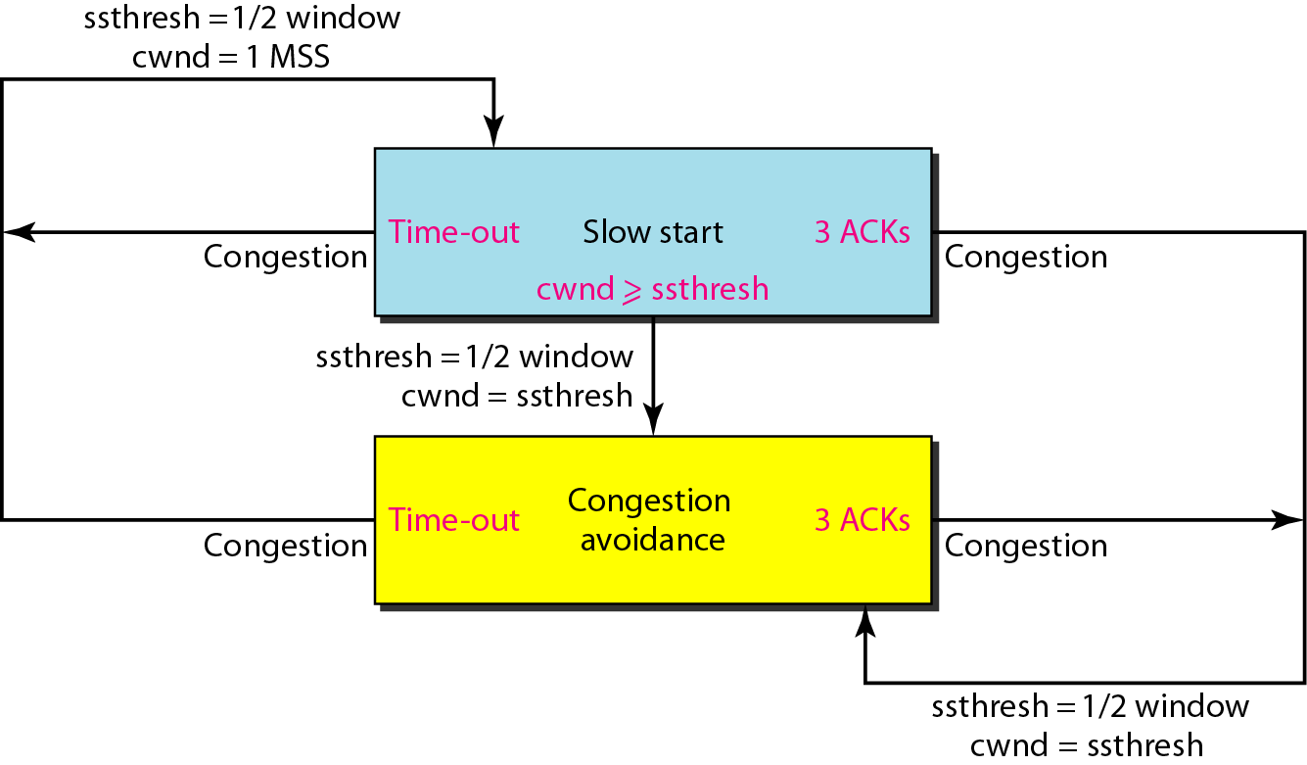
Traditional TCP congestion Control policy summary

Slide 6
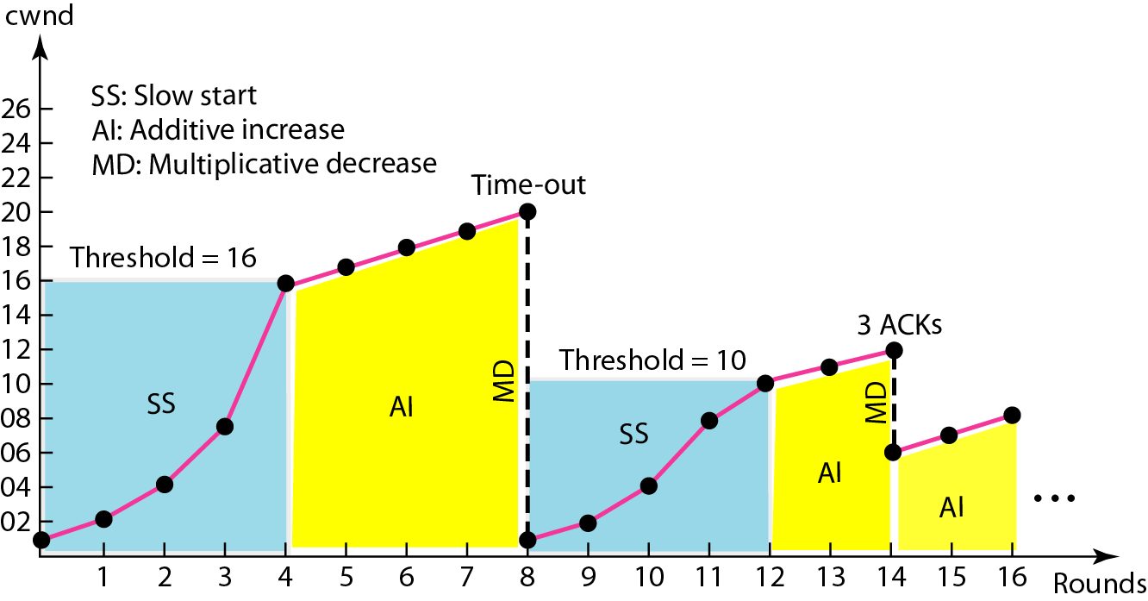
Traditional TCP

Slide 7
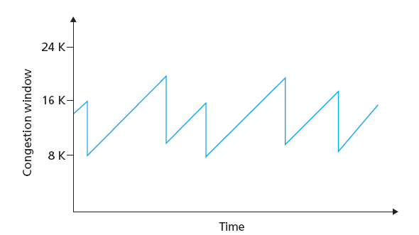
Traditional TCP : AIMD Principle

Slide 8
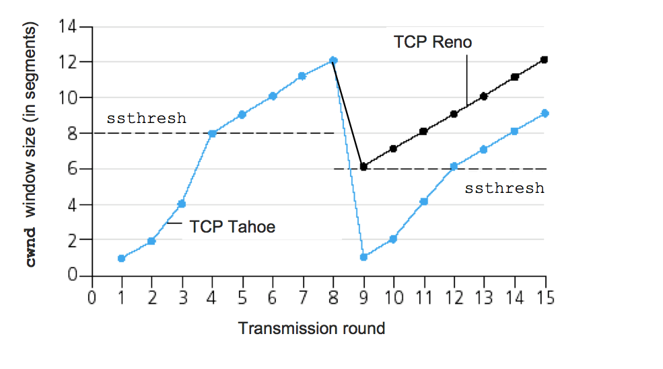
TCP Tahoe vs TCP Reno

Slide 9
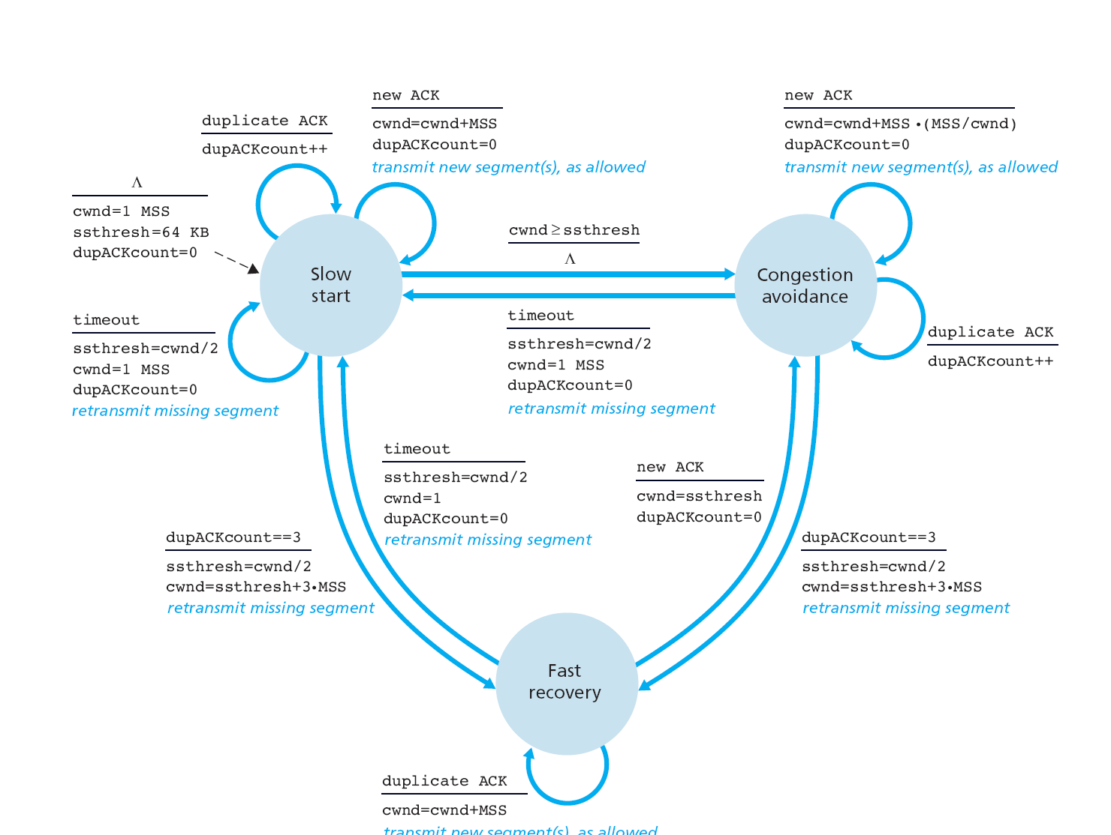
TCP Congestion Control: FSM

Slide 10
TCP : Implications of Wireless and Mobility
TCP consider the Packet loss due to wireless propagation/error and mobility
Hence, unnecessarily reduces the CWND (congestion window) -→ reduces the sending rate
Error rates on wireless links are orders of magnitude higher compared to fixed fiber or copper links
Mobility itself can cause packet loss.
TCP mechanism detecting missing acknowledgements via time-outs and concluding packet loss due to congestion cannot distinguish between the different causes.
unnecessarily reduction of CWND (sending rate)

Slide 11
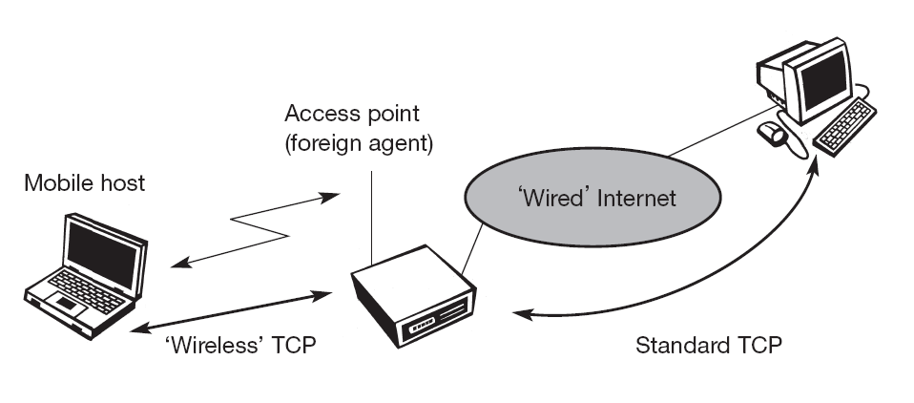
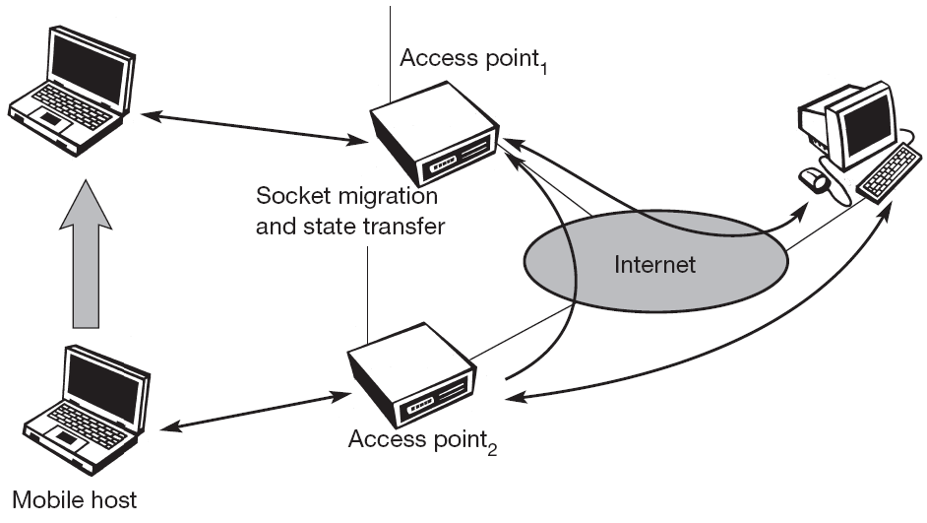
Classical TCP improvements Indirect TCP
Act as a proxy
Socket and state migration after handover of a mobile host
Indirect TCP segments a TCP connection into two parts

Slide 12
I-TCP
Merits
Doesn’t require any change in TCP
Retransmission between Foreign agent and Mobile host
Short RTT
No change in wired network
Different transport protocol can be used in the wireless side.
Demerits:
Violates end-to-end semantics
Handover latency will increase
Foreign agent should be trusted entity

Slide 13
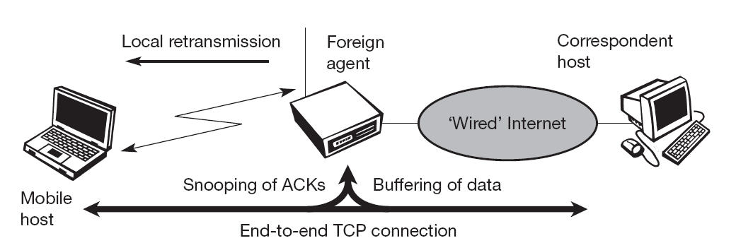
Snooping TCP

Slide 14
Snooping TCP
Merits:
End-to-end semantics is preserved
No change in the correspondent node. The changes only in Foreign agent.
No transfer of the state during the handover
If the foreign agent is modified, standard TCP procedure takes place.
Demerits:
Does not isolate the problems of wireless
NACK is additional mechanism
Snooping does not work if the IP level encryption is applied.

Slide 15
Mobile TCP
What happens to standard TCP in the case of frequent disconnection?
Goals of Mobile TCP (M-TCP): goals of I-TCP + Snooping TCP
Avoid the false reduction in CWND in the case of error.
Maintain End-to-End Semantics
Efficient handover
Retransmission
Supervisory Host (SH)
SH monitors the ACKs from MH.
If there is no ACK from MH (due to disconnection), sets the CWND to 0 and enters into persistent mode.
Reopens the CWND as soon as connectivity is detected.
Optimized TCP
Slow start is not used and hence it needs bandwidth manager

Slide 16
Mobile TCP
Retransmission
Merits:
End-to-end semantics is preserved
Disconnection => shrinks the CWND and reopens after recovery
Does not buffer the data
Supervisory Host (SH)
Optimized TCP
Demerits:
Packet losses due to error propagated to wired link
Requires modification in the Mobile Host

Slide 17
Invoking Fast retransmit/fast recovery during handover
The to artificially force the fast retransmit behavior on the mobile host and correspondent host side.
As soon as the mobile host registers at a new foreign agent using mobile IP, it starts sending duplicated acknowledgements to correspondent hosts.
Merits: Simple design and no need to change FA
Demerits: Delay in handover between HA and FA will affect the transmission
Notes:
s

Slide 18
Transmission/time-out freezing
To address longer interruptions like interruption by the mobile phone system
The MAC layer (which knows the real reason) can inform the TCP layer of an upcoming loss of connection or that the current interruption is not caused by congestion.
TCP can now stop sending and ‘freezes’ the current state of its congestion window and further timers
Merits: TCP connections can resume even after longer interruptions of the connection
Demerits:
All mechanisms rely on the capability of the MAC layer to detect future interruptions.
Freezing the state of TCP does not help in case of some encryption schemes that use time-dependent random numbers

Slide 19
Selective retransmission
TCP can indirectly request a selective retransmission of packets.
The sender can now determine precisely which packet is needed and can retransmit it.
Merits: lowers bandwidth requirements and is extremely helpful in slow wireless links.
Demerits: more buffer is necessary to resequence data and to wait for gaps to be filled.

Slide 20
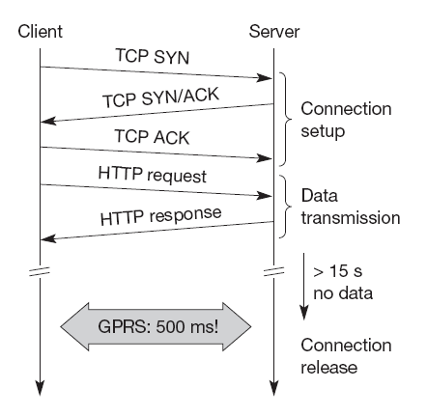
Transaction-oriented TCP
T/TCP can combine packets for connection establishment and connection release with user data packets for short transactions.
This can reduce the number of packets down to two instead of seven.
Merit : Reduction in overhead and time
Demerits : Security problems
not suitable for mobility
TCP connection setup overhead using traditional TCP

