Slide 1
Disease Identification System
Using data science to advance our healthcare system

Slide 2
Why Disease Identification System?
Crowded urgent care and emergency rooms
Patients turned away for lack of hospital beds
Personal connection with healthcare professionals
Using data science and technology where we can

Slide 3
Data Description
Four CSV tables
List of 41 medical conditions with a description for each
List of recommendation for each medical condition
List of 134 unique symptom reported by patients
List of 4920 cases for patients with each row containing the diagnosis and list of symptoms
Published on kaggle.com by Pranay Patil under the name “Disease Symptom Prediction”

Slide 4
Model
A-Priori
A bucket for each patient
New patients will be asked to provide their symptoms
The system will ask the patient about other symptoms that are frequent with the ones the patient provided after running A-Priori algorithm
Collaborative filtering
A Matrix with each row representing a patient case
Run collaborative filtering to find the most k-similar cases and recommend diagnosis

Slide 5
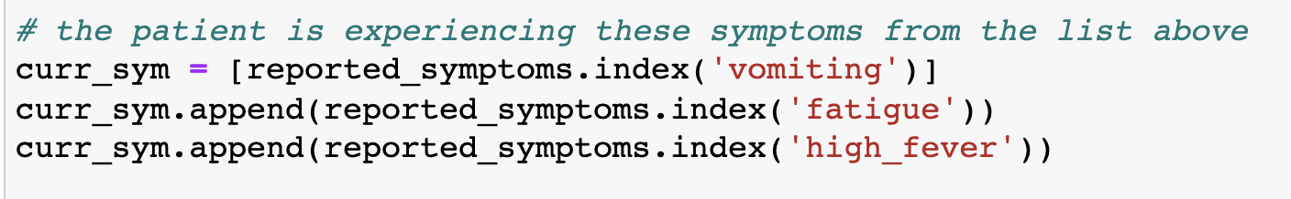
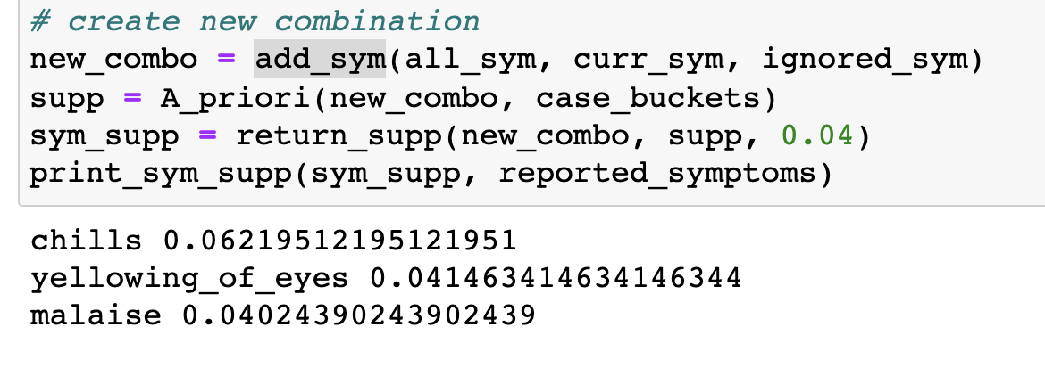
Testing

Slide 6
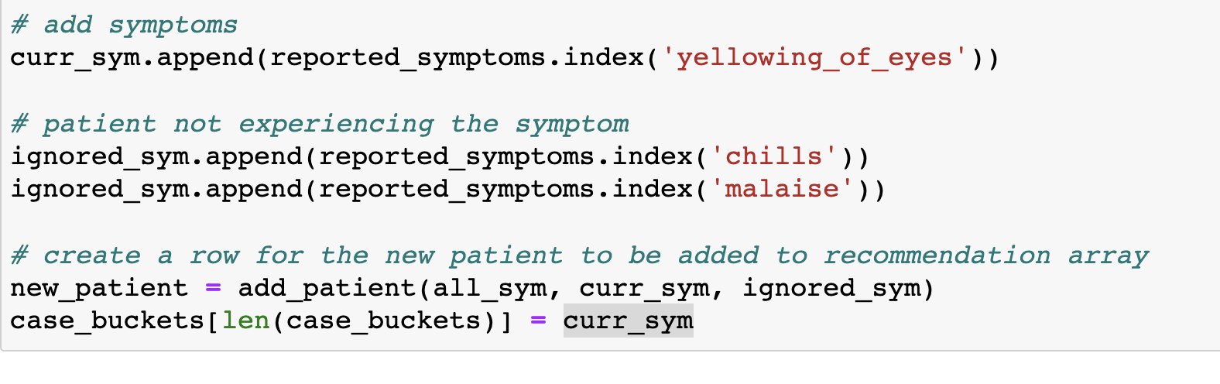
Testing

Slide 7
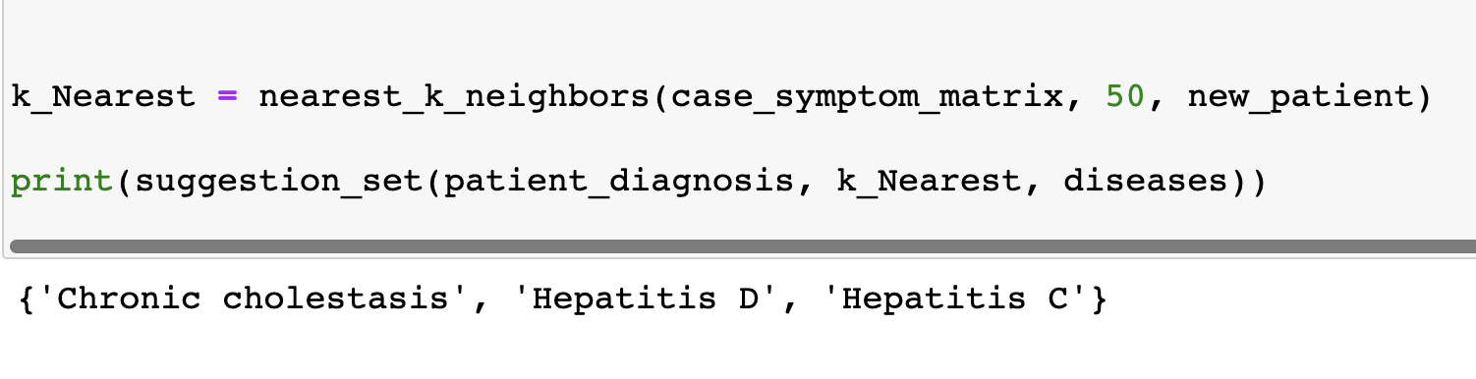
Testing

Slide 8
What Next?
Ask the patients to rate the severity of a symptom from 1 to 10
Use the rating for a more accurate diagnosis for future patients
Work with hospitals to gather more accurate data on patients that includes rating their symptoms

Slide 9
Long Term Goal
System that can accurately diagnose patients
System that is able to recommend lab testing and medications under the supervision of nurses
Tool for healthcare providers to help them narrow down the list of possible diagnosis
Virtual assistance to patients who can’t make it to hospitals

