Slide 1

An Interpretable DenseNet-121 Framework Leveraging Grad-CAM
for Accurate and Robust Grape Leaf Disease Detection
Submitted by:
Name | ID
Ehsanul Haque | 2021-3-60-018
Md. Saymon Hosen Polash | 2022-1-60-171
Rakib Hasan Ovi | 2022-1-60-342
Submitted to:
Md Aminul Kader Bulbul
Lecturer
Department of CSE
04 September, 2025

Slide 2
AGENDA OVERVIEW
01
02
INTRODUCTION
BACKGROUND OF THE STUDY
03
04
DATASET DESCRIPTION
METHODOLOGY
05
06
RESULTS & DISCUSION
FIGURES
07
Grad Cam

Slide 3
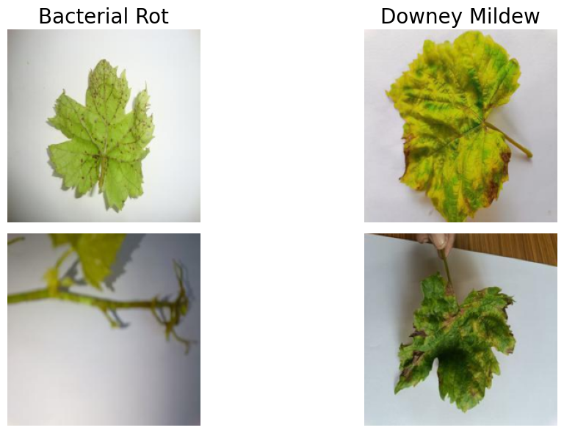
Introduction
Grapes are one of the most widely cultivated fruits worldwide, contributing significantly to the global agricultural economy.However, grape yield and quality are highly susceptible to various leaf diseases, including Bacterial Rot, Downy Mildew,Powdery Mildew, and others. Early and accurate detection of these diseases is crucial for effective vineyard management,reducing crop losses, and minimizing the use of harmful pesticides. Traditional disease detection methods rely on expert visualinspection, which is labor-intensive, time-consuming, and prone to human error, particularly under large-scale field conditions.Recent advances in computer vision and deep learning have enabled automated plant disease detection using image-basedanalysis. Convolutional neural networks (CNNs) and vision transformers have shown promising results in classifying diseasesacross multiple crops.

Slide 4
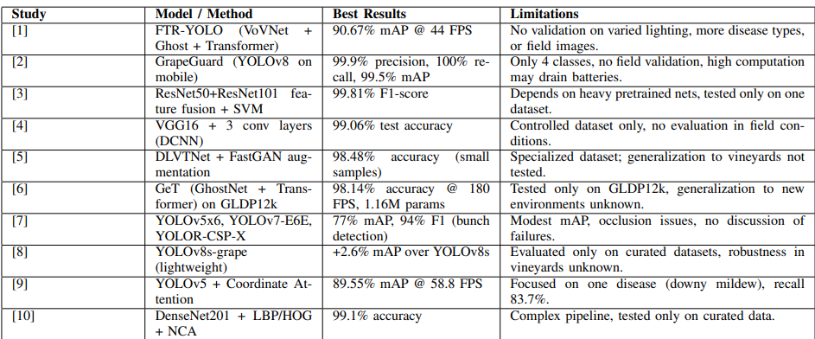
BACKGROUND OF THE STUDY
Summary table of Studies on Grape Disease Detection using Machine Learning:

Slide 5
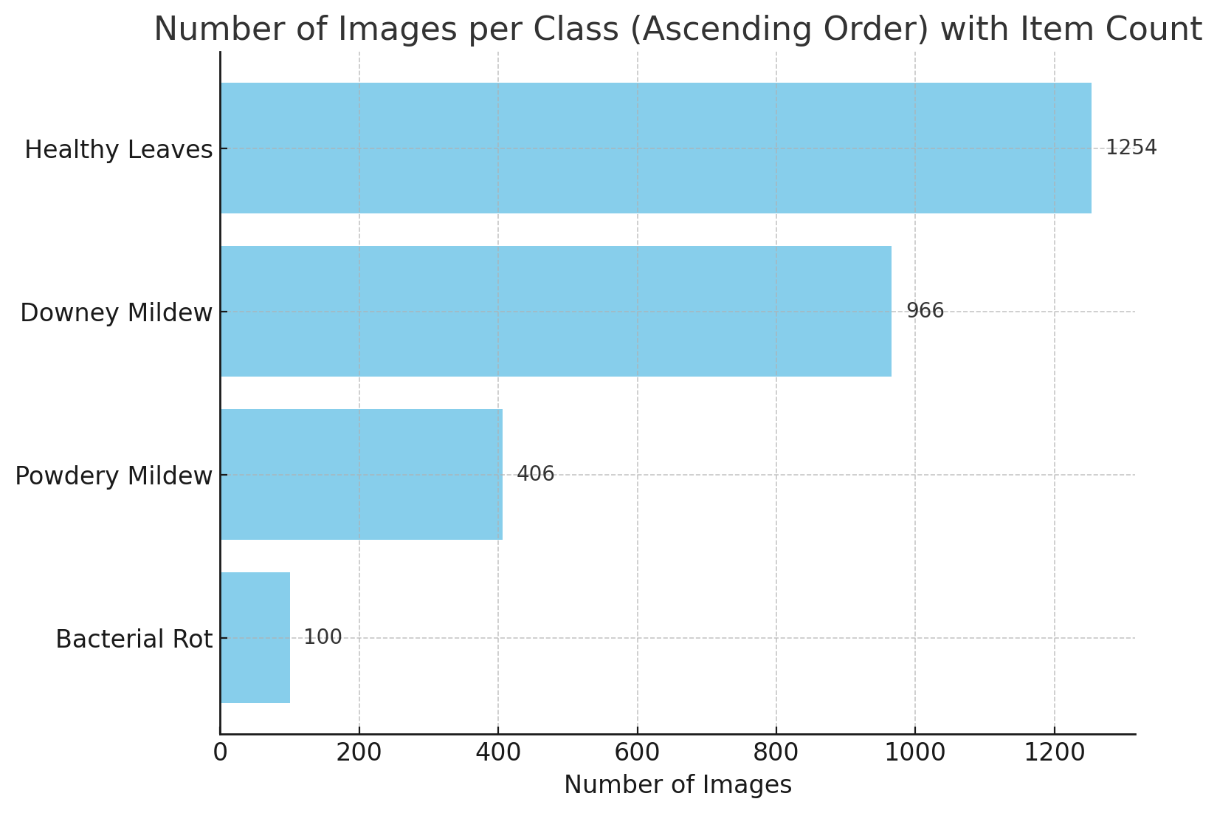
Dataset Description
Niphad Grape Leaf Disease Dataset (NGLD)
Dataset Description
Collection: 2,726 high-quality images of Table Grape leaves
Categories:
Downy Mildew
Bacterial Rot
Powdery Mildew
Healthy Leaves
Purpose:
Ideal for Machine Learning, Plant Pathology, and
Agricultural Research
Used for training AI models to recognize, classify, and
diagnose table grape leaf diseases based on visual
symptoms
Aids in developing automated plant disease detection systems for precision agriculture

Slide 6

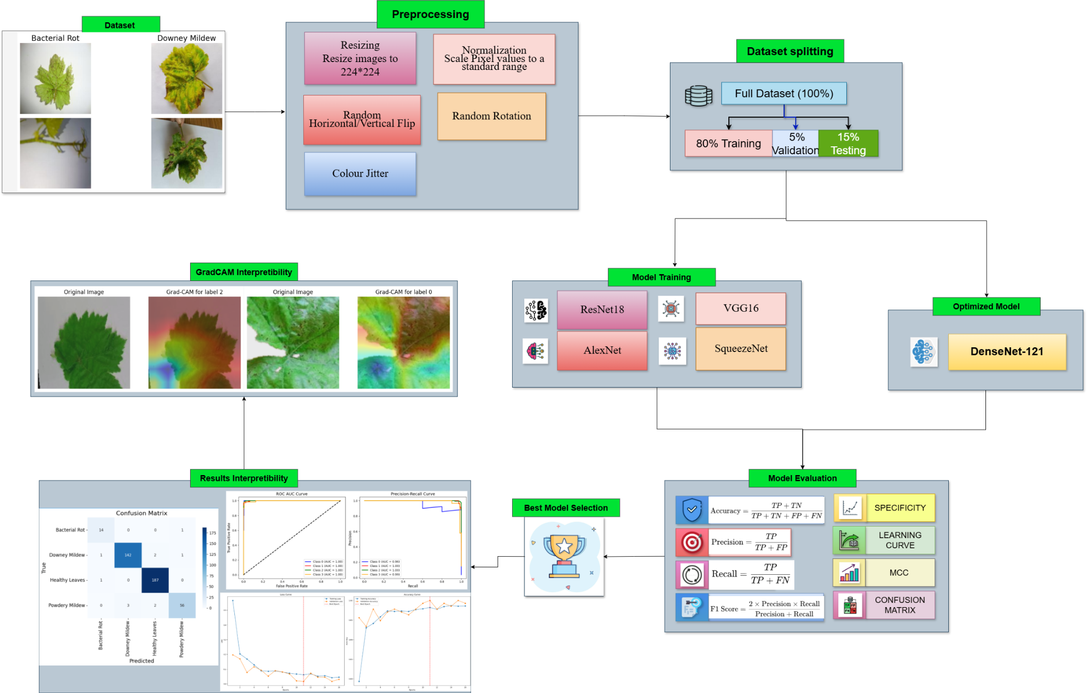





Methodology: A Structured Approach
Our methodology follows a systematic pipeline, ensuring robust model development, rigorous benchmarking, and comprehensive evaluation.
1. Data Transformation
Rezise + Normalization
2. Train-Test Split
Stratified for balance
3. Benchmark Models
Restnet, VGG, Sparsenet, Alexnet
4. Best Model
DenseNet
5. Evaluation Metrics
Accuracy, F1, MCC, Kappa, Specificity, PR-AUC
6. Result Interpretation
Confusion matrix, Accuracy-Loss curve, XAI

Slide 7
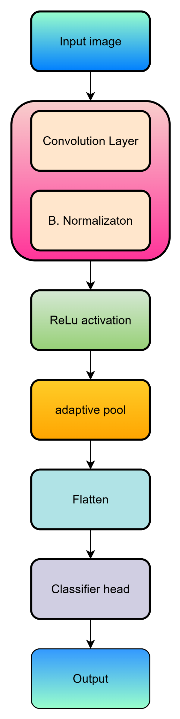
Our Densnet121 Architecture
Input is the starting point where the image is fed into the model.
Convolution layer is responsible for extracting features from the input image using filters.
BN normalizes the input to the next layer, helping improve training efficiency and stability.
The Rectified Linear Unit (ReLU) activation function introduces non-linearity by zeroing out negative values, helping the model learn complex patterns.
Pooling reduces the spatial dimensions of the input feature map, making the model more computationally efficient.
The flattened layer converts the multi-dimensional output from the convolution layers into a one-dimensional vector for input into the fully connected layers.
This CH consists of fully connected layers that make predictions based on the features extracted by the convolution layers.
The final output layer produces the predicted class labels or values.

Slide 8
Advantages:
Efficient Feature Reuse:
Each layer leverages features from all previous layers, improving performance with fewer parameters.
Compact Architecture:
Achieves high accuracy with relatively fewer parameters compared to traditional CNNs.
Effective for Small Datasets:
The model performs well even with limited data, like in specialized datasets (e.g., grape leaf disease detection).
This should highlight the strengths of your custom CNN model and set it apart from other architectures like Restnet, Alexnet, Sparsenet in terms of efficiency and suitability for small datasets.

Slide 9
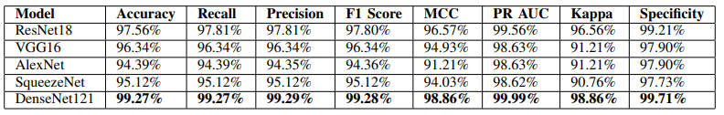
Results & Discussion
Model Performance Comparison
As observed in the table, DenseNet121 outperforms all other models across all the evaluation metrics, achieving the highest values for accuracy, recall, precision, F1 score, MCC, PR AUC, Kappa, and specificity. Specifically, DenseNet121 achieved an accuracy of 99.27%, significantly surpassing the other models, with ResNet18 following closely at 97.56%. The remarkable performance of DenseNet121 highlights its superiority in handling the classification task, particularly when compared to models like AlexNet and SqueezeNet, which exhibited relatively lower accuracies of 94.39% and 95.12%, respectively. The DenseNet121 model’s consistent performance across multiple metrics validates its efficiency and effectiveness for this task.

Slide 10
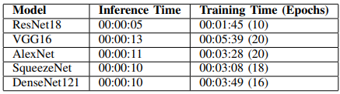
Results & Discussion
Inference and Training Time Comparison
As shown in the table, ResNet18 has the fastest inference time of 00:00:05 and requires the shortest training time of 00:01:45 for 10 epochs. However, the trade-off is its slightly lower performance in accuracy, precision, and recall. VGG16 has a longer training time of 00:05:39 for 20 epochs, with a corresponding increase in validation accuracy, but its inference time is slower compared to ResNet18. AlexNet and SqueezeNet both have relatively fast training times but lag behind in performance metrics such as accuracy and F1 score. On the other hand, DenseNet121 strikes a balance between performance and efficiency with a solid inference time of 00:00:10 and a training time of 00:03:49 for 16 epochs, while outperforming all other models in accuracy, recall, and precision.

Slide 11
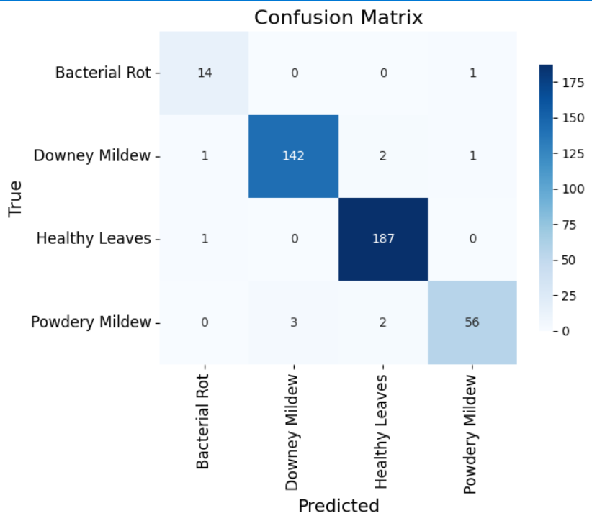
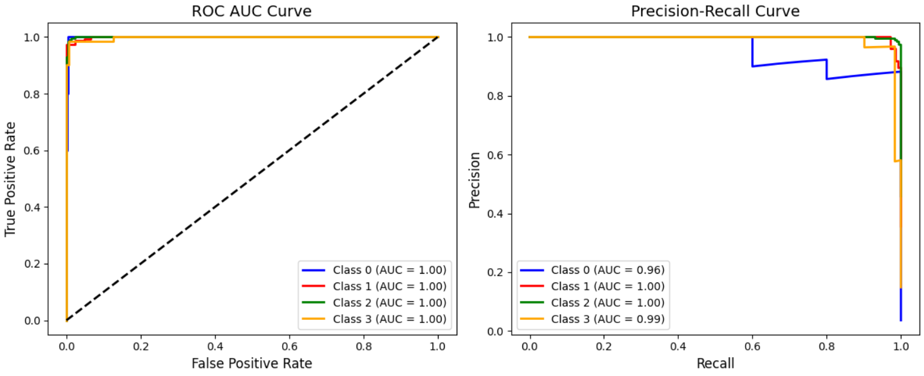
Performance Evaluation Figures
Confusion Matrix
ROC AUC and Precision-Recall Curve
The ROC AUC Curve shows that DenseNet121 has a high true positive rate and low false positive rate, with an AUC value close to 1, confirming its ability to discriminate between classes effectively. The Precision-Recall Curve illustrates that the model maintains high precision and recall, indicating balanced performance in terms of correctly classifying positive samples and minimizing false positives
The Confusion Matrix shows how well the model performs for each class. From the matrix, we can observe that DenseNet121 has a high true positive rate and minimal false positives, indicating its effectiveness in distinguishing between the classes.

Slide 12
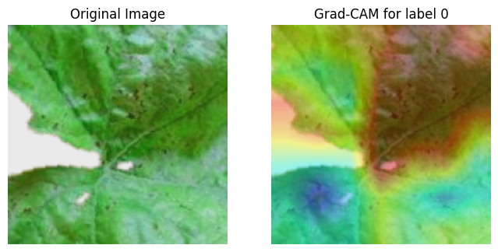
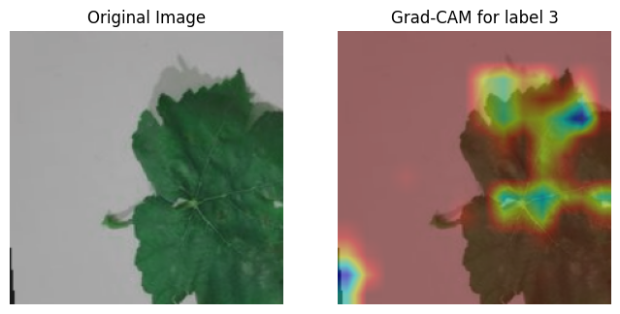
Grad-Cam Interpretation
The following figure demonstrates the Grad-CAM visualization for DenseNet121, showing how the model focuses on the relevant parts of the image for classification.
DenseNet121 consistently focuses on the relevant regions of the image that are critical for classification. The model effectively identifies key features, demonstrating its robustness in distinguishing between various classes. In all the Grad-CAM visualizations, DenseNet121 highlights the most important areas, which indicates the model’s ability to make informed predictions. This behavior remains consistent across different input images, showing that the model is both accurate and reliable. The Grad-CAM images validate the interpretability of DenseNet121 and highlight its potential for real-world applications where model transparency is essential.

Slide 13
THANK YOU

