Slide 1
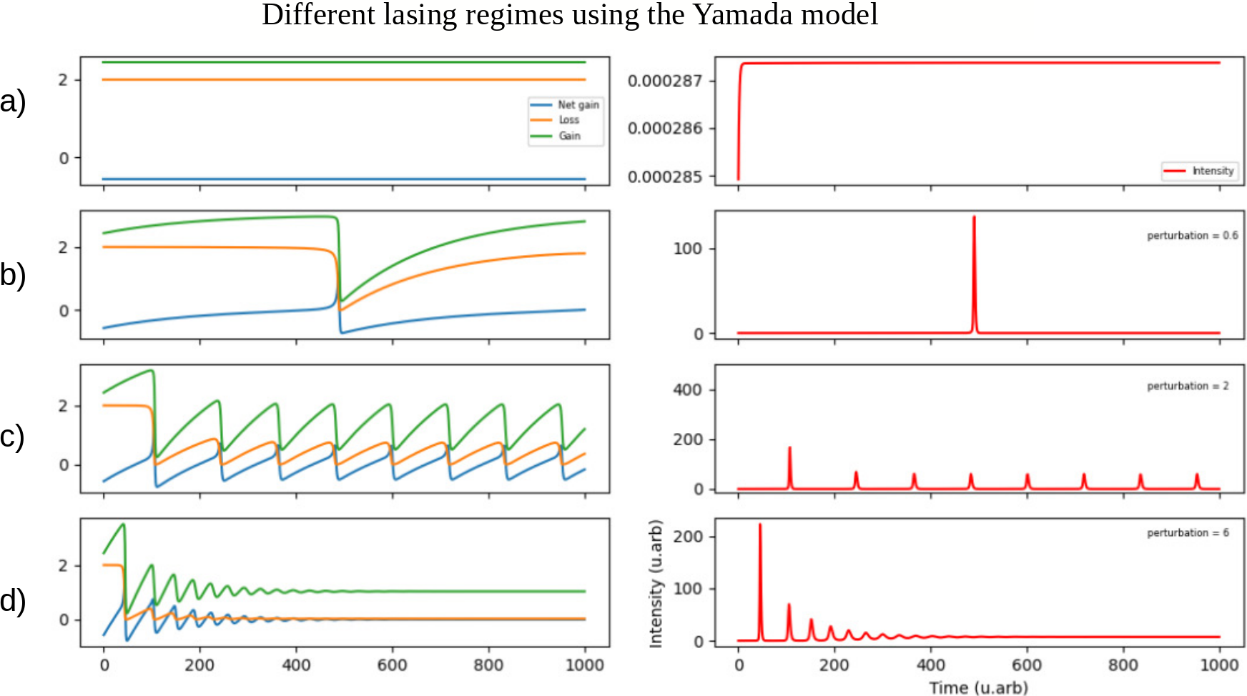
2
0.000287
0.000286
Pump = 2.4
0
0.000285
2
100
Pump = 2.4
+
0
0
2
400
200
Pump = 4.4
0
0
200
2
100
Pump = 8.4
0
0
0 200 400 600 800 1000
0 200 400 600 800 1000
Time (U.arb)

Slide 2
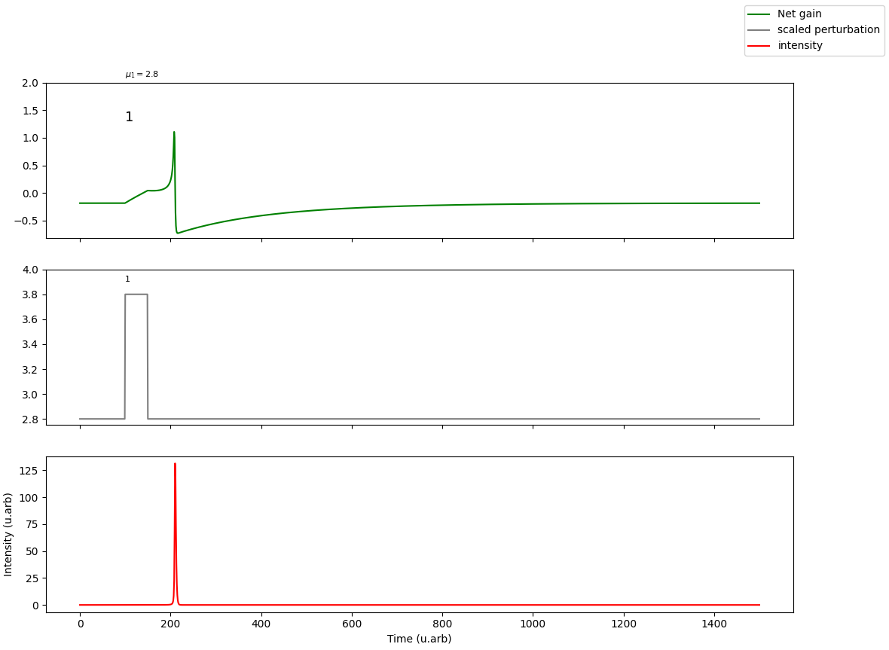
2.0
1.0
Net gain
0
Perturbation
-1.0
Intensity
4.0
3.6
3.2
2.8
125
75
25
0
0 200 400 600 800 1000 1200 1400
Time (U.arb)

Slide 3
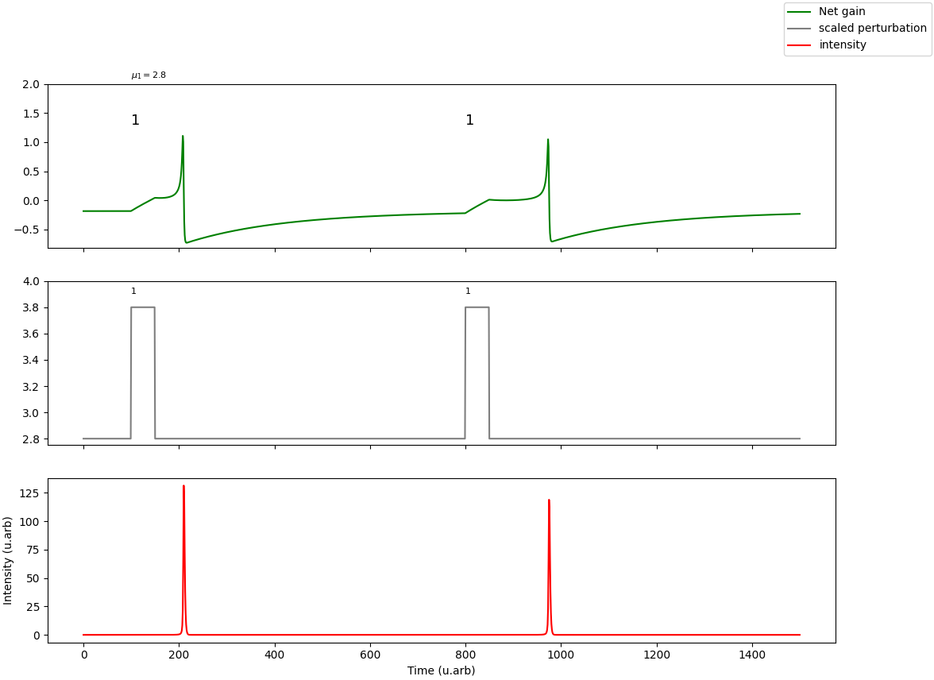
2.0
1.0
Net gain
0
Perturbation
-1.0
Intensity
4.0
3.6
3.2
2.8
125
75
25
0
0 200 400 600 800 1000 1200 1400
Time (U.arb)

Slide 4
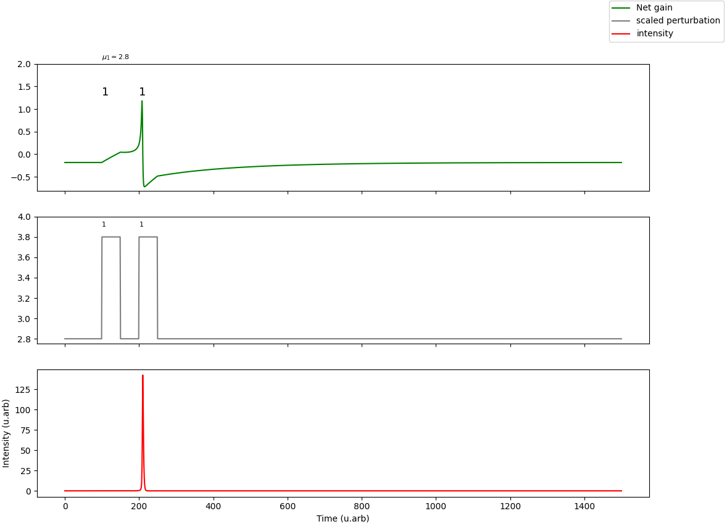
2.0
1.0
Net gain
0
Perturbation
-1.0
Intensity
4.0
3.6
3.2
2.8
125
75
25
0
0 200 400 600 800 1000 1200 1400
Time (U.arb)

Slide 5
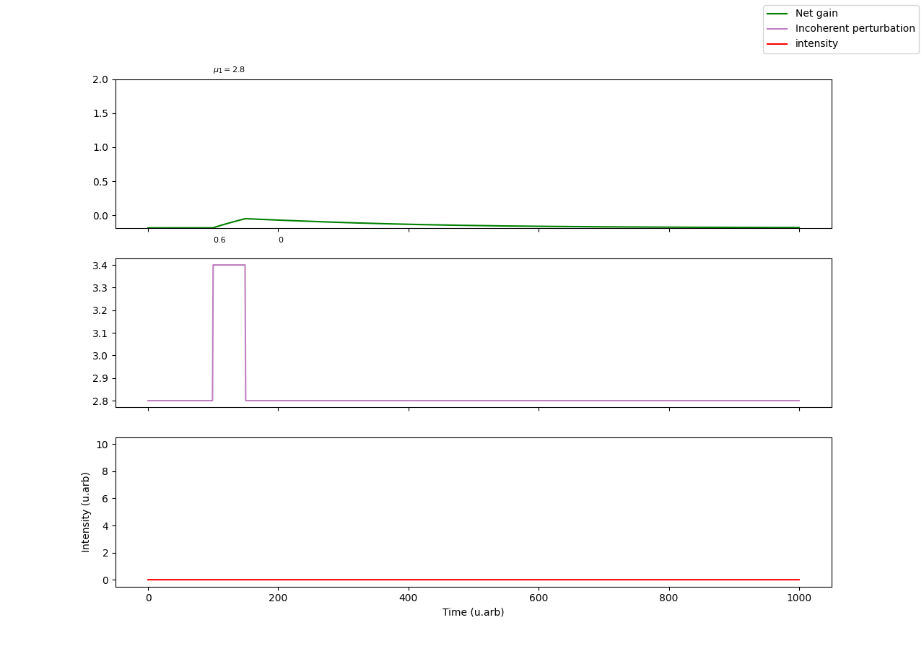
2.0
1.5
Net gain
1.0
0.5
Perturbation
0.0
Intensity
3.4
3.2
3.0
2.8
10
6
2
0 200 400 600 800 1000
Time (U.arb)

Slide 6
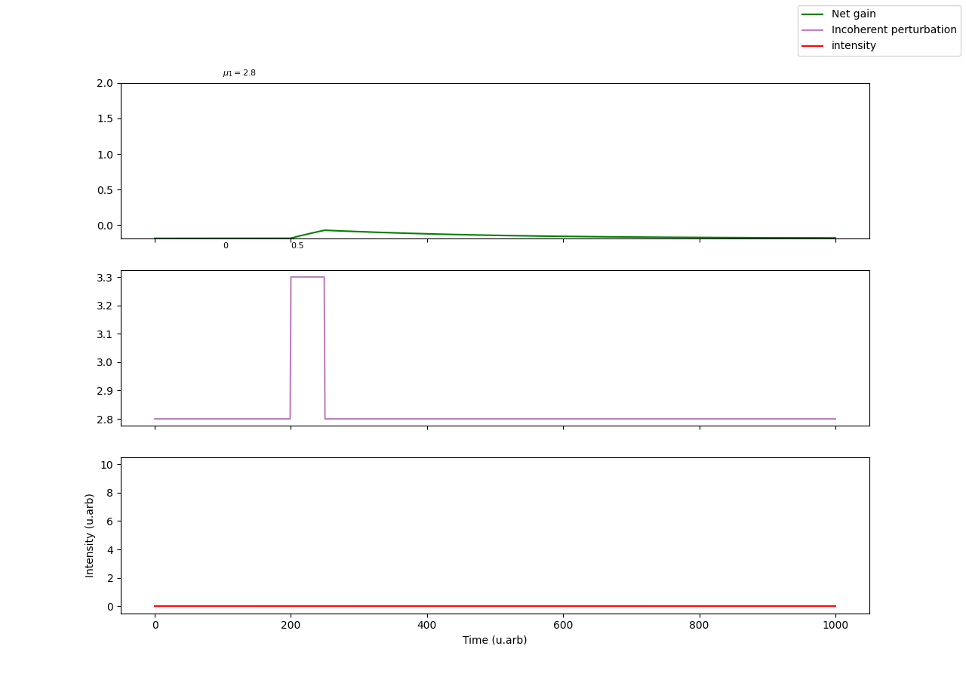
2.0
1.5
Net gain
1.0
0.5
Perturbation
0.0
Intensity
3.4
3.2
3.0
2.8
10
6
2
0 200 400 600 800 1000
Time (U.arb)

Slide 7
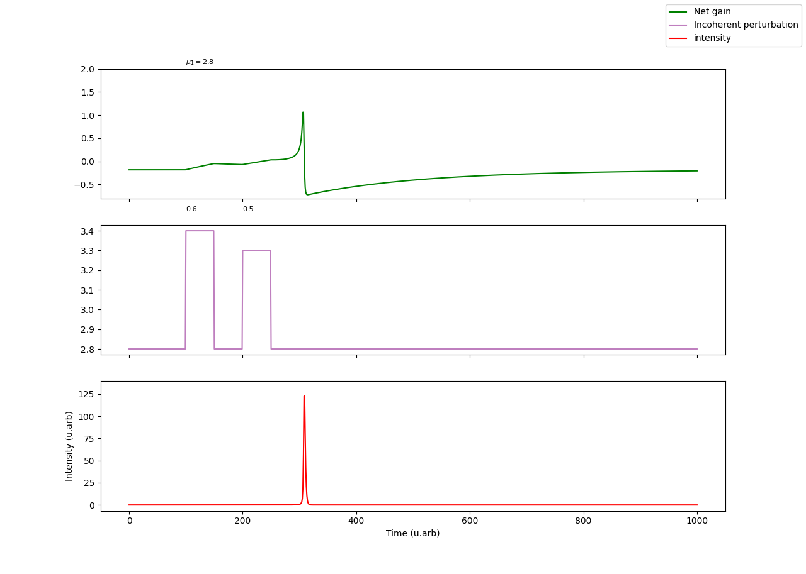
2.0
1.5
Net gain
1.0
0.5
Perturbation
0.0
Intensity
3.4
3.2
3.0
2.8
125
75
25
0 200 400 600 800 1000
Time (U.arb)

Slide 8
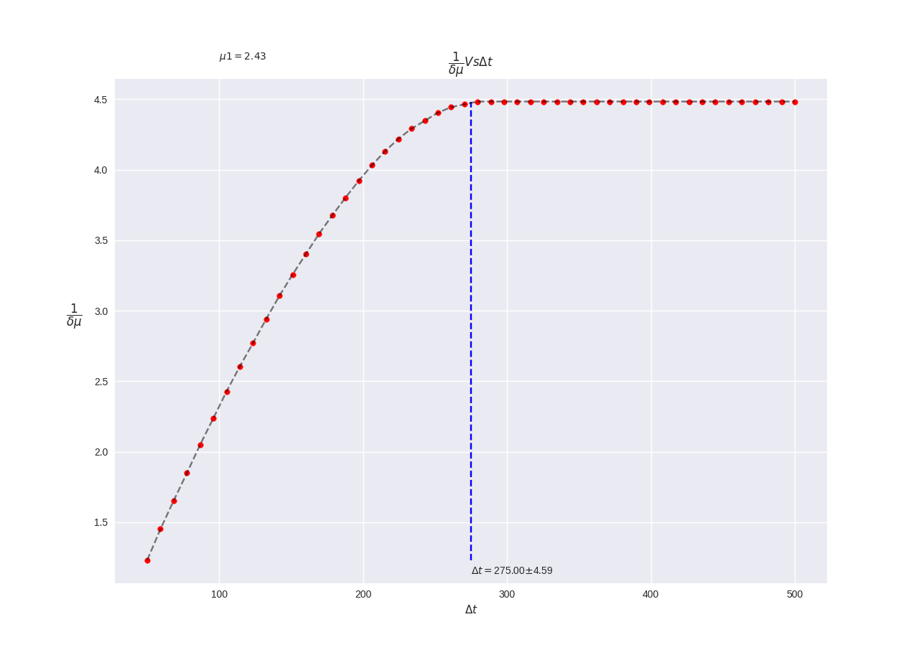
4.5
4.0
3.5
3.0
2.5
2.0
1.5
100 200 300 400 500

Slide 9
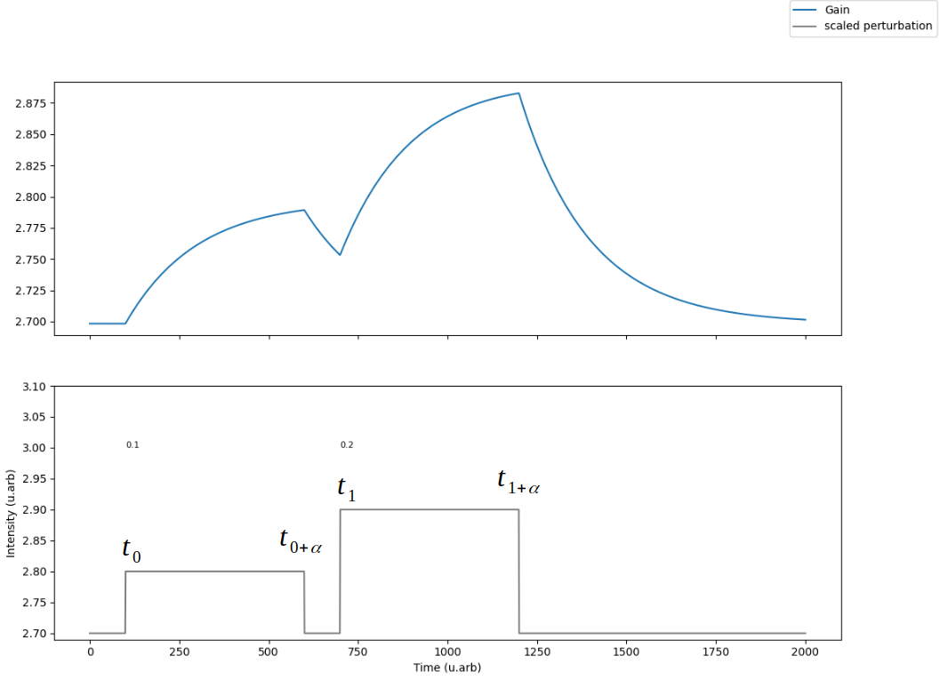
2.850
2.800
Gain
Perturbation
2.750
2.700
3.10
3.00
2.90
2.80
2.70
0 250 500 750 1000 1250 1500 1750 2000
Time (U.arb)

Slide 10
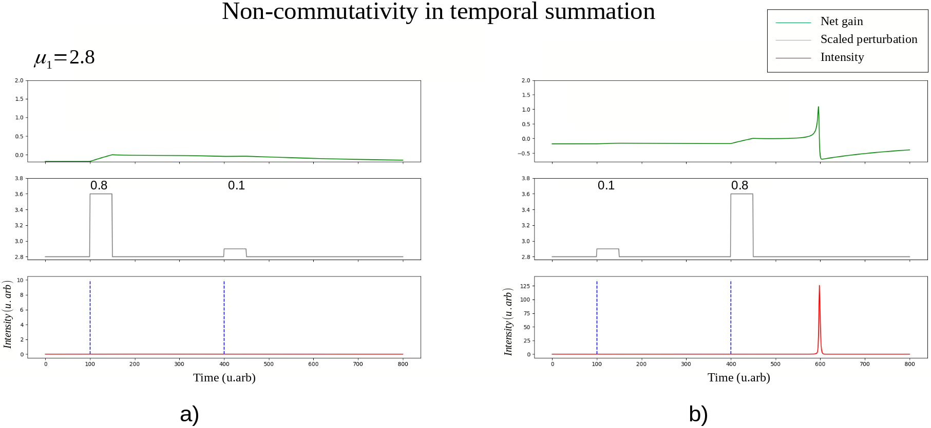
2.0
1.5
1.0
0.5
0
-0.5
3.6
3.6
3.2
3.2
2.8
2.8
8
100
4
50
0
0
0 100 200 300 400 500 600 700 800
0 100 200 300 400 500 600 700 800
Time (U.arb)
Time (U.arb)
a)
b)

Slide 11
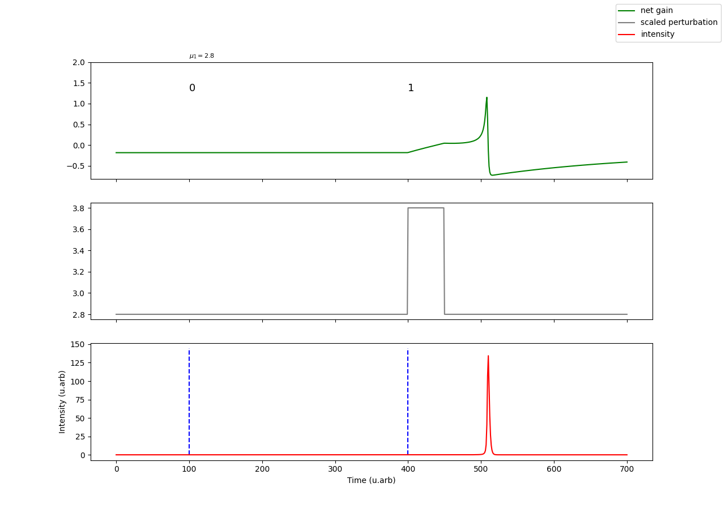
2.0
Net gain
1.0
Perturbation
0
Intensity
-1.0
3.6
3.2
2.8
150
100
50
0
0 100 200 300 400 500 600 700
Time (U.arb)

Slide 12
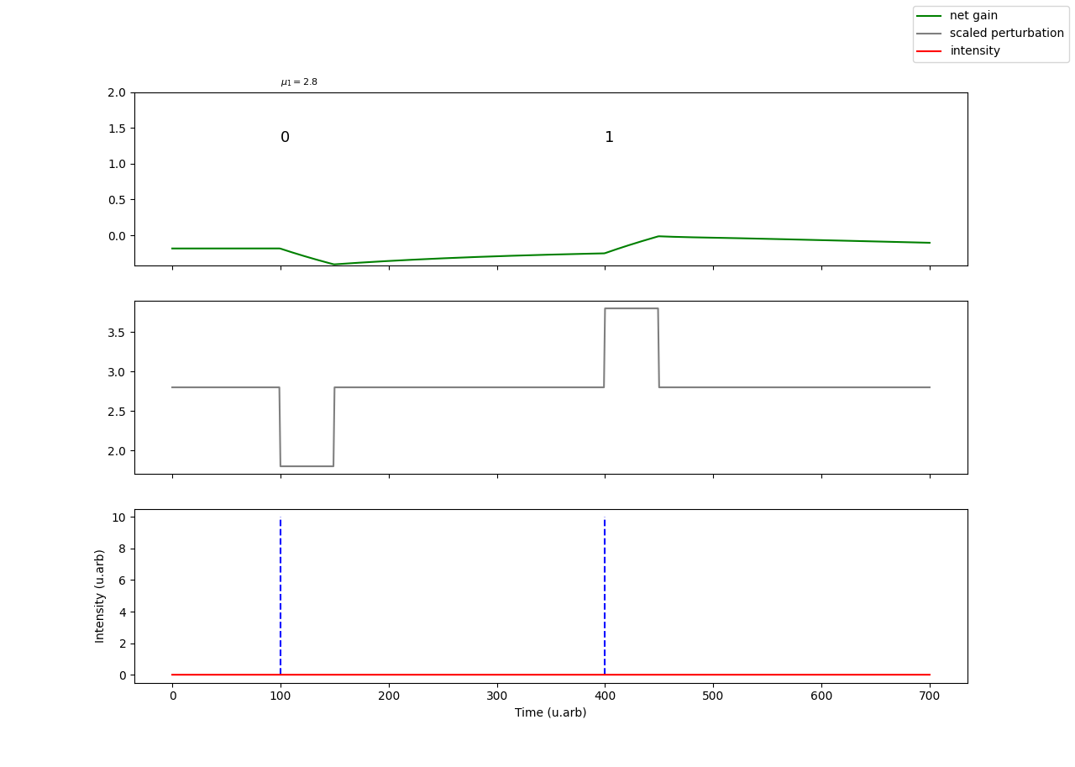
2.0
1.5
Net gain
1.0
Perturbation
0.5
Intensity
0.0
3.5
3.0
2.5
2.0
10
8
6
4
2
0
0 100 200 300 400 500 600 700
Time (U.arb)

Slide 13
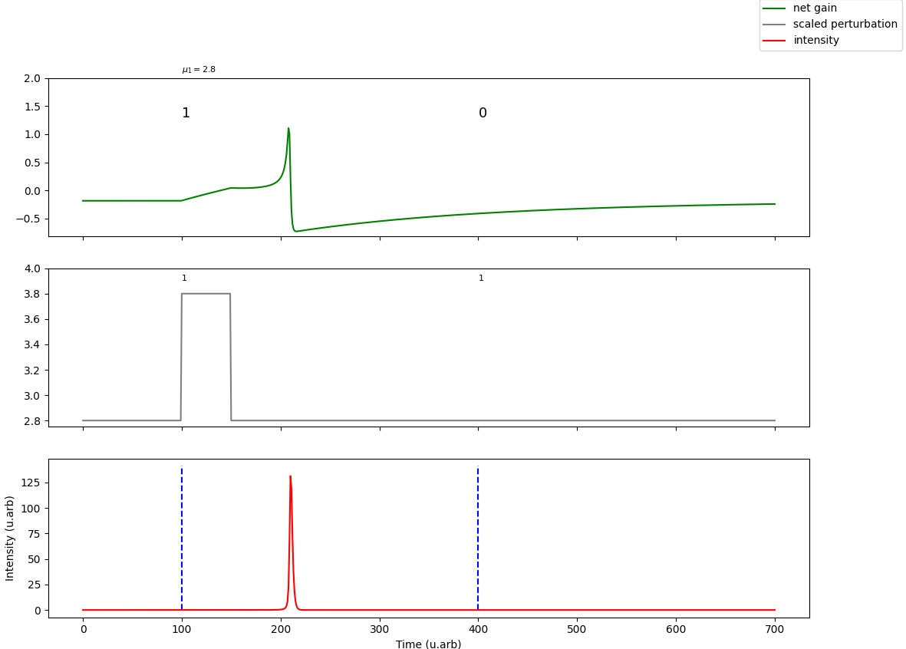
1.5
Net gain
Perturbation
0.5
Intensity
-0.5
4.0
3.6
3.2
2.8
125
75
25
0
0 100 200 300 400 500 600 700
Time (U.arb)

Slide 14
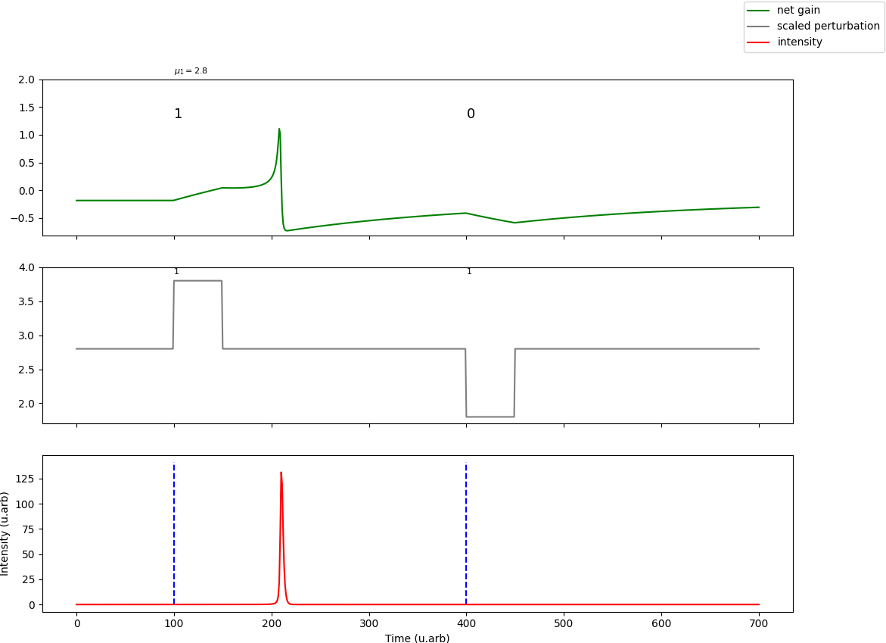
1.5
Net gain
Perturbation
0.5
Intensity
-0.5
4.0
3.5
3.0
2.5
2.0
150
100
50
0
0 100 200 300 400 500 600 700
Time (U.arb)

Slide 15
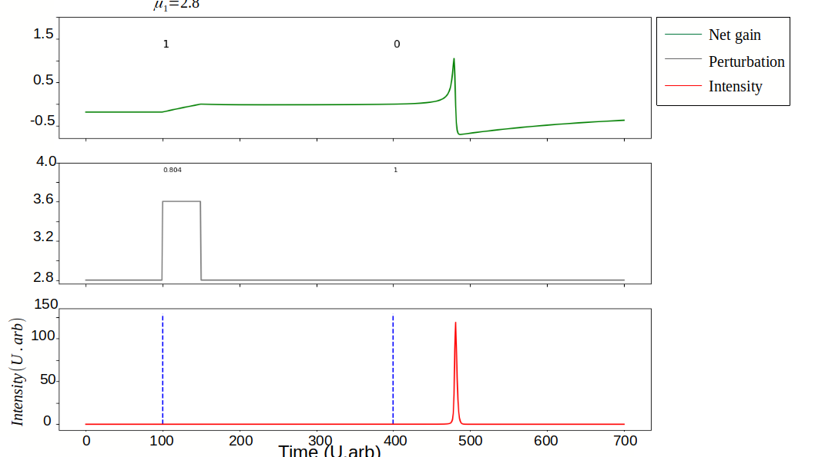
Time (U.arb)

Slide 16
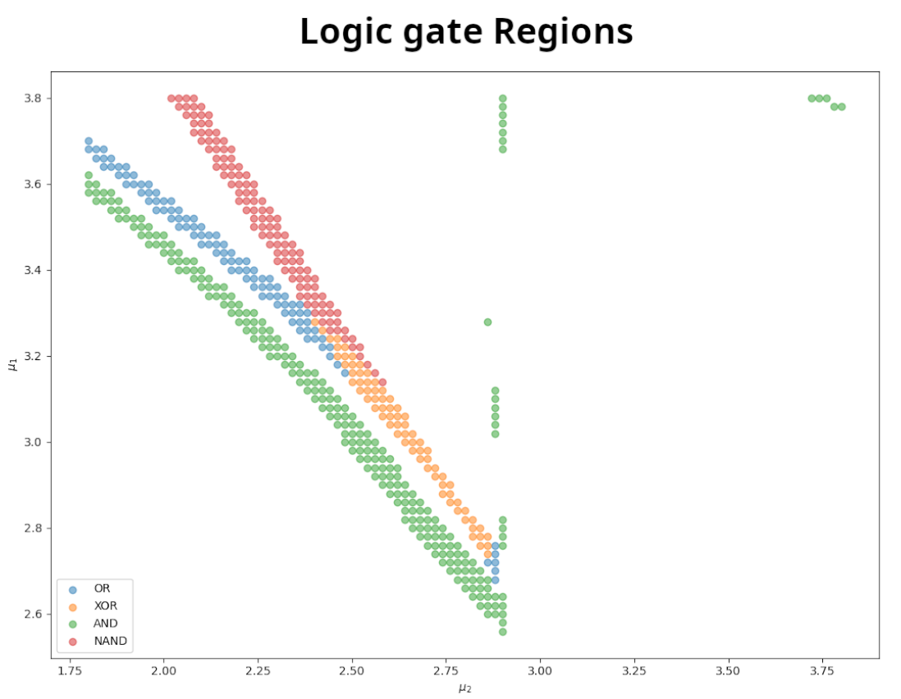
3.8
3.6
3.4
3.2
3.0
2.8
2.6
1.75
2.00
2.25
2.50
2.75
3.00
3.25
3.50
3.75

Slide 17
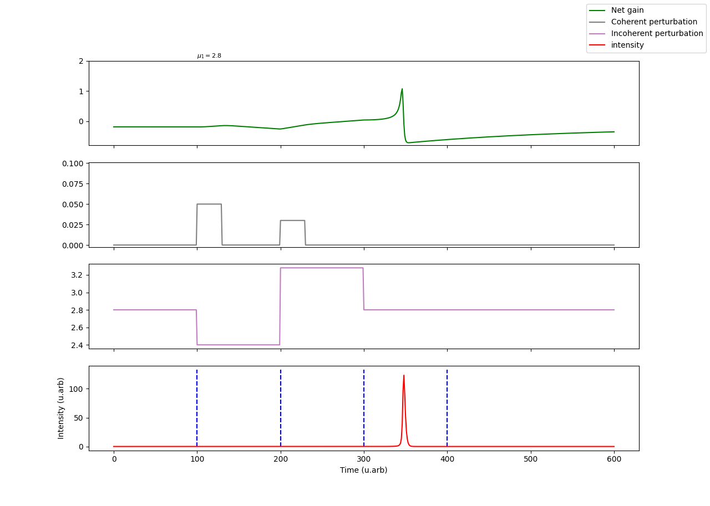
2
1
Net gain
0
Coherent
Perturbation
0.100
0.075
Incoherent
Perturbation
0.050
0.025
0.000
Intensity
3.2
3.0
2.8
2.4
100
50
0
0 100 200 300 400 500 600
Time (U.arb)

