Slide 1
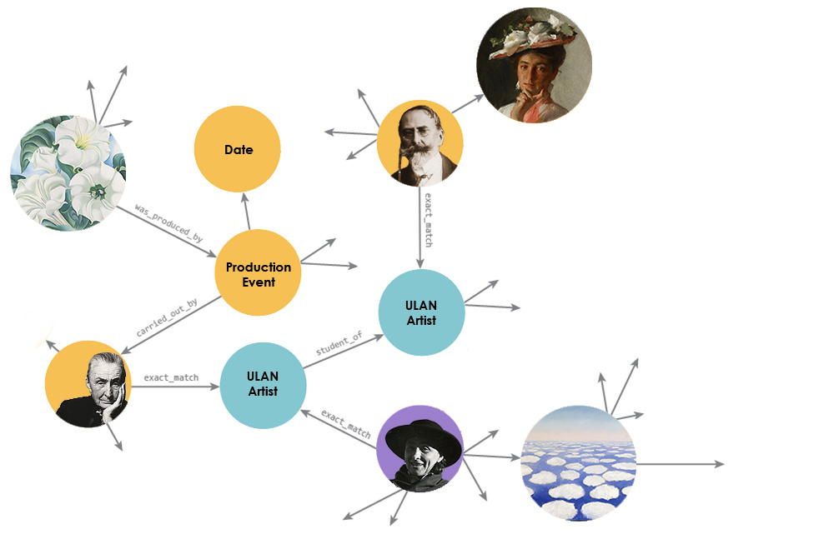
Showcasing Linked Art: Georgia O’Keeffe
https://github.com/linked-art/showcase1
Samantha Norling
Digital Collections Manager Newfields
Notes:
Provide overview of showcase work
- Collected sample data from some Linked Art participating institutions, with input from full group on interesting connections that Linked Art makes it possible to document.
- Participants: Getty, IMA, Met, MoMA, NGA, PMA, PUAM, Rijksmuseum, V&A, YCBA, GOKM
GitHub repository link provided.
From that manual work in transforming small sets of contributed data to Linked Art JSON-LD, some interesting relationships became apparent. This presentation will walk through some of those relationships and connections, and include snippets of mocked up Linked Art JSON-LD, to compare to the common structures of art collections data currently being published online.

Slide 2
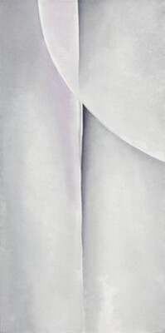
"acquired_title_through": [{ "id": "http://api.nga.gov/art/tms/objects/70182/NGA-acquisition", "type": "Acquisition", "_label": "NGA Acquisition of the Object", "classified_as": [{ "id": "http://vocab.getty.edu/aat/300157782", "type": "Type", "_label": "acquisition (collections management)" }], "timespan": { "id": "https://data.discovernewfields.org/object/16872/IMA-acquisition/timespan", "type": "TimeSpan", "_label": "1987", "begin_of_the_begin": "1987-01-01T00:00:00", "end_of_the_end": "1987-12-31T00:00:00" }}]
Line and Curve
Georgia O’Keeffe, 1927
oil on canvas
1927 Production
1939 Depiction
1946 Exhibition
1987 Acquisition
"produced_by": { "id": "http://api.nga.gov/art/tms/objects/70182/produced_by", "type": "Production", "carried_out_by": [{ "id": "http://vocab.getty.edu/ulan/500018666", "type": "Actor", "_label": "O'Keeffe, Georgia" }], "timespan": { "id": "http://api.nga.gov/art/tms/objects/70182/produced_by/timespan", "type": "TimeSpan", "_label": "1917", "begin_of_the_begin": "1927-01-01T00:00:00", "end_of_the_end": "1927-12-31T00:00:00" }}
Georgia O’Keeffe, Line and Curve, 1927. National Gallery of Art, 1987.58.6. Alfred Stieglitz Collection, Bequest of Georgia O’Keeffe.
Notes:
Linked Art, based on CIDOC-CRM, is an event-based model, so this timeline visual provides a useful frame for talking about certain patterns within the model.
Production Event (basic event model: place, timespan, parties involved, object(s) involved)
Acquisition Event
The Depiction pattern is particularly useful in that it provides a way to connect artworks with the entities that are visually represented within the artwork. People, places, things—even other artworks. Collecting institutions today are for the most part limited by the capabilities of their CMSs to document these kind of relationships, especially in a machine-intelligible and linked way. At the IMA, we have a free text field for capturing information about visual items, and a controlled vocabulary look-up list field, which offers a bit more structure, but doesn’t actually capture URIs or other unique identifiers—just the string preferred labels for entities.

Slide 3
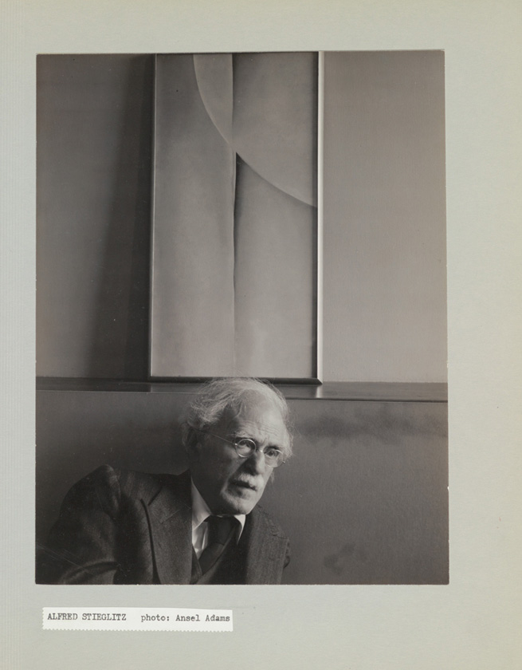
Alfred Stieglitz and Painting by Georgia O’Keeffe, An American Place, New York City
Ansel Adams, 1939
gelatin silver print
"shows": [{ "id": "https://data.moma.org/collection/works/229199/vis-item2", "type": "VisualItem", "_label": "Visual Item Depicted in the Object", "classified_as": [{ "id": "http//vocab.getty.edu/aat/300404126", "type": "Type", "_label": "subjects (content of works)" }], "represents": [{ "id": "http://api.nga.gov/art/tms/objects/70182", "type": “HumanMadeObject", "_label": “Line and Curve" }]}]
"shows": [{ "id": "https://data.moma.org/collection/works/229199/vis-item1", "type": "VisualItem", "_label": "Visual Item Depicted in the Object", "classified_as": [{ "id": "http//vocab.getty.edu/aat/300404126", "type": "Type", "_label": "subjects (content of works)" }], "represents": [{ "id": "http://vocab.getty/edu/ulan/500024301", "type": "Actor", "_label": "Stieglitz, Alfred" }]}]
MoMA Archives, ARCH.8593. Photographic Archive, Artists and Personalities. The Museum of Modern Art Archives, New York.
Notes:
This photograph is held by the MoMA Archives, and depicts both Alfred Stieglitz and Georgia O’Keeffe’s painting, Line and Curve. In the traditional CMS, this information would likely be contained in a free text field, without references to the visual item’s URIs. In Linked Art, the “shows” property connects an object to VisualItems, which can be represented by the URI for the VI.

Slide 4
Line and Curve
Georgia O’Keeffe, 1927
oil on canvas
"member_of": [{ "id": "https://data.moma.org/exhibitions/2851/checklist", "type": "Set", "_label": "Objects in MoMA Georgia O'Keeffe exhibition, 1946" }]
1927 Production
1939 Depiction
1946 Exhibition
1987 Acquisition
Georgia O’Keeffe, Line and Curve, 1927. National Gallery of Art, 1987.58.6. Alfred Stieglitz Collection, Bequest of Georgia O’Keeffe.
Notes:
Back to Line and Curve timeline view…
Connection to an exhibition event from the object is accomplished through the “member_of” property.
The pattern for connecting objects to exhibition events, and the pattern(s) for connecting exhibition activities to the objects, people, and places that were involved in their conception and creation are particularly important for Linked Art. These patterns will illuminate uncountable connections across institutions and their collections.
The example here: 1948 exhibition Georgia O’Keeffe at the Museum of Modern Art.

Slide 5
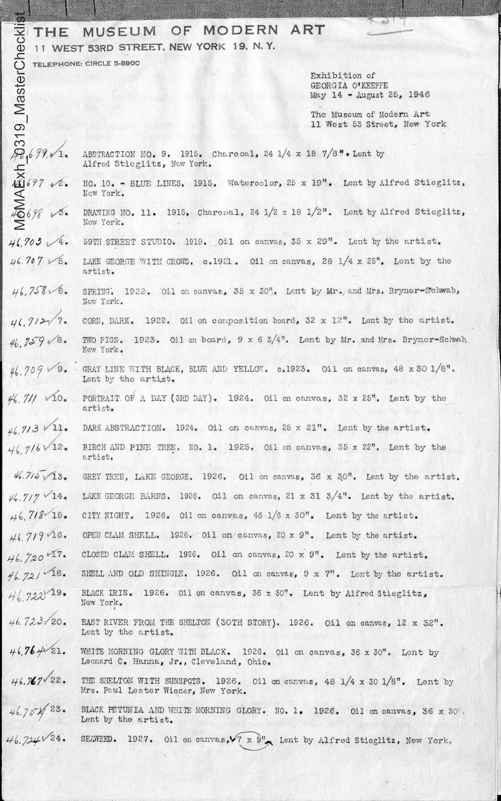
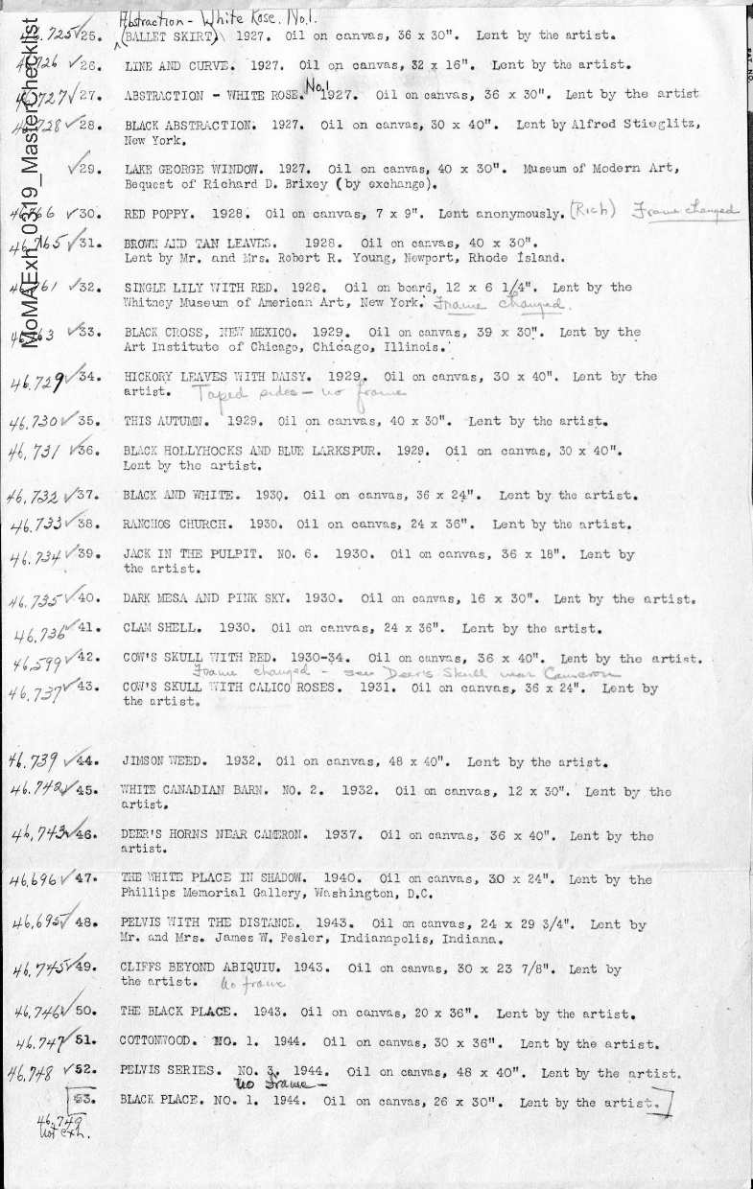
Georgia O’Keeffe
May 14 – August 25, 1946
The Museum of Modern Art
"used_specific_object": [{ "id": "https://data.moma.org/exhibitions/2851/checklist", "type": "Set", "_label": "Objects in MoMA Georgia O'Keeffe exhibition, 1946", "member": [ { "id": "http://api.nga.gov/art/tms/objects/70182", "type": "HumanMadeObject", "_label": "Line and Curve", "classified_as": [ { "id": "http://vocab.getty.edu/aat/300133025", "type": "Type", "_label": "Artwork" } ] } ] }]
The Museum of Modern Art, Checklist for Georgia O’Keeffe Exhibition, 1946. The Museum of Modern Art Archives, New York.
Notes:
Checklists information often published as text. At the IMA, exhibition checklists are catalogued in the CMS, but data about loaned objects is often siloed from owning institution’s data about their object. Often, our loan number is the only identifier used in the checklist.
Linked Art provides not just the possibility of more networked data about art across institutions, but it also provides the encouragement to improve cataloging practices to better support linked art. For example, capturing the URIs for loaned objects in the CMS. This will help to link objects within a past exhibition together again (e.g., linking Line and Curve with Farmhouse Window and Door).
57 objects were exhibited in this 1946 exhibition, including Line and Curve, Pelvis with the Distance (IMA owned), and Farmhouse Window and Door (MoMA owned).

Slide 6
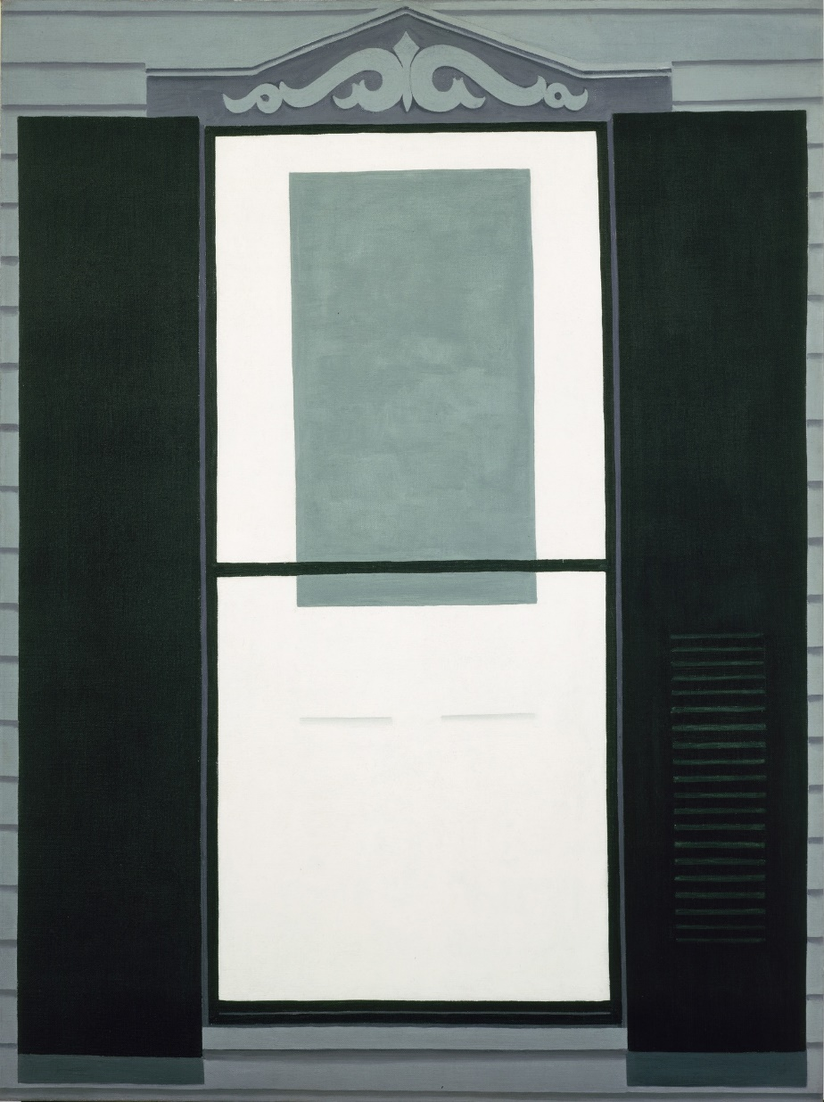
Farmhouse Window and Door
October 1929 Production Event
April 26, 1945
Acquisition Event
1946
Exhibition Event
Georgia O’Keeffe, October 1929
oil on canvas
Provenance Statement:
1929-April 26, 1945, Georgia O'Keeffe, Abiquiú, New Mexico.
April 26, 1945, The Museum of Modern Art, New York, purchased and acquired from the artist through An American Place (Alfred Stieglitz) in exchange for 109.1943.
The Museum of Modern Art, 144.1945. Acquired through the Richard D. Brixey Bequest. © 2019 The Georgia O'Keeffe Foundation / Artists Rights Society (ARS), New York.
Notes:
This painting, which was exhibited in the 1946 MoMA exhibition along with Line and Curve, was acquired by MoMA in a more unique method than the acquisition mentioned earlier.
In this case, MoMA acquired title through an acquisition event that was both a purchase AND an exchange, which involved an additional painting that had been owned by MoMA up to the time of the exchange, Red Hills, Lake George (MoMA number 109.1943). That work has now made its way into The Phillips Collection in Washington, DC.
Linked Art is being developed to accommodate this and all other real-world scenarios for events within the life of an artwork. These events, like the acquisition described here, share key elements:
the Object itself
the Actors (people or organizations) that own the object or facilitate the transfer
the Locations at which the events occur
and the Times at which the events occur
Linked Art will make it possible for institutions to publish their data in a much more structured way than the provenance statement seen here.

Slide 7
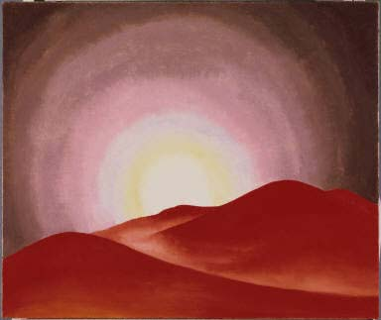
Red Hills, Lake George
{ "@context": "https://linked.art/ns/v1/linked-art.json", "id": "https://linked.art/example/activity/2", "type": "Acquisition", "took_place_at": [], "transferred_title_from": [], "timespan": {}, "transferred_title_to": [], "transferred_title_of": [] }
Georgia O’Keeffe, 1927
oil on canvas
1927 Production Event
May 21, 1943
MoMA Acquisition Event
April 26, 1945
Transfer Event
{ "@context": "https://linked.art/ns/v1/linked-art.json", "id": "https://linked.art/example/activity/1", "type": "Acquisition", "took_place_at": [], "transferred_title_from": [], "timespan": {}, "transferred_title_to": [], "transferred_title_of": [] }
The Phillips Collection. Acquired 1945; © 2008 The Georgia O’Keeffe Foundation/Artists Rights Society (ARS), New York.
Notes:
The Linked Art Editorial Board will be meeting over the next three days to further develop the model, and provenance will be one of the primary elements discussed.

Slide 8
Red Hills, Lake George
Georgia O’Keeffe, 1927
oil on canvas
"made_of": [{ "id": "http://vocab.getty.edu/aat/300015050", "type": "Material", "_label": "oil paint (paint)" }, { "id": "http://vocab.getty.edu/aat/300014078", "type": "Material", "_label": "canvas (textile material)" }]
"produced_by": { "id": "http://data.phillipscollection.org/collection/1450/production", "type": "Production", "timespan": { "id": "http://api.nga.gov/art/tms/objects/70182/produced_by/timespan", "type": "TimeSpan", "_label": "1917", "begin_of_the_begin": "1927-01-01T00:00:00", "end_of_the_end": "1927-12-31T00:00:00" }}
Georgia O’Keeffe, Red Hills, Lake George, 1927. The Phillips Collection. Acquired 1945; © 2008 The Georgia O’Keeffe Foundation/Artists Rights Society (ARS), New York.

Slide 9
Line and Curve
Georgia O’Keeffe, 1927
oil on canvas
"made_of": [{ "id": "http://vocab.getty.edu/aat/300015050", "type": "Material", "_label": "oil paint (paint)" }, { "id": "http://vocab.getty.edu/aat/300014078", "type": "Material", "_label": "canvas (textile material)" }]
"produced_by": { "id": "http://api.nga.gov/art/tms/objects/70182/produced_by", "type": "Production", "timespan": { "id": "http://api.nga.gov/art/tms/objects/70182/produced_by/timespan", "type": "TimeSpan", "_label": "1917", "begin_of_the_begin": "1927-01-01T00:00:00", "end_of_the_end": "1927-12-31T00:00:00" }}
Georgia O’Keeffe, Line and Curve, 1927. National Gallery of Art, 1987.58.6. Alfred Stieglitz Collection, Bequest of Georgia O’Keeffe.
Notes:
Circle back on this Georgia O’Keeffe linked art network exploration to Line and Curve, which shares multiple characteristics with Red Hills, Lake George, such as materials and creation year.
Hopefully this brief exploration gave you a taste of just some of the possibilities of Linked Art in facilitating the creation and discovery of connections between collections. When applied at scale, and with the aid of machines to analyze the data, the possibilities may truly be endless!

Slide 10

Samantha Norling Digital Collections Manager, Newfields snorling@discovernewfields.org @SamiNorling
CONTACT INFORMATION

Slide 11
Image Credits
Georgia O’Keeffe, Jimson Weed, 1936. Indianapolis Museum of Art, 1997.131. Gift of Eli Lilly and Company. © Georgia O'Keeffe Museum / Artists Rights Society (ARS), New York.
Ansel Adams, Georgia O’Keeffe at Yosemite, 1938. Georgia O’Keeffe Museum, 2006.6.858. Gift of the Georgia O’Keeffe Foundation. © Ansel Adams Publishing Rights Trust, Gift.
Georgia O’Keeffe, Above the Clouds I, 1962-1963. Georgia O’Keeffe Museum, 1997.5.14. Gift of The Burnett Foundation and The Georgia O'Keeffe Foundation. © Georgia O'Keeffe Museum, Gift.
William Merritt Chase, Woman in White, 1902. Indianapolis Museum of Art, 45.241. Gift of Mrs. Albert E. Metzger in memory of Albert E. Metzger. Public Domain.
Georgia O’Keeffe, Line and Curve, 1927. National Gallery of Art, 1987.58.6. Alfred Stieglitz Collection, Bequest of Georgia O’Keeffe.
Ansel Adams, Alfred Stieglitz and Painting by Georgia O’Keeffe, An American Place, New York City, 1939. MoMA Archives, ARCH.8593. Photographic Archive, Artists and Personalities. The Museum of Modern Art Archives, New York.

Slide 12
Image Credits
The Museum of Modern Art, Checklist for Georgia O’Keeffe Exhibition, 1946. The Museum of Modern Art Archives, New York.
Georgia O’Keeffe, Farmhouse Window and Door, 1929. The Museum of Modern Art, 144.1945. Acquired through the Richard D. Brixey Bequest. © 2019 The Georgia O'Keeffe Foundation / Artists Rights Society (ARS), New York.
Georgia O’Keeffe, Red Hills, Lake George, 1927. The Phillips Collection. Acquired 1945; © 2008 The Georgia O’Keeffe Foundation/Artists Rights Society (ARS), New York.

