Slide 1




PROJECT IMHOTEP
TEAM
Syed Sami Sayem - 20245103247
Sourav Chandra Shil - 20245103254
Tasmia Anwar Nisa - 20245103261
Raisa Sadik Smrity - 20245103248
Tanvir Islam -20245103244
FACULTY
Farha Akter Munmun
Assistant Professor
Dept. of CSE
Bangladesh University Of Business And Technology

Slide 2

PROJECT IMHOTEP
Introduction
Tools & Technologies Used
run system module
description of
3 portals features
System architecture
Impact and Future Scope
Database schema diagram
Conclusion
Software UI

Slide 3


PROJECT IMHOTEP
Introduction
“The greatest wealth is health.”
Imhotep is a smart healthcare system that connects doctors, patients, and pharmacists in one platform.
It helps manage records, prescriptions, and communication digitally — making healthcare faster and more organized.
The system is built with Python (PyQt5) and MySQL for secure data handling.
In short, Imhotep aims to make healthcare smarter, simpler, and more connected.

Slide 4

PROJECT IMHOTEP
RUN SYSTEM MODULE
System architecture
The system includes three portals — Doctor, Patient, and Pharmacist each linked through a central MySQL database and accessed via a PyQt5 interface.
System Architecture:
The architecture follows a client–server model:
Frontend (PyQt5) → Backend Logic (Python) → Database (MySQL).
All modules communicate securely through database connectivity.

Slide 5
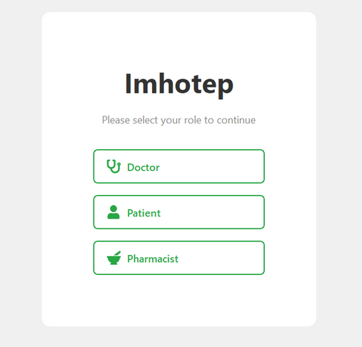
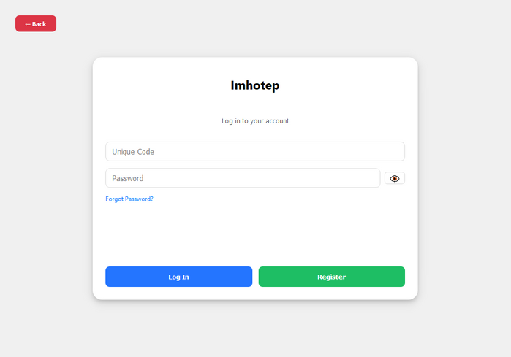
PROJECT IMHOTEP
SOFTWARE UI
ROLE SELECTION & LOGIN

Slide 6
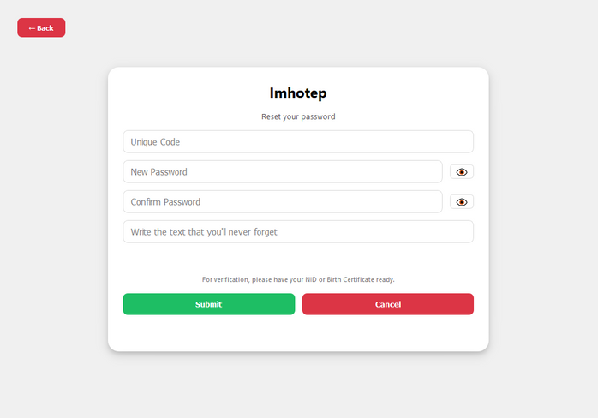
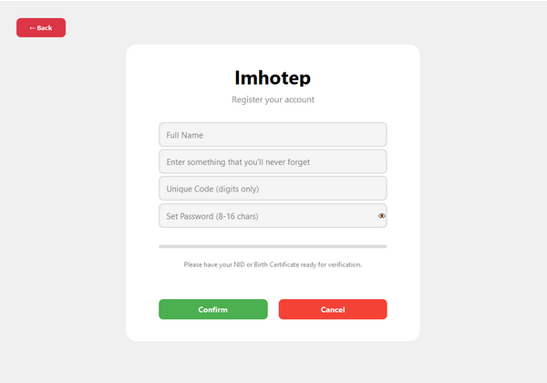
PROJECT IMHOTEP
SOFTWARE UI
REGISTRATION & FORGOT

Slide 7
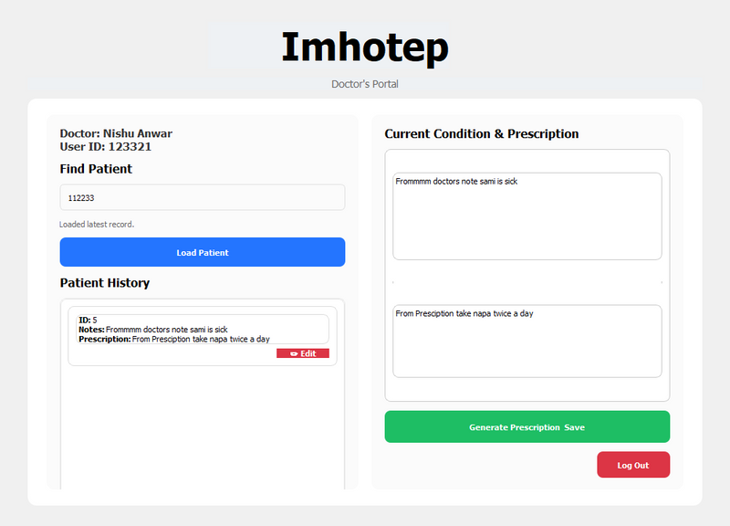
PROJECT IMHOTEP
SOFTWARE UI
DOCTOR PORTAL

Slide 8
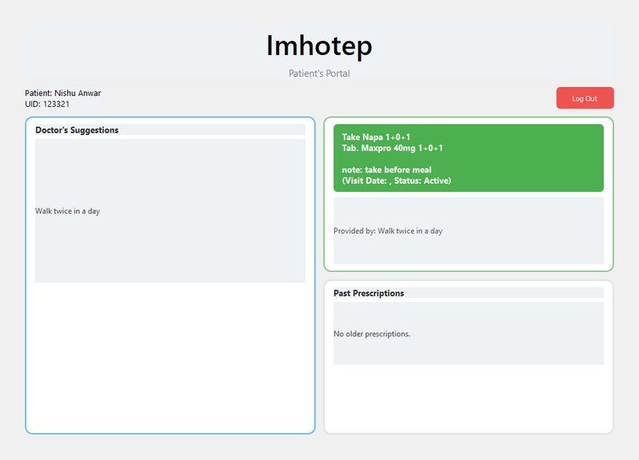
PROJECT IMHOTEP
SOFTWARE UI
PATIENT’S PORTAL

Slide 9
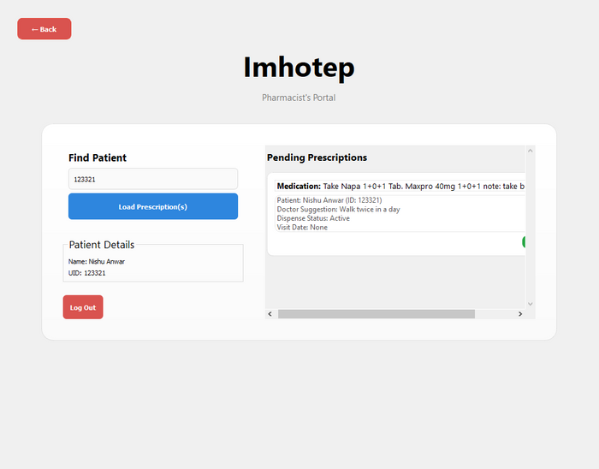
PROJECT IMHOTEP
SOFTWARE UI
PHARMA PORTAL

Slide 10

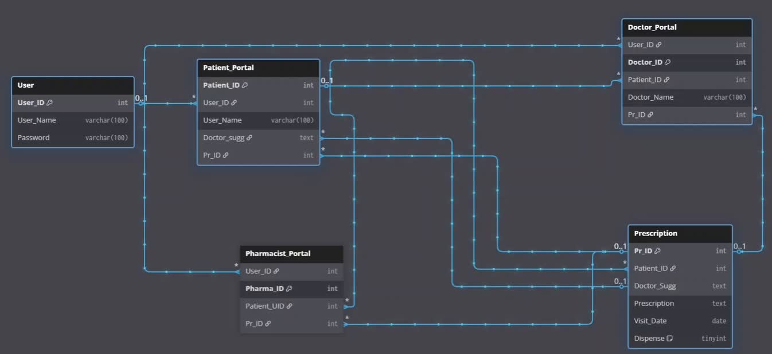
PROJECT IMHOTEP
Database schema diagram

Slide 11

PROJECT IMHOTEP
Tools & Technologies Used
description of
3 portals features
  Programming: Python
  Framework: PyQt5
  Database: MySQL
  IDE: VS Code
  Connector: MySQL Connector for Python
Doctor Portal: Add diagnosis, issue prescriptions, view patient history
Patient Portal: View reports, prescriptions, and request appointments
Pharmacist Portal: Verify prescriptions and manage medicine distribution

Slide 12


PROJECT IMHOTEP
Impact
Future Scope
  Connects doctors, patients, and pharmacists in one system
  Reduces errors and paperwork through digital records
  Speeds up healthcare decisions with real-time data
  AI-assisted diagnosis support
  Cloud-based data access and backup
  Smart analytics and medicine tracking
  Integration with wearable health devices

Slide 13

PROJECT IMHOTEP
Conclusion
“Technology can’t heal, but it can help heal smarter.”
Imhotep brings doctors, patients, and pharmacists together in one digital system — making healthcare faster, smarter, and more connected.

Slide 14




