Slide 1
Implementation of CFG Using Lex and Yacc Program

Slide 2
Presented By
Subna Islam
Id:1743CSE00615
Farjana Sultana Samia
Id: 1743CSE00584

Slide 3
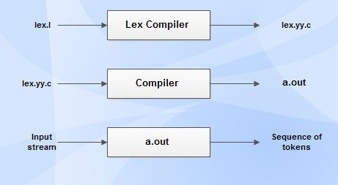
Lex is a computer program that generates lexical analyzers ("scanners" or "lexers"). Lex is commonly used with the yacc parser generator. The lexical analyzer is a program that transforms an input stream into a sequence of tokens. It reads the input stream and produces the source code as output through implementing the lexical analyzer in the C program.
LEX In compiler Design

Slide 4
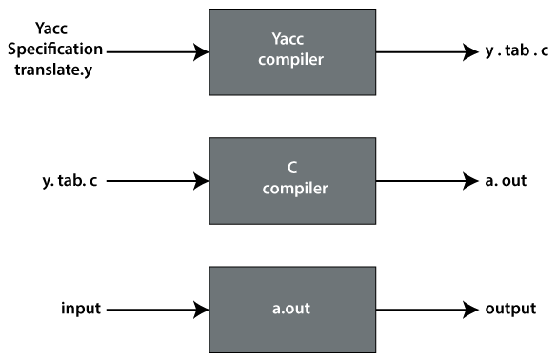
YACC stands for Yet Another Compiler Compiler. YACC provides a tool to produce a parser for a given grammar. . When the lexical analyzer transforms an input stream into a sequence of tokens Yacc is used to give some structure to those tokens. Yacc then implements the actual computer language; recognizing a for statement, for instance, or a function definition.
Yacc In compiler Design

Slide 5
LEX Program For The Grammar
%{
/* Definition section */
#include "y.tab.h"
%}
/* Rule Section */
%%
[A] {return ID;}
[\T] ;
. {return yytext[0];}
[\n] {return 0;}
%%
int yywrap()
{
return 1;
}

Slide 6
YACC Program For The Grammar
%{
/* Definition section */
#include<stdio.h>
#include<stdlib.h>
%}
%token ID
/* Rule Section */
%%
Exp: Exp Exp ‘*’
Exp: Exp Exp ‘+’
Exp: ID
;
%%
int main()
{
Print(“Enter the expression for the grammar S->SS+|SS*|a\n”);
yyparse();
print(“\n Accepted \n”);
}
Int yyerror(char *msg)
{
print(“\n Rejected \n”);
exit(0);
}

Slide 7
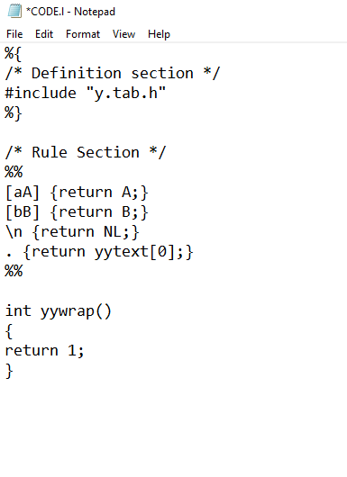
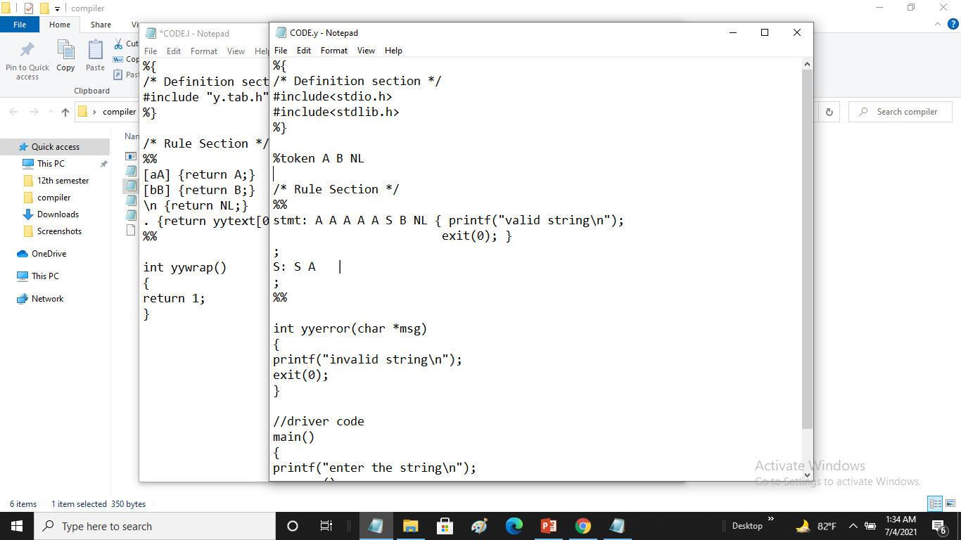
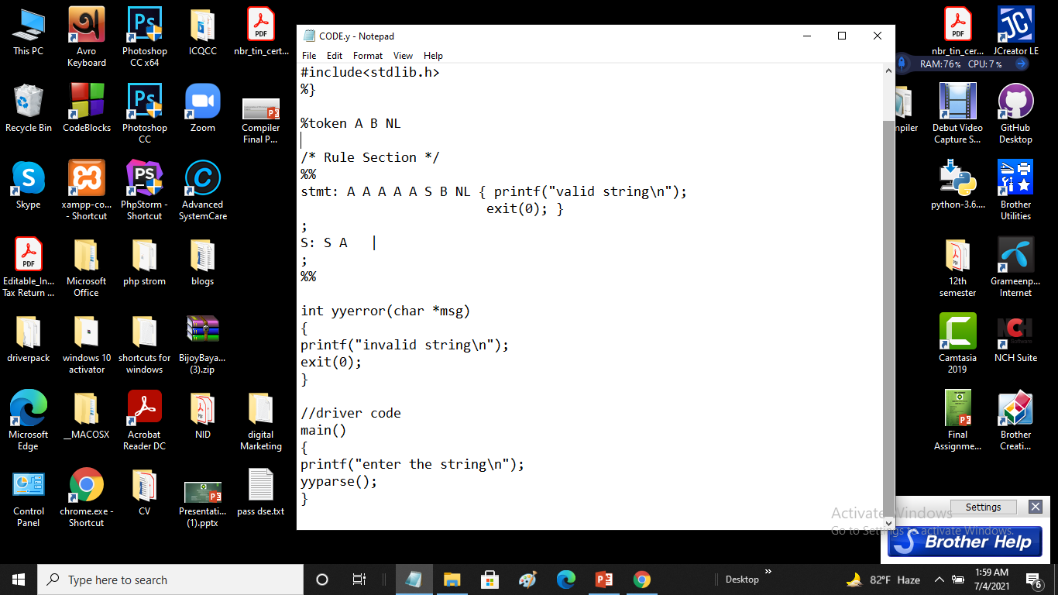
Y ACC program to recognize strings of { a^{n}b | n≥5 }

Slide 8
Commands those are used to compile lex and yacc program
We use two operating system to execute this one program
Commands that use in Windows
lex lex.l - It produce lex.yy.c
Ycc –dy yacc.y - It produce y.tab.c and y.tab.h
Gcc lex.yy.c y.tab.c
a
Commands that use in ubuntu
Lex Demo_Code.l
bison -dy Demo_Code.y
gcc lex.yy.c y.tab.c
./a.out

Slide 9
Thank You

