Slide 1
CSE 4250
Project & Thesis-II
Supervised By
Mr. Tanveer Ahmed Belal
Assistant Professor
Department of Computer Science & Engineering
Ahsanullah University of Science & Technology

Slide 2
Presented By
Samia Zahan 16.01.04.057
Muna Saha 16.01.04.060
Robiul Hasan Nowshad 16.01.04.061
Tasmia - Tuj – Juha 16.01.04.095

Slide 3
Extractive Text Summarization with Pre-training of deep Bidirectional Encoder Representations from Transformers and Clustering

Slide 4


Problems
More and more data Less amount of time

Slide 5
Automatic Summarization
“Converting a large document with in a shorter volume, reflecting the core theme of it.”
Approaches
Extractive
Abstractive
-------------------
-------------
---------------------
---------------------
-----------------------
------
-------------------
---------------------
-------------------
-------------------
---------------------

Slide 6
Extractive Text Summarization
Extractive summaries are created by reusing portions (words, sentences, etc.) of the input text document
The system extracts text from the entire collection, without modifying the text document.
Most of the summarization research today is on extractive summarization.

Slide 7
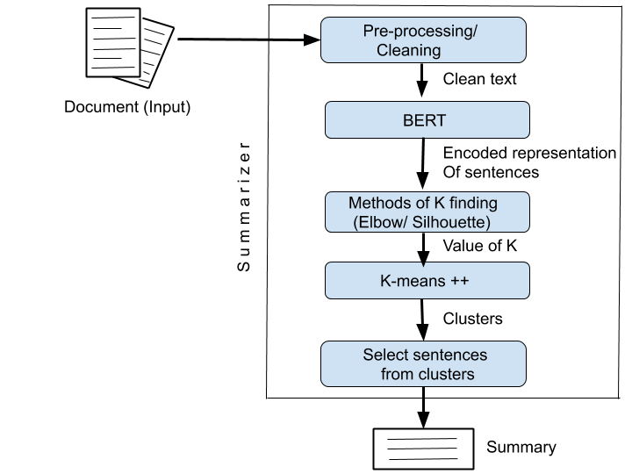
Methodology

Slide 8
Data Acquisition
Document
For that we will generate summary.
BBC News Article from 2004-2005
www.kaggle.com/datasets
CNN/Daily mail

Slide 9
Pre-Processing
Filtering
Tokenization
# Today is Sunday$}. We have a presentation.
Today is Sunday. We have a presentation.
Sentence Tokenize
RegEx
[‘’Today is Sunday ’’, ‘’ We have a presentation’’]
Word Tokenize
Today is Sunday We have a presentation
[‘Today’ ,‘is’ ,‘Sunday’ ‘We’ ,‘have’ ,‘a’ ,‘presentation’]

Slide 10
Pre-Processing (cont…)
Stop Word Removal
Remove less informative words like:
Preposition
Articles
Conjunction
Pronoun
Adverb
Lemmatization
Finds the root word and replace by that
The candidates are reacting nervously
Candidates : candidate
are : be
Reacting : react
nervously : nervous
The candidate be react nervous

Slide 11
Raw data
System

Slide 12
Solution is :
Data featuring
translate raw text document into meaningful numeric form that system algorithm can interpret.
Different methods of featuring:
Bag of words model
TF-IDF model
1-Hot Encoding Model
N-gram Model
Word2Vec
GloVe

Slide 13
Data featuring
translate raw text document into meaningful numeric form that system algorithm can interpret.
Different methods of featuring:
Bag of words model
TF-IDF model
1-Hot Encoding Model
N-gram Model
Word2Vec
GloVe
Previously Used

Slide 14
Draw back of these Representation
TF-IDF- It’s just statistic Data representation
Word2Vec/GloVe – Just encode word doesn’t keep context
Jhon has a crush on lily
I will crush your car
Here one word “Crush”, it has different meaning in two sentences
But Word2Vec/GloVe represent both as same.
So, we go for better solution BERT

Slide 15
BERT: Bidirectional Encoder Representations from Transformers
Main ideas
Propose a new pre-training objective so that a deep bidirectional Transformer can be trained
The “masked language model” (MLM): the objective is to predict the original word of a masked word based only on its context
“Next sentence prediction”

Slide 16
Architecture of BERT
Consists of multilayer bidirectional Transformer encoder
BERT (base)
Lyers = 12
Hidden Size = 768
Self Attention Layer = 12
Total parameters = 110M
BERT (large)
Lyers = 24
Hidden Size = 1024
Self Attention Layer = 16
Total parameters = 340M

Slide 17
Architecture of BERT
Consists of multilayer bidirectional Transformer encoder
BERT (base)
Lyers = 12
Hidden Size = 768
Self Attention Layer = 12
Total parameters = 110M
BERT (large)
Lyers = 24
Hidden Size = 1024
Self Attention Layer = 16
Total parameters = 340M
Used in Our System

Slide 18
Transformer Encoders
Transformer is an attention-based architecture for NLP
Transformer composed of two parts: Encoding component and Decoding component
BERT is a multi-layer bidirectional Transformer encoder
Input
Encoder Block
Encoder Block
Encoder Block

Slide 19
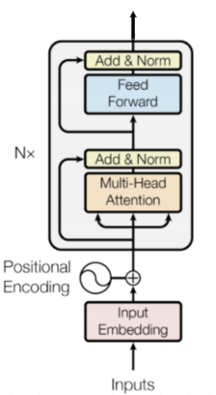
Inside an Encoder Block
In BERT experiments, the number of blocks N was chosen to be 12 and 24. Blocks do not share weights with each other

Slide 20
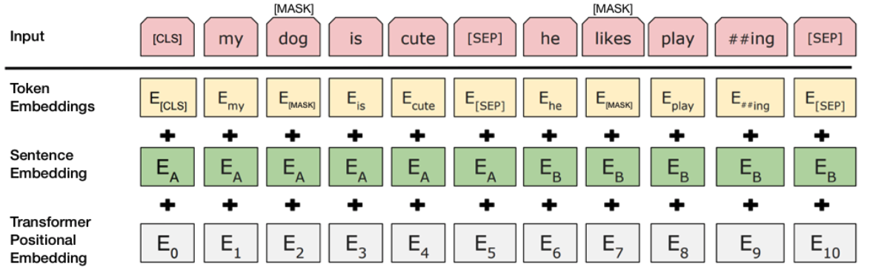
Embedding with BERT
Token Embeddings: Use pretrained WordPiece embeddings
Position Embeddings: Use learned Position Embeddings
Added sentence embedding to every tokens of each sentence
Use [CLS] for start sentences and [SEP] for end

Slide 21
BERT Model Task
BERT Model has 2 tasks :
Masked LM
Next Sentence Prediction

Slide 22
Task#1: Masked LM
15% of the words are masked at random
and the task is to predict the masked words based on its left and right context
Not all tokens were masked in the same way (example sentence “My dog is hairy”)
80% were replaced by the <mask>token: “My dog is <mask> ”
10% were replaced by a random token: “My dog is apple”
10% were left intact: “My dog is hairy”

Slide 23
Task#2: Next Sentence Prediction
Motivation
Many downstream tasks are based on understanding the relationship between two text sentences
Question Answering (QA) and Natural Language Inference (NLI)
Language modeling does not directly capture that relationship
The task is pre-training binarized next sentence prediction task
Input = [CLS] the man went to [MASK] store [SEP] he bought a gallon [MASK] milk [SEP] Label = isNext
Input = [CLS] the man [MASK] to the store [SEP]penguin [MASK] are flight ##less birds [SEP] Label = NotNext

Slide 24
Pre-training procedure
Training data: BooksCorpus (800M words) + English Wikipedia (2,500M words)
To generate each training input sequences: sample two spans of text (A and B) from the corpus
The combined length is ≤ 500 tokens
50% B is the actual next sentence that follows A and 50% of the time it is a random sentence from the corpus
The training loss is the sum of the mean masked LM likelihood and the mean next sentence prediction likelihood

Slide 25
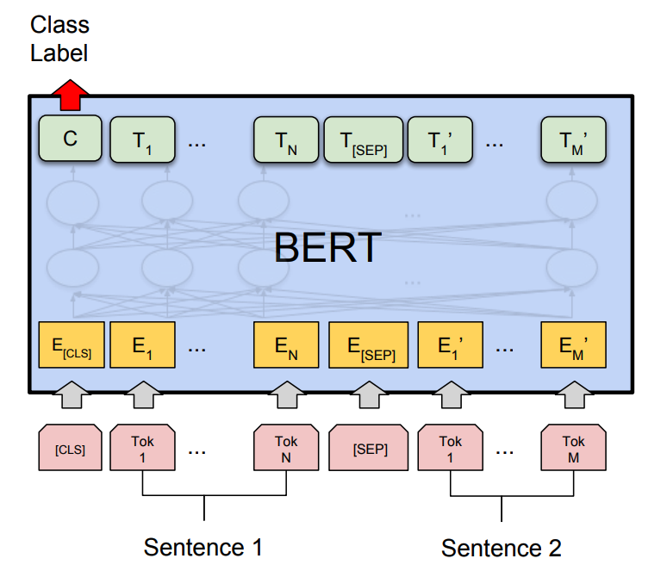
BERT

Slide 26
Clustering
procedure of dividing data objects into subclasses
Clustering
Algorithm
Hierarchical
Cluster
Partitioning
Cluster
Agglomerative
Divisive
Hard Cluster
(K-Means)
Soft Cluster
Fuzzy( c-means)

Slide 27
Clustering(cont…)
Hard Cluster
(K-Means)
Partition the dataset into K pre-defined distinct non-overlapping clusters

Slide 28
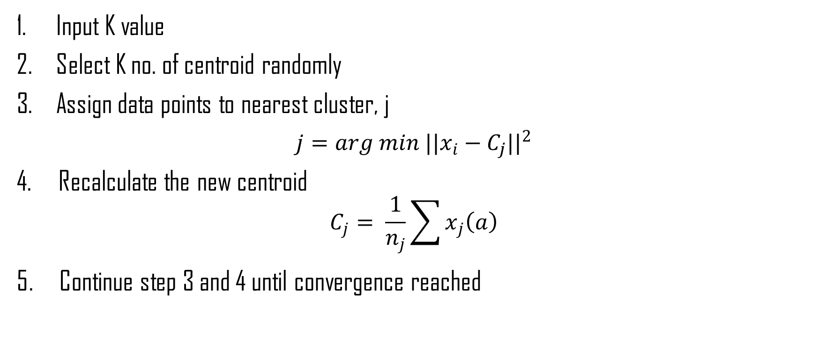
K-Means Algorithm

Slide 29
But What’s the proper number of Cluster?
How to find an optimal K value?
Methods of K finding:
Elbow method
Silhouette method
Gap statistic
Canopy

Slide 30
But What’s the proper number of Cluster?
How to find an optimal K value?
Methods of K finding:
Elbow method
Silhouette method
Gap statistic
Canopy

Slide 31
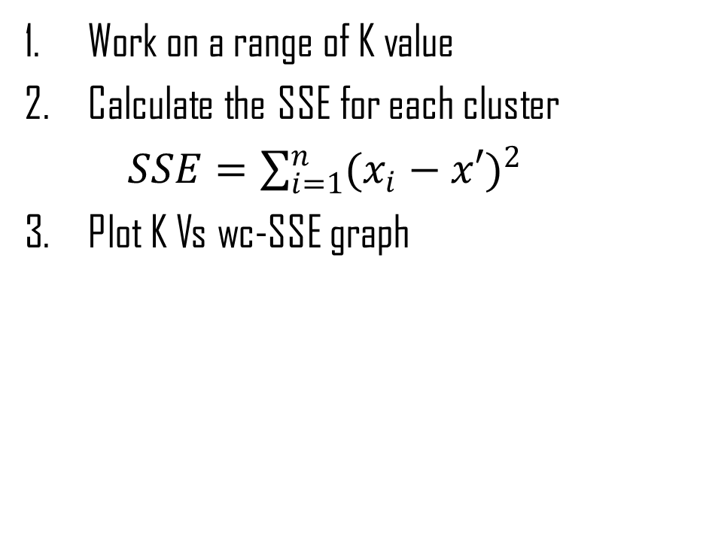
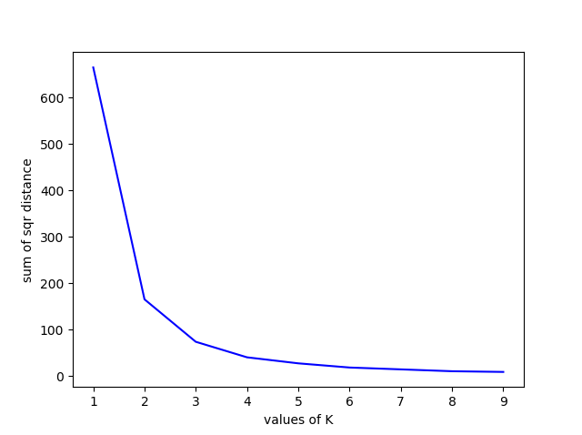
How Elbow Works?

Slide 32
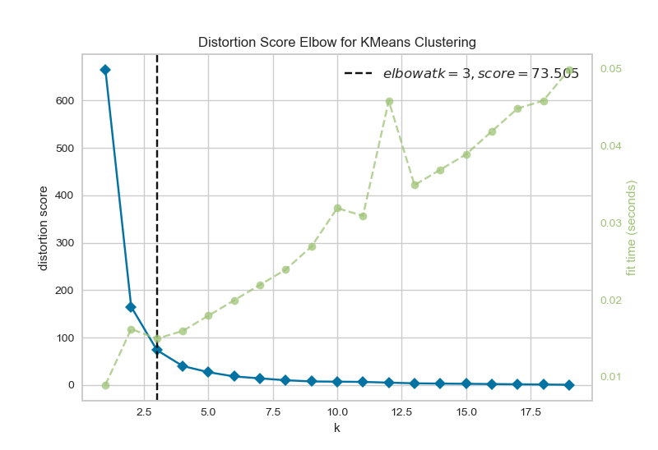
Elbow (cont…)
4. Point specific K value using Python library
YellowBrick
Visualise and point out the optimal K value, where the distortion declines the most.

Slide 33
Summary Extract
Select sentences nearest to centroid from each cluster.
Cluster1: 8
Cluster2: 8
Cluster3: 8
We just pick 1 sentences from each cluster. But exception can happen!
Happy case ☺

Slide 34
Summary Extract(cont…)
What if the situation like
This?
Cluster1: 14
Cluster2: 15
Cluster3: 8
Or
This?
Cluster1: 8
Cluster2: 8
Cluster3: 19
It is not fair to select only 1 sentence from a big and small cluster

Slide 35
Summary Extract(cont…)
Number of Sentences to be picked up from each cluster
From,
Cluster1: 14/8 = 2
Cluster2: 15/8 = 2
Cluster3: 8/8 = 1

Slide 36
We can evaluate the efficiency
Summary Evaluation Method:
ROUGE Metric
BLEU
Both are done by comparing System generated summary with some Human made summary or
Reference Summary

Slide 37
ROUGE Metric
instances
Determine overlapping between reference and system generated summary.
Unigram
Bigram
Trigram
Longest Common Sequence (LCS) etc.
Types:
ROUGE-1
ROUGE-2
ROUGE-3
ROUGE-L
ROUGE-W

Slide 38
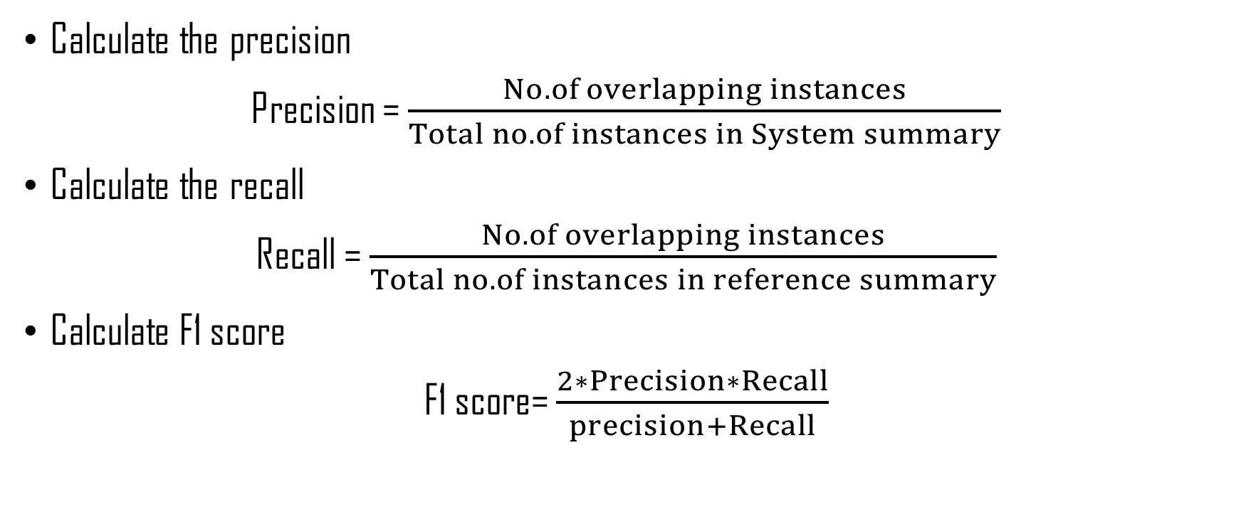
ROUGE Metric(cont…)

Slide 39
ROUGE Metric (cont…)
ROUGE | Score | Generated Summary
 | Precision | 47.29
ROUGE-1 | Recall | 42.61
 | F1-score | 47.29
 | Precision | 50.94
ROUGE-2 | Recall | 47.37
 | F1-score | 50.94
 | Precision | 48.57
Display the cluster having the highest ROUGE scores as the resulting summary.

Slide 40
Comparison
Comparison with other models on CNN/Daily Mail Dataset
Model | ROUGE-1 | ROUGE-2 | ROUGE-L
ImprovedBertSum(This Paper) | 44.96 | 20.21 | 40.11
MatchSum | 44.41 | 20.86 | 40.55
DiscoBERT w.G_R & G_C | 43.77 | 20.85 | 40.67
BertSumExt | 43.85 | 20.34 | 39.90
BERT-ext + RL | 42.76 | 19.87 | 39.11

Slide 41
Thank You

