Slide 1

Wine Quality Prediction
Springboard Data Science Career Track
Samia Saad
April 2025

Slide 2

Problem Statement
In the heart of Portugal’s scenic Douro Valley, nestled between sun-drenched vineyards and centuries-old wineries, a seasoned winemaker named Luís faces a growing challenge. As demand for high-quality Vinho Verde wines rises globally, Luís’s small team of expert tasters is stretched thin, relying on their senses and years of experience to assess the quality of each batch. But human evaluation, though nuanced and rich, is inherently subjective. One taster's “exceptional” may be another's “acceptable.”
Meanwhile, modern wineries around the world are adopting data-driven tools to stay competitive—streamlining production, enhancing consistency, and cutting costs. Luís wonders: Can technology support tradition rather than replace it?
Armed with years of physicochemical data—acidity, sugar content, pH, alcohol levels—Luís partners with a data science team to build a solution. Their goal: create a machine learning model that mirrors the intuition of an expert, predicting wine quality accurately, consistently, and efficiently. If successful, this model could free up valuable time, ensure consistent standards, and even help improve future vintages.
Thus begins a journey to blend the art of winemaking with the science of machine learning.

Slide 3
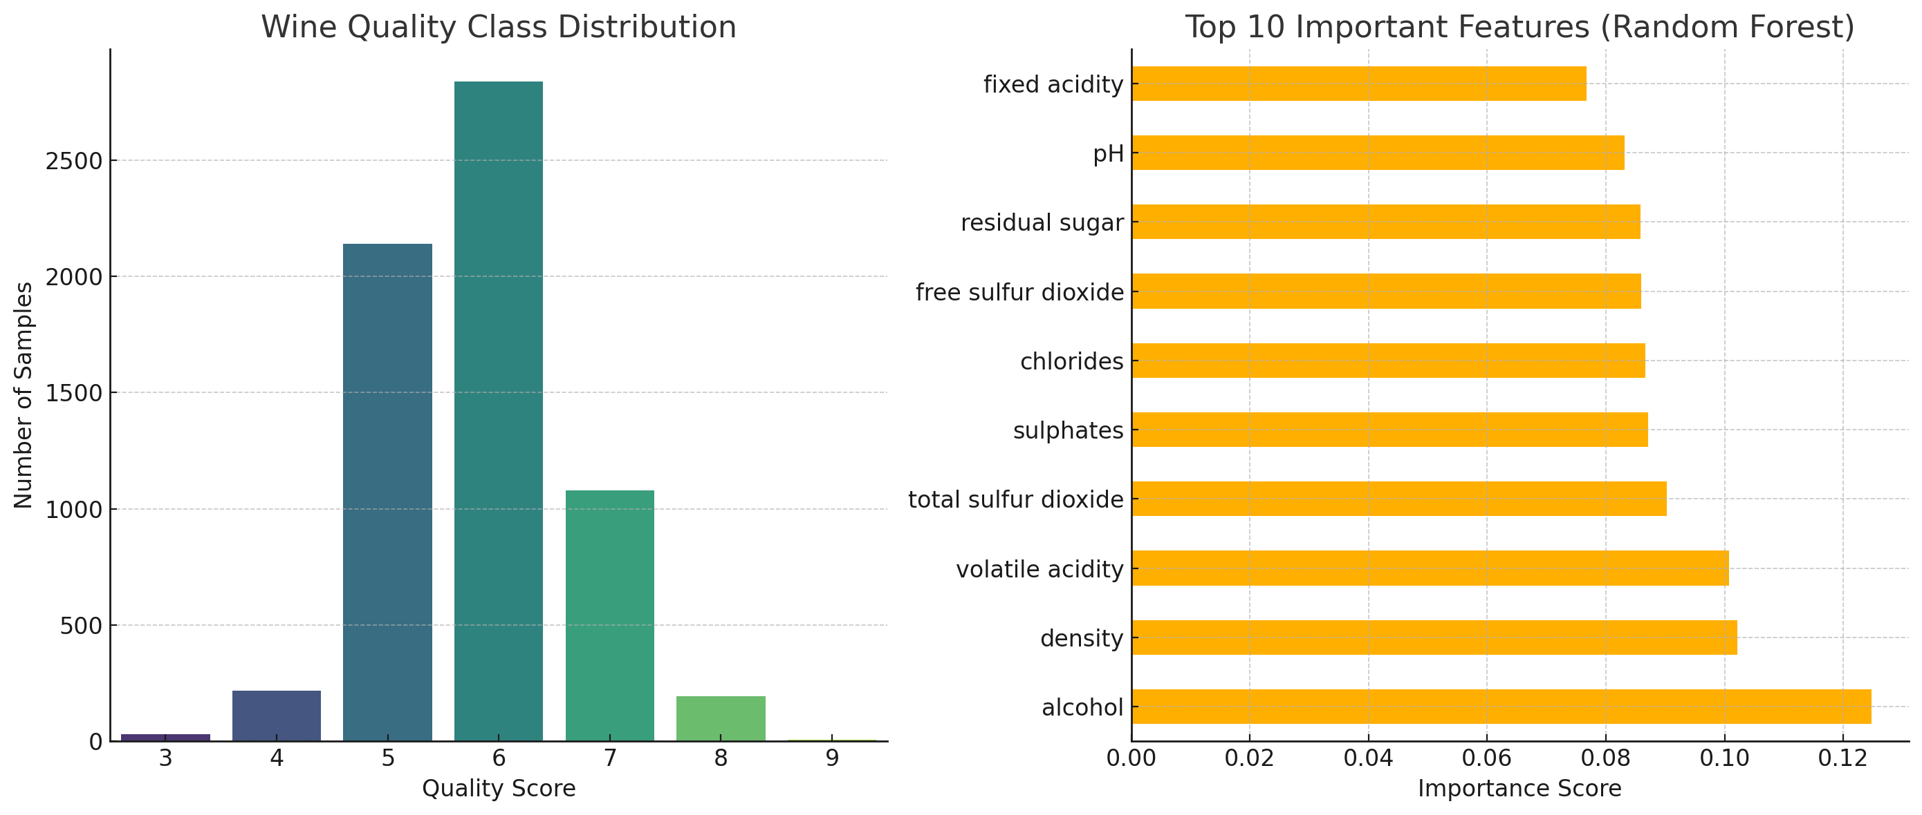
The Dataset
Top 10 Important Features (Random Forest)
• Source: UCI Wine Quality Dataset
• Two datasets: Red and White wine
• Target: Wine quality score (0–10 scale)
• ~6,500 records with 11 features each

Slide 4
Class Imbalance: The wine quality scores are clearly imbalanced.
Most wines are rated between 5 and 6, while very few are
rated as 3, 4, 8, or 9.
This imbalance can negatively impact model performance, especially for underrepresented classes.
Top 10 Features (by importance from Random Forest):
Alcohol
Volatile acidity
Sulphates
Density
Total sulfur dioxide
Fixed acidity
Citric acid
Free sulfur dioxide
pH
Chlorides

Slide 5

Feature Importance
• Top features influencing quality:
- Alcohol
- Sulphates
- Volatile Acidity
• Alcohol is the most predictive feature

Slide 6
Exploratory Data Analysis (EDA)
• Alcohol and sulphates positively correlated with quality
• Volatile acidity negatively correlated
• Class imbalance: most wines are rated 5-6

Slide 7
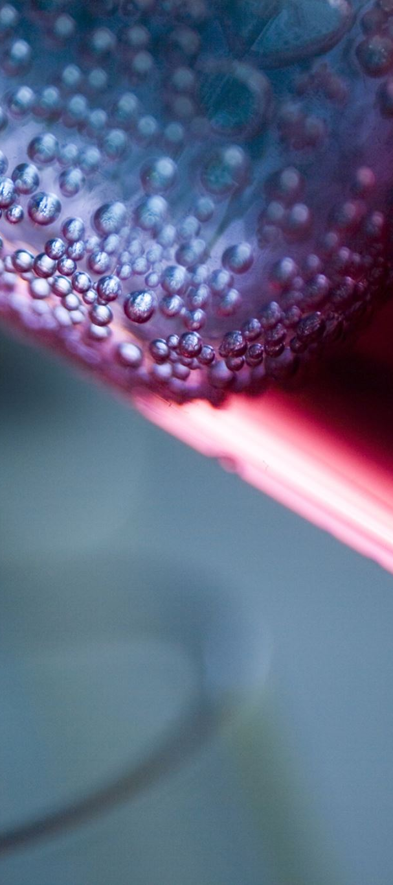
Data Preparation
• Combined red and white wine datasets
• Added 'wine_type' feature (one-hot encoded)
• Standardized numerical features
• Train-test split (80/20)

Slide 8
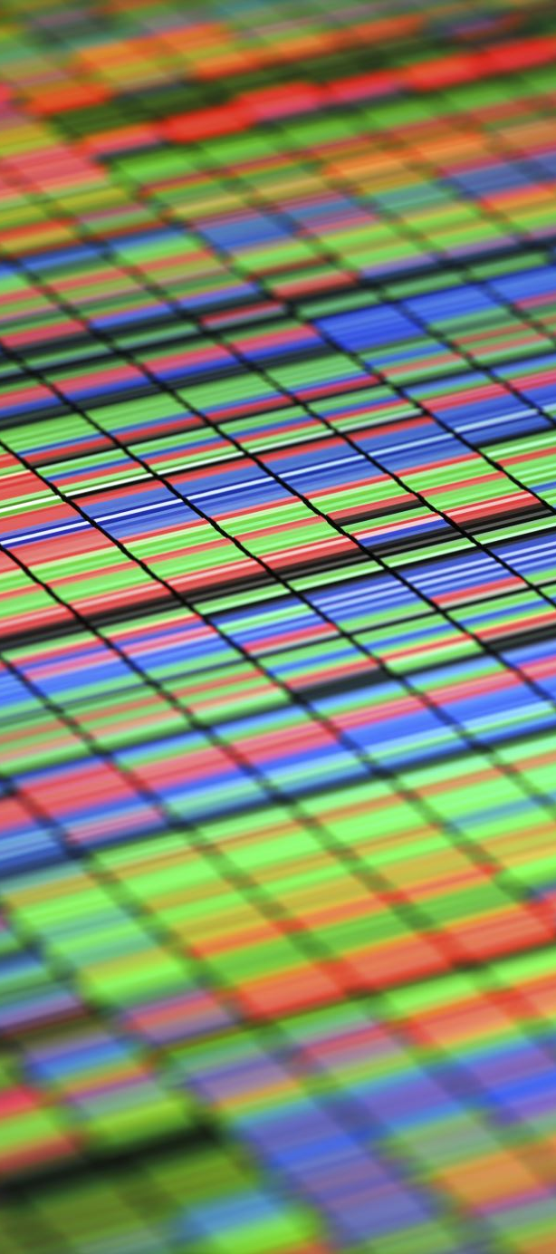
Modeling Approach
• Algorithm: Random Forest Classifier
• Handles feature importance and non-linear patterns
• Hyperparameter tuning: 100 estimators, max depth 10

Slide 9
Class Weights (Model-Level Strategy)
Assign higher weights to minority classes during training.
Works well with models like Logistic Regression, Random Forest, or XGBoost.
python
from sklearn.ensemble import RandomForestClassifier model = RandomForestClassifier(class_weight='balanced', random_state=42) model.fit(X_train, y_train)

Slide 10
For XGBoost:
python
from xgboost import XGBClassifier model = XGBClassifier(scale_pos_weight=imbalance_ratio, random_state=42)
Evaluation Metrics:
Use metrics like F1 score, Precision-Recall or ROC-AUC per class instead of overall accuracy, which is misleading with imbalanced data.
from sklearn.metrics import classification_report
print(classification_report(y_test, model.predict(X_test)))

Slide 11

Model Evaluation
• Accuracy: 83%
• Precision: 81%
• Recall: 80%
• F1 Score: 0.805

Slide 12
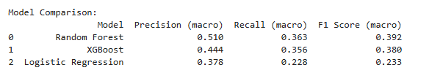
[ ]:
Random Forest performs the best overall, particularly in F1 Score and Precision, indicating a better balance between precision and recall across classes.
XGBoost is close, and may benefit from hyperparameter tuning or better handling of class imbalance (e.g., scale_pos_weight).
Logistic Regression struggles significantly, likely due to the non-linear and imbalanced nature of the data. It may not be ideal unless used as a baseline or with dimensionality reduction.

Slide 13

Limitations & Future Work
• Subjectivity in quality scores
• Explore regression for precise quality scoring
• Add external features: grape type, region, etc.
• Test deep learning models for performance

Slide 14
Thank You / Q&A
Thank you for your time!
Happy to answer any questions.

