Slide 1


Flight Planning System
Unit 3 : Chen, Alex Ashokoumar, Elie C M, Essia Etters,
Naouel K, Samia Ksabi, Tanteley Rakotonari, Stefan V, Julienne Wang
01/29/2016

Slide 2



Flight Planning System
I . Presentation
II . Users
III. Business Objects
IV. Diagram

Slide 3


I. Presentation
The project is about the developpement of a web application for flight companies.
It would allow them to plan flights easily and share required information with employees.
The sharing information should be
available on smartphone and tablet
in addition to computer.

Slide 4
II. Users
  1) OCC (Operations Control Center)
Dedicated interface in a web browser
The only user able to register and modify the information either by manual input or by an import from an excel sheet
  2) Crew
Interface on mobile platforms
Consult their flight information and the related weather data

Slide 5

III. Business Objects (1/2)
Flight information :
    Commercial number
    ATC number (Air Traffic Control)
    Departure/Arrival Airport code
    Departure/Arrival time and date
    Crew
    Plane Identifier
    Weather Maps
    Commercial leaflet
    NOTAM (notice to airmen)
    OFP (Operational Flight Planning)
Plane :
    Identifier
    ICAO (International Civil Aviation Organization)
    Status
Airport :
    Identifier
    ICAO (International Civil Aviation Organization)

Slide 6

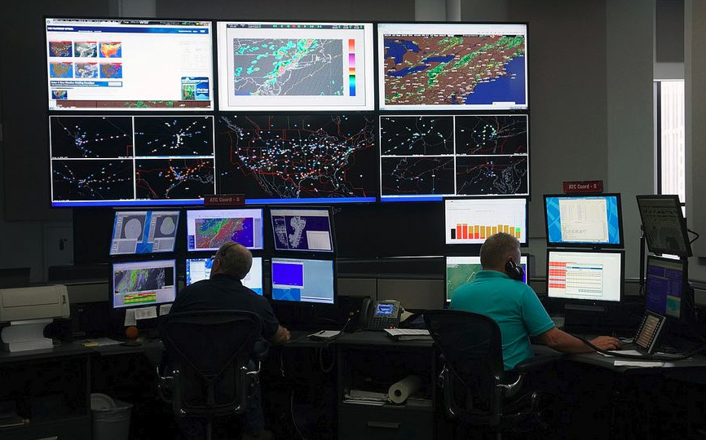

III. Business Objects (2/2)
User :
      Mail
      Password
      Status (OCC/Crew)
Crew :
Name
Status (Pilot/Steward)

Slide 7
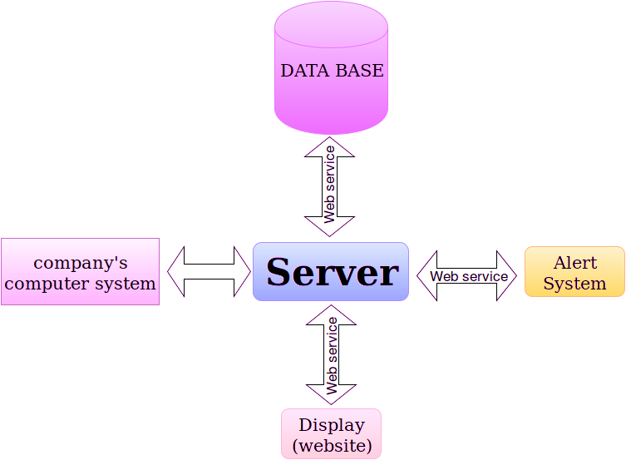
IV. Diagram

Slide 8
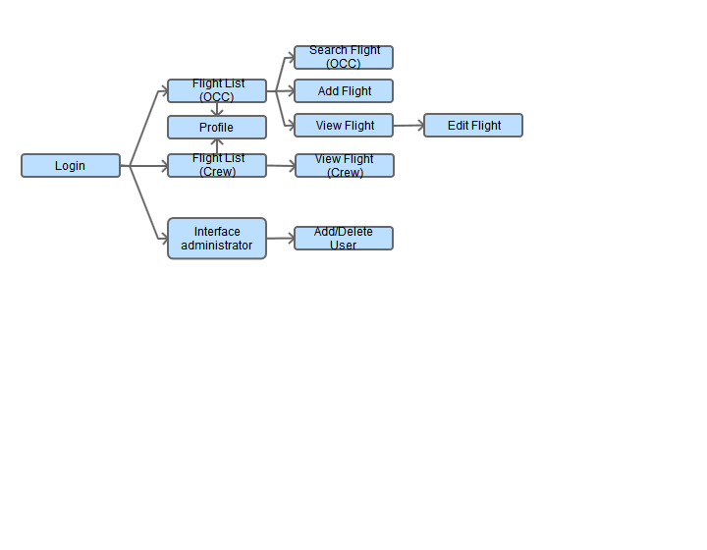
V. Navigation Diagram

Slide 9
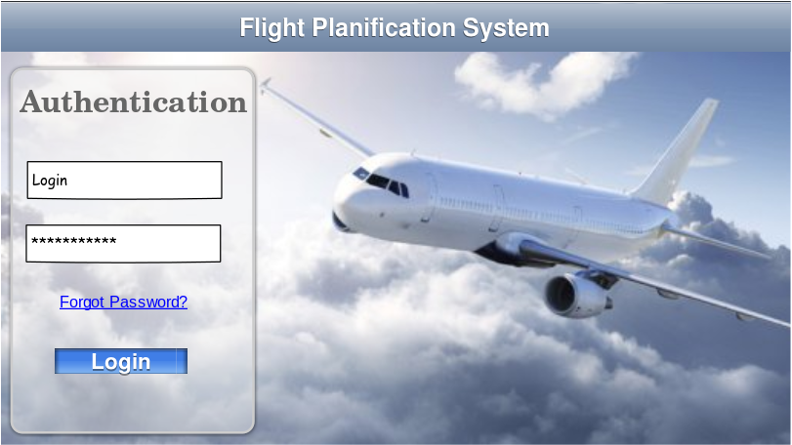
VI. Mock-ups : Login screen

Slide 10
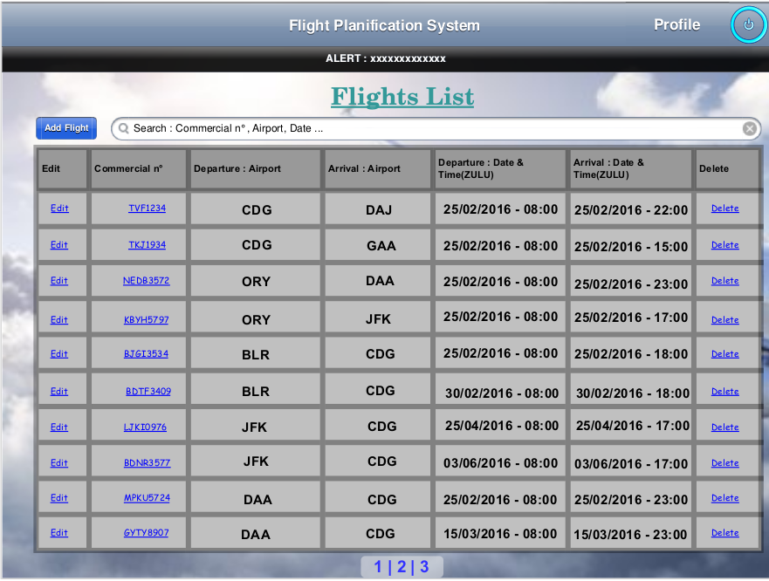
VI. Mock-ups : Flight list screen

Slide 11
VII. Web-services
Method | URL | Behavior
GET | /login/{username} | Returns true if the username is found in the user database and the entered password is valid. Returns false otherwise.
GET | /flight_list | Returns the list of flights.
POST | /flight_list/{id}/edit | Modify the details of flight for the corresponding « id ».
PUT | /flight_list/add | Add a flight
DELETE | /flight_list/{id} | Delete a flight
GET | /flight_list/search/{criteria} | Returns the list of flights matching the search criteria.
GET | /flight_list/{id} | Returns details of flight for the corresponding « id »
GET | /{crew_id}/flight_list | Returns the list of flights for the corresponding « crew_id »
GET | /{crew_id}/flight_list/{id} | Returns details of flight for the corresponding « id »
GET | /{crew_id}/flight_list/search/{criteria} | Returns the list of flights matching the search criteria and the « crew_id »

Slide 12
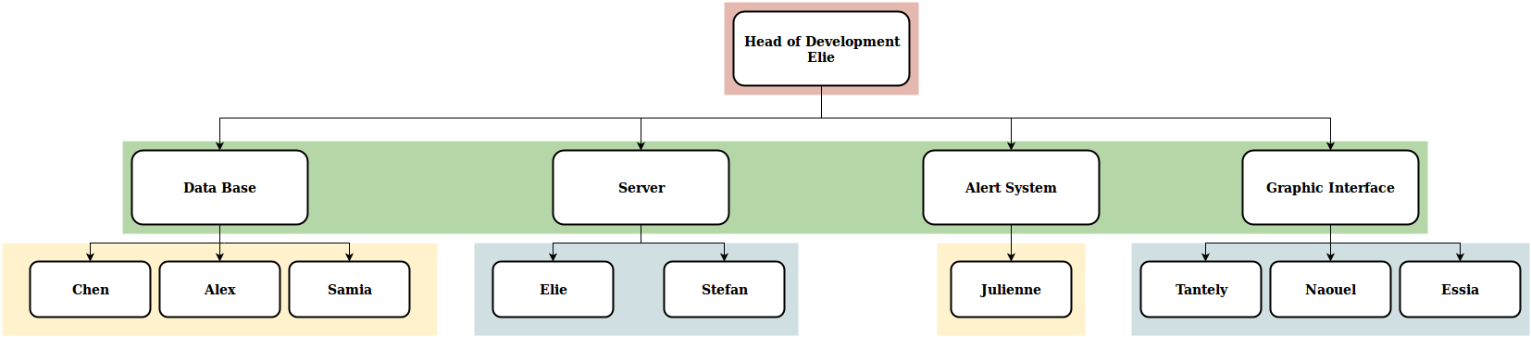
VIII. Developpment Team

