Slide 1

GL M1
Flight Planning System
Flight Planning System
Université Paris Diderot-Paris 7
Unit3 : Alex Ashokoumar, Eile Canonici Merle, Si Chen, Essia Etters, Naouel K, Samia Ksabi, Tantely Rakotomanana, Stefan Vukasinovic, Julienne Wang

Slide 2
I. Presentation
II. Users
III. Business Objects
IV. Diagram

Slide 3
Presentation
Flight Planning System

Slide 4
T
I
t
T
he
he
Project is about the developpement of a web application for flight companies.
would allow them to plan flights easily and share required information with employees.
sharing information should be available on smartphone and tablet in addition to computer.

Slide 5
Users
1
OCC Operation Control Center
Dedicated interface in a web browser
The only user able to register and modify the information either by manual input or by an import from an excel sheet.
2
Crew
Interface on mobile platforms
Consult their flight information and the related weather data

Slide 6
Business Objects
Flight information :
Commercial number Weather Maps
ATC number(Air Traffic Control) Crew
Departure/Arrival Airport Code Commercial leaflet
Departure/Arrival time and data NOTAM(notice to airmen)
OFP(Operational Flight Planning)
Flight
information
Plane :
Identifier
ICAO(Intermational Civil Aviation Organization)
Status
Plane
Airport :
Identifier
ICAO(International Civil Aviation Organization)
Airport

Slide 7
Crew :
Name
Status(Pilot/Steward)
Crew
Mail :
Password
Status(OCC/Crew)
User

Slide 8
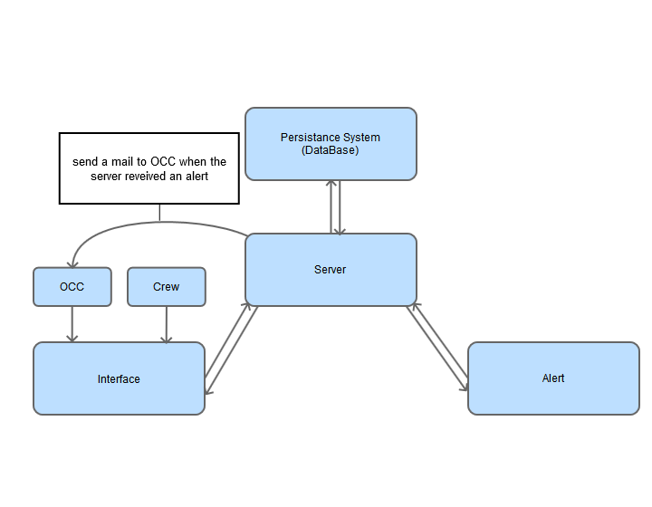
Diagram

