Slide 1


GL M1
Flight Planning System
Flight Planning System
Université Paris Diderot-Paris 7
Unit3 : Alex Ashokoumar, Eile Canonici Merle, Si Chen, Essia Etters, Naouel K, Samia Ksabi, Tantely Rakotomanana, Stefan Vukasinovic, Julienne Wang
01/31/2016

Slide 2
I. Presentation
II. Users
III. Business Objects
IV. Diagram
span
spall
slab
bench
blast
rock brust
RMR
NATM
steel sets
rockbolt
stress field
parameter
shot crete
wire mesh

Slide 3
Presentation
Flight Planning System

Slide 4
T
I
t
T
he
he
Project is about the developpement of a web application for flight companies.
would allow them to plan flights easily and share required information with employees.
sharing information should be available on smartphone and tablet in addition to computer.

Slide 5
Users
1
OCC Operation Control Center
Dedicated interface in a web browser
The only user able to register and modify the information either by manual input or by an import from an excel sheet.
2
Crew
Interface on mobile platforms
Consult their flight information and the related weather data

Slide 6
Business Objects
Plane
Flight information :
Commercial number
ATC number(Air Traffic Control)
Departure/Arrival Airport Code
Departure/Arrival time and data
Crew
Plane identifier
Weather Maps
Commercial leaflet
NOTAM(notice to airmen)
OFP(Operational Flight Planning)
Plane :
Identifier
ICAO(Intermational Civil Aviation Organization)
Status
Airport :
Identifier
ICAO(International Civil Aviation Organization)
Airport
Flight
information

Slide 7
Name
Status(Pilot/Steward)
Crew
Mail
Password
Status(OCC/Crew)
User

Slide 8
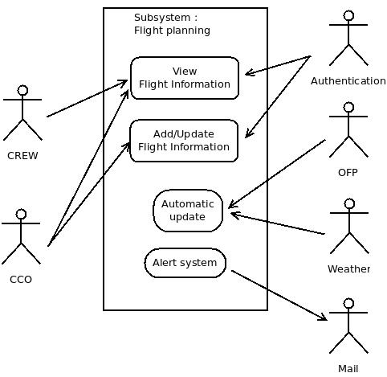
Diagram

