Slide 1

GL M1
Flight Planning System
Flight Planning System
Université Paris Diderot-Paris 7
Unit3 : Alex Ashokoumar, Eile Canonici Merle, Si Chen, Essia Etters, Naouel K, Samia Ksabi, Tantely Rakotomanana, Stefan Vukasinovic, Julienne Wang

Slide 2
I. Presentation
II. Users
III. Business Objects
IV. Diagram
VI. Navigation Diagram
VII. Mock-ups
VIII. Webservices

Slide 3
Presentation
Flight Planning System

Slide 4
T
I
t
T
he
he
Project is about the developpement of a web application for flight companies.
would allow them to plan flights easily and share required information with employees.
sharing information should be available on smartphone and tablet in addition to computer.

Slide 5
Users
1
OCC Operation Control Center
Dedicated interface in a web browser
The only user able to register and modify the information either by manual input or by an import from an excel sheet.
2
Crew
Interface on mobile platforms
Consult their flight information and the related weather data

Slide 6
Business Objects
Flight information :
Commercial number Weather Maps
ATC number(Air Traffic Control) Crew
Departure/Arrival Airport Code Commercial leaflet
Departure/Arrival time and date NOTAM(notice to airmen)
OFP(Operational Flight Planning)
Flight
information
Plane :
Identifier
ICAO(Intermational Civil Aviation Organization)
Status
Plane
Airport :
Identifier
ICAO(International Civil Aviation Organization)
Airport

Slide 7
Crew :
Name
Status(Pilot/Steward)
Crew
User :
Mail
Password
Status(OCC/Crew)
User

Slide 8
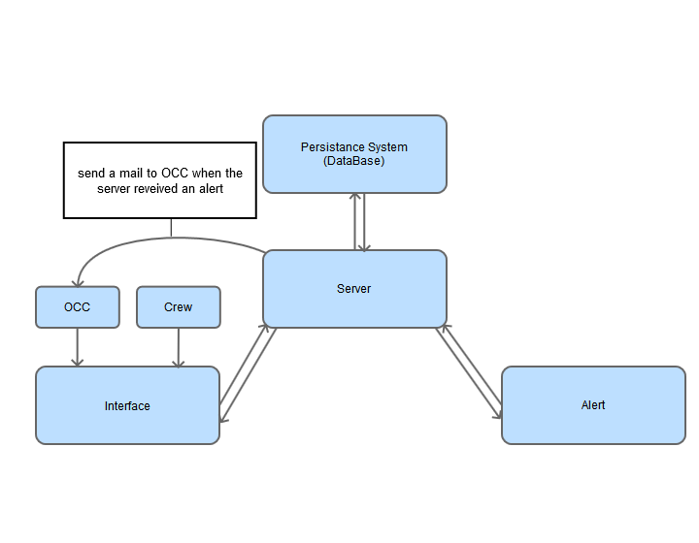
Diagram

Slide 9
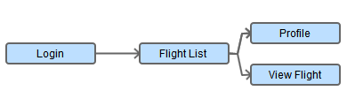
Navigation Diagram (CREW)

Slide 10
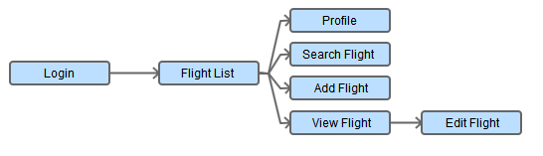
Navigation Diagram (OCC)

Slide 11
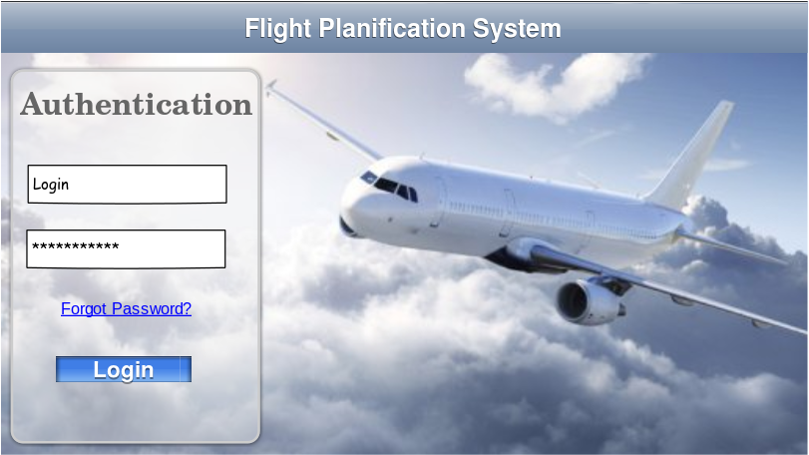
Mock-up: Login screen 1/2

Slide 12
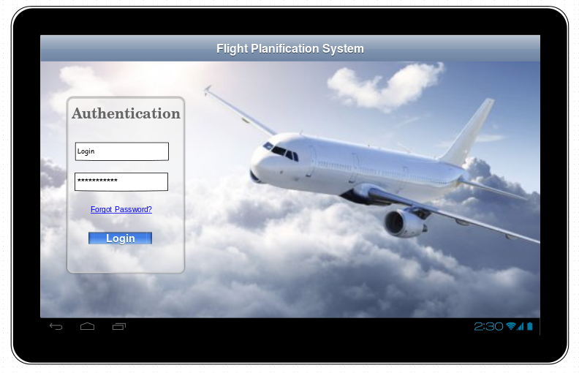
Mock-up: Login screen 2/2

Slide 13
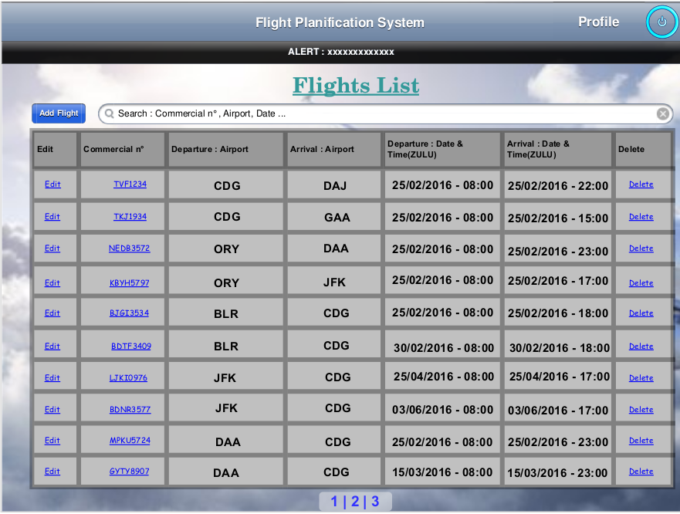
Mock-up: Flight list screen (CCO)

Slide 14
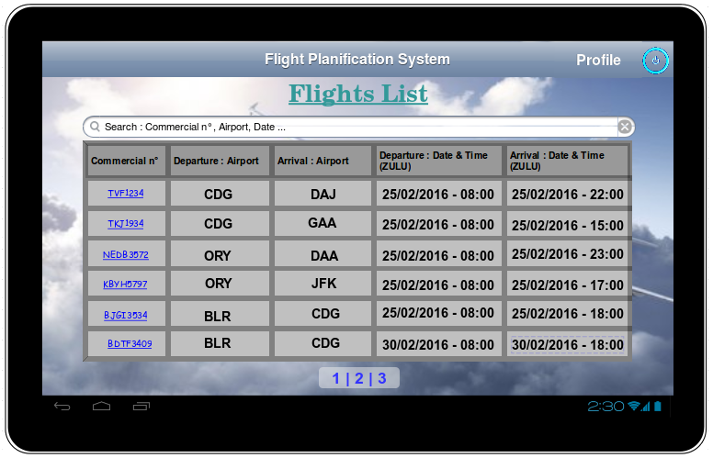
Mock-up: Flight list (Crew)

Slide 15
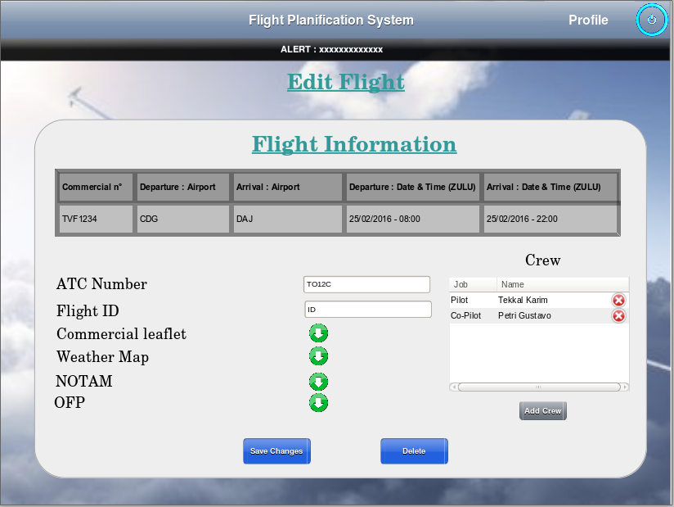
Mock-up: Edit flight screen (CCO)

Slide 16
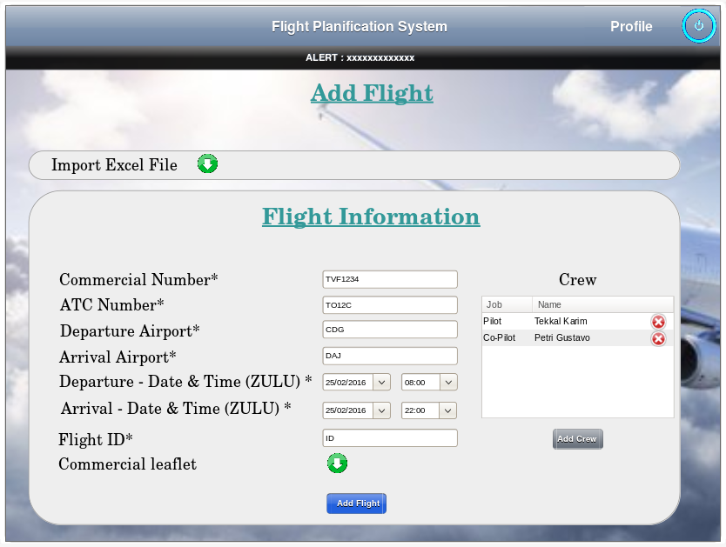
Mock-up: Add Flight screen (CCO)

Slide 17
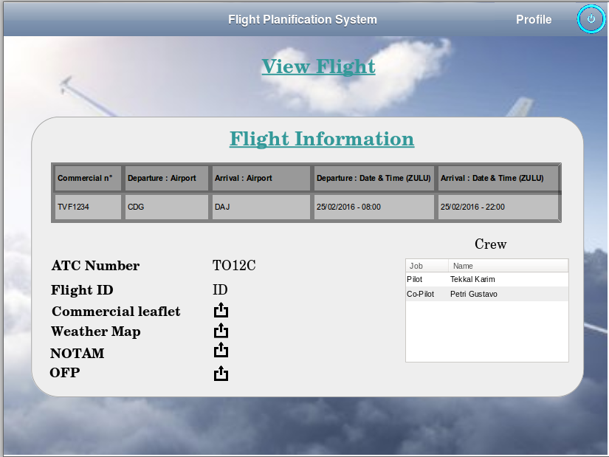
Mock-up: View flight screen

Slide 18
Webservices (1/2)
Method | URL | Behavior
GET | /login | Grants access if login is successful
GET | /flight_list | Returns the list of flights.
POST | /flight_list/{id}/edit | Modify the details of flight for the corresponding « id ».
PUT | /flight_list | Add a flight
DELETE | /flight_list/{id} | Delete a flight
GET | /flight_list/search/{criteria} | Returns the list of flights matching the search criteria.
GET | /flight_list/{id} | Returns details of flight for the corresponding « id »

Slide 19
Webservices (2/2)
Method | URL | Behavior
GET | /{crew_id}/flight_list | Returns the list of flights for the corresponding « crew_id »
GET | /{crew_id}/flight_list/{id} | Returns details of flight for the corresponding « id »
GET | /{crew_id}/flight_list/search/{criteria} | Returns the list of flights matching the search criteria and the « crew_id »

Slide 20
Developpment team

Slide 21
Git
https://github.com/canonici/GL-M1

