Slide 2
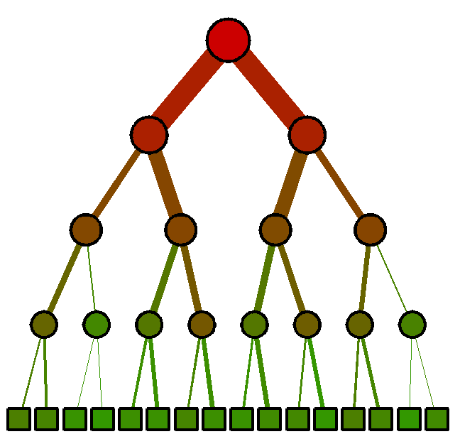
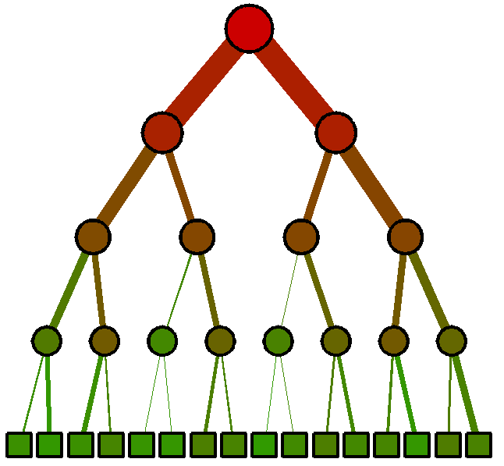
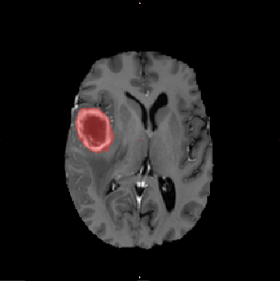
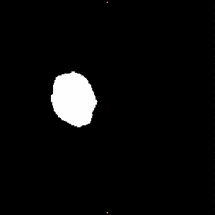
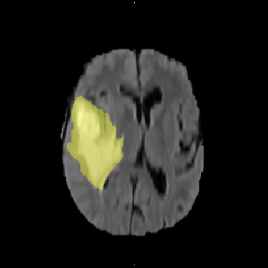
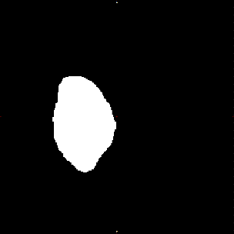
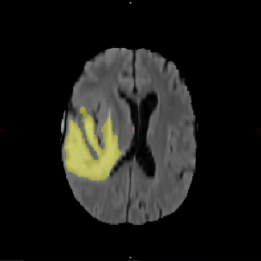
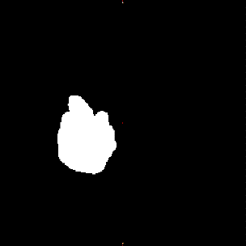
…
Input channels
tumour core
ROI
whole tumour
ROI
whole tumour
ROI
…

Slide 3
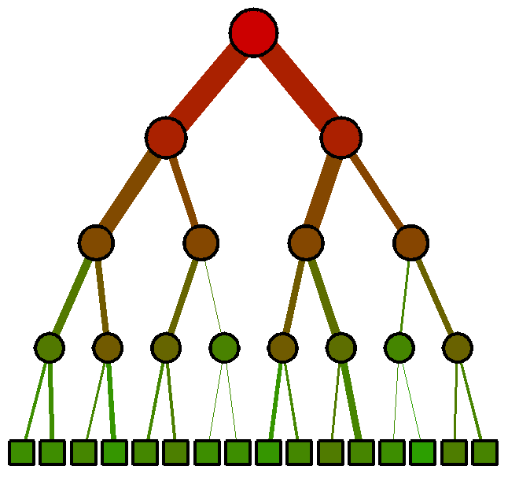
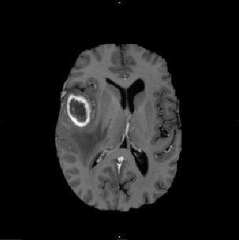
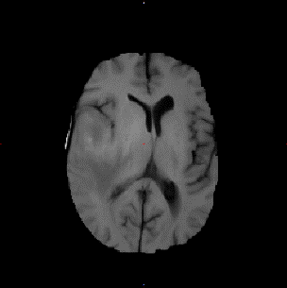
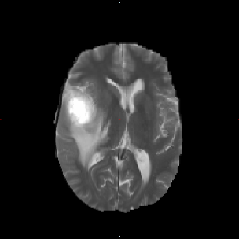
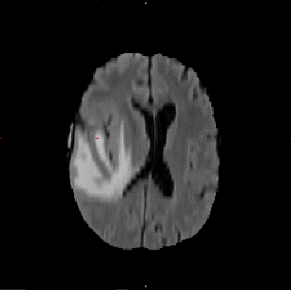
…
T1c
T1
T2
Flair
tumour core
ROI
Input channels
…
whole tumour
ROI
whole tumour
ROI

Slide 4
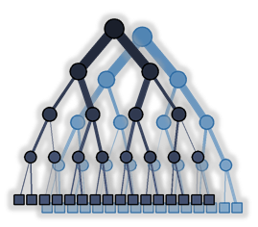




1st layer
2nd layer
3rd layer
…
Input channels ${\left\{I_{j}\right\}}_{j=1⋯J}$
Class probabilities
$${\left\{p\left(c^{\left(1\right)}=c_{k}^{\left(1\right)} | x^{\left(1\right)}\right)\right\}}_{k=1⋯K^{(1)}}$$
Class probabilities
$${\left\{p\left(c^{\left(2\right)}=c_{k}^{\left(2\right)} | x^{\left(2\right)}\right)\right\}}_{k=1⋯K^{(2)}}$$
Class probabilities
$${\left\{p\left(c^{\left(1\right)}=c_{k}^{\left(1\right)} | x^{\left(1\right)}\right)\right\}}_{k=1⋯K^{(1)}}$$

Slide 5
1st layer
2nd layer
3rd layer
…
Input channels ${\left\{I_{j}\right\}}_{j=1⋯J}$
Class probabilities
$${\left\{p\left(c^{\left(1\right)}=c_{k}^{\left(1\right)} | x^{\left(1\right)}\right)\right\}}_{k=1⋯K^{(1)}}$$
Class probabilities
$${\left\{p\left(c^{\left(2\right)}=c_{k}^{\left(2\right)} | x^{\left(2\right)}\right)\right\}}_{k=1⋯K^{(2)}}$$
Class probabilities
$${\left\{p\left(c^{\left(1\right)}=c_{k}^{\left(1\right)} | x^{\left(1\right)}\right)\right\}}_{k=1⋯K^{(1)}}$$

Slide 8
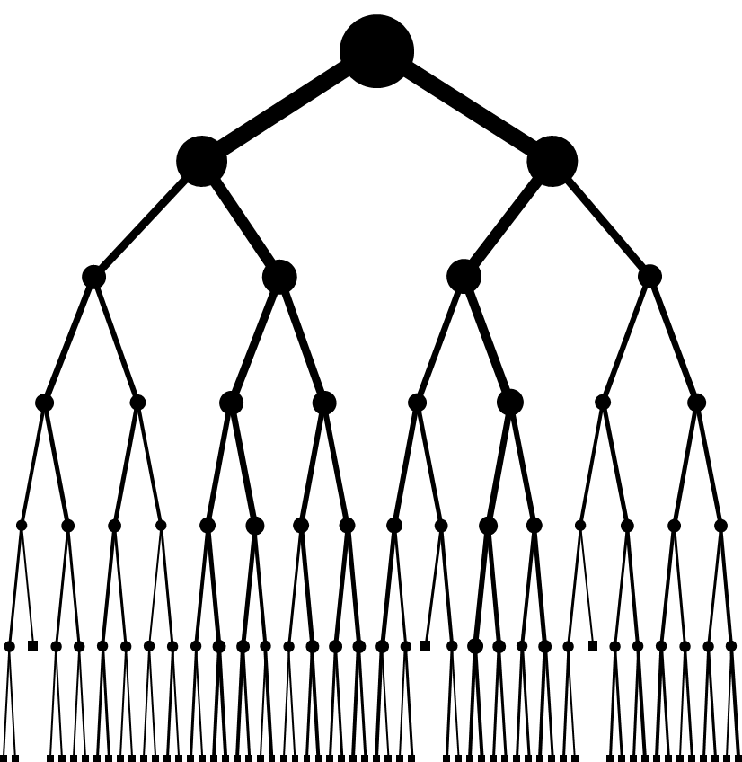
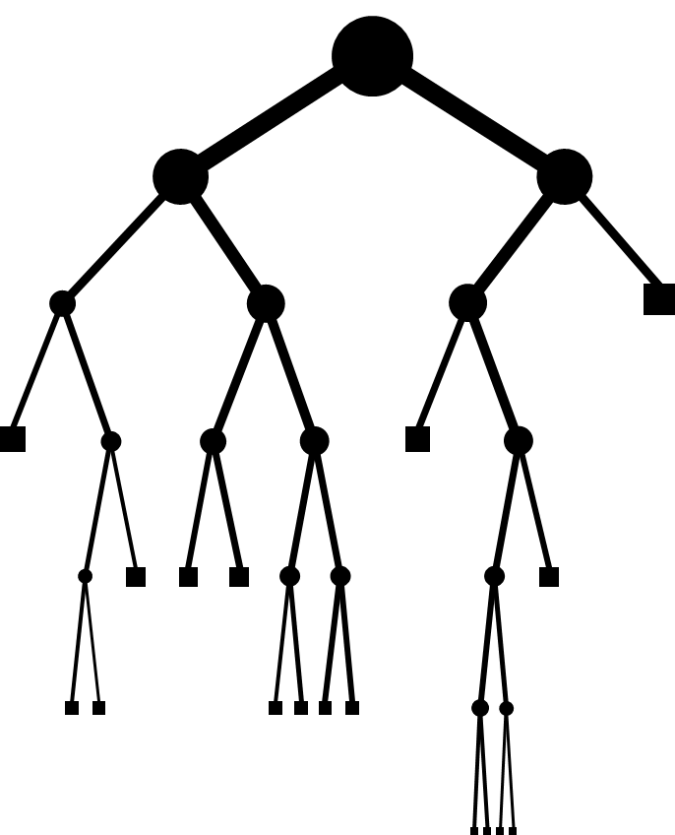
(a)
(b)

Slide 9
1st k-means centroid
2nd k-means centroid

Slide 10
(a)
(b)
(c)
(d)
1st k-means centroid
2nd k-means centroid

Slide 11
(a)
(b)
(c)
(d)

Slide 12
(a)
(b)

Slide 13
(a)
(b)

Slide 14
(MLE bar plot)
(CVE bar plot)
(legend)

