Slide 2
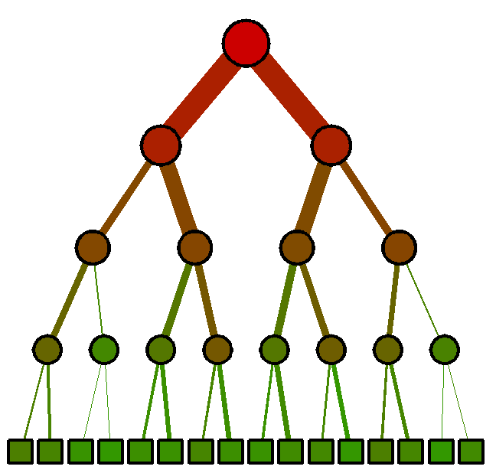
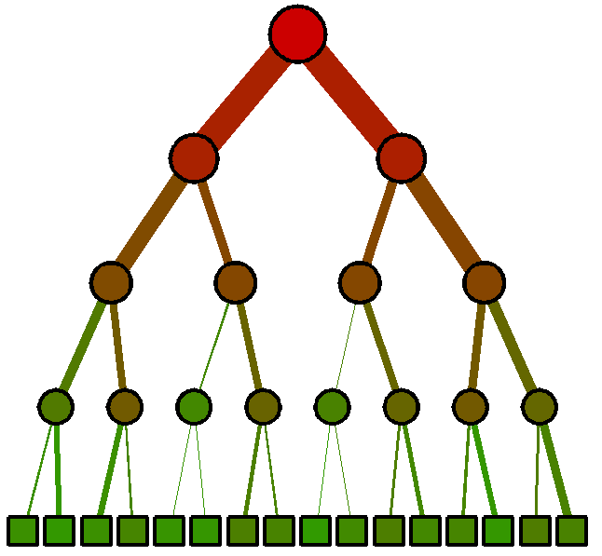
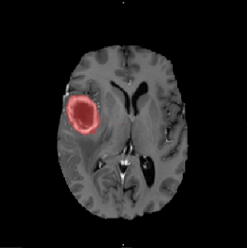
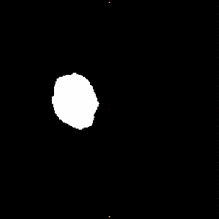
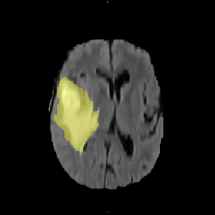
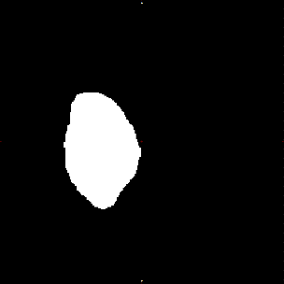
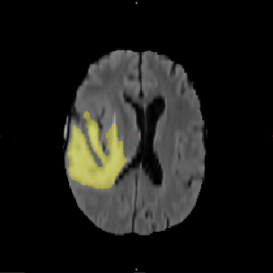
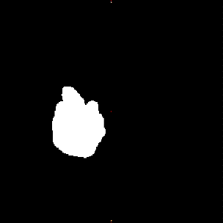
…
Input channels
tumour core
ROI
whole tumour
ROI
whole tumour
ROI
…

Slide 3
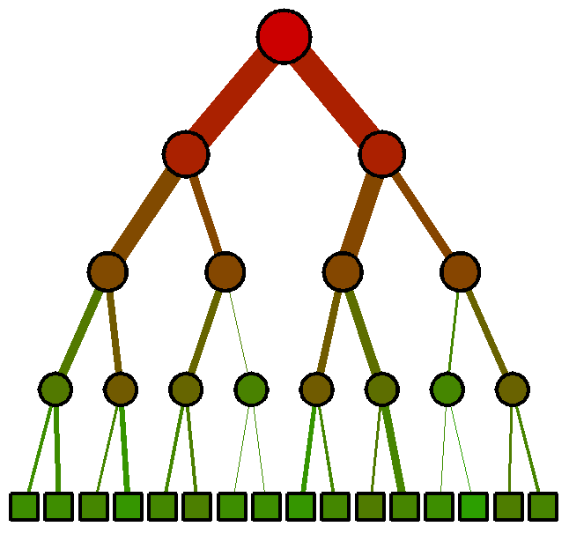
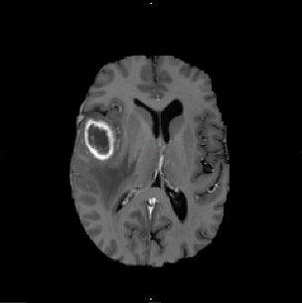
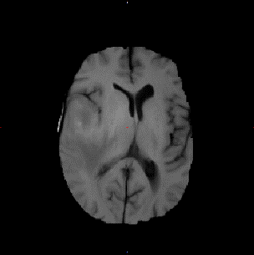
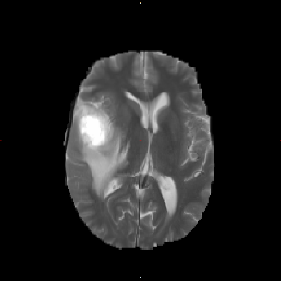
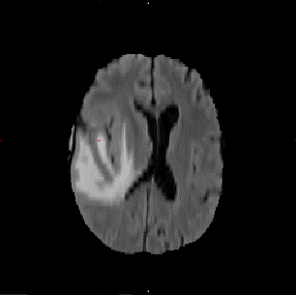
…
T1c
T1
T2
Flair
tumour core
ROI
Input channels
…
whole tumour
ROI
whole tumour
ROI

Slide 4
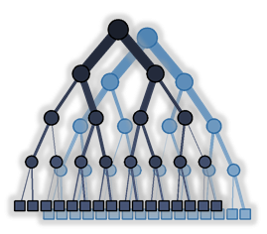




1st layer
2nd layer
3rd layer
…
Input channels ${\left\{I_{j}\right\}}_{j=1⋯J}$
Class probabilities
$${\left\{p\left(c^{\left(1\right)}=c_{k}^{\left(1\right)} | x^{\left(1\right)}\right)\right\}}_{k=1⋯K^{(1)}}$$
Class probabilities
$${\left\{p\left(c^{\left(2\right)}=c_{k}^{\left(2\right)} | x^{\left(2\right)}\right)\right\}}_{k=1⋯K^{(2)}}$$
Class probabilities
$${\left\{p\left(c^{\left(1\right)}=c_{k}^{\left(1\right)} | x^{\left(1\right)}\right)\right\}}_{k=1⋯K^{(1)}}$$

Slide 5
1st layer
2nd layer
3rd layer
…
Input channels ${\left\{I_{j}\right\}}_{j=1⋯J}$
Class probabilities
$${\left\{p\left(c^{\left(1\right)}=c_{k}^{\left(1\right)} | x^{\left(1\right)}\right)\right\}}_{k=1⋯K^{(1)}}$$
Class probabilities
$${\left\{p\left(c^{\left(2\right)}=c_{k}^{\left(2\right)} | x^{\left(2\right)}\right)\right\}}_{k=1⋯K^{(2)}}$$
Class probabilities
$${\left\{p\left(c^{\left(1\right)}=c_{k}^{\left(1\right)} | x^{\left(1\right)}\right)\right\}}_{k=1⋯K^{(1)}}$$

Slide 6

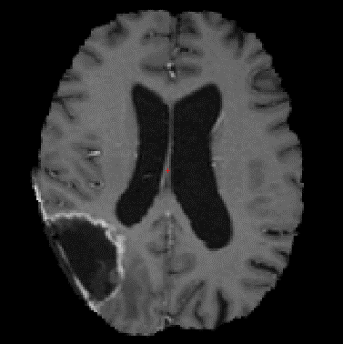
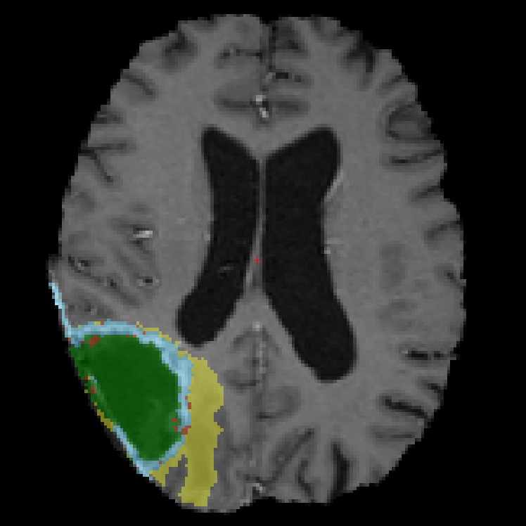
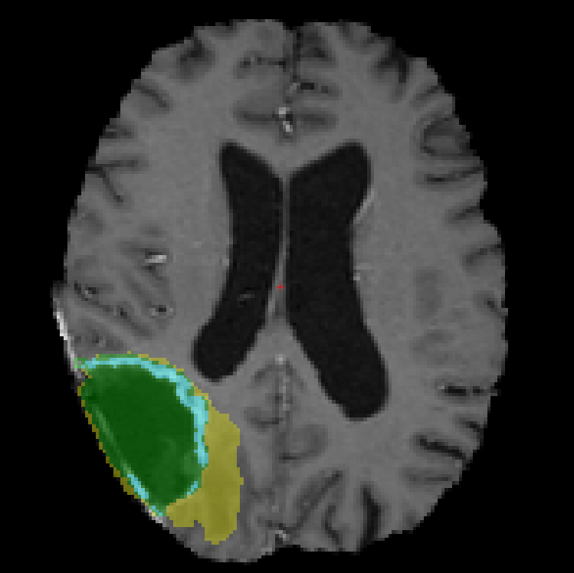
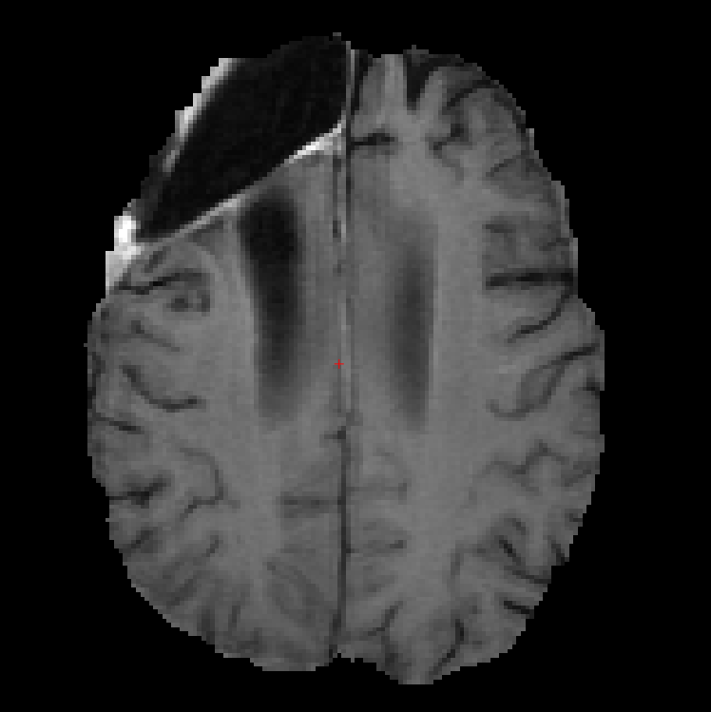
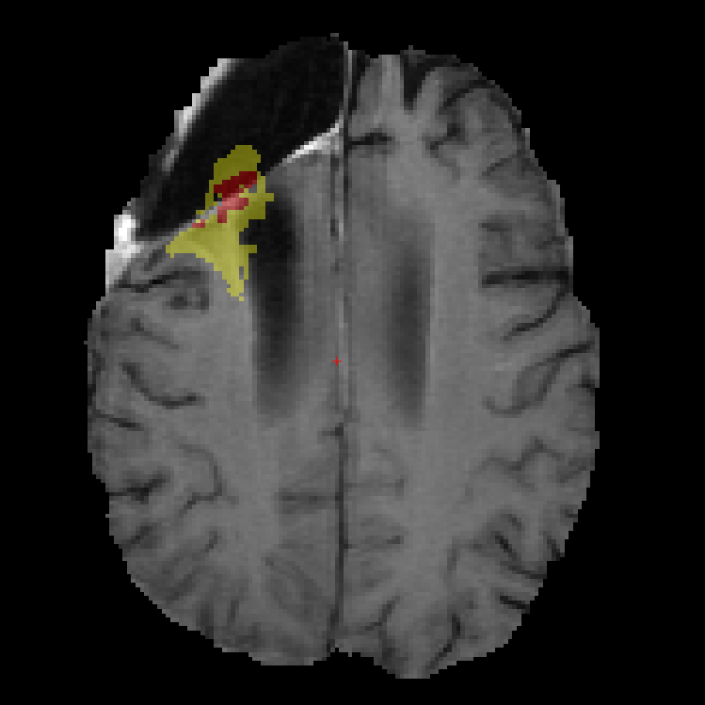
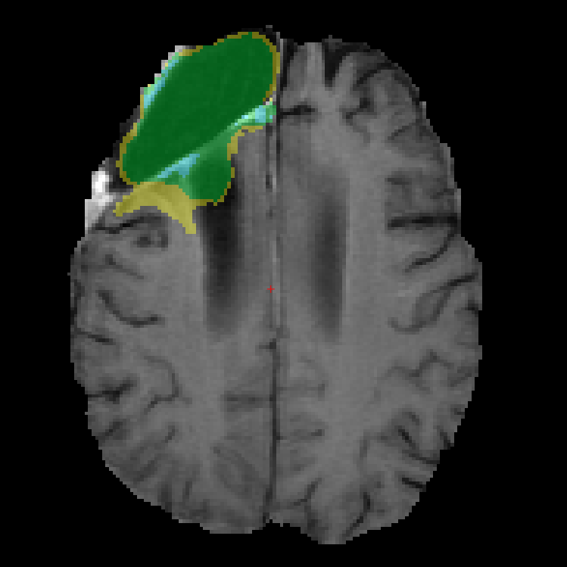
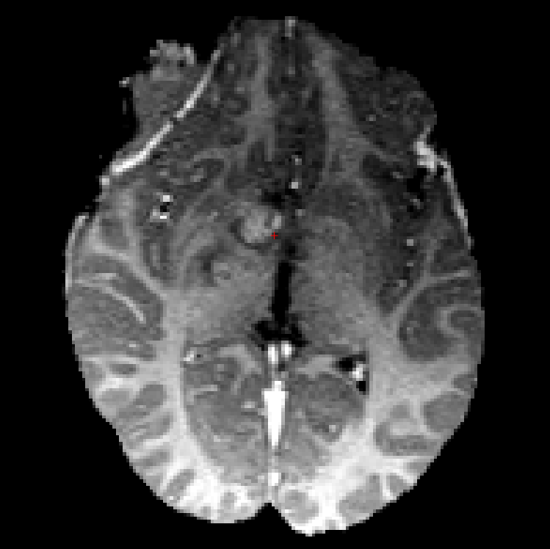
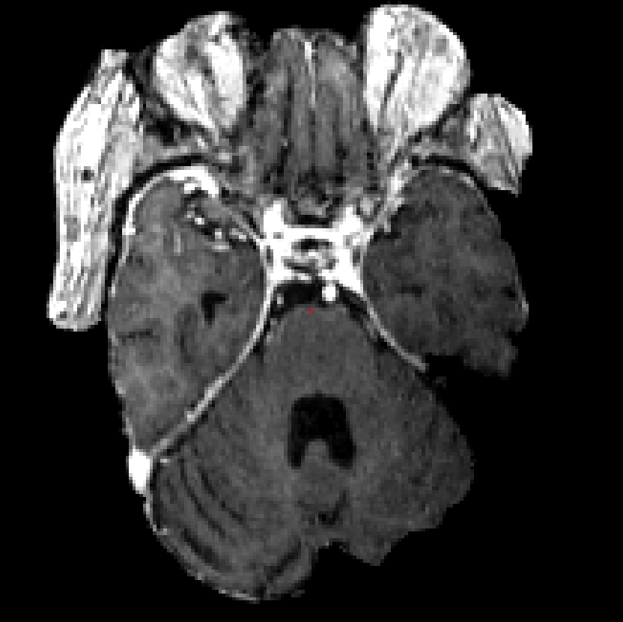
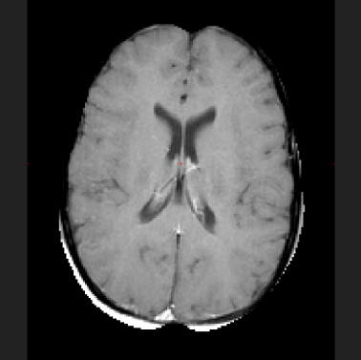

BraTS challenge
2015 dataset & training
T1c
GT
Pred.
1 machine @3.6GHz Intel Xeon, 8+ cores.
$≃$ hrs for training+test (training $≃$seconds / tree)
BraTS 2015 dataset challenge: post-resection cavities
$→$ unsupervised GMM/MRF modelling
Favoured qualitative/visual “metric”!
$→$ training on ¼ BraTS2015 database
Test DICE: 84% WT, 71% TC, 71% ET.
brats_2013_pat0005_1
brats_tcia_pat374_0557
T1c
GT
Pred.
2016 evaluation
Data: only partial pre-processing
Semi-automatic pipeline:
bias field removal, skull stripping, rigid registration
Future directions
Additional modelling: ventricles, WM/GM, cavities, etc.
Robustness to bias field processing & intensity contrast?
brats_2013_pat0103_0
brats_cbica_patAAM_416
brats_klhd_pat165_2

Slide 7


Notes:
Task - segmenting the bladder

Slide 8
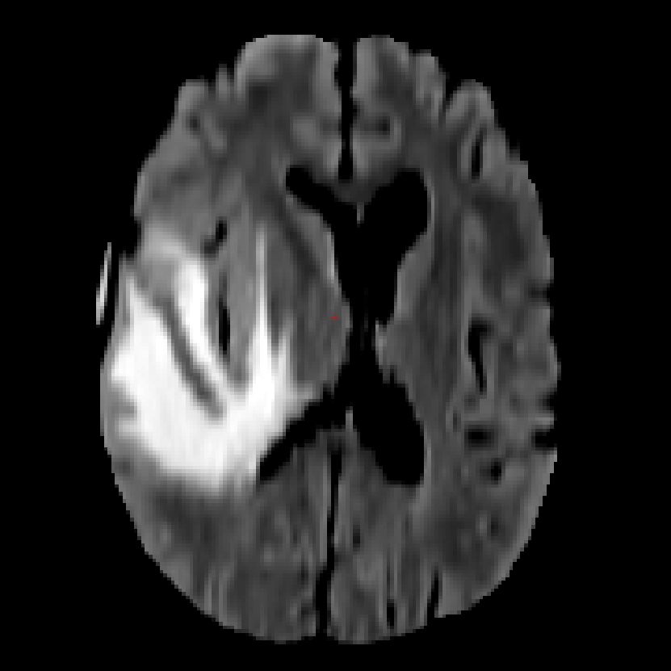
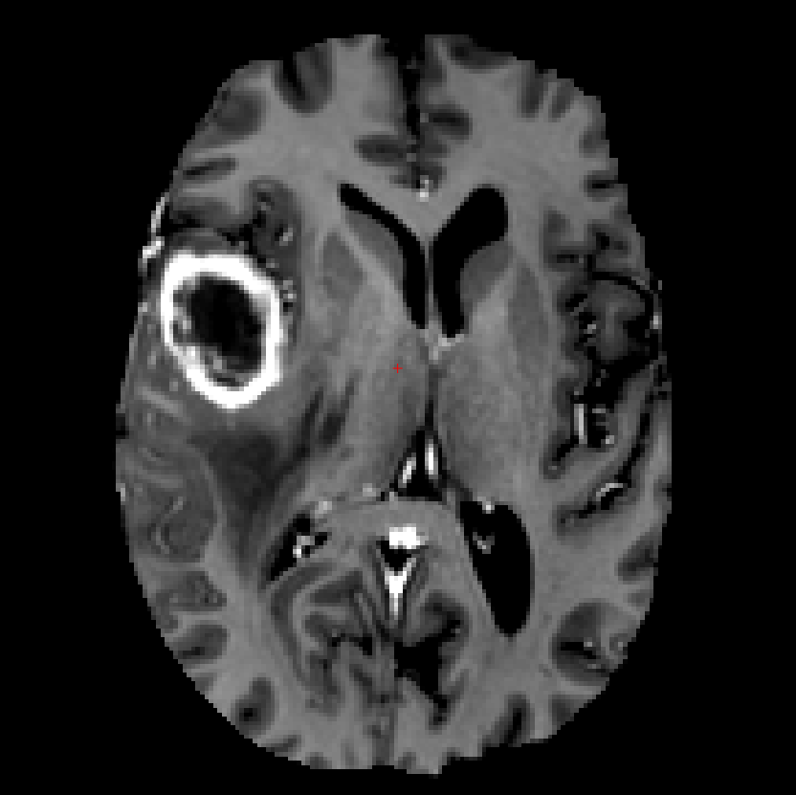
Flair
WT cluster assignments
T1c
TC cluster assignments
Notes:
Task - segmenting the bladder

Slide 11
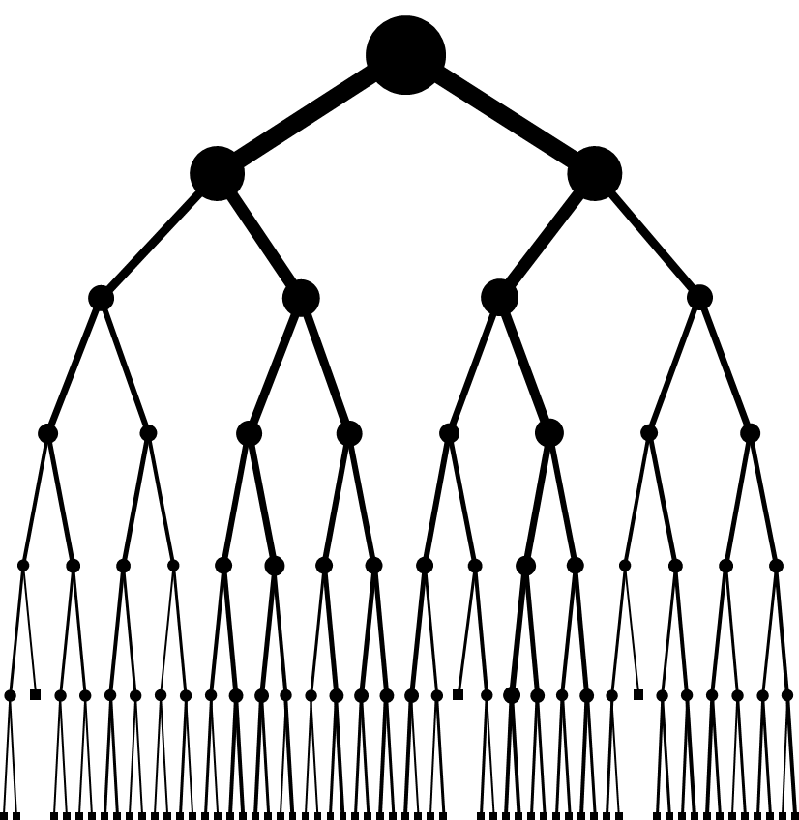
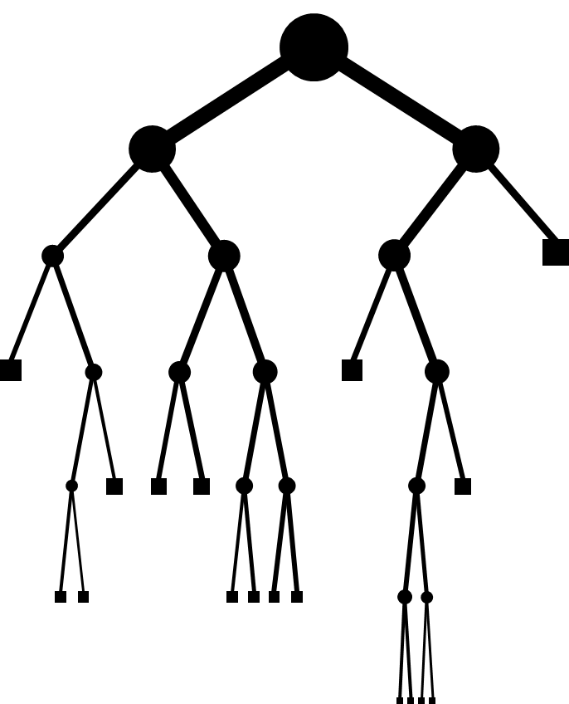
(a)
(b)

Slide 12
1st k-means centroid
2nd k-means centroid

Slide 13
(a)
(b)
(c)
(d)
1st k-means centroid
2nd k-means centroid

Slide 14
(a)
(b)
(c)
(d)

Slide 15
(a)
(b)

Slide 16
(a)
(b)

Slide 17
(MLE bar plot)
(CVE bar plot)
(legend)

