Slide 1
GNNGuard: Defending Graph Neural Networks against Adversarial Attacks
Xiang Zhang and Marinka Zitnik
NeurIPS 2020
Presenters: Sai Kandregula(2020CSY7570) and Samidha Verma(2020CSY7575)

Slide 2
OUTLINE
Motivation
Background : Adversarial Attacks
Key Contributions
Design Concept
Notation and Problem Formulation
GNNGuard :
Key components
Time Complexity
Related Work
Experiments
Setup
Results
Our Experiment
Strengths and Weaknesses
Conclusion
References

Slide 3
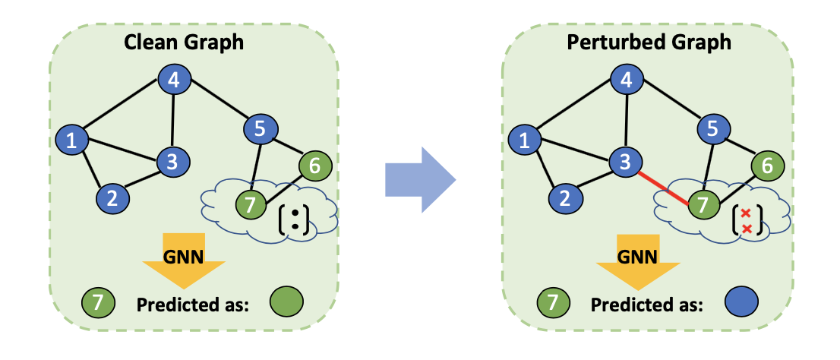
MOTIVATION
GNNs neural message passing scheme which depends on neighborhood information aggregation is vulnerable to perturbation attacks.

Slide 4
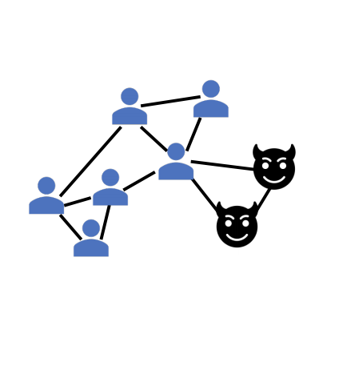
CONSEQUENCES
Small, unnoticeable perturbations of graph structure can catastrophically reduce performance
Financial Systems :
Credit Card Fraud Detection
Recommender Systems :
Social Recommendations
Product Recommendations
https://sites.google.com/view/kdd-2020-attack-and-defense

Slide 5
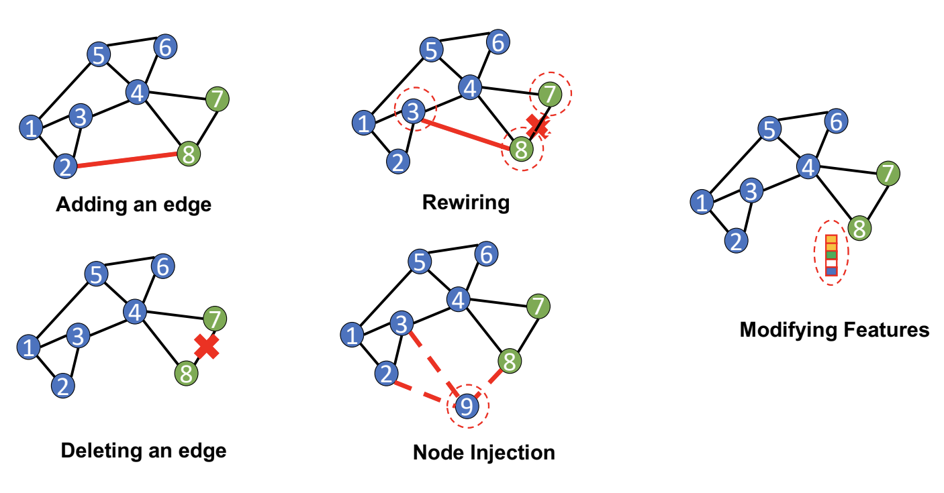
TYPES OF ADVERSARIAL ATTACKS
Adding or Deleting Edges
Injecting Nodes
Perturbation Type
Modifying Features
Rewiring

Slide 6
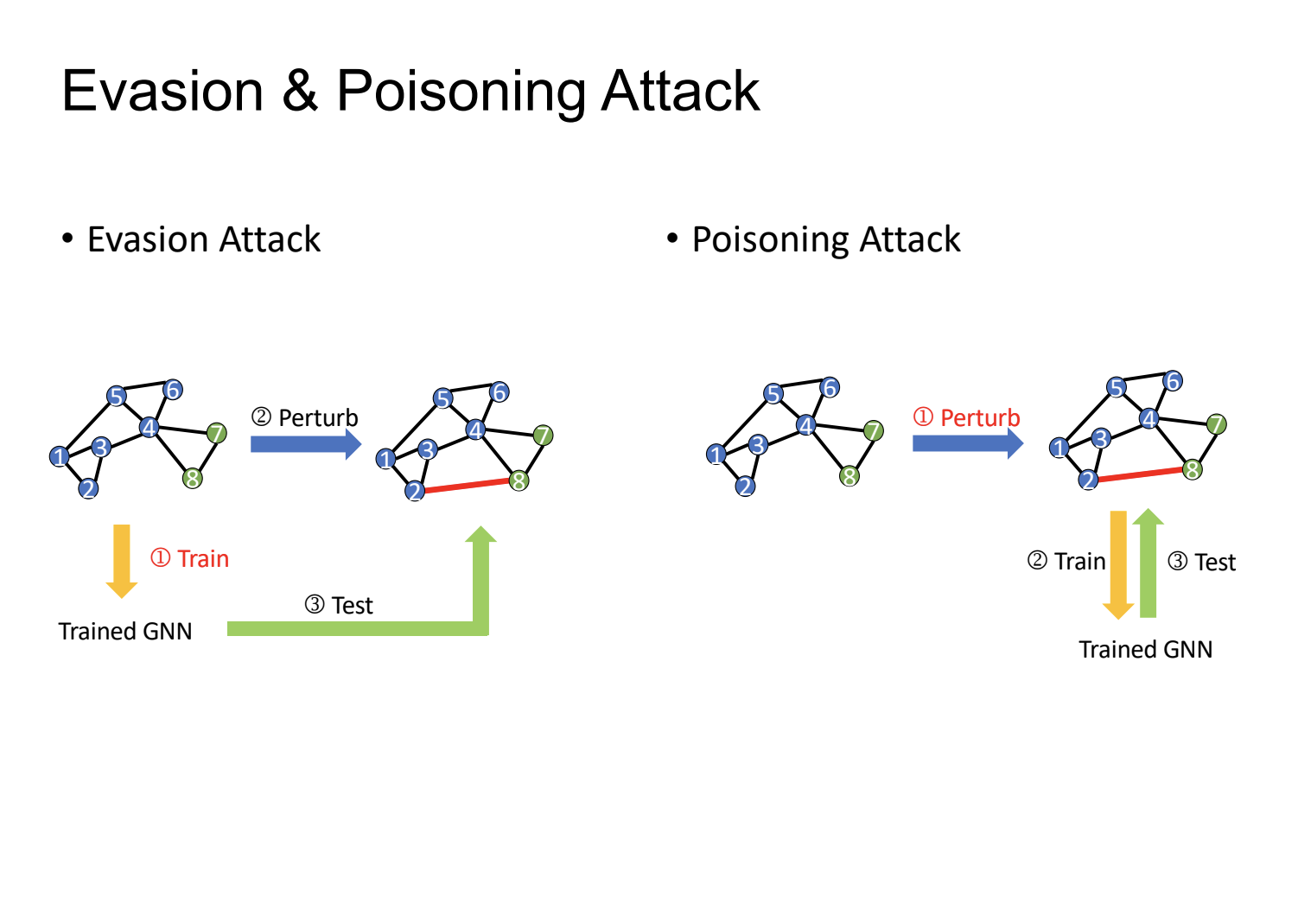
TYPES OF ADVERSARIAL ATTACKS
Attacker’s Capacity
Poisoning Attack :
Attack during model training
Evasion Attack :
Attack during model testing

Slide 7
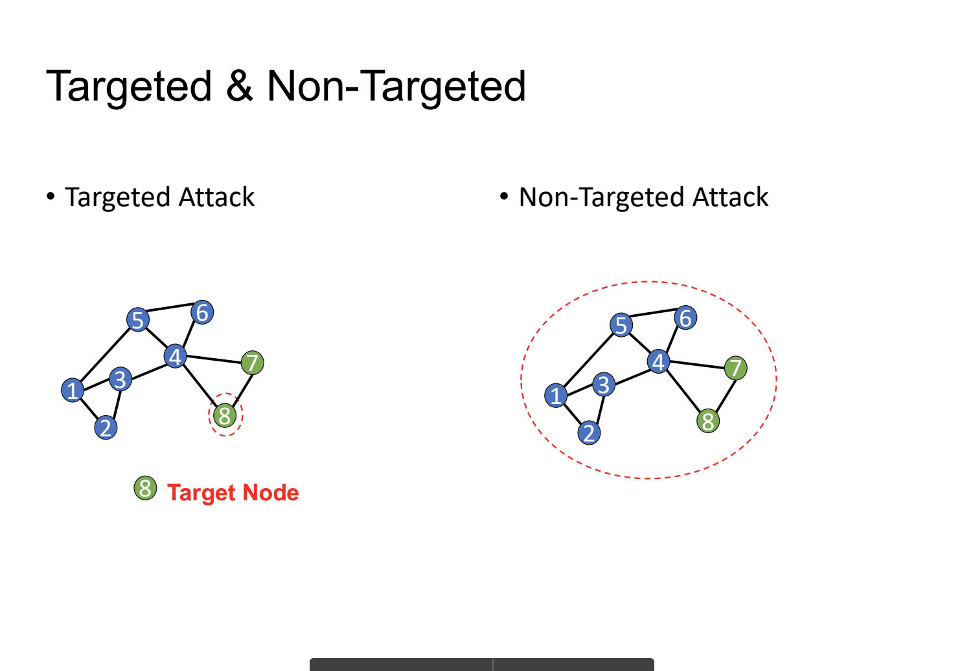
TYPES OF ADVERSARIAL ATTACKS
Attacker’s Goal
Targeted Attack: Misclassify specific nodes
Direct Attack : Attacker modifies the features or edges of the target nodes
Influencer Attack : Attacker can only manipulate edges of the target node’s neighbour
Untargeted Attack: Make overall performance bad

Slide 8
TYPES OF ADVERSARIAL ATTACKS
Attacker’s Knowledge
White-box Attack:
All information about the model parameters, training input (e.g, adjacency matrix, attribute matrix) and the labels.
Gray-box Attack:
The attacker only has limited knowledge about the victim model.
Black-box Attack:
No access to the model’s parameters or training labels. It can access the adjacency matrix and attribute matrix, and do black-box query for output scores or labels.

Slide 9
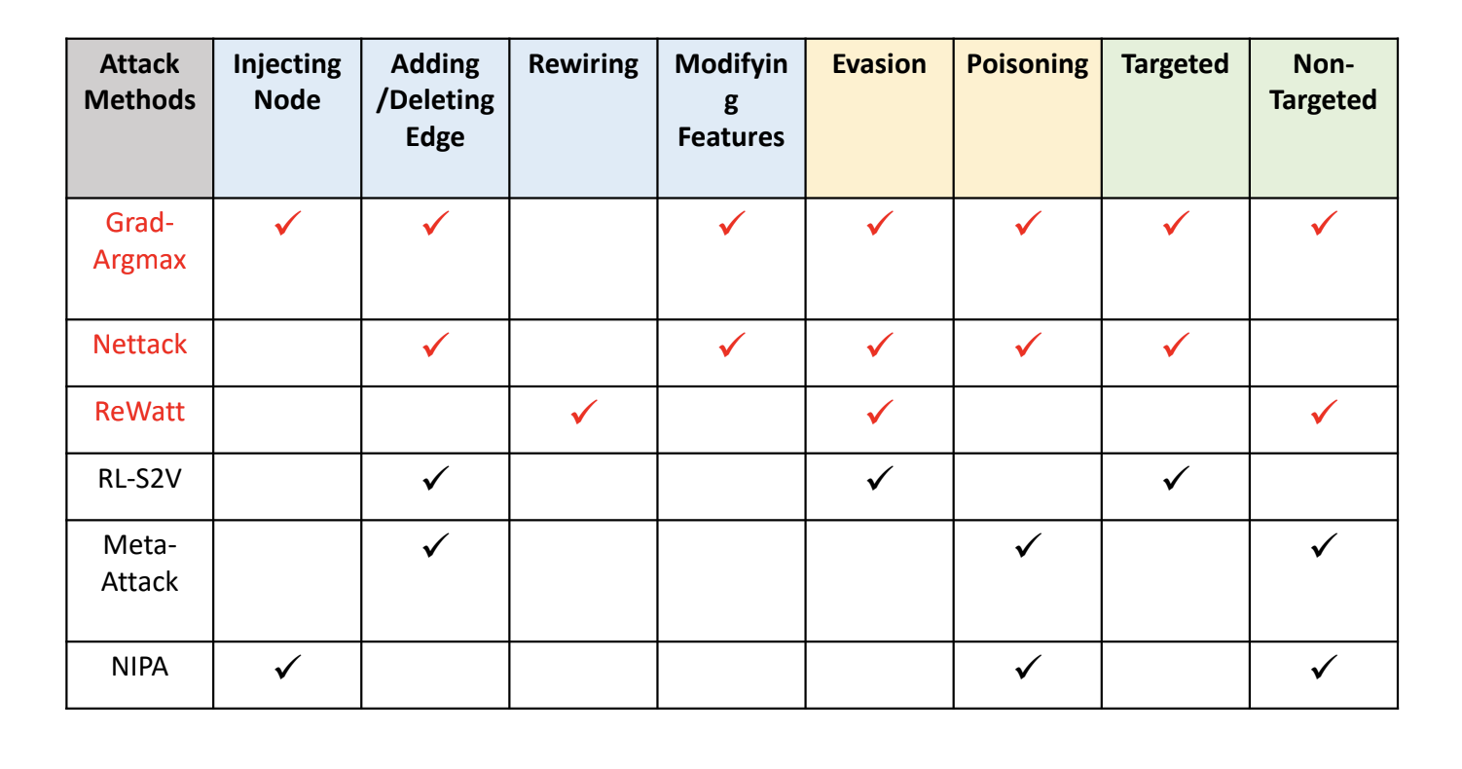
ATTACK METHODS

Slide 10
KEY CONTRIBUTIONS
General approach applicable across all GNN models against various training time (poisoning) attacks.
Revises message passing architecture so that the revised model is robust to adversarial perturbations while at the same time keeping its representational capacity.
Comparison on direct targeted, influence targeted, and non-targeted attacks with three state-of-the-art GNN defenders.
Successful defense on heterophily graphs which have abundant structural equivalences.

Slide 11
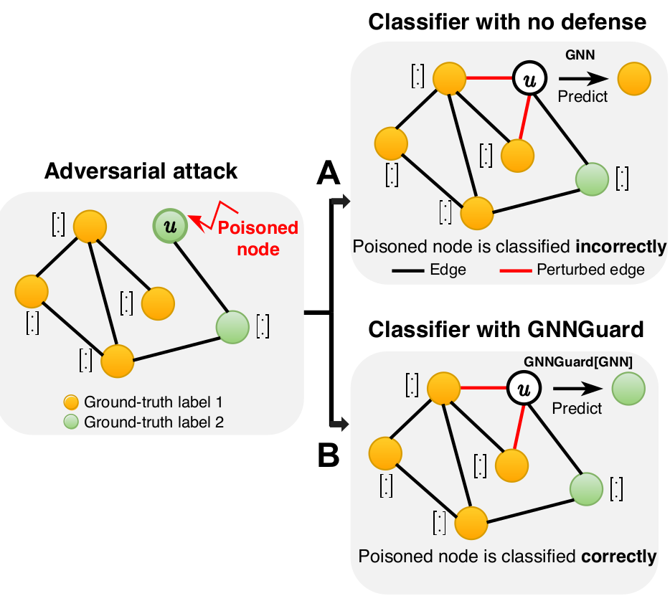
DESIGN CONCEPT

Slide 12

NOTATION
$G= (V, E,$X) denote a graph
X = {x₁, ..., x_{n}}, x_{u} ∈ R^{M} is the $M$-dimensional node feature for node $u ∈ V$.
$A$ ∈ R^{N×N} denote an adjacency matrix whose element $Auv$ ∈ {0, 1}
$Nu$ immediate neighbourhood including node $u$
$N_{u}^{∗}$ excluding node $u$
${\hat{y}}_{u}$ = f_{u}(G), prediction for node $u$ on node classification task with ground-truth labels $yu$ ∈ {1, . . . , $C$}
$G’ = (V, E’$, X) perturbed version of $G$

Slide 13


PROBLEM FORMULATION – ATTACK
Attackers try to fool a GNN by corrupting the graph topology during training by rewiring or perturbing set of edges
The attacker finds optimal perturbation A’ through optimization
$y$ denotes ground-truth labels, $Lattack$ denotes the attacker’s loss function and $Lpredict$denotes GNN’s loss, Θ∗ refers to optimal parameters.
budget $\text{∆} \text{:}\text{ ||}A′ − A\text{||}\text{0}\text{ ≤ ∆ }$
(1)
A
: perturbations that fit into budget

Slide 14
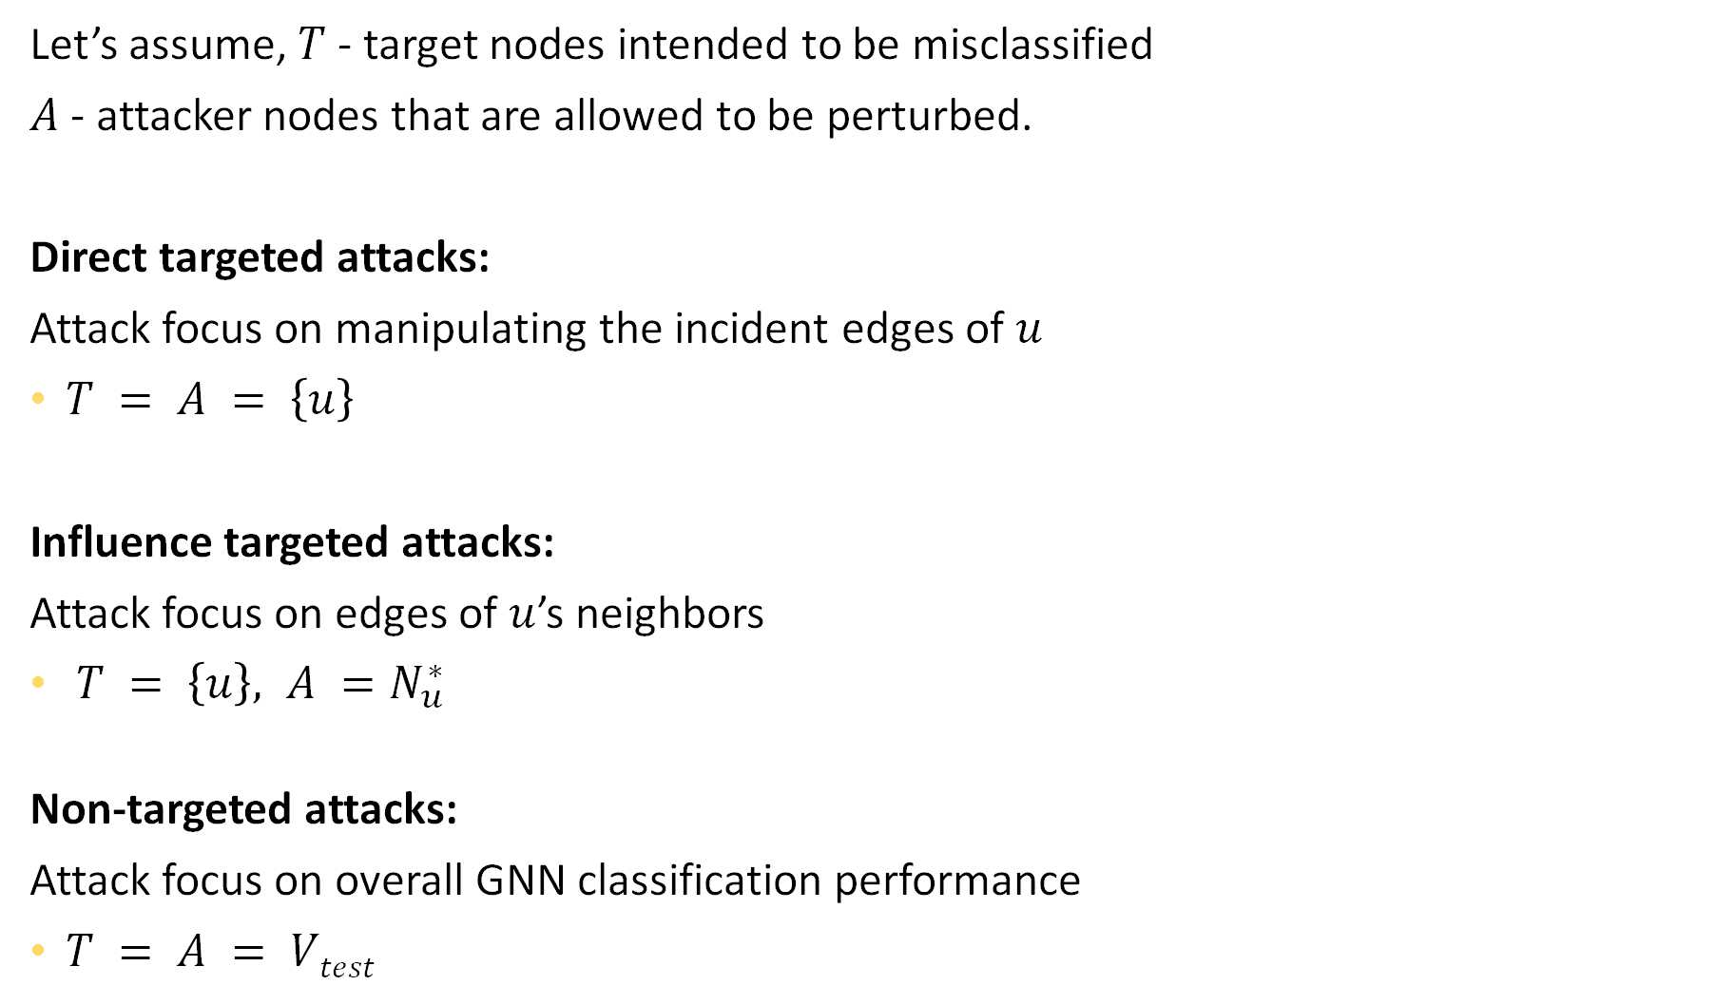
Let’s assume, $T$ - target nodes intended to be misclassified
$A$ - attacker nodes that are allowed to be perturbed.
Direct targeted attacks:
Attack focus on manipulating the incident edges of $u$
$T = A = \left\{u\right\}$
Influence targeted attacks:
Attack focus on edges of $u$’s neighbors
$T = \left\{u\right\}, A =N_{u}^{∗}$
Non-targeted attacks:
Attack focus on overall GNN classification performance
$T = A = Vtest$

Slide 15
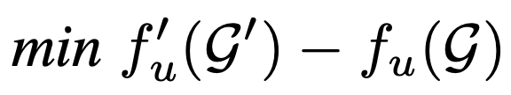
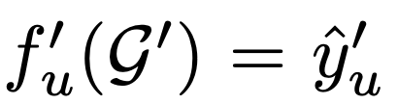
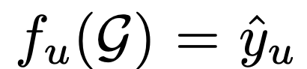
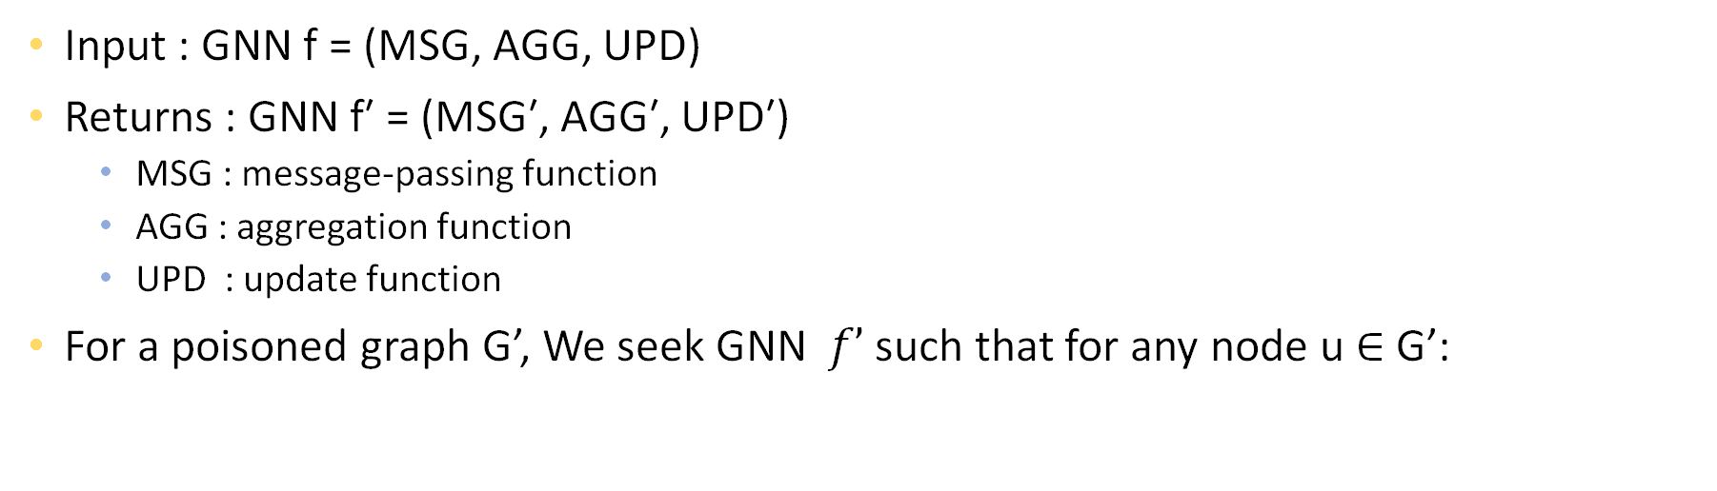
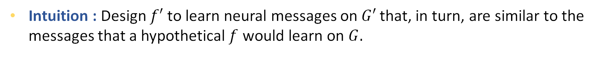
PROBLEM FORMULATION – GNNGuard
Input : GNN f = (MSG, AGG, UPD)
Returns : GNN f′ = (MSG′, AGG′, UPD′)
MSG : message-passing function
AGG : aggregation function
UPD : update function
For a poisoned graph G’, We seek GNN $f’$ such that for any node u ∈ G’:
(2)
: prediction when GNN f′ is trained on G′
: hypothetical prediction that the GNN f would have made if it had access to clean graph G.
Intuition : Design $f′$to learn neural messages on $G′$that, in turn, are similar to the messages that a hypothetical$f$ would learn on $G.$

Slide 16
NOT A TRIVIAL TASK !
It is impossible to access clean graph, G. Therefore, it’s not trivial to optimize Eq (2).
To restore the structure of G and mitigate impact of G’, design a message-passing scheme that can :
Detect fake edges,
Block them
Attend to true, unperturbed edges.

Slide 17
GNNGuard
Most damaging attacks add fake edges between nodes that have different features and labels {[1, SigKDD 2021], [2, IJCAI, 2019]}.
Core defense principle of GNNGuard:
Detect fake edges, alleviate their negative impact on prediction by removing them or assigning them lower weights in neural message passing.

Slide 18
KEY COMPONENTS
Neighbor Importance Estimation : Dynamically adjusts the relevance of nodes’ local network neighbourhoods, prunes likely fake edges, and assigns less weight to suspicious edges based on network theory of homophily.
Layer-wise Graph Memory : Designed to smoothen the defense, by coarsening the graph structure.

Slide 19
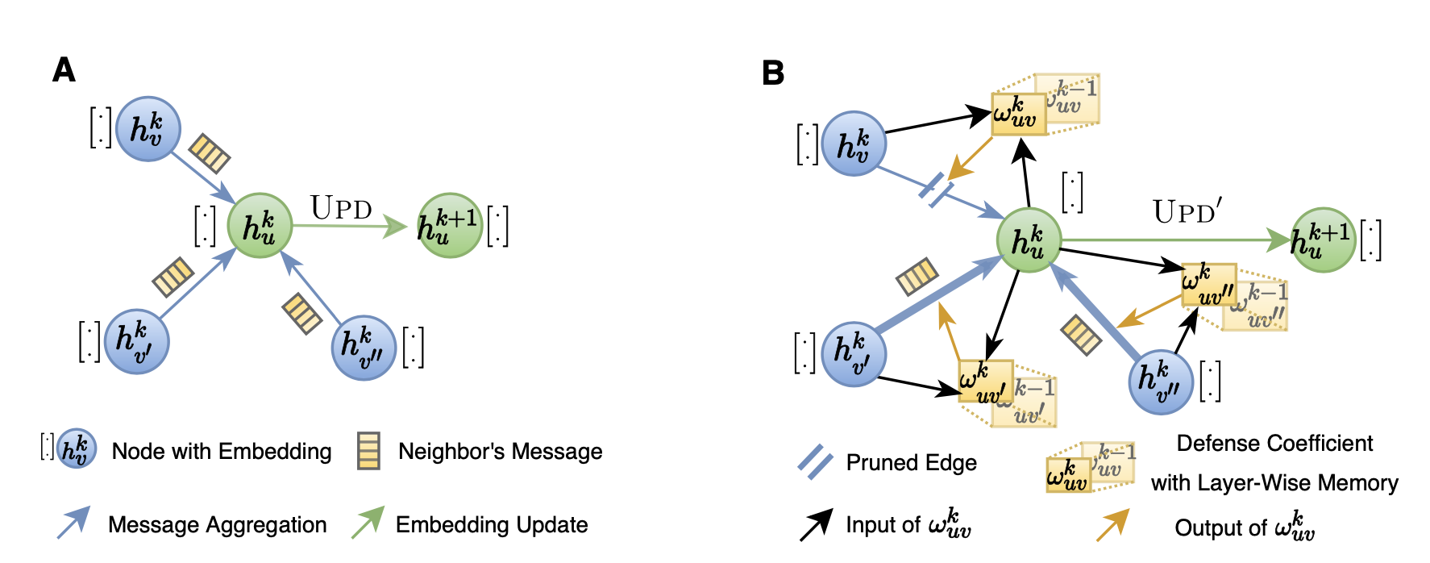
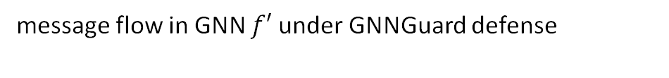
NEIGHBOR IMPORTANCE ESTIMATION : BASIC IDEA
GNN $f$ neural message passing in the k^{th} layer
message flow in GNN $f′$ under GNNGuard defense

Slide 20

NEIGHBOR IMPORTANCE ESTIMATION
Estimates an importance weight for every edge $euv$to quantify how relevant node $u$ is to another node$v$in the sense that it allows for successful routing of GNN’s messages
Basis for importance weight estimation: similar nodes (similar features or similar structural roles) are more likely to interact than dissimilar nodes.
Similarity measure : Cosine similarity (For real values), Jaccard similarity (For binary values)
d is a similarity function
⊙ denotes dot product
Homophily : Measures similarity between nodes’ features
Heterophily : Measures similarity of nodes’ structural roles

Slide 21
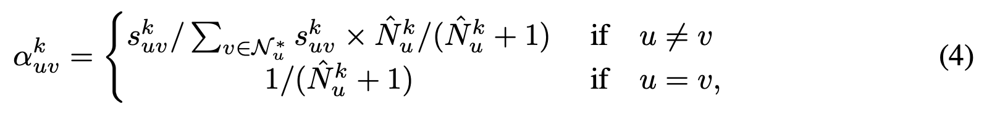

Compute similarity of the node to itself
Normalize node similarity at node-level within neighborhood
GNNGuard assigns small importance weights to suspicious neighbors, which reduces the interference of suspicious nodes in GNN’s message passing operation.
: number of non-zero entries in vector, estimate of node u’s degree in G

Slide 22

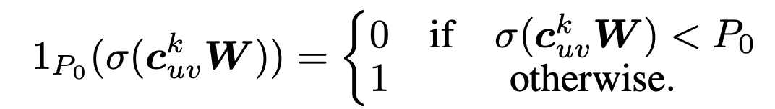



PRUNING
To alleviate the impact of fake edges
Fake edges tend to connect dissimilar nodes, prune edges using importance weights (homophily)
Characteristic vector describing edge $euv$:
Update importance weight :
Perturbed edges connecting dissimilar nodes will likely be ignored by the new GNN
Edge pruning probability for $euv$
user-defined threshold
(5)
binary indicator
(6)

Slide 23
LAYER-WISE GRAPH MEMORY : NEED
Neighbor importance estimation and edge pruning change the graph structure between adjacent GNN layers.
This can destabilize GNN training, especially if a considerable number of edges gets pruned in a single layer.
To allow for robust estimation of importance weights and smooth evolution of edge pruning, the paper proposes layer-wise graph memory
Applied at each GNN layer, keeps partial memory of the pruned graph structure from the previous layer.

Slide 24



LAYER-WISE GRAPH MEMORY
Layer-wise graph memory is defined as follows:
Using defense coefficients, GNNGuard controls information flow across all neural message passing layers.
: Defense coefficient for edge $euv$in the k-th layer
: Memory coefficient (learnable parameter) , $β ε \left[0,1\right], β=0 when k=0$

Slide 25
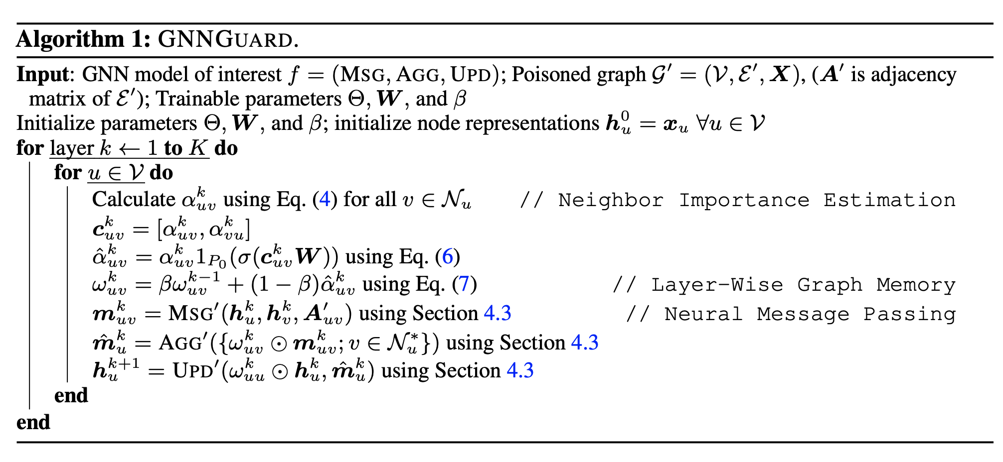



Slide 26
COMPUTATIONAL COMPLEXITY
GNNGuard is practically efficient because it exploits the sparse structure of real-world graphs.
Time complexity :
Neighbor Importance Estimation : O(D_{k}E) in layer k, where D_{k} is the embedding dimensionality and E is the graph size.
Layer-wise Graph Memory : O(E)
Time complexity of GNNGuard grows linearly with the size of the graph as node embeddings are low-dimensional, D_{k} ≪ E.
Time complexity of a GNN endowed with GNNGuard is on the same order as that of the GNN itself.

Slide 27

RELATED WORK AND COMPARISON
GNN-Jaccard, [2, IJCAI, 2019]:
Pre-processes the adjacency matrix of the graph to identify the manipulated edges
Defense on targeted attacks on current GNNs
RobustGCN, [10, KDD, 2019]:
Gaussian distributions as hidden representations of nodes in each convolutional layer
Variance-based attention mechanism
GNN-SVD, [11, WSDM, 2020]:
Attacks like Nettack focus on attacking higher ranks in singular value decomposition
Vaccinating GCN with low-rank approximations
PA-GNN, [12, WSDM 2020]:
Robustness against poison attacks through transfer learning
Using clean unperturbed graphs in the similar domain
Penalised aggregation mechanism to restrict impact of negative edges
Then use meta-optimization approach to transfer that ability

Slide 28
EXPERIMENTS

Slide 29
LIST OF EXPERIMENTS
Defense performance against targeted and non-targeted attacks
Ablation Study (No Defense, GNNGUARD w/o pruning, GNNGUARD w/o memory)
Inspection of defense mechanism :
Performance on node classification on clean datasets
Defense under different attack intensity
A case study on citation network
Defense performance on graph datasets with heterophily

Slide 30

HYPERPARAMETER TUNING
Number of epochs = 200
Use early stopping (for 10 consecutive epochs).
Every experiment repeated 5 times and average performance across independent runs is reported.
$P0$ = 0.5, $K$ = 2, $D2$ = 16, and dropout rate = 0.5
Cross-entropy loss
Adam optimizer
learning rate = 0.01

Slide 31
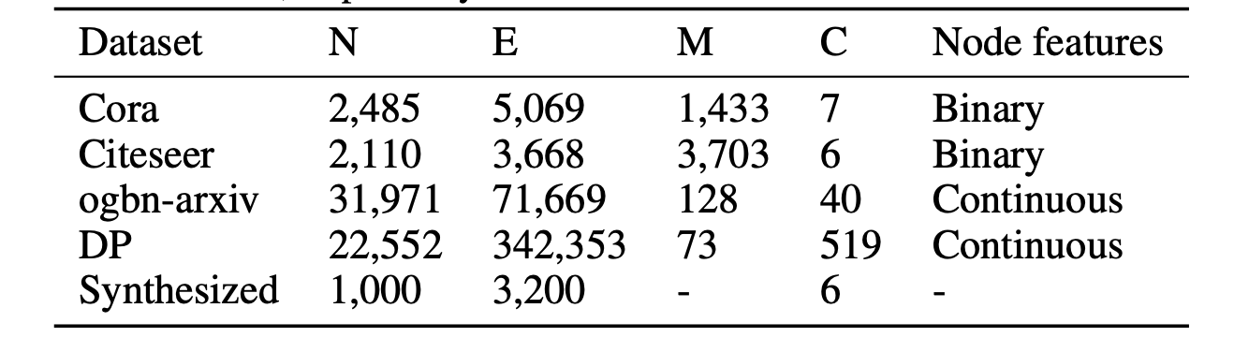
DATASETS
node feature
dimensionality
labels/
classes
The dataset is randomly split into training (10%), validation (10%), and test set (80%) as in [3, KDD 2018]

Slide 32


EXPERIMENTAL SETUP
Generating adversarial attacks :
3 kinds of adversarial attacks:
Direct targeted attack (Nettack-Di [3, KDD 2018]),
Influence targeted attack (Nettack-In [3]),
Non-targeted attack (Mettack [4, ICLR 2019])
Settings:
Mettack: 20% perturbation rate (i.e., ∆ = 0.2E) - ‘Meta-Self’ training strategy.
Nettack-Di :
Nettack-In :
Perturb 5 neighbors of target node
∆ = $\hat{N}v0$ , for all those neighbors.

Slide 33
Target node selection in targeted attack:
40 correctly classified target nodes [3, KDD 2018]:
10 nodes with the largest classification margin,
10 nodes with the smallest margin,
20 random nodes
Run the whole attack and defense procedure for each target node
Report average classification accuracy
GNNs :
Integrate GNNGUARD with five GNNs (GCN [5, ICLR 2017], GAT [6, ICLR 2018], GIN [7, ICLR 2019], JK-Net [8, ICML 2018], and GraphSAINT [9, ICLR, 2020])
Baseline defense algorithms :
Comparison of GNNGUARD to three state-of-the-art graph defenders: GNN-Jaccard [2, IJCAI 2019], RobustGCN [10, KDD 2019], and GNN-SVD [11, WSDM 2020].

Slide 34
RESULTS

Slide 35
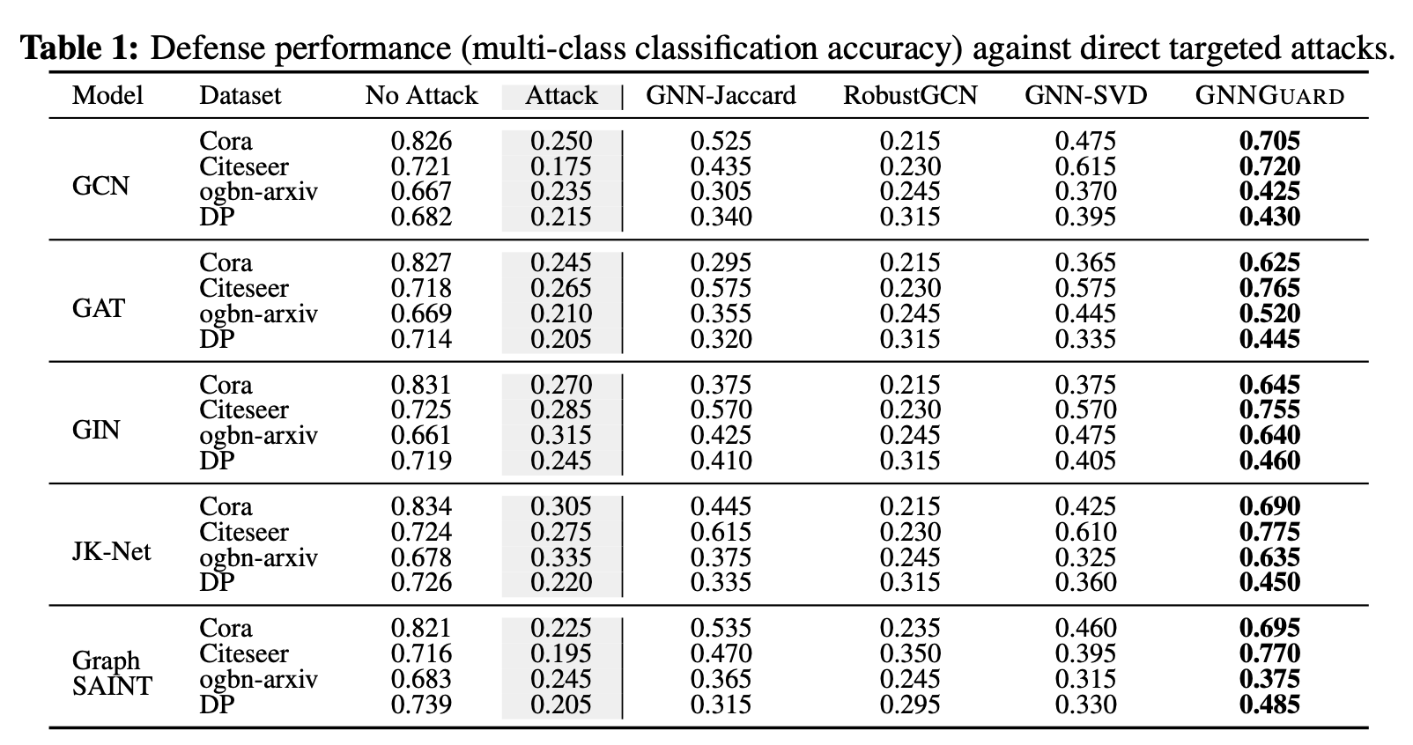
DIRECT TARGETTED ATTACK
Avg 15.3%

Slide 36
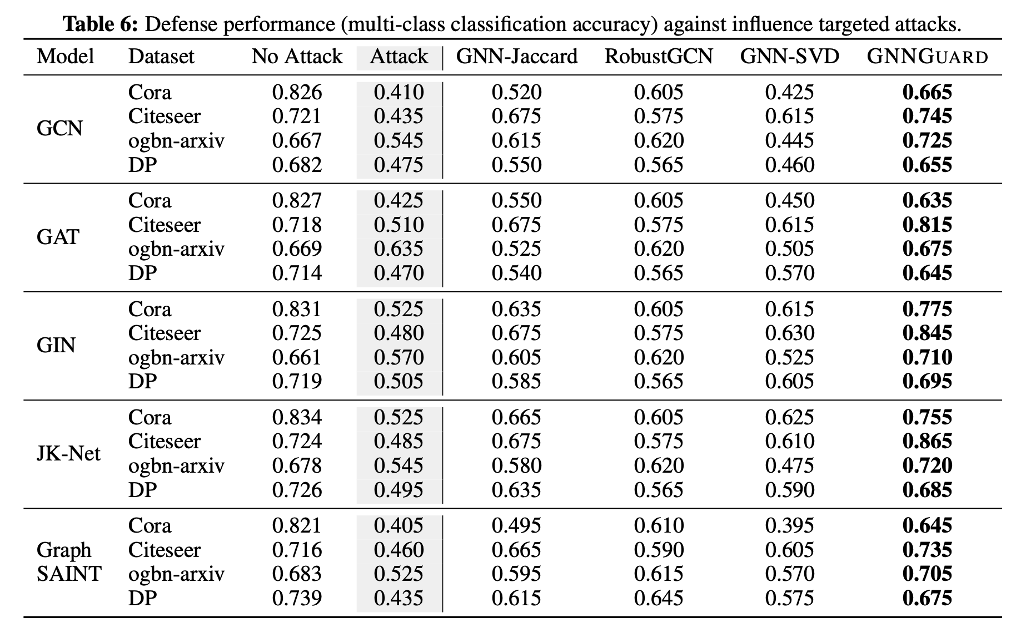
INFLUENCE TARGETTED ATTACK
Avg 8.77%

Slide 37
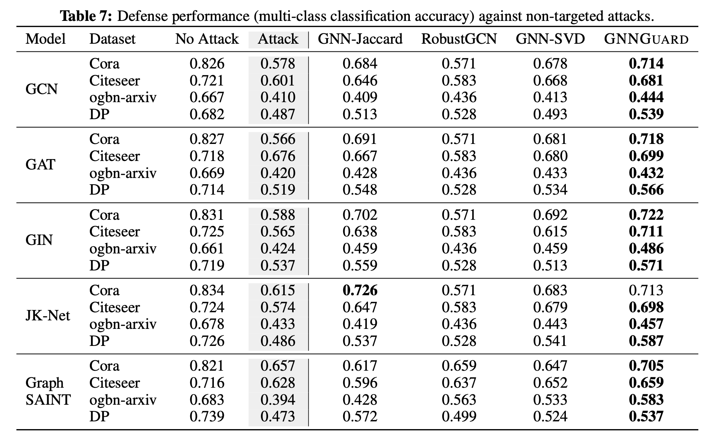
NON-TARGETTED ATTACK

Slide 38
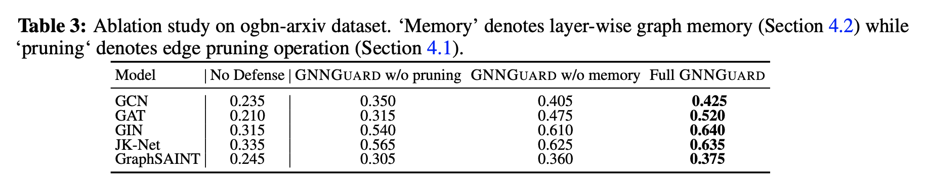
ABLATION STUDY
Dataset: ogbn-arXiv
Attack : Nettack-Di
Metric : Classification accuracy

Slide 39
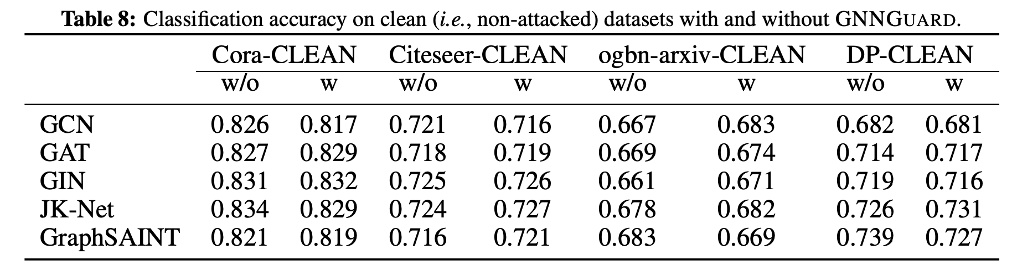
NODE CLASSIFICATION ON CLEAN DATASETS.

Slide 40
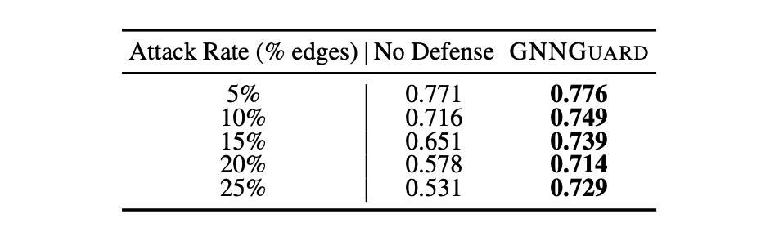
DEFENSE UNDER DIFFERENT ATTACK INTENSITY.
Dataset: Cora
Attack : Mettack
Metric : Classification accuracy
Model : GCN
(19.8%)

Slide 41
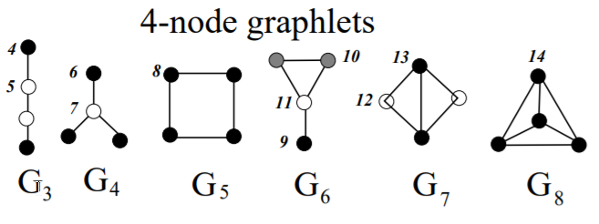
DEFENSE OF HETEROPHILY GRAPHS
Graphs with structural roles
Graphlet degree vectors [Cancer informatics, 2008] to reflect nodes’ structural properties
For structural similarity, these act as the input embeddings for similarity function
Graphlet:
connected non-isomorphic induced subgraphs
GDV:
number of graphlets that the node touches
Milenkovic et al, Cancer informatics, 2008

Slide 42
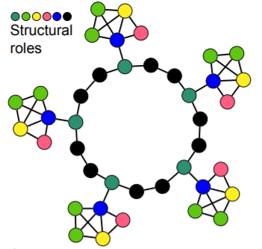
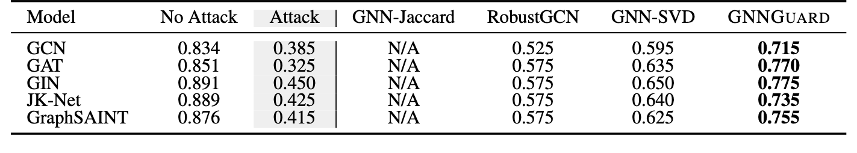
HETEROPHILY GRAPHS PERFORMANCE
Orbit counting algorithm [Hocevar et al, Bioinformatics, 2014]
Synthetic graphs of 6 roles, 1000 nodes,
Each node with 73-dimensional GDV
Attack model: Nettack-Di
(19.2%)

Slide 43

CASE STUDY
GIN on ogbn-arXiv with 40 labels
Netattack-Di
IT
IT
TreeP: A Tree Based P2P Network Architecture
IT
IT
IT
$fu(G)$ = 0.536

Slide 44


CASE STUDY
AI
AI
GIN on ogbn-arXiv with 40 labels
Netattack-Di
AI
TreeP: A Tree Based P2P Network Architecture
AI
TreeP: A Tree Based P2P Network Architecture
IT
AI
$fu(G′)$ = 0.201
$f_{u}^{′}(G′)$ = 0.489

Slide 45
OUR EXPERIMENT
Tested performance of GNNGuard against evasive Nettack on Cora dataset.
RESULTS
Number of edges perturbed per target node | Overall (No attack) : GNNGuard False | Overall (No attack) : GNNGuard True | On target nodes (No-attack) : GNNGuard False | On target nodes (With Attack ) GNNGuard - False) | On target nodes (No-attack)-GNNGuard True | Accuracy(With Attack - On target nodes, GNNGuard - True)
1 | 0.7787 | 0.7802 | 0.9 | 0.85 | 0.85 | 0.85
2 | 0.7752 | 0.7762 | 0.9 | 0.85 | 0.9 | 0.85
3 | 0.7772 | 0.7752 | 0.9 | 0.75 | 0.9 | 0.8
4 | 0.7731 | 0.7721 | 0.9 | 0.75 | 0.9 | 0.7
5 | 0.7731 | 0.7721 | 0.9 | 0.65 | 0.9 | 0.65
Metric: Accuracy score
Perturbation rate : Varying from 0.3% to 1%
At higher rates, accuracy became 0, even when GNNGuard is used.

Slide 46
STRENGTHS
Defence against variety of attacks.
Model-agnostic: Integrates with any message passing GNN.
State-of-the-art performance even on clean graphs.
Works in case of homophily and heterophily.

Slide 47
WEAKNESSES
Lacks theoretical guarantee.
Heuristic defense and hence has a limited performance on adaptive attacker.
No experiments done to show affects when the attacker poisons features.
Analysis on different attacks – such as node injection.
Analysis with respect to node degrees.
Only limited to structural similarity in heterophily.
It is possible that one could use GNNGUARD to get insights into black-box GNN optimization and then use those insights to improve existing attack algorithms, thereby identifying and potentially exploiting new, currently unknown vulnerabilities of GNNs.

Slide 48
CONCLUSION
Extending current message passing GNN models with GNNGuard gave them better defense against various poisoning attacks (direct targeted, influence targeted, and non-targeted)
Key ideas are the Neighbor relevance estimation using cosine similarity, pruning and Graph memory layer for previous layers memory.
Prune likely fake edges and lesser weight to suspicious ones.
Extended to heterophily graphs with structural equivalence

Slide 49
REFERENCES
[1] Wei Jin, Yaxin Li, Han Xu, Yiqi Wang, and Jiliang Tang. Adversarial attacks and defenses on graphs: A review and empirical study. SIGKDD, 2021.
[2] Huijun Wu, Chen Wang, Yuriy Tyshetskiy, Andrew Docherty, Kai Lu, and Liming Zhu. Adversarial examples for graph data: Deep insights into attack and defense. In IJCAI, 2019.
[3] Daniel Zügner, Amir Akbarnejad, and Stephan Günnemann. Adversarial attacks on neural networks for graph data. In KDD, 2018.
[4] Daniel Zügner and Stephan Günnemann. Adversarial attacks on graph neural networks via meta learning. In ICLR, 2019.
[5] Thomas N Kipf and Max Welling. Semi-supervised classification with graph convolutional networks. In ICLR, 2017.
[6] Petar Veličković, Guillem Cucurull, Arantxa Casanova, Adriana Romero, Pietro Lio, and Yoshua Bengio. Graph attention networks. In ICLR, 2018.
[7] Keyulu Xu, Weihua Hu, Jure Leskovec, and Stefanie Jegelka. How powerful are graph neural networks? In ICLR, 2019.

Slide 50
[8] Keyulu Xu, Chengtao Li, Yonglong Tian, Tomohiro Sonobe, Ken-ichi Kawarabayashi, and Stefanie Jegelka. Representation learning on graphs with jumping knowledge networks. In ICML, 2018.
[9] Hanqing Zeng, Hongkuan Zhou, Ajitesh Srivastava, Rajgopal Kannan, and Viktor Prasanna. Graphsaint: Graph sampling based inductive learning method. ICLR, 2020.
[10] Dingyuan Zhu, Ziwei Zhang, Peng Cui, and Wenwu Zhu. Robust graph convolutional networks against adversarial attacks. In KDD, 2019.
[11] Negin Entezari, Saba A Al-Sayouri, Amirali Darvishzadeh, and Evangelos E Papalexakis. All you need is low (rank) defending against adversarial attacks on graphs. In WSDM, 2020.
[12] Xianfeng Tang, Yandong Li, Yiwei Sun, Huaxiu Yao, Prasenjit Mitra, and Suhang Wang. Transferring robustness for graph neural network against poisoning attacks. In WSDM, 2020

