Slide 1
OPEC and the World Oil Market
Prepared by : Samidha Upadhyay

Slide 2
INTRODUCTION
OPEC(organization of the petroleum exporting countries) is the international organization of 15 nations, founded in 1960 in Baghdad by first five members. The stated mission of the organization is to "coordinate and unify the petroleum policies of its member countries in order to secure an efficient, economic and regular supply of petroleum to consumers.”

Slide 3
WHY DID OPEC FAIL TO KEEP THE PRICE OF OIL HIGH???
In the 1970s members of the Organization of Petroleum Exporting Countries decided to raise the world price of oil to increase their income. They reduced the supply to increase the price of the oil. From 1982 to 1985, the price of oil steadily declined about 10 percent per year. Dissatisfaction and disarray soon prevailed among the OPEC countries. Yet OPEC found it difficult to maintain a high price and the price of the oil decreased by 45% as it was at beginning of 1970s.

Slide 4
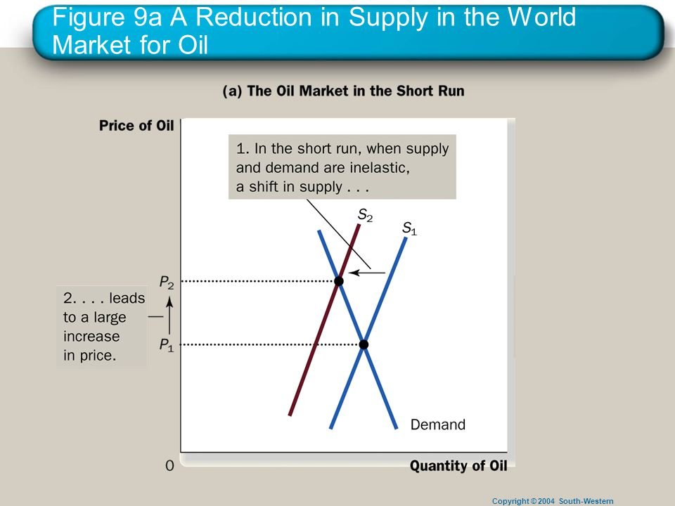
THE OIL MARKET IN SHORT RUN
In short run both the supply and demand for oil are relatively inelastic.

Slide 5
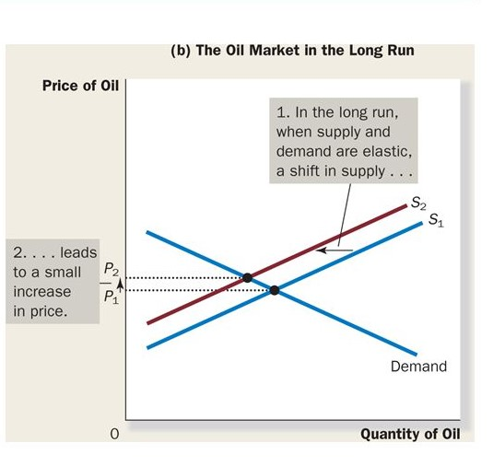
THE OIL MARKET IN LONG RUN
In long run the supply and demand curve are more elastic.

Slide 6
CONCLUSION
OPEC still exist today and it has formed time to time succeeding at reducing supply and rising price but the price of the oil has never returned to the pick reached in 1981.

Slide 7
THANK YOU

