Slide 1
FINAL PROJECT · GPT-FROM-SCRATCH
01 / 14
A STUDY IN DOMAIN-SPECIFIC TOKENIZATION
Does a domain-specific BPE tokenizer improve in-domain language modeling?
An evaluation on medical text — one variable, two tokenizers, three corpora.
ch
|
ole
|
cy
|
st
|
ect
|
omy
vs.
cholecystectomy
Samih Amer · Individual project
April 2026
Notes:
Hi everyone. I'm Samih. The title is a mouthful but the project is simple. I took our course GPT, swapped its tokenizer for one I trained on medical text, and measured what changed. Everything else — architecture, optimizer, training corpus, evaluation — is held fixed. The whole question is: does a medical-text tokenizer make a medical language model better? You'll see the answer is 'yes — but only narrowly, and with two surprises along the way.'

Slide 2
§ 01 · MOTIVATION
02 / 14
The tokenizer constrains what the model can learn.
A unit the tokenizer doesn't respect is a unit the model has to reconstruct from pieces.
GENERAL BPE · WIKITEXT
MEDICAL BPE · PUBMED
ch
|
ole
|
cy
|
st
|
ect
|
omy
cholecystectomy
6 tokens
1 token
S·02
Notes:
Before any training happens, the tokenizer decides what vocabulary the model will see. That matters because a unit the tokenizer doesn't respect — like 'cholecystectomy' — is a unit the model has to reconstruct from pieces. A general tokenizer, trained on web text, shatters that word into six subword pieces. A tokenizer trained on PubMed treats it as one. The claim this project tests: if you shift that workload from the model to the tokenizer, the in-domain model should get better. Let me make that concrete.

Slide 3
§ 01 · MOTIVATION
03 / 14
Byte-Pair Encoding, formally.
Same algorithm, same vocabulary size—the training corpus decides the contents.
THE MERGE RULE
SAME RECIPE · DIFFERENT PANTRY
At each step, find the most frequent adjacent pair of symbols in the corpus and merge them into a new symbol. Repeat until you have V = 10,000 symbols.
wikitext‑103
the
and
tion
ed_
ing_
PubMed
cellular
clinical
patient
both reach ~9,743 merges at V = 10,000
“A BPE trained on wikitext sees the, and, tion as high-utility merges; a BPE trained on PubMed sees cellular, clinical, cholecystectomy .”
(a, b) ⋆ = argmax_{(a,b) ∈ Σ×Σ} count(ab; 𝒞)
Σ = current symbol set · 𝒞 = training corpus · new symbol s = a⋅b added to Σ
S·03
Notes:
Before the experiment, a quick grounding in how BPE actually works. Byte-Pair Encoding starts from a byte-level alphabet and iteratively merges the most frequent adjacent pair until it hits a target vocabulary size — ten thousand here. The training corpus decides which merges are profitable. Wikitext makes 'the', 'and', 'tion' high-utility. PubMed makes 'cellular', 'clinical', 'cholecystectomy' high-utility. Same algorithm, same vocab size — different vocabulary contents. That's the whole lever I'm pulling.

Slide 4
§ 02 · METHOD
04 / 14
Experimental design.
Only the tokenizer changes. Everything else is held fixed.
HELD FIXED
VARIED · ONE VARIABLE
Architecture
Pre-LN GPT · 6L · 8H · d=512
general
byte-level BPE
Parameters
29,283,088
Trained on wikitext-103 (129k lines). General-purpose web-text vocabulary.
Vocab / context
10,000 · 256 tokens
Optimizer
AdamW · lr = 3·10⁻⁴
medical
byte-level BPE
Schedule
warmup 500 · cosine → 10%
Trained on 100k PubMed abstracts . Same algorithm, medical corpus.
Batch / clip
32 · 1.0
Training corpus
100k PubMed abstracts
EVALUATED ON
Epochs
2
PubMed (in-domain) · Wikitext (out-of-domain) · MTSamples (cross-domain medical)
S·04
Notes:
The experiment is minimal by design. Two runs. Same 29-million-parameter GPT — pre-LayerNorm, 6 layers, 8 heads, d-model 512, the Module 6 configuration. Same optimizer, same learning rate, same batch size, same cosine schedule. Same training corpus: 100,000 PubMed abstracts. Same three evaluation corpora. The only variable that changes is which of two tokenizers I use. Both are 10k-vocab byte-level BPEs — one trained on wikitext, one on PubMed. Anything I find has to come from the tokenizer, because nothing else has moved.

Slide 5
§ 02 · METHOD
05 / 14
Bits per character: the only fair metric.
Per-token perplexity cannot compare tokenizers—the token itself is different.
THE PROBLEM
THE FIX — NORMALIZE TO CHARACTERS
If tokenizer A represents a doc in 100 tokens and tokenizer B in 200, a per-token loss of ℓ means very different things in each case. B's tokens are easier to predict —each one carries less information.
BPC
=
log₂ (e) · CE · N_{tok}
N_{chars}
We need a unit that doesn't depend on the tokenizer.
CE
average cross-entropy in nats (per token)
N_{tok}
tokens in the evaluation corpus
N_{chars}
raw characters in the same text
log₂(e)
convert nats → bits ( ≈ 1.4427 )
S·05
Notes:
You can't compare two tokenizers with per-token perplexity. If my tokenizer packs text into fewer tokens, each of my tokens carries more information — so a per-token loss of, say, 2 means something different for each tokenizer. The fix is bits-per-character. Take the cross-entropy in nats, convert to bits with log base 2 of e, multiply by number of tokens, divide by number of raw characters. Same unit on both sides — bits of surprise per character of English text. BPC is my primary metric throughout.

Slide 6
§ 02 · METHOD
06 / 14
The fairness problem.
Medical packs 27% more chars per token. Hold compute and text and tokens all constant? Can't be done. You get to pick two.
OPTION 1
same compute
OPTION 2
same text exposure
Match total gradient updates. Both models stop at step 6,141.
Each runs 2 full epochs. Medical at 6,141, general at 7,783.
Medical sees more raw text per step — fair at a matched compute budget.
General does more gradient updates — fair at matched data exposure.
I report both frames throughout.
S·06
Notes:
Here's the unavoidable fairness problem. Because medical packs more characters per token, one epoch of PubMed is fewer gradient updates for medical than for general. You can't hold compute and tokens and text all constant simultaneously — they're tied together by the compression ratio. So I report two frames. Option 1: same compute, same step count, but medical sees more raw text. Option 2: same text exposure, one epoch each, but general does more gradient steps. Both are honest; they answer slightly different questions. I report both.

Slide 7
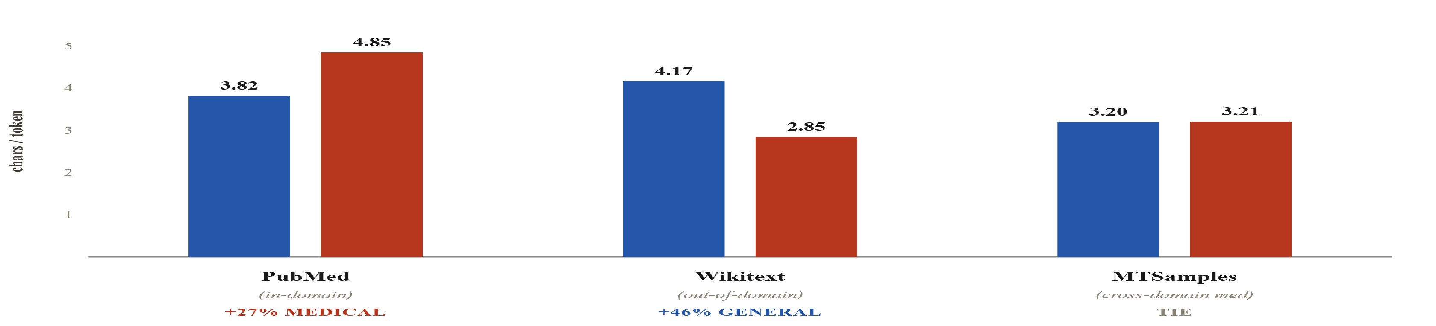
§ 03 · RESULTS
07 / 14
Compression — before any training at all.
Medical wins big on PubMed, loses big on wikitext, and ties on MTSamples.
general
medical
Figure 1. Characters per token on each held-out corpus — higher is better for that tokenizer. The MTSamples tie is the first clue that tokenizer specialization is register-specific, not domain-specific.
S·07
Notes:
First result — and this one requires no trained model at all. The tokenizers themselves compress the three eval corpora differently. Medical wins by 27% on in-domain PubMed, as expected. Medical loses by 46% on wikitext, also expected — it has no 'the-and-tion' merges. And then — medical ties on MTSamples. That's a medical corpus, but the medical tokenizer has no compression edge. Hold onto that. It's the first clue that 'medical text is medical text' is wrong.

Slide 8
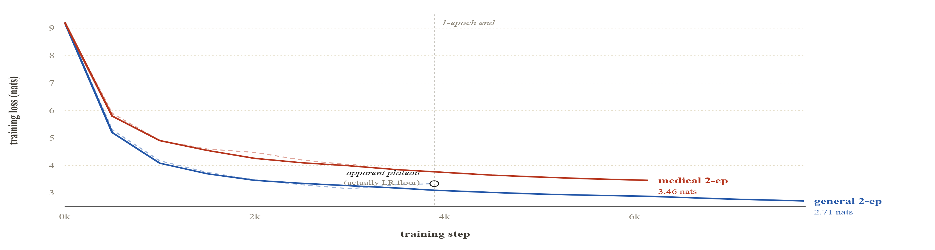
§ 03 · RESULTS
08 / 14
A methodological detour—the 1-epoch trap.
The pilot's “plateau” was the cosine LR schedule collapsing to its floor. Not convergence.
1-epoch run
2-epoch run
Figure 3. 1-epoch (dashed) vs 2-epoch (solid) training runs. When the schedule spans the full 2-epoch horizon, general keeps learning ~0.5 nats past where it appeared to plateau. Under-training can mask the effect you're studying.
S·08
Notes:
A detour on methodology that almost cost me the result. I first trained both models for one epoch. General's loss plateaued around 3.2 nats; medical kept descending. I nearly wrote it up as 'general converged, medical had headroom.' Then I looked at the LR schedule — cosine had collapsed to three-times-ten-to-the-minus-five, 10 percent of peak, at the 1-epoch mark. The plateau wasn't convergence; it was the schedule bottoming out. I re-ran for two epochs with a schedule spanning the full horizon. General kept learning another half-nat. The moral: under-training can mask the effect you're studying. A quick pilot would have given me the wrong answer.

Slide 9
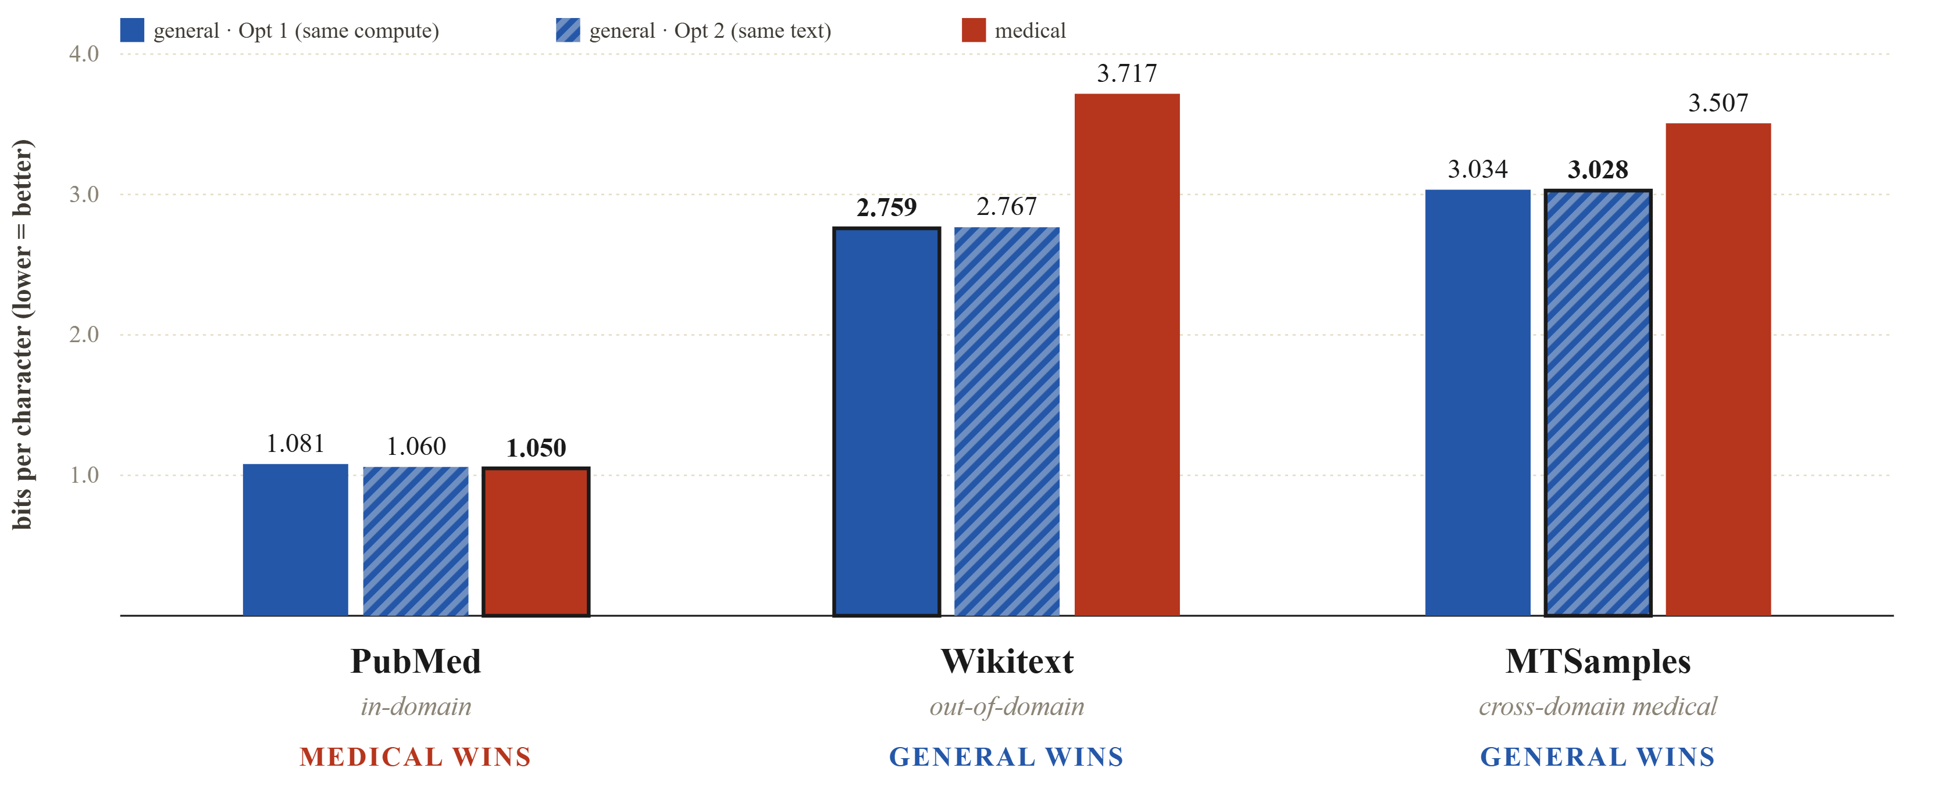
§ 03 · RESULTS — HEADLINE
09 / 14
Held-out BPC—medical wins, but only on PubMed.
S·09
−0.031
−0.010
+0.95 / +0.48
BPC · PubMed · Option 1
BPC · PubMed · Option 2
BPC cost · wikitext / MTSamples
Figure 4. Held-out BPC at 2 epochs. Medical wins on PubMed under both fairness frames — the gap is small (0.010 BPC) but consistent. Out-of-domain and cross-register costs are substantial.
Notes:
With both models properly converged, here's the held-out BPC on all three corpora. On in-domain PubMed, medical wins under both fairness frames — by 0.031 BPC at matched compute, by 0.010 at matched text exposure. On wikitext, general wins by almost a full bit per character. On MTSamples, general wins by about half a bit. The PubMed lead is small but consistent across frames; the out-of-domain costs are substantial. Domain tokenization is a real win — it's just a narrow one.

Slide 10
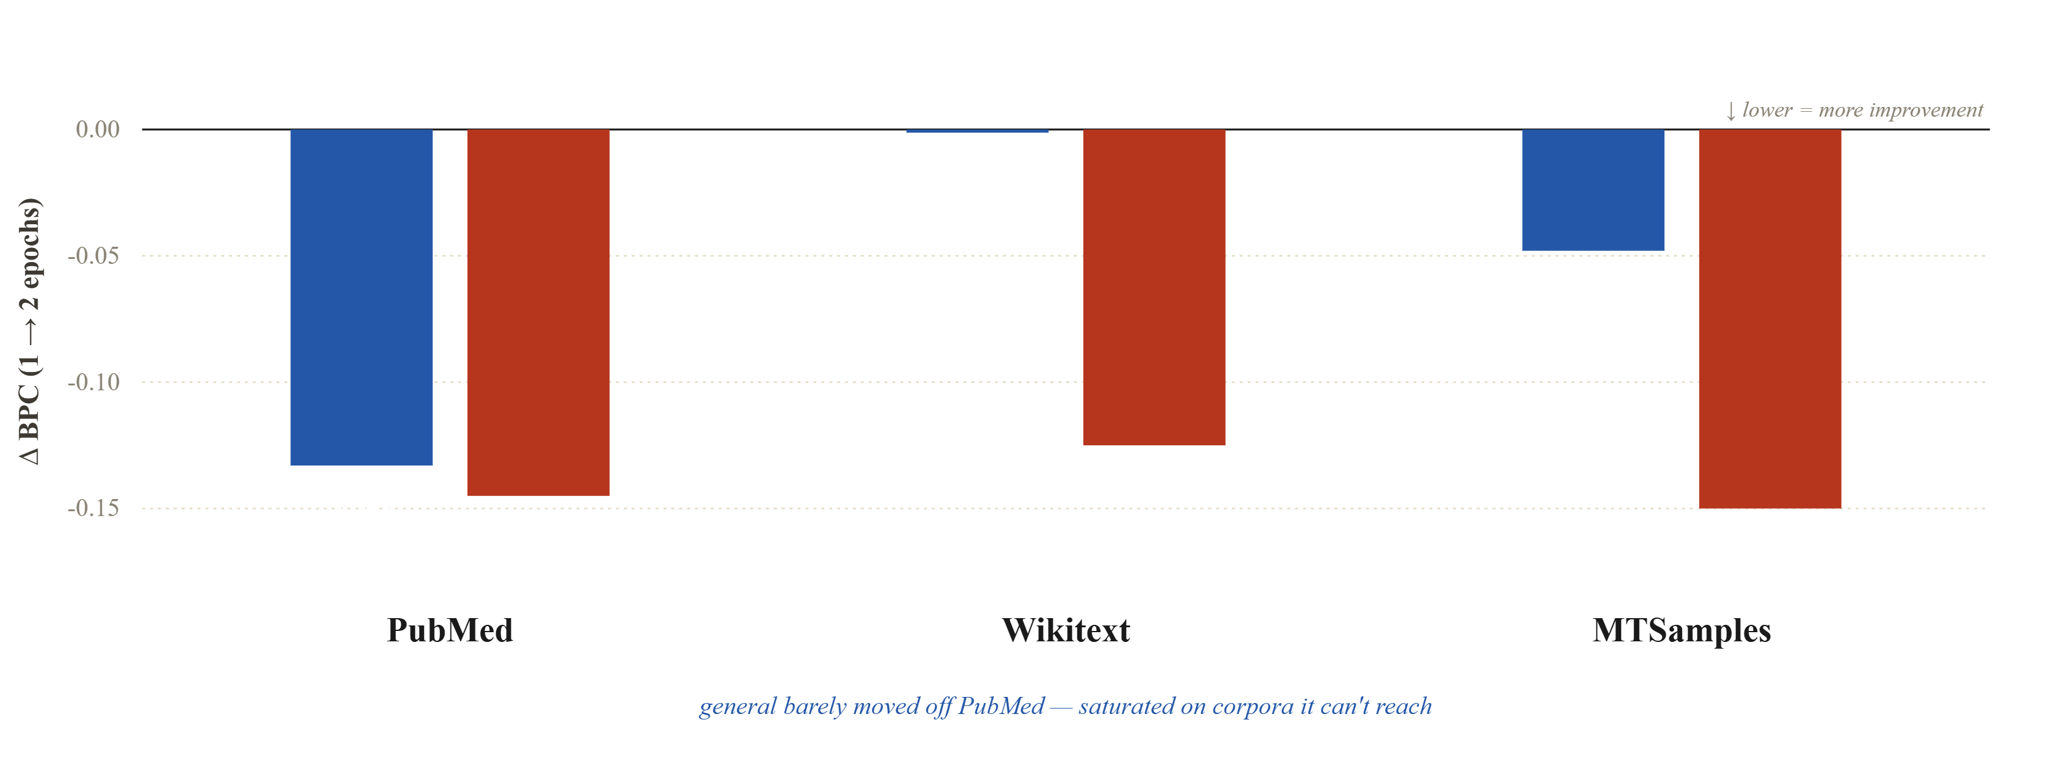
§ 03 · RESULTS
10 / 14
Differential convergence — what did epoch 2 buy each model?
Medical improved everywhere. General only improved where it could.
S·10
general
medical
Figure 5. Per-corpus BPC improvement going from 1 to 2 epochs (negative = improved). General is already saturated on corpora its model cannot reach—more training buys it nothing. Medical's representations were still being refined across the board.
Notes:
Zoom into just the second epoch. What did each model learn from that extra pass? Medical improved roughly uniformly — 0.12 to 0.15 BPC better on all three corpora. General improved strongly on PubMed, barely moved on MTSamples, and went nowhere on wikitext. That's an interesting pattern: general was already saturated on corpora its tokenizer can't reach. More training only helps where the representation is good enough to keep pulling signal from the data.

Slide 11
§ 04 · SURPRISES
11 / 14
A medical tokenizer that loses on medical text.
Because register matters more than domain.
PUBMED · WHAT MEDICAL KNOWS
MTSAMPLES · WHAT MEDICAL DOESN'T
“Patients with acute myocardial infarction were randomly assigned to...”
“Pt is a 54 y/o M w/ cp x 2 days, admitted for r/o MI...”
Clinical dictation. pt, y/o, r/o, w/ — abbreviations that never appear in PubMed.
Formal academic prose. Long, latinate terms. “Myocardial infarction” survives as whole-word tokens.
Tokenizer specialization is register-specific, not domain-specific.
S·11
Notes:
The MTSamples result is the finding I didn't expect. The medical tokenizer loses on medical text. Why? Because MTSamples isn't PubMed. PubMed is formal academic prose — 'patients with acute myocardial infarction were randomly assigned.' MTSamples is clinical dictation — 'pt is 54 y/o M w/ CP times two days, admitted for r/o MI.' My tokenizer learned 'myocardial.' It didn't learn 'pt', 'y/o', 'w/', 'r/o' — those didn't appear enough in PubMed. The lesson is that tokenizer specialization is register-specific, not domain-specific. The phrase 'medical tokenizer' is less meaningful than 'PubMed-abstract tokenizer.'

Slide 12
§ 04 · SURPRISES
12 / 14
The shape of errors differs—not just the rate.
And the difference traces directly to how each tokenizer fragments rare words.
GENERAL · CHAR-LEVEL DRIFT
MEDICAL · MORPHEME PORTMANTEAUS
cholesterolecystitis
pancreaticoduodenectomy
udgulopathy
extraperitoneal lymphoma
bronchiolitin stenting
thoracoscopic surgery
cholecystostomyectomy
emtourmesing
Real multi-syllabic terms, one token each. Still fabricates — but by concatenating real morphemes, never by char-drift.
Because cholecystectomy is 6 tokens, swapping in one wrong subword mid-word produces a plausible-sounding fake.
S·12
Different failure shapes, not just different error rates—hallucination analysis should be tokenizer-conditioned.
Notes:
Even at similar loss, the two models fail in different shapes. General invents words mid-sequence — 'cholesterolecystitis', 'udgulopathy', 'bronchiolitin stenting.' It does this because 'cholecystectomy' is six tokens for it — swap one and you get a plausible-sounding fake. Medical can fabricate too — 'laparoscopic cholecystostomyectomy' is a portmanteau of two real procedure names — but it can't do char-level drift, because the whole word is one token. Different failure shapes, not just different error rates. Hallucination analysis should probably be tokenizer-conditioned.

Slide 13
§ 05 · CONCLUSIONS
13 / 14
Three things to take away.
01
Domain-specific tokenizers work — modestly and narrowly.
An in-domain win of 0.010–0.031 BPC, with real out-of-domain cost on everything else.
02
Specialization is register-specific, not domain-specific.
“Medical” is not a monolithic target. PubMed-abstracts ≠ clinical dictation.
03
Check convergence before you compare.
A bad LR schedule produced a misleading 1-epoch result. Under-training mimics a null effect.
S·13
Notes:
To summarize: domain-specific tokenizers work, modestly, on the exact register they were trained on — and they impose a real cost everywhere else. Second: 'specialization' is finer-grained than I assumed; PubMed-medical and clinical-dictation-medical are different targets for a tokenizer. Third, the methodological point: if you run a short pilot and see a null result, check your LR schedule before you believe it. An under-trained model looks a lot like a no-effect result.

Slide 14
§ 06 · FUTURE WORK
14 / 14
With more compute, next.
01 · TOKENIZATION
02 · INFERENCE
Mixed-corpus tokenizer
Register-aware switching
PubMed + MTSamples + drug monographs + general English. Preserve the in-domain win, close the cross-register gap.
A lightweight classifier routes each document to its best-matched subword dictionary at inference time.
03 · SCALE
04 · EVALUATION
Chinchilla-optimal training
Tokenizer-conditioned hallucination
29M params × 20 tokens/param ≈ 580M tokens — we trained at ~32M. Does the gap widen or close?
Different tokenizers produce qualitatively different failure modes. Score fabrications by the merge tree that produced them.
Thank you.
github.com/SamihAmer/ChatGPT-from-Scratch-
Questions welcome.
Samih Amer · April 2026
Notes:
What I'd do with more compute. A mixed-corpus tokenizer — PubMed plus MTSamples plus general — might keep the in-domain win while closing the cross-register gap. Register-aware tokenizer switching at inference is an interesting trick. Chinchilla-scale training — we're currently 18x below optimal — would tell us if the gap widens or collapses at scale. And tokenizer-conditioned hallucination analysis, because these models fail differently, not just differently often. Thanks — happy to take questions.

