Slide 1
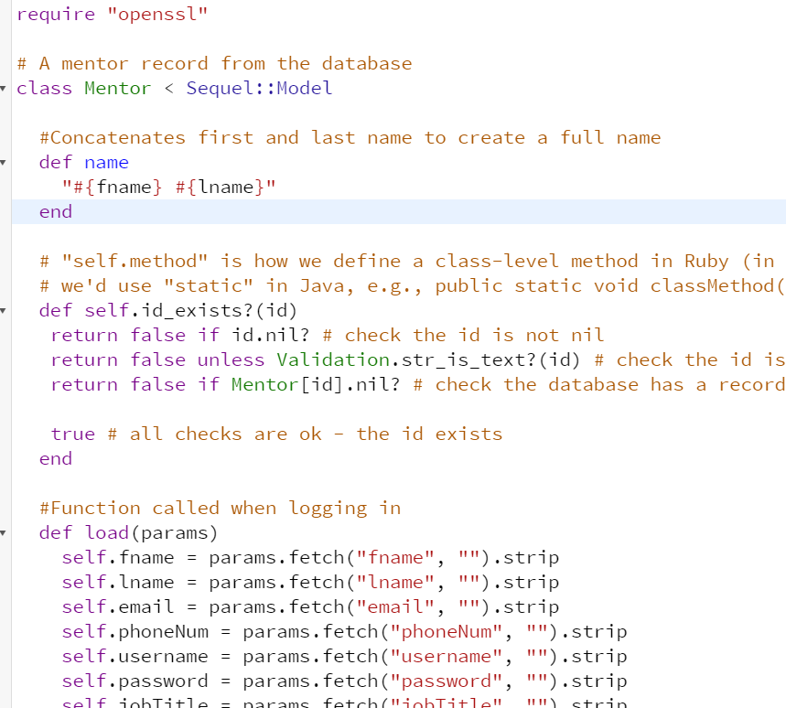
example code
listing A:models/mentor.rb

Slide 2
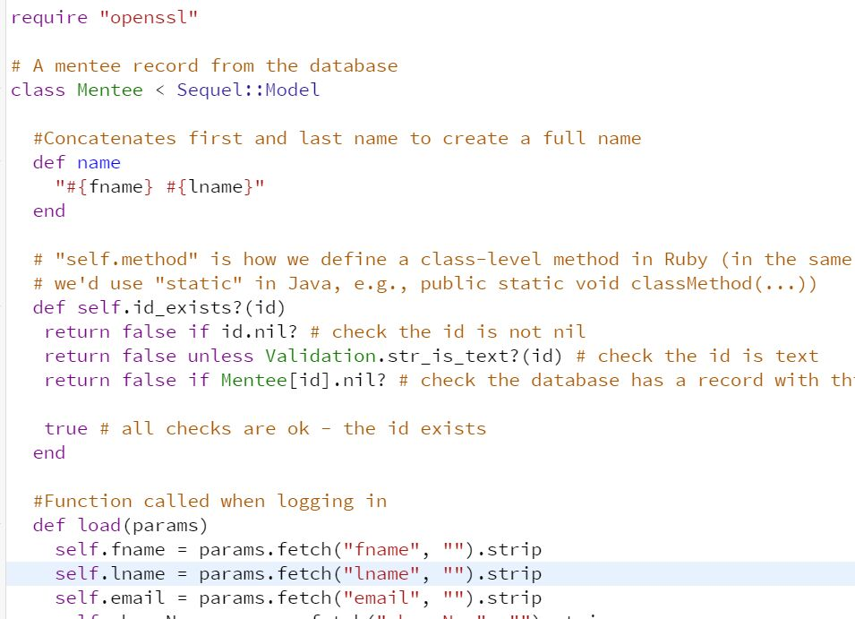
listing B:models/mentee.rb

Slide 3
In order to achieve the function, the models made some changes by other members.

